Slide 1
THP Enablement:
AMD Field Team Playbook
How to identify, demonstrate, and quantify THP value for production fleets

Slide 2
Qualifying the Opportunity
SECTION 01
Is the customer a THP candidate?

Slide 3
Three questions to determine THP fit
QUICK QUALIFICATION CHECKLIST
Q1 — Working set > 1 GiB per instance? — In-memory databases, JVM services, KV stores, ML inference. YES → strong candidate.
Q2 — THP currently disabled or madvise? — cat /sys/kernel/mm/transparent_hugepage/enabled. If [never] or [madvise] is active → opportunity.
Q3 — CPU-saturated but throughput flat? — Process CPU is high but requests/sec not scaling. Classic dTLB saturation signature.
Confirm with PMC — sudo perf stat -a -e ls_l1_d_tlb_miss.all_l2_miss -- sleep 10. If walks/s > 500K at load: THP will help.

Slide 4
Does This Exist in Production?
In-Memory Caches & Databases — Redis, Ignite, Hazelcast: pointer-chasing through giant hash tables. Every 4 KB boundary = page-table walk. THP → 2 MB pages → dTLB covers orders of magnitude more data.
JVM Microservices at Scale — G1GC heap is one large contiguous mmap. A top-5 SaaS company on EPYC saw 12% throughput gain from a single kernel parameter — no code change, no recompile, no downtime.
LLM Inference (KV-Cache) — KV-cache is a large contiguous buffer (10–80 GiB). THP reduces dTLB pressure during memory-bandwidth-bound decode. Gains: 3–8% tokens/sec at sequence lengths ≥ 8 K tokens.
TCO impact: 12% throughput gain on 10,000-instance JVM fleet → defer ~1,200 instances of new capacity. Zero cost: one kernel parameter.

Slide 5
Framing the problem without jargon
THE CUSTOMER CONVERSATION
Customer says — "Our JVM nodes are CPU-saturated but throughput is not growing."
Your response — "What you are seeing is likely dTLB pressure. Think of your CPU as a librarian with a 256 KB index card tray. Your application has an 8 GiB library. Every memory access the index card does not cover forces the librarian to walk the full stacks — that is a page-table walk. We measured 1.47 million of those per second on your workload type. With 2 MB pages, the same tray covers 128 MB. Walk rate drops 33×."
Close — "One command. No code changes. We measured 12% throughput recovery on identical hardware. Want to see the live recording?"

Slide 6
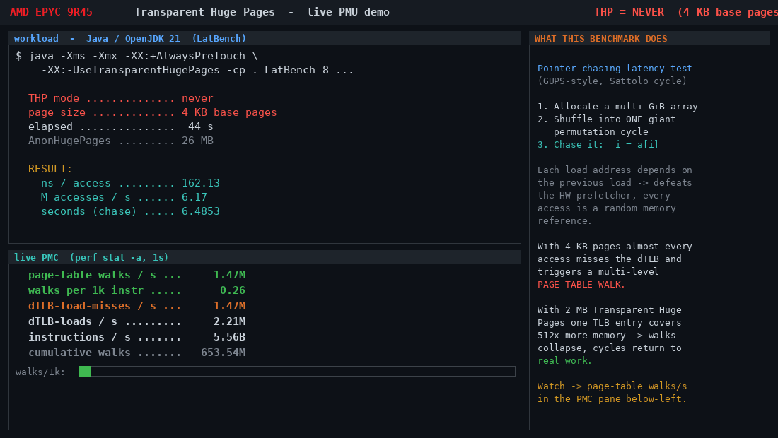
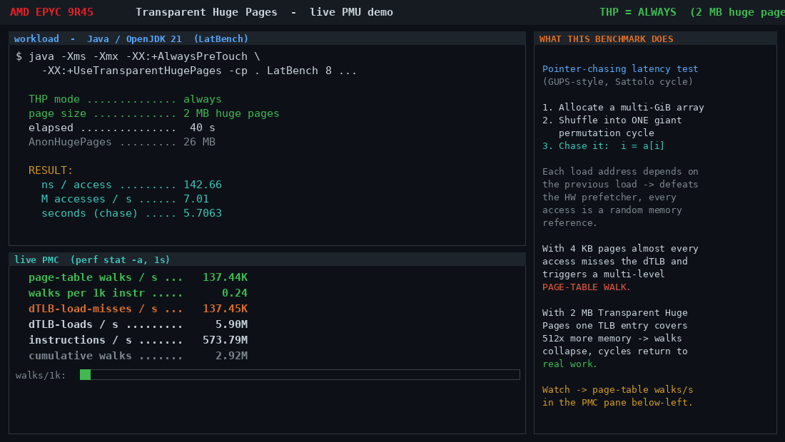
Show the customer what changed
EVIDENCE · LIVE PMC CAPTURES · AMD EPYC 9R45
+12%
33×
$5.1M
1 cmd
JVM throughput
fewer walks
AWS savings/yr
to enable
no code changes
44K vs 1.47M/s
10K fleet OD
echo always > …
Java · THP=NEVER · 162 ns/access · 1,470,000 walks/s
Java · THP=ALWAYS · 143 ns/access · 44,000 walks/s

Slide 7
Quantifying the savings conversation
TCO MODEL · ANONYMIZED · ANY AMD EPYC CLOUD FLEET
Fleet assumption: 10,000 JVM instances · 12% measured throughput gain · same work, 12% fewer instances needed
Cloud | Instance | $/hr | Fleet/yr | THP saves/yr
AWS | m8a.2xlarge | $0.4869 | $42,650,688 | $5,121,871
GCP | n2d-standard-8 | $0.3397 | $29,757,720 | $3,573,569
Azure | D8as_v5 | $0.3440 | $30,134,400 | $3,618,804
OCI | E5.Flex 8 OCPU | $0.4480 | $39,244,800 | $4,712,862
Prices: AWS Vantage instances.vantage.sh · Azure public API · GCP/OCI published list rates · Jun 2026

Slide 8
Detecting dTLB pressure in the field
DIAGNOSTIC RUNBOOK · RUN THESE ON THE CUSTOMER INSTANCE
# 1. Check current THP mode:
cat /sys/kernel/mm/transparent_hugepage/enabled
# Problem state: always madvise [never]
# 2. Measure page-table walks live (30s sample):
sudo perf stat -a -e ls_l1_d_tlb_miss.all_l2_miss,instructions -- sleep 30
# >500K walks/s at load = confirmed THP opportunity
# 3. Check AnonHugePages (should jump MB → GB after enable):
grep AnonHugePages /proc/meminfo
# 4. Enable and re-measure:
echo always | sudo tee /sys/kernel/mm/transparent_hugepage/enabled
echo always | sudo tee /sys/kernel/mm/transparent_hugepage/defrag
sudo perf stat -a -e ls_l1_d_tlb_miss.all_l2_miss -- sleep 30

Slide 9
Addressing pushback in the field
COMMON OBJECTIONS
"THP causes latency spikes" — True for madvise + khugepaged defrag under memory pressure. Avoid: set both enabled and defrag to always. khugepaged runs at startup, not on demand. Spike risk: near zero.
"We tested it and saw no improvement" — Ask: was defrag also set to always? Was the working set > 1 GiB? Was the test under load? All three must be true.
"Our ops team is risk-averse" — Zero binary changes. Rollback is one command: echo never. Shadow-test on one node first; PMC before/after confirms immediately.
"Our cloud provider handles this" — AWS, GCP, and Azure all default THP to madvise on most distros. The customer must opt in. This is not automatic.

