Slide 1
Data Collection Session 1
Introduction to Data Collection
Manish Gupta

Slide 2

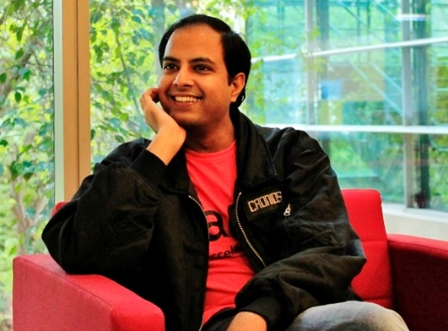
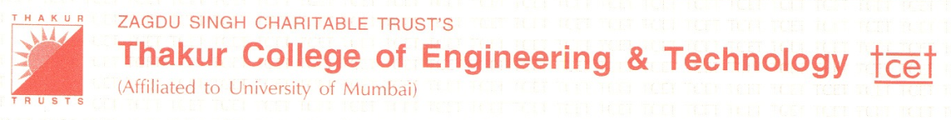














Myself
2001-2005, BE, Mumbai
2005-2007, MTech, Mumbai
2007-2009, Bangalore
2009-2013, PhD, Urbana, IL
2010, New York, NY
2011, Redmond, WA
2012, Princeton, NJ
2013-, Hyderabad, Principal Applied Scientist
2013-, Hyderabad, Adjunct Faculty
2016-, Hyderabad, Visiting Faculty

Slide 3
Agenda
Administrative Information
What is data collection?
Data collection decisions, rules, approaches
Data collection planning

Slide 4
Agenda
Administrative Information
What is data collection?
Data collection decisions, rules, approaches
Data collection planning

Slide 5
Course Overview: Session Plan
Session 1: Basics of Data Collection
  What is data collection?
  Plain old wget and shell script -- collecting Amazon reviews.
  Data collection using APIs:
    Using Reddit API, International Space Station API, NY Times API.
    Getting stocks data
    Getting weather data
Session 2: Structured Data Collection and Pre-processing
  Types of datasets, data, and attributes
  Basic Statistical descriptions of data: histograms, box plots, Q-Q plots.
  Data pre-processing tasks
  Data cleaning
  Data integration
  Data reduction
  Data transformation
Session 3: Collecting and pre-processing Text Data
  Web scraping in R/Python
  Introduction to Stanford CoreNLP package
  Introduction to NLTK
  Twitter scraping example

Slide 6
Course Overview: Session Plan
Session 4
  Data collection from the web
    Crawling
    Indexing
  Collecting images and videos data from Instagram and youtube
    instaloader to download instagram posts, comments, images.
    Selenium to download Youtube videos, transcripts, extract shots and run entity linking.
Session 5
  Crowd-sourcing
    Introduction to Crowdsourcing
    Applications of Crowdsourcing
    Challenges in Crowdsourcing
    Managing Quality for Simple Tasks
  Sensor Data Collection and IoT
    Different types of data collection sensors
    Applications of sensor data by provisioning it on the cloud.

Slide 7
Course Overview: Grade Components
Hands-on Homework Assignment: 40%
  Need to know R or Python
Final exam: 60%
  Closed book, closed notes

Slide 8
Agenda
Administrative Information
What is data collection?
Data collection decisions, rules, approaches
Data collection planning

Slide 9
What is Data Collection?
Data collection is the process of gathering and measuring information on variables of interest, in an established systematic fashion that enables one to answer stated research questions, test hypotheses, and evaluate outcomes.
The data collection component of research is common to all fields of study including physical and social sciences, humanities, business, etc.
While methods vary by discipline, the emphasis on ensuring accurate and honest collection remains the same.

Slide 10
Why is data quality critical?
Consequences from improperly collected data include
  inability to answer research questions accurately
  inability to repeat and validate the study
  distorted findings resulting in wasted resources
  misleading other researchers to pursue fruitless avenues of investigation
  compromising decisions for public policy
  causing harm to human participants and animal subjects
Issues related to maintaining integrity of data collection
  Quality assurance - activities that take place before data collection begins
  Quality control - activities that take place during and after data collection

Slide 11
Agenda
Administrative Information
What is data collection?
Data collection decisions, rules, approaches
Data collection planning

Slide 12
Data Collection Decisions
No one best way of performing data collection. Decision depends on:
  What you need to know: numbers or stories
  Where the data reside: environment, files, people
  Resources and time available
  Complexity of the data to be collected
  Frequency of data collection
  Intended forms of data analysis: how the information could be organized, analyzed, interpreted and then reported to various audiences

Slide 13
Rules for Collecting Data
Use available data or collect original data
Use available data, but need to know
  how the measures were defined
  how the data were collected and cleaned
  the extent of missing data
  how accuracy of the data was ensured
If must collect original data
  be sensitive to burden on others
  pre-test, pre-test, pre-test
  establish procedures and follow them (protocol)
  maintain accurate records of definitions and coding
  verify accuracy of coding, data input

Slide 14
Structured vs semi-structured approach
Structured approach
  All data collected in the same way
  Especially important for multi-site evaluations so you can compare
  Important when you need to make comparisons with alternate interventions
  Used in the following situations
    have a large sample or population
    know what needs to be measured
    need to show results numerically
    need to make comparisons across different sites or interventions

Slide 15
Structured vs semi-structured approach
Semi-structured approach
  Systematic and follow general procedures but data are not collected in exactly the same way every time
  More open and fluid
  Does not follow a rigid script
    may ask for more detail
    people can tell what they want in their own way
  Used in the following situations
    conducting exploratory work
    seeking understanding, themes, and/or issues
    need narratives or stories
    want in-depth, rich, information

Slide 16
Quantitative vs Qualitative Approach
Quantitative approach
  Data in numerical form
  Data that can be precisely measured
    age, cost, length, height, area, volume, weight, speed, time, and temperature
  Harder to develop
  Easier to analyze
Qualitative approach
  Data that deals with description
  Data that can be observed or self-reported, but not always precisely measured
  Less structured, easier to develop
  Can provide “rich data” — detailed and widely applicable
  Is challenging to analyze
  Is labor intensive to collect
  Usually generates longer reports
  Used when you are not sure what you are able to measure

Slide 17
Agenda
Administrative Information
What is data collection?
Data collection decisions, rules, approaches
Data collection planning

Slide 18
Developing a data collection plan
Identify types of data needed for the study
  Structured, notes, audio, video, photo
Select the types of measures to measure each variable
  Relevant (don’t measure what is easy but what is needed)
  Credible (Is the measure believable? Will it be viewed as a reasonable and appropriate way to capture the information sought?)
  Valid (Are waiting lists a valid measure of demand?)
  Reliable, i.e., precision and stability or repeatability (How reliable are: birth weights of newborn infants? speeds measured by a stopwatch?)
Select and/or develop instruments
Secure written permission to use each instrument
Pilot test researcher-developed instrument and revise plan
Develop data collection forms and procedures
Implement data collection plan

Slide 19
Other Data Collection Aspects
Costs of data collection
  Instrument use
  Data collectors salary
  Subject compensation
  Data pre-processing and archiving/packaging
Meta data related to data collection
  Records of subject IDs
  Data on number of times subjects recruited or approached, dates of data collection, length of time for data collection, location, time of day, and who collected data
  Who, what, when, where, and how of data collection

Slide 20
Take-aways
Choose more than one data collection technique
No “best” tool
High data quality is essential.

Slide 21
Hands-on examples
Plain old wget and shell script -- collecting Amazon reviews.
Data collection using APIs:
  Using Reddit API, International Space Station API, NY Times API.
  Getting stocks data
  Getting weather data

Slide 22
References
Robert Weisz, Learning from Strangers: The Art and Method of Qualitative Interview Studies
Glesne, C. and Peshkin, A. (1992). Becoming qualitative researchers: An
introduction. White Plains, NY: Longman Publishing.
Patton, M.Q. (1990). Qualitative evaluation and research methods (2nd ed.). Thousand Oaks, CA: Sage Publications.
Morse, J.M. (ed.) (1993). Critical issues in qualitative research methods.Thousand Oaks, CA: Sage Publications.
Rubin, H.J. and Rubin, I.S. (1995). Qualitative interviewing. Thousand,Oaks, CA: Sage Publications.
https://www.slideshare.net/priyansakthi/methods-of-data-collection-16037781

