Slide 1
Data Collection Session 2
Structured Data Collection and Pre-processing
Manish Gupta

Slide 2
Recap
What is data collection?
Data collection decisions, rules, approaches
  Original vs available data, quantitative vs qualitative approach, Obtrusive vs. Unobtrusive Methods
Data collection planning
  Developing a plan, costs, meta data, data collection implementation
Hands-on data collection using shell script and Python.

Slide 3
Agenda
Types of datasets, data, and attributes
Data pre-processing tasks
  Data cleaning
  Data integration
  Data reduction
  Data transformation
Take-aways

Slide 4
Agenda
Types of datasets, data, and attributes
Data pre-processing tasks
  Data cleaning
  Data integration
  Data reduction
  Data transformation
Take-aways

Slide 5
Types of Data Sets
Record
  Relational records
  Data matrix, e.g., numerical matrix, crosstabs
  Document data: text documents: term-frequency vector
  Transaction data
Graph and network
  World Wide Web
  Social or information networks
  Molecular Structures
Ordered
  Video data: sequence of images
  Temporal data: time-series
  Sequential Data: transaction sequences
  Genetic sequence data
Spatial, image and multimedia:
  Spatial data: maps
  Image data
  Video data
Notes:
May we categorize data along the following dimensions?
- structured, semi-structured, and unstructured
- numeric and categorical
- static and dynamic (temporal?)
- by application

Slide 6
Data Objects
Data sets are made up of data objects.
A data object represents an entity.
Examples:
  sales database: customers, store items, sales
  medical database: patients, treatments
  university database: students, professors, courses
Also called samples , examples, instances, data points, objects, tuples.
Data objects are described by attributes.
Database rows -> data objects; columns ->attributes.

Slide 7
Attributes
Attribute (or dimensions, features, variables): a data field, representing a characteristic or feature of a data object.
  E.g., customer _ID, name, address
Types:
  Nominal
  Binary
  Ordinal
  Numeric: quantitative
    Interval-scaled
    Ratio-scaled

Slide 8
Attribute Types
Nominal: categories, states, or “names of things”
  Hair_color = {auburn, black, blond, brown, grey, red, white}
  marital status, occupation, ID numbers, zip codes
Binary
  Nominal attribute with only 2 states (0 and 1)
  Symmetric binary: both outcomes equally important
    e.g., gender
  Asymmetric binary: outcomes not equally important.
    e.g., medical test (positive vs. negative)
    Convention: assign 1 to most important outcome (e.g., HIV positive)
Ordinal
  Values have a meaningful order (ranking) but magnitude between successive values is not known.
  Size = {small, medium, large}, grades, army rankings

Slide 9
Numeric Attribute Types
Quantity (integer or real-valued)
Interval
    Measured on a scale of equal-sized units
    Values have order
      E.g., temperature in C˚or F˚, calendar dates
    No true zero-point
Ratio
    Inherent zero-point
    We can speak of values as being an order of magnitude larger than the unit of measurement (10 K˚ is twice as high as 5 K˚).
      e.g., temperature in Kelvin, length, counts, monetary quantities

Slide 10
Discrete vs. Continuous Attributes
Discrete Attribute
  Has only a finite or countably infinite set of values
    E.g., zip codes, profession, or the set of words in a collection of documents
  Sometimes, represented as integer variables
  Note: Binary attributes are a special case of discrete attributes
Continuous Attribute
  Has real numbers as attribute values
    E.g., temperature, height, or weight
  Practically, real values can only be measured and represented using a finite number of digits
  Continuous attributes are typically represented as floating-point variables

Slide 11
Agenda
Types of datasets, data, and attributes
Data pre-processing tasks
  Data cleaning
  Data integration
  Data reduction
  Data transformation
Take-aways

Slide 12
Data Quality: Why Preprocess the Data?
Measures for data quality:
  Accuracy: correct or wrong, accurate or not
  Completeness: not recorded, unavailable, …
  Consistency: some modified but some not, dangling, …
  Timeliness: timely update?
  Believability: how trustable the data is?
  Interpretability: how easily the data can be understood?

Slide 13
Major Tasks in Data Preprocessing
Data cleaning
  Fill in missing values, smooth noisy data, identify or remove outliers, and resolve inconsistencies
Data integration
  Integration of multiple databases, or files
Data reduction
  Dimensionality reduction
  Numerosity reduction
  Data compression
Data transformation
  Normalization
  Concept hierarchy generation

Slide 14
Data Cleaning
Data in the Real World Is Dirty: Lots of potentially incorrect data, e.g., instrument faulty, human or computer error, transmission error
  incomplete: lacking attribute values, lacking certain attributes of interest, or containing only aggregate data
    e.g., Occupation = “ ” (missing data)
  noisy: containing noise, errors, or outliers
    e.g., Salary = “−10” (an error)
  inconsistent: containing discrepancies in codes or names, e.g.,
    Age = “42”, Birthday = “03/07/2010”
    Was rating “1, 2, 3”, now rating “A, B, C”
    discrepancy between duplicate records
  Intentional (e.g., disguised missing data)
    Jan. 1 as everyone’s birthday?

Slide 15
Incomplete (Missing) Data
Data is not always available
  E.g., many tuples have no recorded value for several attributes, such as customer income in sales data
Missing data may be due to
  equipment malfunction
  inconsistent with other recorded data and thus deleted
  data not entered due to misunderstanding
  certain data may not be considered important at the time of entry
  not register history or changes of the data
Missing data may need to be inferred

Slide 16
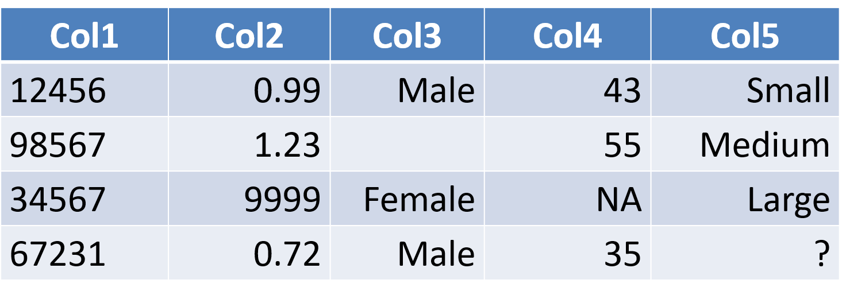
How to Handle Missing Data?
Ignore the tuple
Fill in the missing value manually: tedious + infeasible?
Fill in it automatically with
  a global constant : e.g., “unknown”
  the attribute mean
  the attribute mean for all samples belonging to the same class: smarter
  the most probable value: using decision trees or KNN

Slide 17
Noisy Data
Noise: random error or variance in a measured variable
Incorrect attribute values may be due to
  faulty data collection instruments
  data entry problems
  data transmission problems
  technology limitation
  inconsistency in naming convention
Other data problems which require data cleaning
  duplicate records
  incomplete data
  inconsistent data
Notes:
17

Slide 18
How to Handle Noisy Data?
Binning
  first sort data and partition into (equal-frequency) bins
  then one can smooth by bin means, smooth by bin median, smooth by bin boundaries, etc.
Regression
  smooth by fitting the data into regression functions
Clustering
  detect and remove outliers
Combined computer and human inspection
  detect suspicious values and check by human (e.g., deal with possible outliers)
Notes:
Enrich using data integration research!!

Slide 19
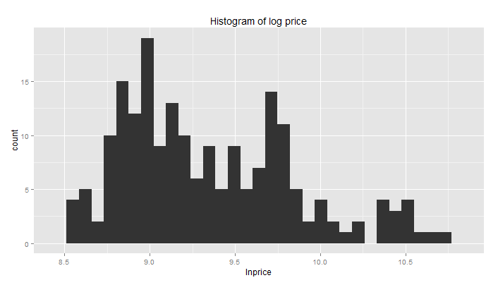
Identify Outliers and Errors
Outliers?

Slide 20
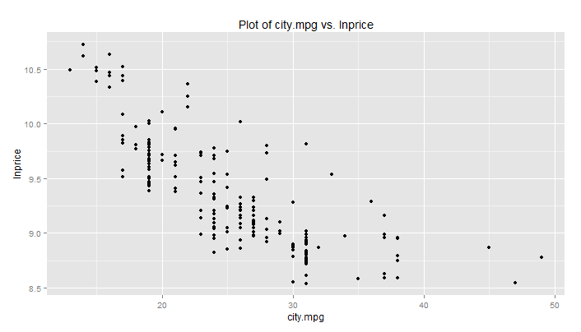
Identify Outliers and Errors
Outliers?

Slide 21
Agenda
Types of datasets, data, and attributes
Basic Statistical descriptions of data: histograms, box plots, Q-Q plots.
Data pre-processing tasks
  Data cleaning
  Data integration
  Data reduction
  Data transformation
Take-aways

Slide 22
Data Integration
Data integration:
  Combines data from multiple sources into a coherent store
Schema integration: e.g., A.cust-id ≡ B.cust-#
  Integrate metadata from different sources
Entity identification problem:
  Identify real world entities from multiple data sources, e.g., Bill Clinton = William Clinton
Detecting and resolving data value conflicts
  For the same real world entity, attribute values from different sources are different
  Possible reasons: different representations, different scales, e.g., metric vs. British units
22
Notes:
Should ask students to do some survey on data integration. -JH

Slide 23
Handling Redundancy in Data Integration
Redundant data occur often when integration of multiple databases
  Object identification: The same attribute or object may have different names in different databases
  Derivable data: One attribute may be a “derived” attribute in another table, e.g., annual revenue
Redundancy should be removed when performing integration.
Redundant attributes may be detected by correlation analysis.
23

Slide 24
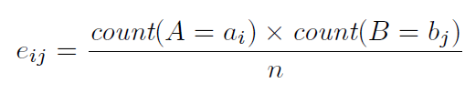

Correlation Analysis (Nominal Data): Chi-Square Test
 | Play chess | Not play chess | Sum (row)
Like science fiction | 250(90) | 200(360) | 450
Not like science fiction | 50(210) | 1000(840) | 1050
Sum(col.) | 300 | 1200 | 1500
Χ² (chi-square) calculation (numbers in parenthesis are expected counts calculated based on the data distribution in the two categories)
507.93>10.828 shows that like_science_fiction and play_chess are correlated in the group
For this 2 × 2 table, the degrees of freedom are (2 − 1)(2 − 1) = 1. For 1 degree of freedom, the 2 value needed to reject the hypothesis at the 0.001 significance level is 10.828

Slide 25
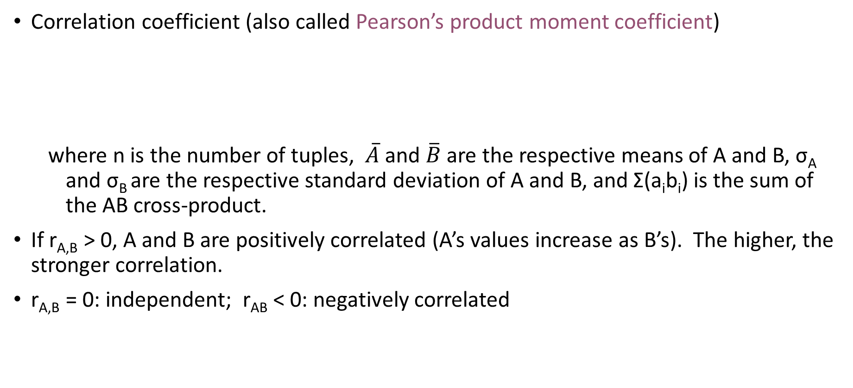
Correlation Analysis (Numeric Data)
Correlation coefficient (also called Pearson’s product moment coefficient)
  where n is the number of tuples, $\overline{A}$ and $\overline{B}$ are the respective means of A and B, σ_{A} and σ_{B} are the respective standard deviation of A and B, and Σ(a_{i}b_{i}) is the sum of the AB cross-product.
If r_{A,B} > 0, A and B are positively correlated (A’s values increase as B’s). The higher, the stronger correlation.
r_{A,B} = 0: independent; r_{AB} < 0: negatively correlated

Slide 26
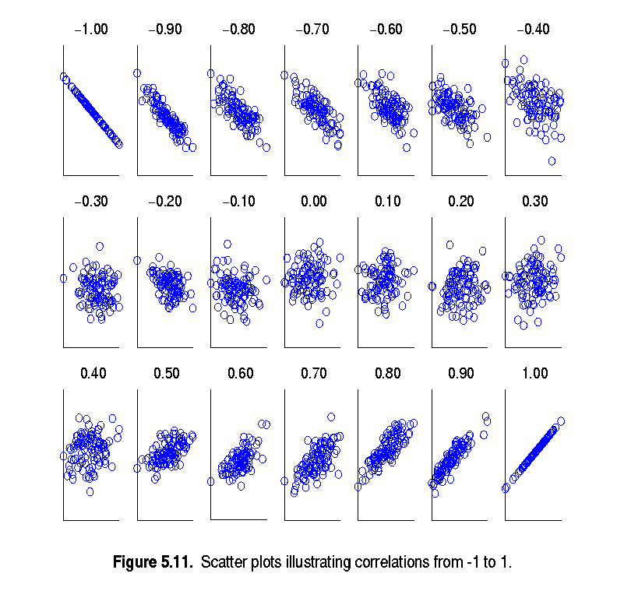
Visually Evaluating Correlation
Scatter plots showing the similarity from –1 to 1.

Slide 27
Agenda
Types of datasets, data, and attributes
Basic Statistical descriptions of data: histograms, box plots, Q-Q plots.
Data pre-processing tasks
  Data cleaning
  Data integration
  Data reduction
  Data transformation
Take-aways

Slide 28
Normalization
Min-max normalization: to [new_min_{A}, new_max_{A}]
  Ex. Let income range $12,000 to $98,000 normalized to [0.0, 1.0]. Then $73,000 is mapped to
Z-score normalization (μ: mean, σ: standard deviation):
  Ex. Let μ = 54,000, σ = 16,000. Then
Normalization by decimal scaling
Where j is the smallest integer such that Max(|ν’|) < 1

Slide 29
Take-aways
Data attribute types: nominal, binary, ordinal, interval-scaled, ratio-scaled
Many types of data sets, e.g., numerical, text, graph, Web, image.
Data quality: accuracy, completeness, consistency, timeliness, believability, interpretability
Data pre-processing
  Data cleaning: e.g. missing/noisy values, outliers
  Data integration from multiple sources:
    Entity identification problem; Remove redundancies; Detect inconsistencies
  Data reduction
    Dimensionality reduction; Numerosity reduction
  Data transformation
    Normalization

Slide 30
References: Data Types and Statistical Measures
W. Cleveland, Visualizing Data, Hobart Press, 1993
T. Dasu and T. Johnson. Exploratory Data Mining and Data Cleaning. John Wiley, 2003
U. Fayyad, G. Grinstein, and A. Wierse. Information Visualization in Data Mining and Knowledge Discovery, Morgan Kaufmann, 2001
L. Kaufman and P. J. Rousseeuw. Finding Groups in Data: an Introduction to Cluster Analysis. John Wiley & Sons, 1990.
H. V. Jagadish et al., Special Issue on Data Reduction Techniques. Bulletin of the Tech. Committee on Data Eng., 20(4), Dec. 1997
D. A. Keim. Information visualization and visual data mining, IEEE trans. on Visualization and Computer Graphics, 8(1), 2002
D. Pyle. Data Preparation for Data Mining. Morgan Kaufmann, 1999
S. Santini and R. Jain,” Similarity measures”, IEEE Trans. on Pattern Analysis and Machine Intelligence, 21(9), 1999
E. R. Tufte. The Visual Display of Quantitative Information, 2nd ed., Graphics Press, 2001
C. Yu et al., Visual data mining of multimedia data for social and behavioral studies, Information Visualization, 8(1), 2009

Slide 31
References: Data Pre-processing
D. P. Ballou and G. K. Tayi. Enhancing data quality in data warehouse environments. Comm. of ACM, 42:73-78, 1999
T. Dasu and T. Johnson. Exploratory Data Mining and Data Cleaning. John Wiley, 2003
T. Dasu, T. Johnson, S. Muthukrishnan, V. Shkapenyuk. Mining Database Structure; Or, How to Build a Data Quality Browser. SIGMOD’02
H. V. Jagadish et al., Special Issue on Data Reduction Techniques. Bulletin of the Technical Committee on Data Engineering, 20(4), Dec. 1997
D. Pyle. Data Preparation for Data Mining. Morgan Kaufmann, 1999
E. Rahm and H. H. Do. Data Cleaning: Problems and Current Approaches. IEEE Bulletin of the Technical Committee on Data Engineering. Vol.23, No.4
V. Raman and J. Hellerstein. Potters Wheel: An Interactive Framework for Data Cleaning and Transformation, VLDB’2001
T. Redman. Data Quality: Management and Technology. Bantam Books, 1992
R. Wang, V. Storey, and C. Firth. A framework for analysis of data quality research. IEEE Trans. Knowledge and Data Engineering, 7:623-640, 1995

