Slide 1
Data Collection Session 4
Web Data Collection
Manish Gupta

Slide 2
Recap
Web scraping: various applications, DOM structure, different levels of data complexity, information extraction goals, techniques, methods to prevent.
Scraping using Python: Beautiful Soup and Scrapy.

Slide 3
Agenda
Data collection from the web
  Crawling and Nutch demo
Collecting images and videos data from Instagram and youtube
  instaloader to download instagram posts, comments, images.
  Selenium to download Youtube videos, transcripts, extract shots and run entity linking.

Slide 4
Agenda
Data collection from the web
  Crawling and Nutch demo
Collecting videos data from youtube
  Selenium to download Youtube videos, transcripts, extract shots and run entity linking.

Slide 5
Basic crawler operation
Begin with known “seed” pages
Fetch and parse them
  Extract URLs they point to
  Place the extracted URLs on a queue
Fetch each URL on the queue and repeat

Slide 6
Crawling picture
URLs crawled
and parsed
Unseen Web
Seed
pages
URLs frontier
Web

Slide 7
Simple picture – complications
Web crawling isn’t feasible with one machine
  Hence, distributed operation
Even non-malicious pages pose challenges
  Latency/bandwidth to remote servers vary
  Webmasters’ stipulations
    How “deep” should you crawl a site’s URL hierarchy?
  Site mirrors and duplicate pages
Malicious pages
  Spam pages
  Spider traps – incl. dynamically generated
Politeness – don’t hit a server too often
Notes:
All this defines requirements, indirectly

Slide 8
What any crawler should do
Fetch pages of “higher quality” first
Continuous operation: Continue fetching fresh copies of a previously fetched page
Extensible: Adapt to new data formats, protocols

Slide 9
Basic crawl architecture
WWW
DNS
Doc
FP’s
robots
filters
URL
set
Parse
(handle
relative
URLs)
Fetch
Content
seen?
(Shingling,
LSH)
URL
filter
Dup
URL
elim
URL Frontier

Slide 10
Nutch demo
Download latest binaries from https://downloads.apache.org/nutch/1.17/
You may also have to update your /etc/hosts file.
  127.0.0.1 localhost gmanish2
Make required directories
  sudo mkdir /usr/local/nutch
  sudo mkdir /usr/local/nutch/framework
sudo tar -xvzf apache-nutch-1.17-bin.tar.gz -C /usr/local/nutch/framework/
sudo chmod +x /usr/local/nutch/framework/apache-nutch-1.17/bin/nutch
Make seed url file
  sudo mkdir -p /usr/local/nutch/framework/apache-nutch-1.17/bin/urls
  sudo vi /usr/local/nutch/framework/apache-nutch-1.17/bin/urls/nutch.txt
Add following to nutch.txt: http://www.gnu.org/

Slide 11
Nutch demo
Add this in Configuration
  sudo vi /usr/local/nutch/framework/apache-nutch-1.17/conf/nutch-site.xml
  <property> <name>http.agent.name</name> <value>My Spider</value> </property>
Edit regex
  sudo vi /usr/local/nutch/framework/apache-nutch-1.17/conf/regex-urlfilter.txt
  Replace “+.” by “+http://www.gnu.org/([a-z0-9]*\.)*”
Setup JDK & set JAVA_HOME
  export JAVA_HOME=/usr/lib/jvm/java-11-openjdk-amd64
Start Crawling!
  /usr/local/nutch/framework/apache-nutch-1.17/bin/crawl -s /usr/local/nutch/framework/apache-nutch-1.17/bin/urls crawlDir 2
  Get the text dump
    /usr/local/nutch/framework/apache-nutch-1.17/bin/nutch dump -segment segments -outputDir dump/
https://cwiki.apache.org/confluence/display/nutch /CommandLineOptions#

Slide 12
How Nutch works
The injector takes all the URLs of the nutch.txt file and adds them to the crawldb.
  As a central part of Nutch, the crawldb maintains information on all known URLs (fetch schedule, fetch status, metadata, …).
Based on the data of crawldb, the generator creates a fetchlist and places it in a newly created segment directory.
Next, the fetcher gets the content of the URLs on the fetchlist and writes it back to the segment directory. This step usually is the most time-consuming one.
Now the parser processes the content of each web page and for example omits all html tags. If the crawl functions as an update or an extension to an already existing one (e.g. depth of 3), the updater would add the new data to the crawldb as a next step.
Before indexing, all the links need to be inverted, which takes into account that not the number of outgoing links of a web page is of interest, but rather the number of inbound links. This is quite similar to how Google PageRank works and is important for the scoring function. The inverted links are saved in the linkdb.
and 7. Using data from all possible sources (crawldb, linkdb and segments), the indexer creates an index and saves it within the Solr directory. For indexing, the popular Lucene library is used. Now, the user can search for information regarding the crawled web pages via Solr.

Slide 13
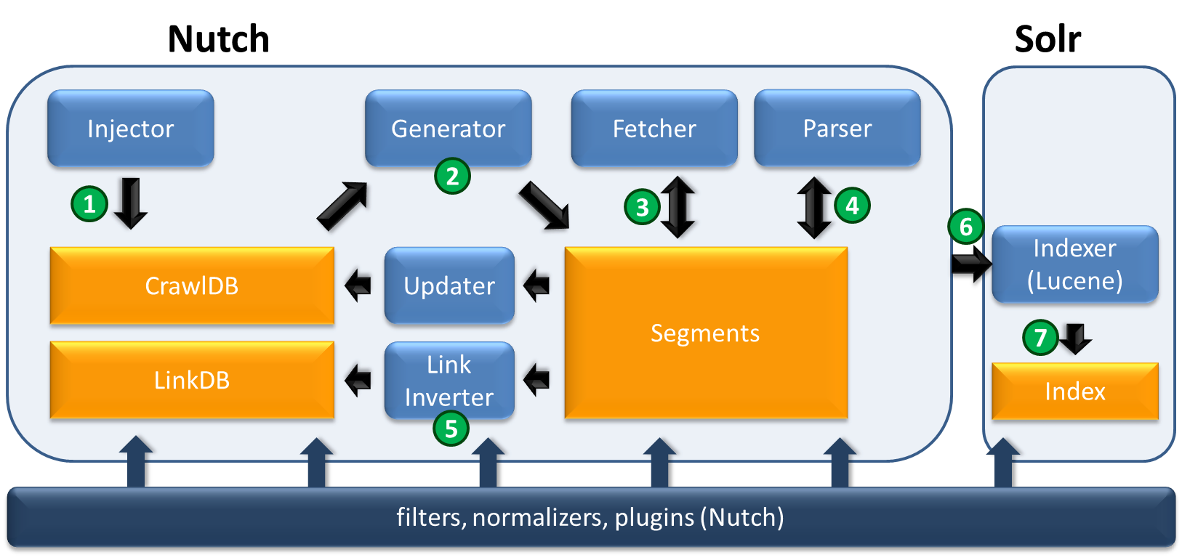

Slide 14
Make Nutch crawl faster
<property>
<name>fetcher.server.delay</name>
<value>0.5</value>
<description>The number of seconds the fetcher will delay between
successive requests to the same server. Note that this might get
overriden by a Crawl-Delay from a robots.txt and is used ONLY if
fetcher.threads.per.queue is set to 1.
</description>
</property>

Slide 15
Agenda
Data collection from the web
  Crawling and Nutch demo
Collecting videos data from youtube
  Selenium to download Youtube videos, transcripts, extract shots and run entity linking.

Slide 16
References: Crawling
Chapters 1,2,5 of Manning-Raghavan-Schuetze book
  http://nlp.stanford.edu/IR-book/
Chapter 3 (Web Search and Information Retrieval) from Mining the Web
  http://www.cse.iitb.ac.in/soumen/mining-the-web/
As We May Think -- Vannevar Bush
  http://www.theatlantic.com/magazine/archive/1945/07/as-we-may-think/303881/
https://wiki.apache.org/nutch/NutchTutorial

