Slide 1
Natural Language Processing
Adapted from Dan Jurafsky’s course slides on
https://web.stanford.edu/~jurafsky/NLPCourseraSlides.html
https://www.cse.iitb.ac.in/~nlp-ai/WSD.ppt

Slide 2
What is NLP?

Slide 3
Question Answering: IBM’s Watson
Won Jeopardy on February 16, 2011!
WILLIAM WILKINSON’S
“AN ACCOUNT OF THE PRINCIPALITIES OF
WALLACHIA AND MOLDOVIA”
INSPIRED THIS AUTHOR’S
MOST FAMOUS NOVEL
Bram Stoker

Slide 4
Information Extraction
Subject: curriculum meeting
Date: January 15, 2012
To: Dan Jurafsky
Hi Dan, we’ve now scheduled the curriculum meeting.
It will be in Gates 159 tomorrow from 10:00-11:30.
-Chris
Event: Curriculum meeting
Date: Jan-16-2012
Start: 10:00am
End: 11:30am
Where: Gates 159
Create new Calendar entry

Slide 5

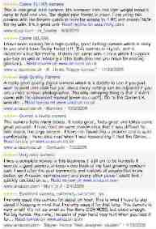
Information Extraction & Sentiment Analysis
Attributes:
zoom
affordability
size and weight
flash
ease of use
Size and weight
✓
nice and compact to carry!
since the camera is small and light, I won't need to carry around those heavy, bulky professional cameras either!
the camera feels flimsy, is plastic and very light in weight you have to be very delicate in the handling of this camera
✓
✗

Slide 6
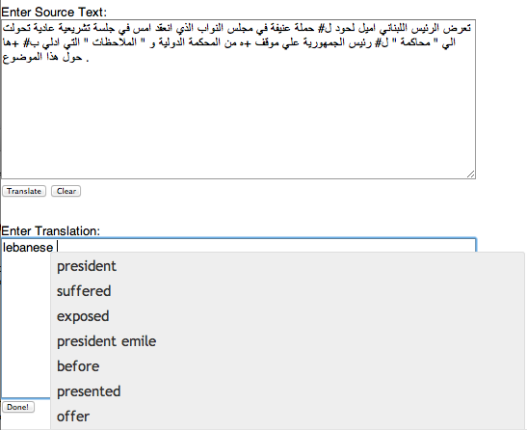
Machine Translation
Fully automatic
Helping human translators
Enter Source Text:
这 不过 是 一 个 时间 的 问题 .
Translation from Stanford’s Phrasal:
This is only a matter of time.

Slide 7
List of NLP Tasks

Slide 8




Language Technology
making good progress
Sentiment analysis
still really hard
mostly solved
Best roast chicken in San Francisco!
Question answering (QA)
The waiter ignored us for 20 minutes.
Spam detection
Coreference resolution
Q. How effective is ibuprofen in reducing fever in patients with acute febrile illness?
✓
Let’s go to Agra!
✗
Carter told Mubarak he shouldn’t run again.
Paraphrase
Buy V1AGRA …
Word sense disambiguation (WSD)
XYZ acquired ABC yesterday
Part-of-speech (POS) tagging
I need new batteries for my mouse.
ABC has been taken over by XYZ
ADJ ADJ NOUN VERB ADV
Summarization
Colorless green ideas sleep furiously.
Parsing
The Dow Jones is up
Economy is good
I can see Alcatraz from the window!
The S&P500 jumped
Named entity recognition (NER)
Machine translation (MT)
Housing prices rose
PERSON ORG LOC
第13届上海国际电影节开幕…
Dialog
Where is Sonu Nigam playing in Hyderabad?
Einstein met with UN officials in Princeton
The 13th Shanghai International Film Festival…
Information extraction (IE)
Ella Hotels at 7:30. Do you want a ticket?
You’re invited to our dinner party, Friday May 27 at 8:30
Party
May 27
add

Slide 9
Other NLP Tasks
Discourse analysis
Morphological segmentation
Natural language generation
Natural language understanding
Optical character recognition (OCR)
Relationship extraction
Sentence breaking
Speech recognition
Speech segmentation
Topic segmentation and recognition
Word segmentation
Speech processing
Native Language Identification
Stemming
Text simplification
Text-to-speech
Text-proofing
Natural language search
Query expansion
Automated essay scoring
Truecasing

Slide 10
Why is NLP challenging?

Slide 11
NLP Challenges
Teacher Strikes Idle Kids
Red Tape Holds Up New Bridges
Hospitals Are Sued by 7 Foot Doctors
Juvenile Court to Try Shooting Defendant
Local High School Dropouts Cut in Half
Ambiguity
non-standard English
segmentation issues
idioms
Great job @justinbieber! Were SOO PROUD of what youve accomplished! U taught us 2 #neversaynever & you yourself should never give up either♥
dark horse
get cold feet
lose face
throw in the towel
the New York-New Haven Railroad
the New York-New Haven Railroad
neologisms
world knowledge
tricky entity names
unfriend
Retweet
bromance
Mary and Sue are sisters.
Mary and Sue are mothers.
Where is A Bug’s Life playing …
Let It Be was recorded …
… a mutation on the for gene …

Slide 12
Tokenization

Slide 13
Tokenization
Issues in English tokenization
  Finland’s capital → Finland Finlands Finland’s ?
  what’re, I’m, isn’t → What are, I am, is not
  Hewlett-Packard → Hewlett Packard ?
  state-of-the-art → state of the art ?
  Lowercase → lower-case lowercase lower case ?
  San Francisco → one token or two?
  Acronyms: m.p.h., PhD. → ??
French
  L'ensemble → one token or two? L ? L’ ? Le ?
    La - feminine, Le - masculine, L' - starting a vowel, Les - plural, Un - masculine a, Une - feminine a, Des - plural a
German noun compounds are not segmented
  Lebensversicherungsgesellschaftsangestellter
  ‘life insurance company employee’
  German information retrieval needs compound splitter

Slide 14
Tokenization: Language issues
Chinese and Japanese no spaces between words:
  莎拉波娃现在居住在美国东南部的佛罗里达。
  莎拉波娃 现在 居住 在 美国 东南部 的 佛罗里达
  Sharapova now lives in US southeastern Florida
Further complicated in Japanese, with multiple alphabets intermingled
  Dates/amounts in multiple formats
  フォーチュン500社は情報不足のため時間あた$500K(約6,000万円)
Katakana
Hiragana
Kanji
Romaji
End-user can express query entirely in hiragana!

Slide 15
Word Tokenization in Chinese
Also called Word Segmentation
Chinese words are composed of characters
  Characters are generally 1 syllable and 1 morpheme.
  Average word is 2.4 characters long.
Standard baseline segmentation algorithm:
  Maximum Matching (also called Greedy)

Slide 16
Max-match segmentation illustration
Thecatinthehat
Thetabledownthere
Doesn’t generally work in English!
But works astonishingly well in Chinese
  莎拉波娃现在居住在美国东南部的佛罗里达。
  莎拉波娃 现在 居住 在 美国 东南部 的 佛罗里达
Modern probabilistic segmentation algorithms even better
  the cat in the hat
  the table down there
  theta bled own there

Slide 17
Maximum Matching
Word Segmentation Algorithm
Given a wordlist of Chinese, and a string.
Start a pointer at the beginning of the string
Find the longest word in dictionary that matches the string starting at pointer
Move the pointer over the word in string
Go to 2

Slide 18
Lemmatization and Stemming

Slide 19
Lemmatization
Reduce inflections or variant forms to base form
  am, are, is → be
  car, cars, car's, cars' → car
the boy's cars are different colors → the boy car be different color
Lemmatization: have to find correct dictionary headword form
Machine translation
  Spanish quiero (‘I want’), quieres (‘you want’) same lemma as querer ‘want’

Slide 20
Stemming
Reduce terms to their stems in information retrieval
Stemming is crude chopping of affixes
  language dependent
  e.g., automate(s), automatic, automation all reduced to automat.
for example compressed
and compression are both
accepted as equivalent to
compress.
for exampl compress and
compress ar both accept
as equival to compress

Slide 21
Porter’s algorithm
The most common English stemmer
Step 1a
  sses → ss caresses → caress
  ies → i ponies → poni
  ss → ss caress → caress
  s → ø cats → cat
Step 1b
  (*v*)ing → ø
  walking → walk
  sing → sing
  (*v*)ed → ø
  plastered → plaster
  …
Step 2 (for long stems)
  ational→ ate relational→ relate
  izer→ ize digitizer → digitize
  ator→ ate operator → operate
  …
Step 3 (for longer stems)
  al → ø revival → reviv
  able → ø adjustable → adjust
  ate → ø activate → activ
  …

Slide 22
Viewing morphology in a corpus
Why only strip –ing if there is a vowel?
  (*v*)ing → ø walking → walk
  sing → sing
1312 King
548 being
541 nothing
388 king
375 bring
358 thing
307 ring
152 something
145 coming
130 morning
548 being
541 nothing
152 something
145 coming
130 morning
122 having
120 living
117 loving
116 Being
102 going

Slide 23
Problems with stemming
Lack of domain-specificity and context can lead to occasional serious retrieval failures (which “stocking” is meant)
Stemmers are often difficult to understand and modify
Sometimes too aggressive in conflation
  e.g., “policy”/“police”, “execute”/“executive”, “university”/“universe”, “organization”/“organ” are conflated by Porter
Miss good conflations
  e.g., “European”/“Europe”, “matrices”/“matrix”, “machine”/“machinery” are not conflated by Porter
Produce stems that are not words and are often difficult for a user to interpret
  e.g., with Porter, “iteration” produces “iter” and “general” produces “gener”

Slide 24
Stemming vs lemmatization
Stemming:
  crude heuristic process
  chops off the ends of words in the hope of achieving this goal correctly most of the time.
Lemmatization:
  does things properly with the use of a vocabulary and morphological analysis of words
  normally aims to remove inflectional endings only
  returns the base or dictionary form of a word, which is known as the lemma.
For the token “saw”
  stemming might return just “s”
  lemmatization would attempt to return either “see” or “saw” depending on whether the use of the token was as a verb or a noun.

Slide 25
Sentence Segmentation

Slide 26
Sentence Segmentation
!, ? are relatively unambiguous
Period “.” is quite ambiguous
  Sentence boundary
  Abbreviations like Inc. or Dr.
  Numbers like .02% or 4.3
Build a binary classifier
  Looks at a “.”
  Decides EndOfSentence/NotEndOfSentence
  Classifiers: hand-written rules, regular expressions, or machine-learning

Slide 27
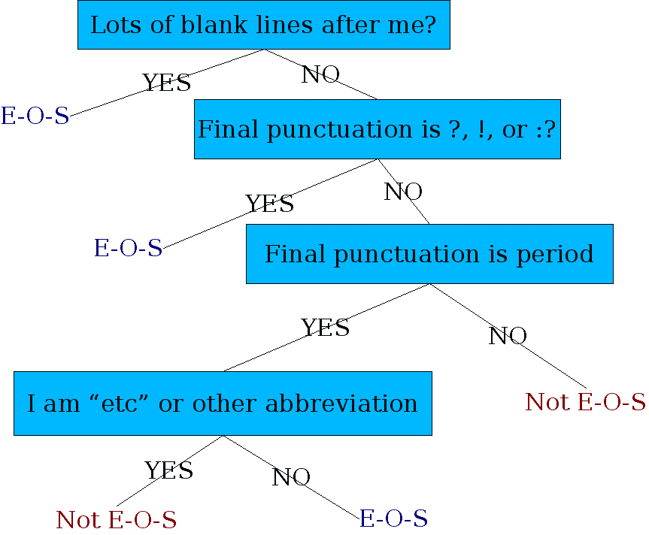
Determining if a Word is End-of-sentence: A Decision Tree
Other features
  Case of word with/after “.”: Upper, Lower, Cap, Number
  Length of word with “.”

Slide 28
Phrase Identification

Slide 29
Phrase Identification
Goal is to use phrases as indexing units
  Makes general words more specific
  blood → blood hound, blood test, blood brother, …
Statistical approach
  Index all pairs of adjacent words (“bigrams”)
  Explosion in index elements makes this non-feasible
  Also, it adds lots of “nonsense” phrases
    “also it”, “it adds”, “adds lots”, “lots of”, “of nonsense”, “nonsense phrases”
NLP approaches
  Runs of words
  Sentence parsing
  Statistical models

Slide 30
Phrases as Runs of Words
Consider all runs of words between stop words
  Can easily be extended to allow some stopwords
    e.g., Library of Congress, cats and dogs
Scan a large body of text for occurrences of phrases
Any that occur more than n times are valid
  Small n (e.g., 4) works impressively well

Slide 31
“Phrase identification”
“Goal” is to “use phrases” as “indexing units”
  Makes “general words” more “specific”
  “blood” → “blood hound”, “blood test”, “blood brother”, …
“Statistical approach”
  “Index” all “pairs” of “adjacent words” (“bigrams”)
  “Explosion” in “index elements” makes this “non-feasible”
“NLP approaches”
  “Runs” of “words”
  “Sentence parsing”
  “Statistical models”

Slide 32
Phrases and Their Counts
TREC
U.S. patents
65824 United States
61327 Article Type
33864 Los Angeles
18062 Hong Kong
17788 North Korea
17308 New York
15513 San Diego
15009 Orange County
12869 prime minister
12799 first time
12067 Soviet Union
10811 Russian Federation
9912 United Nations
8127 Southern California
7640 South Korea
7620 end recording
7524 European Union
7436 South Africa
7362 San Francisco
7086 news conference
6792 City Council
6348 Middle East
6157 peace process
5955 human rights
5837 White House
5778 long time
5776 Armed Forces
5636 Santa Ana
5619 Foreign Ministry
5527 Bosnia-Herzegovina
5458 words indistinct
5452 international community
5443 vice president
5247 Security Council
5098 North Korean
5023 Long Beach
4981 Central Committee
4872 economic development
4808 President Bush
4652 press conference
4602 first half
4565 second half
4495 nuclear weapons
4448 UN Security Council
4426 South Korean
4219 first quarter
4166 Los Angeles County
4107 State Duma
4085 State Council
3969 market economy
3941 World War II
975362 present invention
191625 U.S. Pat
147352 preferred embodiment
95097 carbon atoms
87903 group consisting
81809 room temperature
78458 SEQ ID
75850 BRIEF DESCRIPTION
66407 prior art
59828 perspective view
58724 first embodiment
56715 reaction mixture
54619 DETAILED DESCRIPTION
54117 ethyl acetate
52195 Example 1
52003 block diagram
46299 second embodiment
41694 accompanying drawings
40554 output signal
37911 first end
35827 second end
34881 appended claims
33947 distal end
32338 cross-sectional view
30193 outer surface
29635 upper surface
29535 preferred embodiments
29252 present invention provides
29025 sectional view
28961 longitudinal axis
27703 title compound
27434 PREFERRED EMBODIMENTS
27184 side view
25903 inner surface
25802 Table 1
25047 lower end
25047 plan view
24513 third embodiment
24432 control signal
24296 upper end
24275 methylene chloride
24117 reduced pressure
23831 aqueous solution
23618 SEQUENCE DESCRIPTION
23616 SEQUENCE CHARACTERISTICS
22382 weight percent
22070 closed position
21356 light source
21329 image data
21026 flow chart
21003 PREFERRED EMBODIMENT

Slide 33
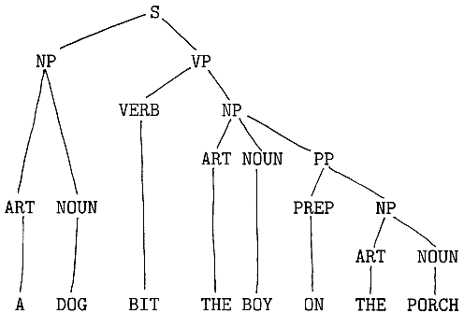
Phrases from Sentence Parsing
Run a shallow or deep parsing system
  Simplest and common approach uses noun phrases
  Can use other types, too, of course
    Verb phrases, noun phrases with adjectives, prepositional phrases, noun+verb phrases, …

Slide 34
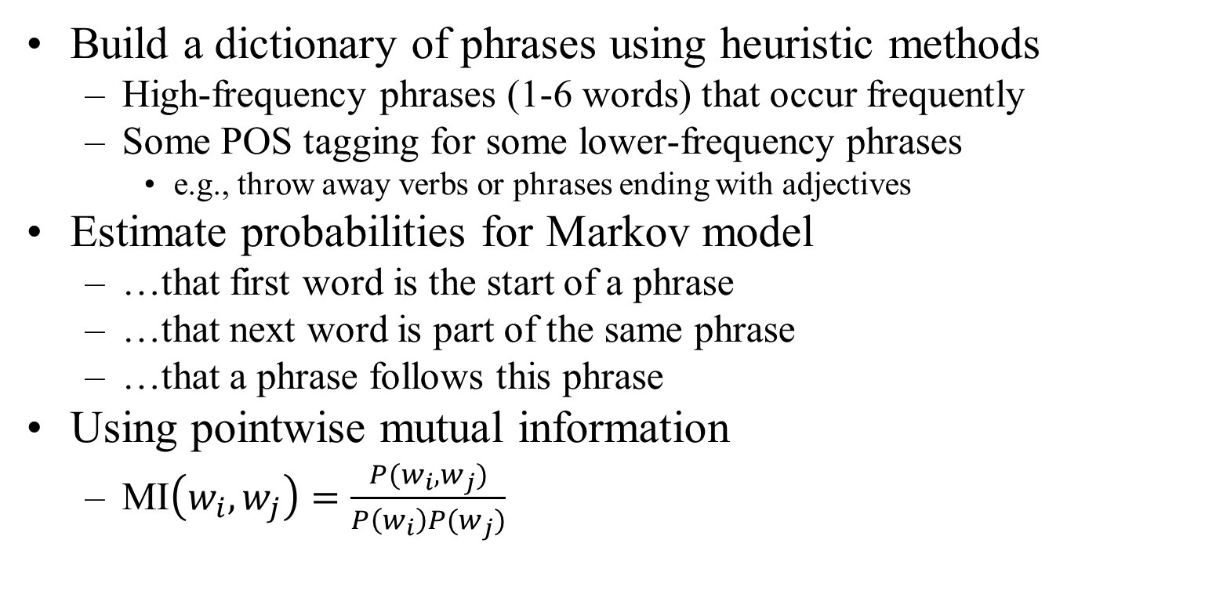
Phrases from statistical models
Build a dictionary of phrases using heuristic methods
  High-frequency phrases (1-6 words) that occur frequently
  Some POS tagging for some lower-frequency phrases
    e.g., throw away verbs or phrases ending with adjectives
Estimate probabilities for Markov model
  …that first word is the start of a phrase
  …that next word is part of the same phrase
  …that a phrase follows this phrase
Using pointwise mutual information
  MI$\left(w_{i},w_{j}\right)=\frac{P(w_{i},w_{j})}{P\left(w_{i}\right)P(w_{j})}$

Slide 35
Word Sense Disambiguation
Part 1

Slide 36
Word Sense Disambiguation
Computationally determining which sense of a word is activated by its use in a particular context.
  E.g. I am going to withdraw money from the bank.
A classification problem:
  Senses → Classes
  Context → Used to compute features
36

Slide 37
WSD USING SELECTIONAL PREFERENCES & ARGUMENTS
Sense 1
Sense 2
This airlines serves dinner in the evening flight.
serve (Verb)
  agent
  object – dinner
This airlines serves the sector between Agra & Delhi.
serve (Verb)
  agent
  object – sector
Requires exhaustive enumeration of:
  Argument-structure of verbs.
  Selectional preferences of arguments.
  Description of properties of words such that meeting the selectional preference criteria can be decided.
    E.g. This flight serves the “region” between Mumbai and Delhi
    How do you decide if “region” is compatible with “sector”

Slide 38
OVERLAP BASED APPROACHES
Require a Machine Readable Dictionary (MRD).
Find the overlap between the features of different senses of an ambiguous word (sense bag) and the features of the words in its context (context bag).
These features could be sense definitions, example sentences, hypernyms etc.
The features could also be given weights.
The sense which has the maximum overlap is selected as the contextually appropriate sense.
Lesk’s and Walker’s algorithms.
38

Slide 39
LESK’S ALGORITHM
Sense Bag: contains the words in the definition of a candidate sense of the ambiguous word.
Context Bag: contains the words in the definition of each sense of each context word.
E.g. “On burning coal we get ash.”
Ash
Coal
Sense 1
Trees of the olive family with pinnate leaves, thin furrowed bark and gray branches.
Sense 2
The solid residue left when combustible material is thoroughly burned or oxidized.
Sense 3
To convert into ash
Sense 1
A piece of glowing carbon or burnt wood.
Sense 2
charcoal.
Sense 3
A black solid combustible substance formed by the partial decomposition of vegetable matter without free access to air and under the influence of moisture and often increased pressure and temperature that is widely used as a fuel for burning
In this case Sense 2 of ash would be the winner sense.

Slide 40
WALKER’S ALGORITHM
A Thesaurus Based approach.
Step 1: For each sense of the target word find the thesaurus category to which that sense belongs.
Step 2: Calculate the score for each sense by using the context words. A context word will add 1 to the score of the sense if the thesaurus category of the word matches that of the sense.
  E.g. The money in this bank fetches an interest of 8% per annum
  Target word: bank
  Clue words from the context: money, interest, annum, fetch
 | Sense1: Finance | Sense2: Location
Money | +1 | 0
Interest | +1 | 0
Fetch | 0 | 0
Annum | +1 | 0
Total | 3 | 0
Context words
add 1 to the
sense when
the topic of the
word matches that
of the sense

Slide 41
Word Sense Disambiguation
Part 2

Slide 42
WSD USING CONCEPTUAL DENSITY
Select a sense based on the relatedness of that word-sense to the context.
Relatedness is measured in terms of conceptual distance
  (i.e. how close the concept represented by the word and the concept represented by its context words are)
This approach uses a structured hierarchical semantic net (WordNet) for finding the conceptual distance.
Smaller the conceptual distance higher will be the conceptual density.
  (i.e. if all words in the context are strong indicators of a particular concept then that concept will have a higher density.)
42

Slide 43
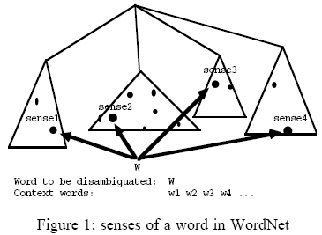
CONCEPTUAL DENSITY (EXAMPLE)
The dots in the figure represent the senses of the word to be disambiguated or the senses of the words in context.
The CD formula will yield highest density for the sub-hierarchy containing more senses.
The sense of W contained in the sub-hierarchy with the highest CD will be chosen.
43

Slide 44
CONCEPTUAL DENSITY (EXAMPLE)
The jury(2) praised the administration(3) and operation (8) of Atlanta Police Department(1)
administrative_unit
body
division
CD = 0.256
CD = 0.062
committee
department
government department
local department
jury
operation
police department
jury
administration
Step 1: Make a lattice of the nouns in the context, their senses and hypernyms.
Step 3: The concept with highest CD is selected.
Step 2: Compute the conceptual density of resultant concepts (sub-hierarchies).
Step 4: Select the senses below the selected concept as the correct sense for the respective words.
44

Slide 45
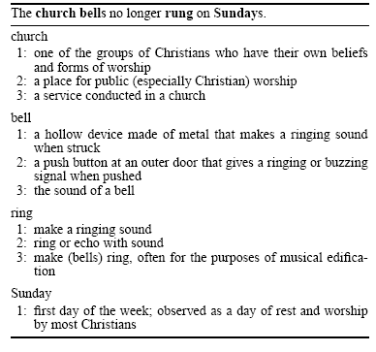
WSD USING RANDOM WALK ALGORITHM
Bell ring church Sunday
0.46
0.97
0.42
S3
a
S3
S3
b
a
c
0.49
e
S2
S2
0.35
S2
0.63
f
g
k
h
0.92
i
0.56
0.58
l
0.67
S1
j
S1
S1
S4
Step 1: Add a vertex for each possible sense of each word in the text.
Step 3: Apply graph based ranking algorithm to find score of each vertex (i.e. for each word sense).
Step 2: Add weighted edges using definition based semantic similarity (Lesk’s method).
Step 4: Select the vertex (sense) which has the highest score.
45

Slide 46
WSD Using Parallel Corpora
A word having multiple senses in one language will have distinct translations in another language, based on the context in which it is used.
The translations can thus be considered as contextual indicators of the sense of the word.

Slide 47
Parsing

Slide 48
Two views of linguistic structure:
1. Constituency (phrase structure)

Slide 49
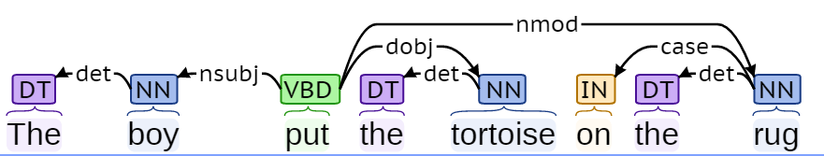
Two views of linguistic structure:
2. Dependency structure
Dependency structure shows which words depend on (modify or are arguments of) which other words.
The boy put the tortoise on the rug
http://nlp.stanford.edu:8080/corenlp/process

Slide 50
Dependency Grammar and Dependency Structure
Dependency syntax postulates that syntactic structure consists of lexical items linked by binary asymmetric relations (“arrows”) called dependencies
submitted
The arrows are commonly typed with the name of grammatical relations (subject, prepositional object, apposition, etc.)
nsubjpass
auxpass
prep
Bills
were
by
prep
pobj
on
Brownback
pobj
nn
appos
ports
Senator
Republican
cc
conj
prep
and
immigration
of
pobj
Kansas

Slide 51
Dependency Grammar and Dependency Structure
Dependency syntax postulates that syntactic structure consists of lexical items linked by binary asymmetric relations (“arrows”) called dependencies
The arrow connects a head (governor, superior, regent) with a dependent (modifier, inferior, subordinate)
Usually, dependencies form a tree (connected, acyclic, single-head)
submitted
nsubjpass
auxpass
prep
Bills
were
by
prep
pobj
on
Brownback
pobj
nn
appos
ports
Senator
Republican
cc
conj
prep
and
immigration
of
pobj
Kansas
Notes:
The arrows may be drawn in either direction.
If tree height is used to show governor, then you don’t need arrows at all.
Mention ROOT and draw it in.

Slide 52
Take-aways
NLP is set of tasks for natural language processing.
We looked at a few of such tasks in detail
  Tokenization
  Stemming
  Sentence Segmentation
  Phrase Identification
  Word Sense Disambiguation
  Parsing

Slide 53
Further Reading
Books
  Foundations of Statistical Natural Language Processing: Christopher D. Manning, Hinrich Schütze
  Speech and Language Processing, 2nd Edition: Daniel Jurafsky, James H. Martin

