Slide 1
COMPLETE
BUSINESS
STATISTICS
by
AMIR D. ACZEL
&
JAYAVEL SOUNDERPANDIAN
7th edition.
Prepared by Lloyd Jaisingh, Morehead State University
Chapter 3
Random Variables
McGraw-Hill/Irwin
Copyright © 2009 by The McGraw-Hill Companies, Inc. All rights reserved.

Slide 2
_{3-<number>}
3
Random Variables
Using Statistics
Expected Values of Discrete Random Variables
Sum and Linear Composite of Random Variables
Bernoulli Random Variable
The Binomial Random Variable
Continuous Random Variables
Uniform Distribution

Slide 3
_{3-<number>}
LEARNING OBJECTIVES
3
After studying this chapter you should be able to:
Distinguish between discrete and continuous random variables
Explain how a random variable is characterized by its probability distribution
Compute statistics about a random variable
Compute statistics about a function of a random variable
Compute statistics about the sum or a linear composite of a random variable
Identify which type of distribution a given random variable is most likely to follow
Solve problems involving standard distributions manually using formulas
Solve business problems involving standard distributions using spreadsheet templates.

Slide 4
3-1 Using Statistics
_{3-<number>}
Consider the different possible orderings of boy (B) and girl (G) in four sequential births. There are 2*2*2*2=2⁴ = 16 possibilities, so the sample space is:
BBBB BGBB GBBB GGBB
BBBG BGBG GBBG GGBG
BBGB BGGB GBGB GGGB
BBGG BGGG GBGG GGGG
If girl and boy are each equally likely [P(G) = P(B) = 1/2], and the gender of each child is independent of that of the previous child, then the probability of each of these 16 possibilities is:
(1/2)(1/2)(1/2)(1/2) = 1/16.

Slide 5
Random Variables
_{3-<number>}
Now count the number of girls in each set of four sequential births:
BBBB (0) BGBB (1) GBBB (1) GGBB (2)
BBBG (1) BGBG (2) GBBG (2) GGBG (3)
BBGB (1) BGGB (2) GBGB (2) GGGB (3)
BBGG (2) BGGG (3) GBGG (3) GGGG (4)
Notice that:
each possible outcome is assigned a single numeric value,
all outcomes are assigned a numeric value, and
the value assigned varies over the outcomes.
The count of the number of girls is a random variable:
A random variable, say X, is a an uncertain quantity whose value depends on chance.

Slide 6
Random Variables (Continued)
_{3-<number>}
BBBB
BGBB
GBBB
BBBG
BBGB
GGBB
GBBG
BGBG
BGGB
GBGB
BBGG
BGGG
GBGG
GGGB
GGBG
GGGG
0
1
X
2
3
4
Points on the Real Line
Sample Space

Slide 7
Random Variables (Continued)
_{3-<number>}
Since the random variable X = 3 when any of the four outcomes BGGG, GBGG, GGBG, or GGGB occurs,
P(X = 3) = P(BGGG) + P(GBGG) + P(GGBG) + P(GGGB) = 4/16
The probability distribution of a random variable is a table that lists the possible values of the random variables and their associated probabilities.
x P(x)
0 1/16
1 4/16
2 6/16
3 4/16
4 1/16
16/16=1
The Graphical Display for this
Probability Distribution
is shown on the next Slide.

Slide 8
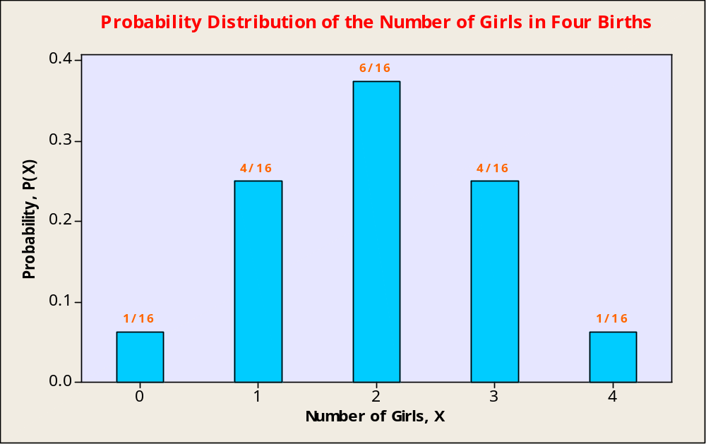
Random Variables (Continued)
_{3-<number>}

Slide 9


Example 3-1
_{3-<number>}
Consider the experiment of tossing two six-sided dice. There are 36 possible outcomes. Let the random variable X represent the sum of the numbers on the two dice:
x P(x)*
2 1/36
3 2/36
4 3/36
5 4/36
6 5/36
7 6/36
8 5/36
9 4/36
10 3/36
11 2/36
12 1/36
1
P
r
o
b
a
b
i
l
i
t
y
D
i
s
t
r
i
b
u
t
i
o
n
o
f
S
u
m
o
f
T
w
o
D
i
c
e
0
.
1
7
2
3
4
5
6
7
1,1
1,2
1,3
1,4
1,5
1,6
8
0
.
1
2
)
x
2,1
2,2
2,3
2,4
2,5
2,6
9
(
p
3,1
3,2
3,3
3,4
3,5
3,6
10
0
.
0
7
4,1
4,2
4,3
4,4
4,5
4,6
11
5,1
5,2
5,3
5,4
5,5
5,6
12
0
.
0
2
2
3
4
5
6
7
8
9
1
0
1
1
1
2
6,1
6,2
6,3
6,4
6,5
6,6
x

Slide 10
Example 3-2
_{3-<number>}
Probability Distribution of the Number of Switches
x P(x)
0 0.1
1 0.2
2 0.3
3 0.2
4 0.1
5 0.1
1
T
h
e
P
r
o
b
a
b
i
l
i
t
y
D
i
s
t
r
i
b
u
t
i
o
n
o
f
t
h
e
N
u
m
b
e
r
o
f
S
w
i
t
c
h
e
s
0
.
4
0
.
3
)
x
(
0
.
2
P
0
.
1
0
.
0
0
1
2
3
4
5
x
Probability of more than 2 switches:
P(X > 2) = P(3) + P(4) + P(5) = 0.2 + 0.1 + 0.1 = 0.4
Probability of at least 1 switch:
P(X ≥ 1) = 1 - P(0) = 1 - 0.1 = .9

Slide 11
Discrete and Continuous Random Variables
_{3-<number>}
A discrete random variable:
  has a countable number of possible values
  has discrete jumps (or gaps) between successive values
  has measurable probability associated with individual values
  counts
A continuous random variable:
  has an uncountably infinite number of possible values
  moves continuously from value to value
  has no measurable probability associated with each value
  measures (e.g.: height, weight, speed, value, duration, length)

Slide 12
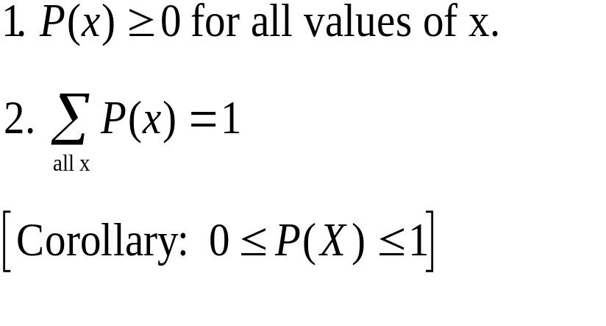
Rules of Discrete Probability Distributions
_{3-<number>}
The probability distribution of a discrete random variable X must satisfy the following two conditions.

Slide 13
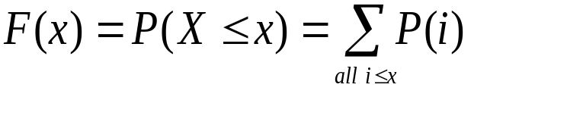
Cumulative Distribution Function
_{3-<number>}
The cumulative distribution function, F(x), of a discrete random variable X is:
x P(x) F(x)
0 0.1 0.1
1 0.2 0.3
2 0.3 0.6
3 0.2 0.8
4 0.1 0.9
5 0.1 1.0
1.00
C
u
m
u
l
a
t
i
v
e
P
r
o
b
a
b
i
l
i
t
y
D
i
s
t
r
i
b
u
t
i
o
n
o
f
t
h
e
N
u
m
b
e
r
o
f
S
w
i
t
c
h
e
s
1
.
0
0
.
9
0
.
8
0
.
7
)
0
.
6
x
(
0
.
5
F
0
.
4
0
.
3
0
.
2
0
.
1
0
.
0
0
1
2
3
4
5
x

Slide 14
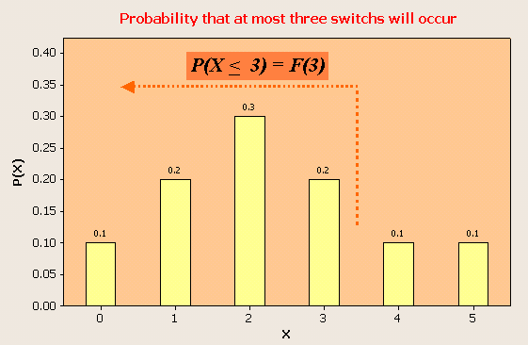
Cumulative Distribution Function
_{3-<number>}
The probability that at most three switches will occur:
x P(x) F(x)
0 0.1 0.1
1 0.2 0.3
2 0.3 0.6
3 0.2 0.8
4 0.1 0.9
5 0.1 1.0
1
Note: P(X < 3) = F(3) = 0.8 = P(0) + P(1) + P(2) + P(3)

Slide 15
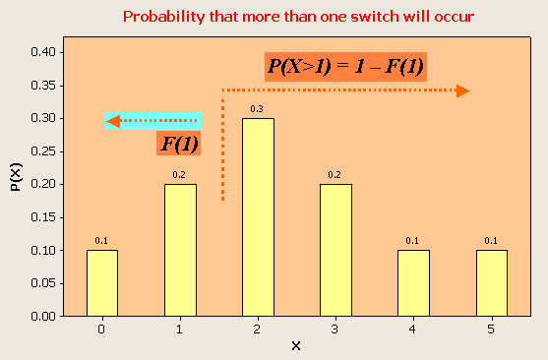
Using Cumulative Probability Distributions
_{3-<number>}
The probability that more than one switch will occur:
x P(x) F(x)
0 0.1 0.1
1 0.2 0.3
2 0.3 0.6
3 0.2 0.8
4 0.1 0.9
5 0.1 1.0
1
Note: P(X > 1) = P(X > 2) = 1 – P(X < 1) = 1 – F(1) = 1 – 0.3 = 0.7

Slide 16
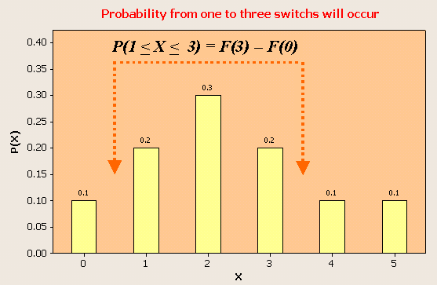
Using Cumulative Probability Distributions
_{3-<number>}
The probability that anywhere from one to three switches will occur:
x P(x) F(x)
0 0.1 0.1
1 0.2 0.3
2 0.3 0.6
3 0.2 0.8
4 0.1 0.9
5 0.1 1.0
1
Note: P(1 < X < 3) = P(X < 3) – P(X < 0) = F(3) – F(0) = 0.8 – 0.1 = 0.7

Slide 17
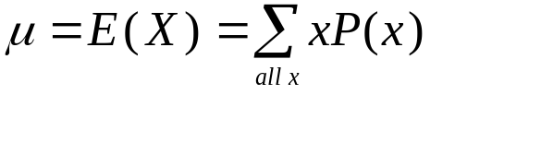
3-2 Expected Values of Discrete Random Variables
_{3-<number>}
The mean of a probability distribution is a measure of its centrality or location, as is the mean or average of a frequency distribution. It is a weighted average, with the values of the random variable weighted by their probabilities.
0
1
2
3
4
5
2.3
The mean is also known as the expected value (or expectation) of a random variable, because it is the value that is expected to occur, on average.
x P(x) xP(x)
0 0.1 0.0
1 0.2 0.2
2 0.3 0.6
3 0.2 0.6
4 0.1 0.4
5 0.1 0.5
1.0 2.3 = E(X) = μ
The expected value of a discrete random variable X is equal to the sum of each value of the random variable multiplied by its probability.

Slide 18
A Fair Game
_{3-<number>}
Suppose you are playing a coin toss game in which you are paid $1 if the coin turns up heads and you lose $1 when the coin turns up tails. The expected value of this game is E(X) = 0. A game of chance with an expected payoff of 0 is called a fair game.
x P(x) xP(x)
-1 0.5 -0.50
1 0.5 0.50
1.0 0.00 = E(X)=μ
-1
0
1

Slide 19
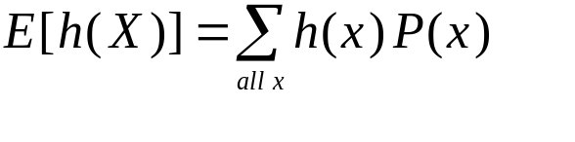
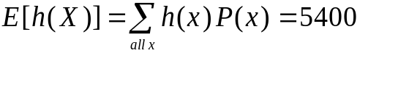
Expected Value of a Function of a Discrete Random Variables
_{3-<number>}
The expected value of a function of a discrete random variable X is:
Example 3-3: Monthly sales of a certain product are believed to follow the given probability distribution. Suppose the company has a fixed monthly production cost of $8000 and that each item brings $2. Find the expected monthly profit h(X), from product sales.
Number
of items, x P(x) xP(x) h(x) h(x)P(x)
5000 0.2 1000 2000 400
6000 0.3 1800 4000 1200
7000 0.2 1400 6000 1200
8000 0.2 1600 8000 1600
9000 0.1 900 10000 1000
1.0 6700 5400
Note: h (X) = 2X – 8000 where X = # of items sold
The expected value of a linear function of a random variable is:
E(aX+b)=aE(X)+b
In this case: E(2X-8000)=2E(X)-8000=(2)(6700)-8000=5400

Slide 20
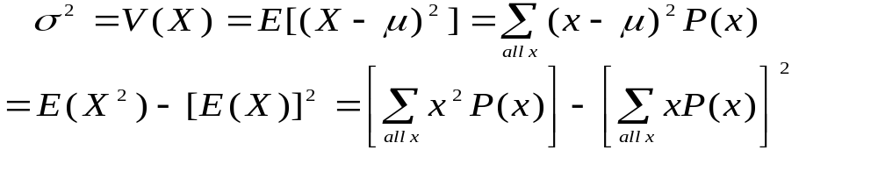
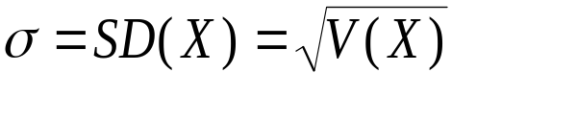
Variance and Standard Deviation of a Random Variable
_{3-<number>}
The variance of a random variable is the expected squared deviation from the mean:
The standard deviation of a random variable is the square root of its variance:

Slide 21

Variance and Standard Deviation of a Random Variable – using Example 3-2
_{3-<number>}
σ
2
=
V
(
X
)
=
E
[(
X
−
μ
)
2
]
Table 3-8
=
∑
(
x
−
μ
)
2
P
(
x
)
=
2
.
01
Number of
Switches, x P(x) xP(x) (x-μ) (x-μ)² P(x-μ)² x²P(x)
0 0.1 0.0 -2.3 5.29 0.529 0.0
1 0.2 0.2 -1.3 1.69 0.338 0.2
2 0.3 0.6 -0.3 0.09 0.027 1.2
3 0.2 0.6 0.7 0.49 0.098 1.8
4 0.1 0.4 1.7 2.89 0.289 1.6
5 0.1 0.5 2.7 7.29 0.729 2.5
2.3 2.010 7.3
all
x
=
E
(
X
2
)
−
[
E
(
X
)]
2
2
⎡
2
⎤
⎡
⎤
=
⎢
∑
x
P
(
x
)
⎥
−
⎢
∑
xP
(
x
)
⎥
Recall: μ = 2.3.
⎣
all
x
⎦
⎣
all
x
⎦
=
7
.
3
−
2
.
3
2
=
2
.
01

Slide 22
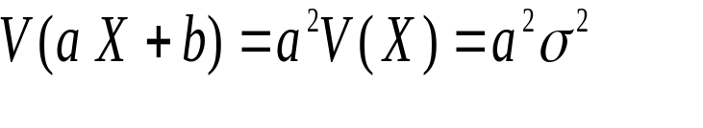
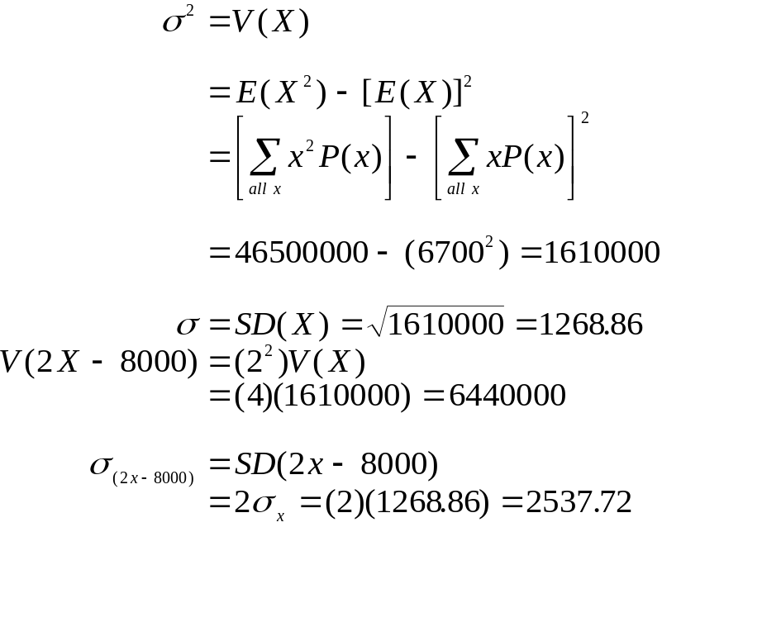
Variance of a Linear Function of a Random Variable
_{3-<number>}
The variance of a linear function of a random variable is:
Example 3-3:
Number
of items, x P(x) xP(x) x² P(x)
5000 0.2 1000 5000000
6000 0.3 1800 10800000
7000 0.2 1400 9800000
8000 0.2 1600 12800000
9000 0.1 900 8100000
1.0 6700 46500000

Slide 23
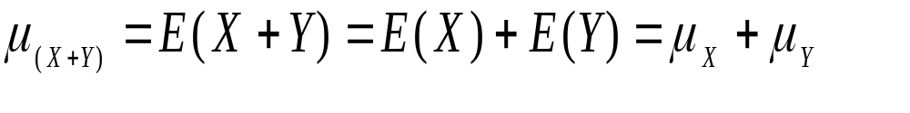
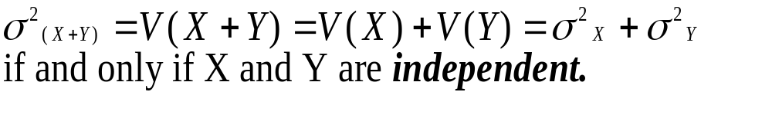
3-3 Sum and Linear Composites of Random Variables
_{3-<number>}
The mean or expected value of the sum of random variables is the sum of their means or expected values:
For example: E(X) = $350 and E(Y) = $200
E(X+Y) = $350 + $200 = $550
The variance of the sum of mutually independent random variables is the sum of their variances:
For example: V(X) = 84 and V(Y) = 60
V(X+Y) = 144

Slide 24
3-3 Sum and Linear Composites of Random Variables (Continued)
_{3-<number>}
NOTE:
The variance of the sum of k mutually independent random variables is the sum of their variances:
and

Slide 25
3-3 Sum and Linear Composites of Random Variables (Continued)
_{3-<number>}
Example 3-4: A portfolio includes stocks in three industries: financial, energy, and consumer goods. Assume that the three sectors are independent of each other. The expected annual return and standard deviations are as follows: Financial – 1,000, and 700; energy – 1,200 and 1,100; consumer goods – 600 and 300. What is the mean and standard deviation of the annual return on this portfolio?
The mean of the sum of the three random variables is: 1,000 + 1,200 + 600 = $2,800.
The variance of the three random variables for the three sectors,
assuming independence is: 700² + 1,100² + 300² = 1,790,000.
Thus the standard deviation is √(1,790,000) = $1,337.9.

Slide 26
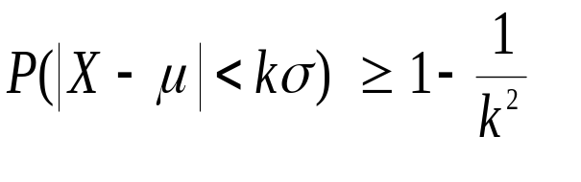
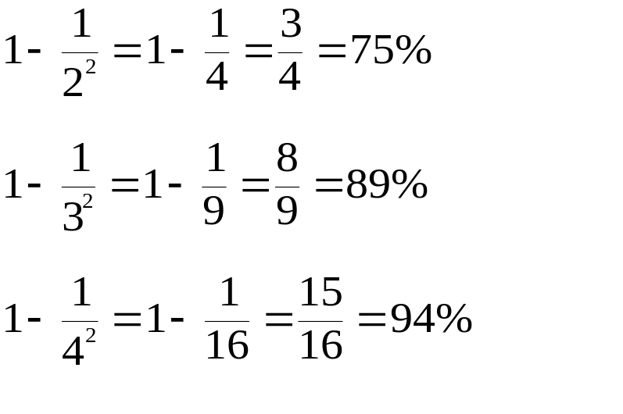
Chebyshev’s Theorem Applied to Probability Distributions
_{3-<number>}
Chebyshev’s Theorem applies to probability distributions just as it applies to frequency distributions.
For a random variable X with mean μ, standard deviation σ, and for any number k > 1:
2
3
4
Lie
within
Standard
deviations
of the mean
At
least

Slide 27
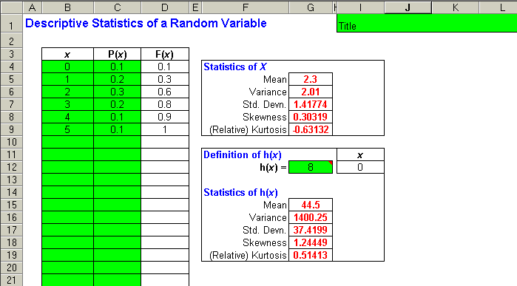
Using the Template to Calculate statistics of h(x)
_{3-<number>}

Slide 28
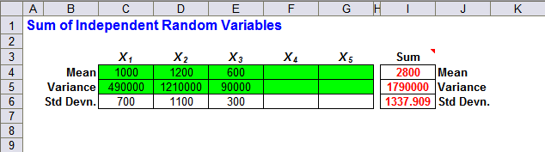
Using the Template to Calculate Mean and Variance for the Sum of Independent Random Variables
_{3-<number>}
Output for Example 3-4

Slide 29
3-4 Bernoulli Random Variable
_{3-<number>}
If an experiment consists of a single trial and the outcome of the trial can only be either a success* or a failure, then the trial is called a Bernoulli trial.
The number of success X in one Bernoulli trial, which can be 1 or 0, is a Bernoulli random variable.
Note: If p is the probability of success in a Bernoulli experiment, then P(1) = p, P(0) = 1 – p, E(X) = p and V(X) = p(1 – p).
* The terms success and failure are simply statistical terms, and do not have positive or negative implications. In a production setting, finding a defective product may be termed a “success,” although it is not a positive result.

Slide 30
3-5 The Binomial Random Variable
_{3-<number>}
Consider a Bernoulli Process in which we have a sequence of n identical trials satisfying the following conditions:
1. Each trial has two possible outcomes, called success *and failure. The two outcomes are mutually exclusive and exhaustive.
2. The probability of success, denoted by p, remains constant from trial to trial. The probability of failure is denoted by q, where q = 1-p.
3. The n trials are independent. That is, the outcome of any trial does not affect the outcomes of the other trials.
A random variable, X, that counts the number of successes in n Bernoulli trials, where p is the probability of success* in any given trial, is said to follow the binomial probability distribution with parameters n (number of trials) and p (probability of success). We call X the binomial random variable.
* The terms success and failure are simply statistical terms, and do not have positive or negative implications. In a production setting, finding a defective product may be termed a “success,” although it is not a positive result.

Slide 31
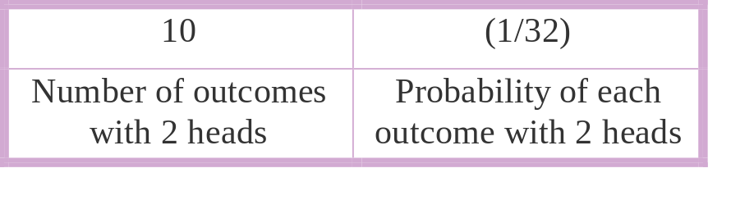
Binomial Probabilities (Introduction)
_{3-<number>}
Suppose we toss a single fair and balanced coin five times in succession,
and let X represent the number of heads.
There are 2⁵ = 32 possible sequences of H and T (S and F) in the sample space for this experiment. Of these, there are 10 in which there are exactly 2 heads (X=2):
HHTTT HTHTH HTTHT HTTTH THHTT THTHT THTTH TTHHT TTHTH TTTHH
The probability of each of these 10 outcomes is p³q³ = (1/2)³(1/2)²=(1/32), so the probability of 2 heads in 5 tosses of a fair and balanced coin is:
P(X = 2) = 10 * (1/32) = (10/32) = 0.3125

Slide 32
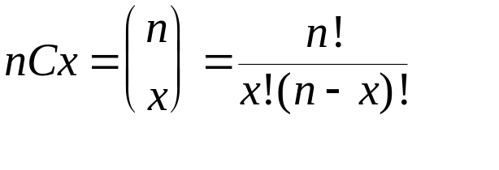
Binomial Probabilities (continued)
_{3-<number>}
P(X=2) = 10 * (1/32) = (10/32) = .3125
Notice that this probability has two parts:
In general:
1. The probability of a given sequence of x successes out of n trials with probability of success p and probability of failure q is equal to:
p^{x}q^{(n-x)}
2. The number of different sequences of n trials that result in exactly x successes is equal to the number of choices of x elements out of a total of n elements. This number is denoted:

Slide 33
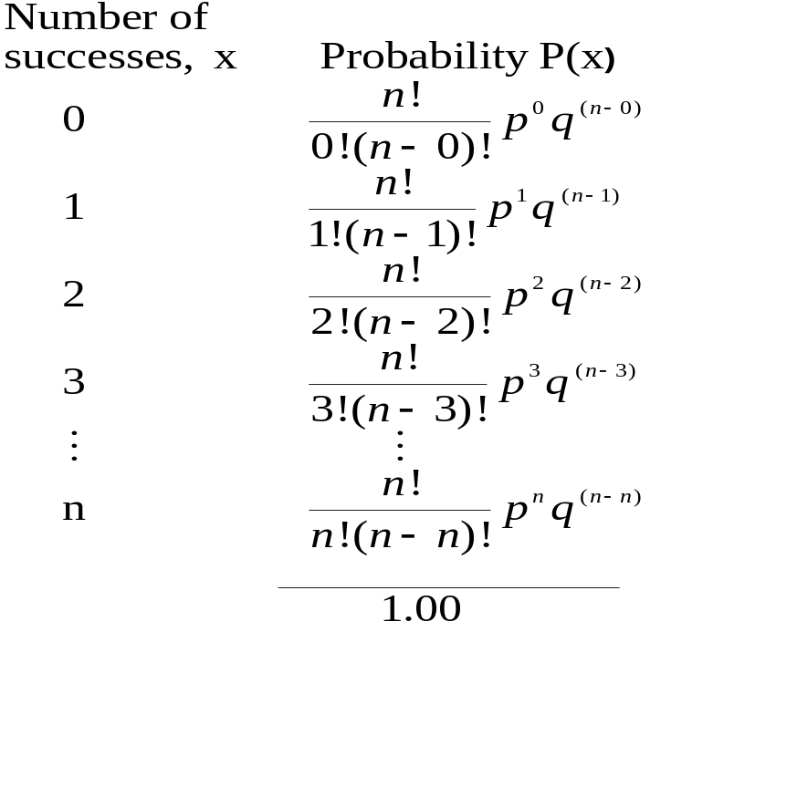
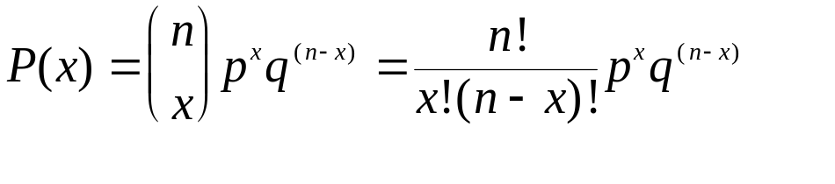
The Binomial Probability Distribution
_{3-<number>}
The binomial probability distribution:
where :
p is the probability of success in a single trial,
q = 1-p,
n is the number of trials, and
x is the number of successes.

Slide 34
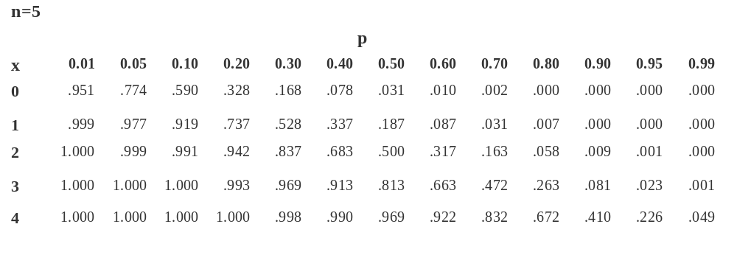
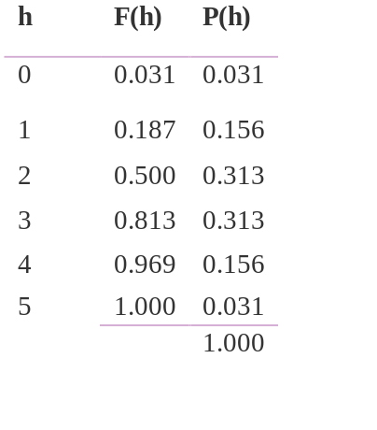
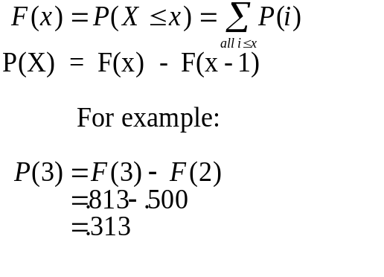
The Cumulative Binomial Probability Table (Table 1, Appendix C)
_{3-<number>}
Cumulative Binomial Probability Distribution and Binomial Probability Distribution of H,the Number of Heads Appearing in Five Tosses of a Fair Coin
Deriving Individual Probabilities from Cumulative Probabilities

Slide 35
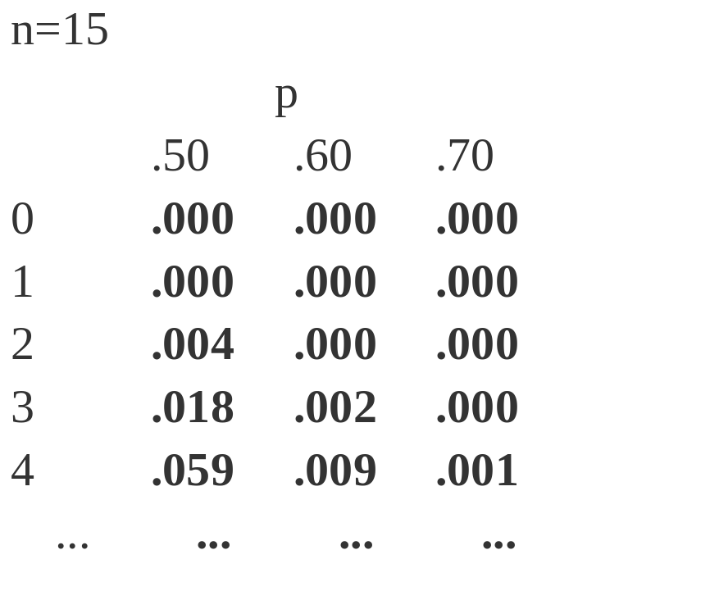
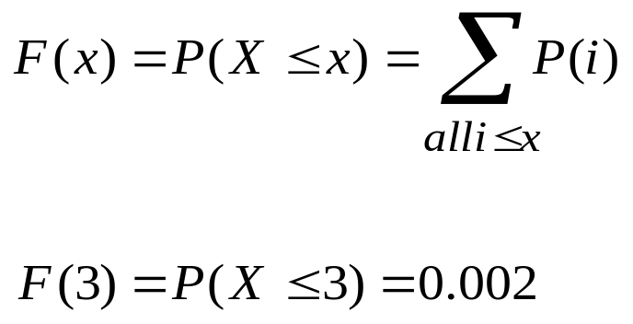
Calculating Binomial Probabilities -
Example
_{3-<number>}
60% of Brooke shares are owned by LeBow. A random sample of 15 shares is chosen. What is the probability that at most three of them will be found to be owned by LeBow?

Slide 36
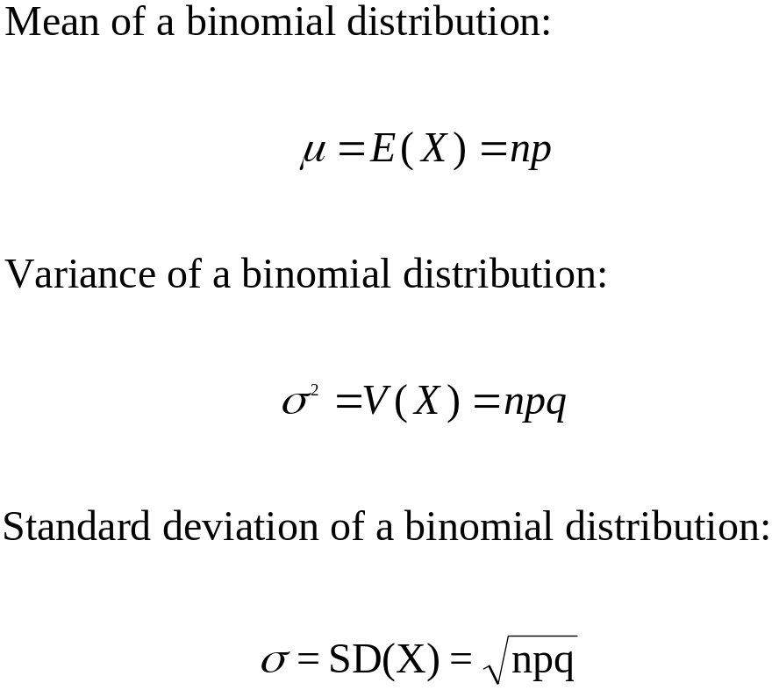
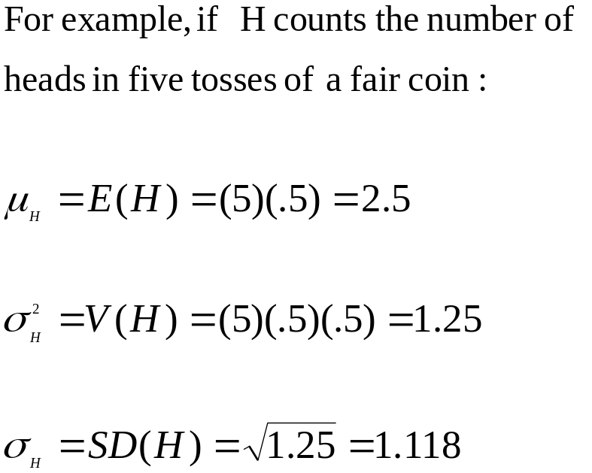
Mean, Variance, and Standard Deviation of the Binomial Distribution
_{3-<number>}

Slide 37
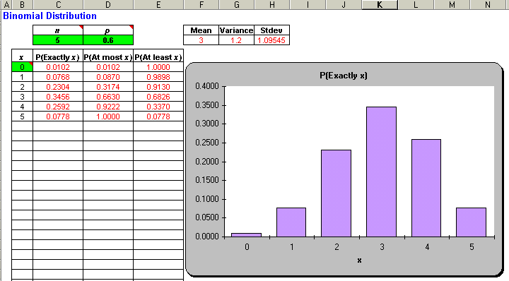
Calculating Binomial Probabilities using the Template
_{3-<number>}

Slide 38
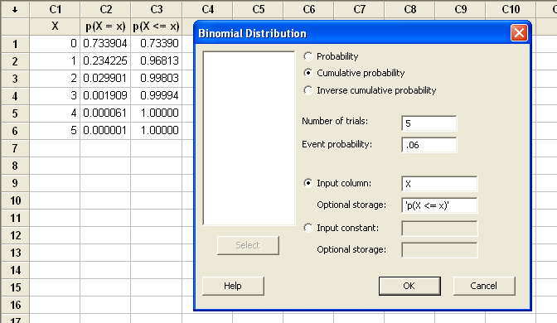
Calculating Binomial Probabilities using Minitab
_{3-<number>}

Slide 39
Shape of the Binomial Distribution
_{3-<number>}
p = 0.1
p = 0.3
p = 0.5
B
i
n
o
m
i
a
l
P
r
o
b
a
b
i
l
i
t
y
:
n
=
4
p
=
0
.
1
B
i
n
o
m
i
a
l
P
r
o
b
a
b
i
l
i
t
y
:
n
=
4
p
=
0
.
3
B
i
n
o
m
i
a
l
P
r
o
b
a
b
i
l
i
t
y
:
n
=
4
p
=
0
.
5
0
.
7
0
.
7
0
.
7
0
.
6
0
.
6
0
.
6
n = 4
)
0
.
5
)
0
.
5
)
0
.
5
x
0
.
4
x
0
.
4
x
0
.
4
(
(
(
P
0
.
3
P
0
.
3
P
0
.
3
0
.
2
0
.
2
0
.
2
0
.
1
0
.
1
0
.
1
0
.
0
0
1
2
3
4
0
.
0
0
1
2
3
4
0
.
0
0
1
2
3
4
x
x
x
B
i
n
o
m
i
a
l
P
r
o
b
a
b
i
l
i
t
y
:
n
=
1
0
p
=
0
.
1
B
i
n
o
m
i
a
l
P
r
o
b
a
b
i
l
i
t
y
:
n
=
1
0
p
=
0
.
3
B
i
n
o
m
i
a
l
P
r
o
b
a
b
i
l
i
t
y
:
n
=
1
0
p
=
0
.
5
0
.
5
0
.
5
0
.
5
n = 10
0
.
4
0
.
4
0
.
4
)
0
.
3
)
0
.
3
)
0
.
3
x
x
x
(
(
(
P
0
.
2
P
0
.
2
P
0
.
2
0
.
1
0
.
1
0
.
1
0
.
0
0
1
2
3
4
5
6
7
8
9
1
0
0
.
0
0
1
2
3
4
5
6
7
8
9
1
0
0
.
0
0
1
2
3
4
5
6
7
8
9
1
0
x
x
x
B
i
n
o
m
i
a
l
P
r
o
b
a
b
i
l
i
t
y
:
n
=
2
0
p
=
0
.
1
B
i
n
o
m
i
a
l
P
r
o
b
a
b
i
l
i
t
y
:
n
=
2
0
p
=
0
.
3
B
i
n
o
m
i
a
l
P
r
o
b
a
b
i
l
i
t
y
:
n
=
2
0
p
=
0
.
5
n = 20
)
0
.
2
)
0
.
2
)
0
.
2
x
x
x
(
(
(
P
0
.
1
P
0
.
1
P
0
.
1
0
.
0
0
1
2
3
4
5
6
7
8
9
1
0
1
1
1
2
1
3
1
4
1
5
1
6
1
7
1
8
1
9
2
0
0
.
0
0
1
2
3
4
5
6
7
8
9
1
0
1
1
1
2
1
3
1
4
1
5
1
6
1
7
1
8
1
9
2
0
0
.
0
0
1
2
3
4
5
6
7
8
9
1
0
1
1
1
2
1
3
1
4
1
5
1
6
1
7
1
8
1
9
2
0
x
x
x
Binomial distributions become more symmetric as n increases and as p 0.5.

Slide 40
Discrete and Continuous Random Variables - Revisited
_{3-<number>}
A discrete random variable:
  counts occurrences
  has a countable number of possible values
  has discrete jumps between successive values
  has measurable probability associated with individual values
  probability is height
A continuous random variable:
  measures (e.g.: height, weight, speed, value, duration, length)
  has an uncountably infinite number of possible values
  moves continuously from value to value
  has no measurable probability associated with individual values
  probability is area
For example:
Binomial
n=3 p=.5
x P(x)
0 0.125
1 0.375
2 0.375
3 0.125
1.000
B
i
n
o
m
i
a
l
:
n
=
3
p
=
.
5
For example:
In this case, the shaded area epresents the probability that the task takes between 2 and 3 minutes.
M
i
n
u
t
e
s
t
o
C
o
m
p
l
e
t
e
T
a
s
0
.
4
k
0
.
0
.
3
3
)
x
(
0
.
P
0
.
2
)
2
x
(
P
0
.
1
0
.
1
0
.
0
0
.
0
1
C
1
2
3
0
1
2
3
4
5
6
M
i
n
u
t
e
s

Slide 41
From a Discrete to a Continuous Distribution
_{3-<number>}
The time it takes to complete a task can be subdivided into:
Half-Minute Intervals
Quarter-Minute Intervals
Eighth-Minute Intervals
M
i
n
u
t
e
s
t
o
C
o
m
p
l
e
t
e
T
a
s
k
:
F
o
u
r
t
h
s
o
f
a
M
i
n
u
t
e
M
i
n
u
t
e
s
t
o
C
o
m
p
l
e
t
e
T
a
s
k
:
E
i
g
h
t
h
s
o
f
a
M
i
n
u
t
M
e
i
n
u
t
e
s
t
o
C
o
m
p
l
e
t
e
T
a
s
k
:
B
y
H
a
l
f
-
M
i
n
u
t
e
s
0
.
1
5
0
.
1
)
0
)
)
x
x
x
(
(
(
P
P
P
0
.
0
5
0
.
0
0
0.0
.
1
.
0
1
.
5
2
.
0
2
.
5
3
.
0
3
.
5
4
.
0
4
.
5
5
.
0
5
.
5
6
.
0
6
.
M
5
0 1 2 3 4 5 6 7
0 1 2 3 4 5 6 7
i
n
u
t
e
s
M
i
n
u
t
e
s
M
i
n
u
t
e
s
Or even infinitesimally small intervals:
Minutes to Complete Task: Probability Density Function
When a continuous random variable has been subdivided into infinitesimally small intervals, a measurable probability can only be associated with an interval of values, and the probability is given by the area beneath the probability density function corresponding to that interval. In this example, the shaded area represents P(2 ≤ X ≤ 3).
)
z
(
f
0
1
2
3
4
5
6
7
Minutes

Slide 42
3-6 Continuous Random Variables
_{3-<number>}
A continuous random variable is a random variable that can take on any value in an interval of numbers.
The probabilities associated with a continuous random variable X are determined by the probability density function of the random variable. The function, denoted f(x), has the following properties.
1. f(x) ≥ 0 for all x.
2. The probability that X will be between two numbers a and b is equal to the area under f(x) between a and b.
3. The total area under the curve of f(x) is equal to 1.00.
The cumulative distribution function of a continuous random variable:
F(x) = P(X ≤ x) =Area under f(x) between the smallest possible value of X (often -∞) and the point x.

Slide 43
Probability Density Function and Cumulative Distribution Function
_{3-<number>}
F(x)
1
F(b)
}
P(a ≤ X ≤ b)=F(b) - F(a)
F(a)
0
a
b
x
f(x)
P(a ≤ X ≤ b) = Area under f(x) between a and b
= F(b) - F(a)
0
a
b
x

Slide 44
3-7 Uniform Distribution
_{3-<number>}
The uniform [a,b] density:
1/(a – b) for a ≤ X ≤ b
f(x)=
0 otherwise
E(X) = (a + b)/2; V(X) = (b – a)²/12
{
Uniform [a, b] Distribution
The entire area under f(x) = 1/(b – a) * (b – a) = 1.00
)
x
(
f
The area under f(x) from a1 to b1 = P(a1≤X≤ b1)
= (b1 – a1)/(b – a)
a
a1
b1
b
x

Slide 45
Uniform Distribution (continued)
_{3-<number>}
The uniform [0,5] density:
1/5 for 0 ≤ X ≤ 5
f(x)=
0 otherwise
E(X) = 2.5
{
U
n
i
f
o
r
m
[
0
,
5
]
D
i
s
t
r
i
b
u
t
i
o
n
0
.
5
0
The entire area under f(x) = 1/5 * 5 = 1.00
.
4
0
.
)
3
x
(
f
0
The area under f(x) from 1 to 3 = P(1≤X≤3)
= (1/5)2 = 2/5
.
2
0
.
1
.
0.0
-
1
2
1
0
3
4
5
6
x

Slide 46
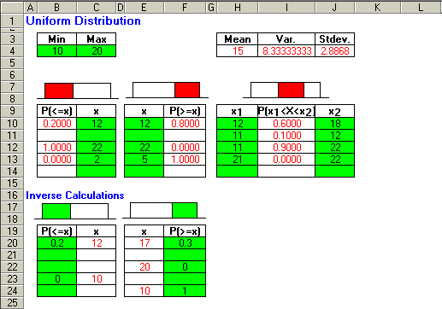
Calculating Uniform Distribution Probabilities using the Template
_{3-<number>}

