Slide 1
COMPLETE
BUSINESS
STATISTICS
by
AMIR D. ACZEL
&
JAYAVEL SOUNDERPANDIAN
7th edition.
Prepared by Lloyd Jaisingh, Morehead State University
Chapter 5
Sampling and Sampling Distributions
McGraw-Hill/Irwin
Copyright © 2009 by The McGraw-Hill Companies, Inc. All rights reserved.

Slide 2
_{5-<number>}
5
Sampling and Sampling Distributions
Using Statistics
Sample Statistics as Estimators of Population Parameters
Sampling Distributions
Estimators and Their Properties
Degrees of Freedom
The Template

Slide 3
_{5-<number>}
5
LEARNING OBJECTIVES
After studying this chapter you should be able to:
Take random samples from populations
Distinguish between population parameters and sample statistics
Apply the central limit theorem
Derive sampling distributions of sample means and proportions
Explain why sample statistics are good estimators of population parameters
Judge one estimator as better than another based on desirable properties of estimators
Apply the concept of degrees of freedom
Identify special sampling methods
Compute sampling distributions and related results using templates

Slide 4
5-1 Using Statistics
_{5-<number>}
Statistical Inference:
  Predict and forecast values of population parameters...
  Test hypotheses about values of population parameters...
  Make decisions...
On basis of sample statistics derived from limited and incomplete sample information.
Make generalizations about the characteristics of a population...
On the basis of observations of a sample, a part of a population

Slide 5
The Literary Digest Poll (1936)
_{5-<number>}
Unbiased
Sample
Unbiased, representative sample drawn at random from the entire population.
Democrats
Republicans
Population
Biased
Sample
Biased, unrepresentative sample drawn from people who have cars and/or telephones and/or read the Digest.
People who have phones and/or cars and/or are Digest readers.
Democrats
Republicans
Population

Slide 6
5-2 Sample Statistics as Estimators of Population Parameters
_{5-<number>}
A sample statistic is a numerical measure of a summary characteristic
of a sample.
A population parameter is a numerical measure of a summary characteristic of a population.
An estimator of a population parameter is a sample statistic used to estimate or predict the population parameter.
An estimate of a parameter is a particular numerical value of a sample statistic obtained through sampling.
A point estimate is a single value used as an estimate of a population parameter.

Slide 7


Estimators
_{5-<number>}
The sample mean, , is the most common estimator of the population mean, μ.
The sample variance, s², is the most common estimator of the population variance, σ².
The sample standard deviation, s, is the most common estimator of the population standard deviation, σ.
The sample proportion, , is the most common estimator of the population proportion, p.

Slide 8
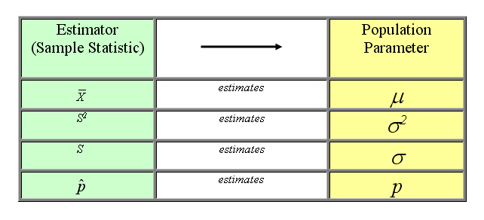
Estimators
_{5-<number>}

Slide 9
Population and Sample Proportions
_{5-<number>}
The population proportion is equal to the number of elements in the population belonging to the category of interest, divided by the total number of elements in the population:
X
p
=
N
The sample proportion is the number of elements in the sample belonging to the category of interest, divided by the sample size:
x
p
=

n

Slide 10
A Population Distribution, a Sample from a Population, and the Population and Sample Means
_{5-<number>}
Population mean (μ)
Frequency distribution of the population
X
X
X
X
X
X
X
X
X
X
X
X
X
X
X
X
X
X
Sample points
Sample mean ( )
X

Slide 11
Other Sampling Methods
_{5-<number>}
Stratified sampling: in stratified sampling, the population is partitioned into two or more subpopulation called strata, and from each stratum a desired sample size is selected at random.
Cluster sampling: in cluster sampling, a random sample of the strata is selected and then samples from these selected strata are obtained.
Single-stage Cluster sampling: in single-stage cluster sampling, a cluster is chosen at random and every item or person in that cluster is sampled.

Slide 12
Other Sampling Methods
_{5-<number>}
Two-stage Cluster sampling: in two-stage cluster sampling, a cluster is chosen at random and random samples of the items or persons are taken from that cluster.
Multistage Cluster sampling: in multistage cluster sampling, a random sample of the strata is selected, then samples of items or persons from these strata are taken and then samples from these items and persons are selected.

Slide 13

5-3 Sampling Distributions
_{5-<number>}
The sampling distribution of a statistic is the probability distribution of all possible values the statistic may assume, when computed from random samples of the same size, drawn from a specified population.
The sampling distribution of X is the probability distribution of all possible values the random variable may assume when a sample of size n is taken from a specified population.

Slide 14
Sampling Distributions (Continued)
_{5-<number>}
Uniform population of integers from 1 to 8:
X P(X) XP(X) (X-μ_{x}) (X-μ_{x})² P(X)(X-μ_{x})²
1 0.125 0.125 -3.5 12.25 1.53125
2 0.125 0.250 -2.5 6.25 0.78125
3 0.125 0.375 -1.5 2.25 0.28125
4 0.125 0.500 -0.5 0.25 0.03125
5 0.125 0.625 0.5 0.25 0.03125
6 0.125 0.750 1.5 2.25 0.28125
7 0.125 0.875 2.5 6.25 0.78125
8 0.125 1.000 3.5 12.25 1.53125
1.000 4.500 5.25000
U
n
i
f
o
r
m
D
i
s
t
r
i
b
u
t
i
o
n
(
1
,
8
)
0
.
2
)
X
(
0
.
1
P
0
.
0
1
2
3
4
5
6
7
8
X
E(X) = μ = 4.5
V(X) = σ² = 5.25
SD(X) = σ = 2.2913

Slide 15
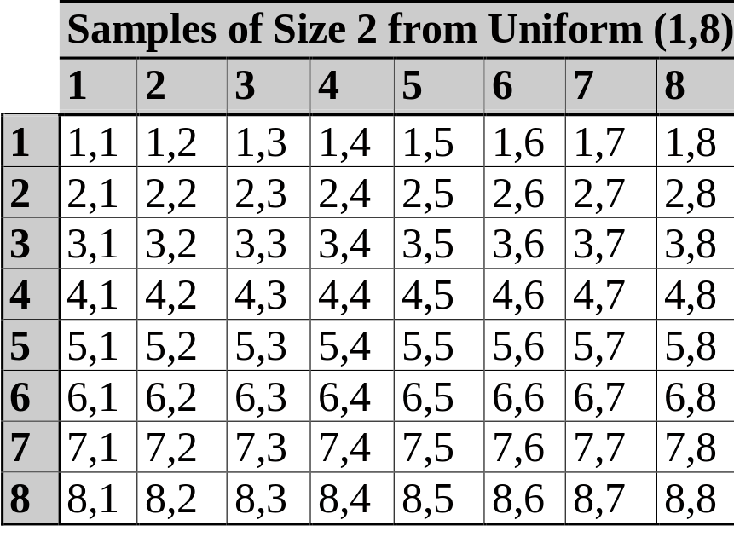
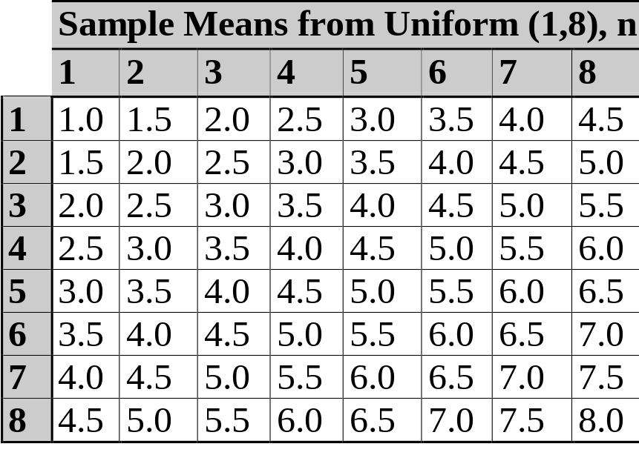
Sampling Distributions (Continued)
_{5-<number>}
There are 8*8 = 64 different but equally-likely samples of size 2 that can be drawn (with replacement) from a uniform population of the integers from 1 to 8:
Each of these samples has a sample mean. For example, the mean of the sample (1,4) is 2.5, and the mean of the sample (8,4) is 6.

Slide 16
Sampling Distributions (Continued)
_{5-<number>}
The probability distribution of the sample mean is called the sampling distribution of the the sample mean.
Sampling Distribution of the Mean
S
a
m
p
l
i
n
g
D
i
s
t
r
i
b
u
t
i
o
n
o
f
t
h
e
M
e
a
n
X P(X) XP(X) X-μ_{X} (X-μ_{X})² P(X)(X-μ_{X})²
1.0 0.015625 0.015625 -3.5 12.25 0.191406
1.5 0.031250 0.046875 -3.0 9.00 0.281250
2.0 0.046875 0.093750 -2.5 6.25 0.292969
2.5 0.062500 0.156250 -2.0 4.00 0.250000
3.0 0.078125 0.234375 -1.5 2.25 0.175781
3.5 0.093750 0.328125 -1.0 1.00 0.093750
4.0 0.109375 0.437500 -0.5 0.25 0.027344
4.5 0.125000 0.562500 0.0 0.00 0.000000
5.0 0.109375 0.546875 0.5 0.25 0.027344
5.5 0.093750 0.515625 1.0 1.00 0.093750
6.0 0.078125 0.468750 1.5 2.25 0.175781
6.5 0.062500 0.406250 2.0 4.00 0.250000
7.0 0.046875 0.328125 2.5 6.25 0.292969
7.5 0.031250 0.234375 3.0 9.00 0.281250
8.0 0.015625 0.125000 3.5 12.25 0.191406
1.000000 4.500000 2.625000
0
.
1
0
)
X
(
P
0
.
0
5
0
.
0
0
1
.
0
1
.
5
2
.
0
2
.
5
3
.
0
3
.
5
4
.
0
4
.
5
5
.
0
5
.
5
6
.
0
6
.
5
7
.
0
7
.
5
8
.
0
X
E
(
X
)
=
μ
=
4.
5
V
(
X
)
=
σ
X
=
2
2.
625
=
X
SD
(
X
)
σ
=
1
.
6202
X

Slide 17
Properties of the Sampling Distribution of the Sample Mean
_{5-<number>}
Comparing the population distribution and the sampling distribution of the mean:
  The sampling distribution is more bell-shaped and symmetric.
  Both have the same center.
  The sampling distribution of the mean is more compact, with a smaller variance.
U
n
i
f
o
r
m
D
i
s
t
r
i
b
u
t
i
o
n
(
1
,
8
)
0
.
2
)
X
(
0
.
1
P
0
.
0
1
2
3
4
5
6
7
8
X
S
a
m
p
l
i
n
g
D
i
s
t
r
i
b
u
t
i
o
n
o
f
t
h
e
M
e
a
n
0
.
1
0
)
X
(
P
0
.
0
5
0
.
0
0
1
.
0
1
.
5
2
.
0
2
.
5
3
.
0
3
.
5
4
.
0
4
.
5
5
.
0
5
.
5
6
.
0
6
.
5
7
.
0
7
.
5
8
.
X
0

Slide 18

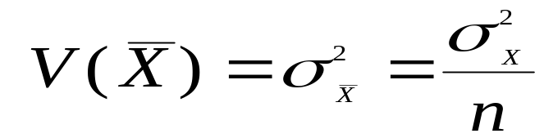
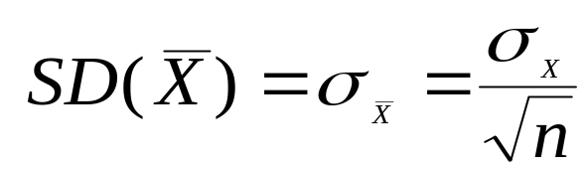
Relationships between Population Parameters and the Sampling Distribution of the Sample Mean
_{5-<number>}
The expected value of the sample mean is equal to the population mean:
The variance of the sample mean is equal to the population variance divided by the sample size:
The standard deviation of the sample mean, known as the standard error of the mean, is equal to the population standard deviation divided by the square root of the sample size:

Slide 19
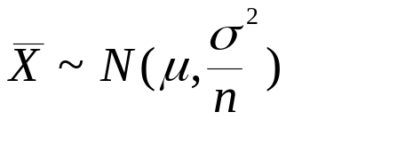
Sampling from a Normal Population
_{5-<number>}
When sampling from a normal population with mean μ and standard deviation σ, the sample mean, X, has a normal sampling distribution:
This means that, as the sample size increases, the sampling distribution of the sample mean remains centered on the population mean, but becomes more compactly distributed around that population mean.
S
a
m
p
l
i
n
g
D
i
s
t
r
i
b
u
t
i
o
n
o
f
t
h
e
S
a
m
p
l
e
M
e
a
n
0
.
4
Sampling Distribution: n =16
0
.
3
Sampling Distribution: n = 4
)
X
0
.
(
2
f
0
Sampling Distribution: n = 2
.
1
Normal population
Normal population
0
.
0
μ

Slide 20


The Central Limit Theorem
_{5-<number>}
When sampling from a population with mean μ and finite standard deviation σ, the sampling distribution of the sample mean will tend to a normal distribution with mean μ and standard deviation as the sample size becomes large
(n >30).
For “large enough” n:
n = 5
0
.
2
5
0
.
2
)
0
X
0
.
1
(
5
P
0
.
1
0
0
.
0
5
0
.
0
0
X
n = 20
0
.
2
)
X
(
P
0
.
1
0
.
0
X
Large n
0
.
4
0
.
)
3
X
(
0
.
f
2
0
.
1
0
.
0
-
μ
X

Slide 21
The Central Limit Theorem Applies to Sampling Distributions from Any Population
_{5-<number>}
Normal
Uniform
Skewed
General
Population
n = 2
n = 30
μ
X
μ
X
μ
X
μ
X

Slide 22
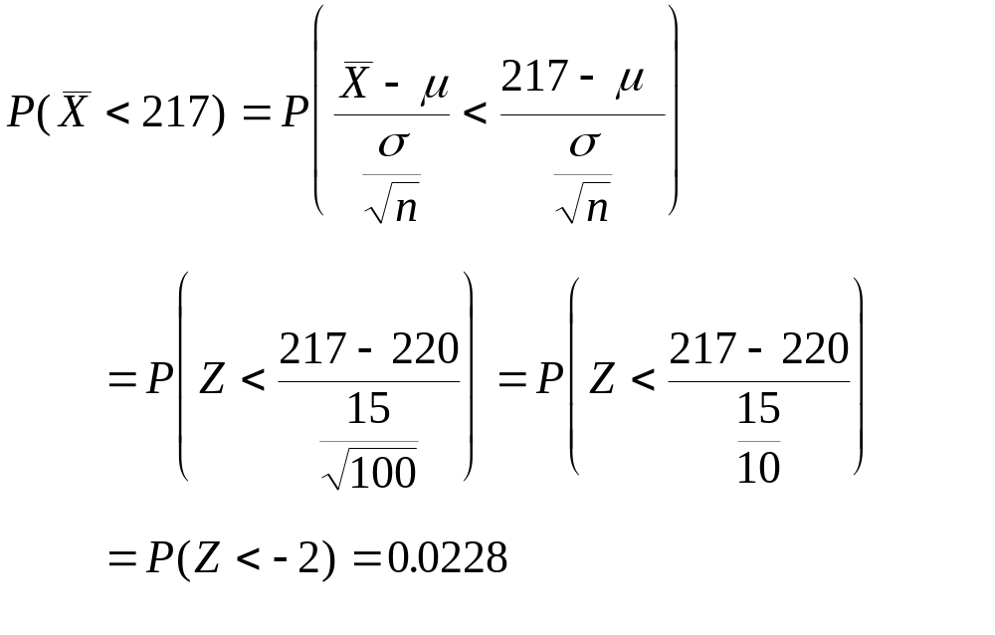
The Central Limit Theorem
(Example 5-1)
_{5-<number>}
Mercury makes a 2.4 liter V-6 engine, the Laser XRi, used in speedboats. The company’s engineers believe the engine delivers an average power of 220 horsepower and that the standard deviation of power delivered is 15 HP. A potential buyer intends to sample 100 engines (each engine is to be run a single time). What is the probability that the sample mean will be less than 217HP?

Slide 23
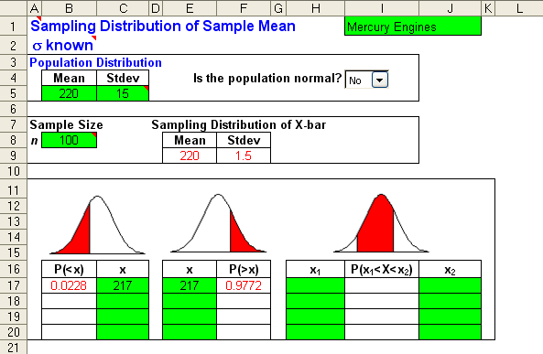
The Central Limit Theorem
(Example 5-1) – Using the Template
_{5-<number>}
Mercury makes a 2.4 liter V-6 engine, the Laser XRi, used in speedboats. The company’s engineers believe the engine delivers an average power of 220 horsepower and that the standard deviation of power delivered is 15 HP. A potential buyer intends to sample 100 engines (each engine is to be run a single time). What is the probability that the sample mean will be less than 217HP?

Slide 24
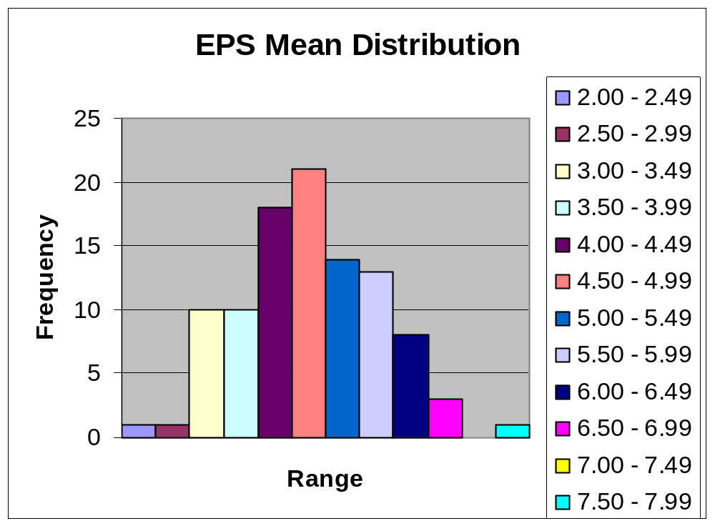
Example 5-2
_{5-<number>}

Slide 25
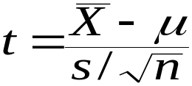
Student’s t Distribution
_{5-<number>}
If the population standard deviation, σ, is unknown, replace σ with the sample standard deviation, s. If the population is normal, the resulting statistic:
has a t distribution with (n - 1) degrees of freedom.
The t is a family of bell-shaped and symmetric distributions, one for each number of degree of freedom.
The expected value of t is 0.
The variance of t is greater than 1, but approaches 1 as the number of degrees of freedom increases. The t is flatter and has fatter tails than does the standard normal.
The t distribution approaches a standard normal as the number of degrees of freedom increases.
Standard normal
t, df=20
t, df=10
0
μ

Slide 26
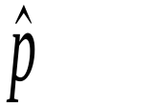
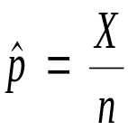

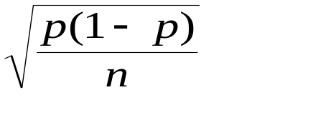
The Sampling Distribution of the Sample Proportion,
_{5-<number>}
n
=
2
,
p
=
0
.
The sample proportion is the percentage of successes in n binomial trials. It is the number of successes, X, divided by the number of trials, n.
3
0
.
5
0
.
4
)
0
.
X
3
(
P
0
.
2
0
.
1
0
.
0
0
1
2
X
n=10,p=0.3
Sample proportion:
0
.
3
)
0
.
2
X
(
P
0
.
1
0
.
0
0
1
2
3
4
5
6
7
8
9
1
0
As the sample size, n, increases, the sampling distribution of approaches a normal distribution with mean p and standard deviation
X
n
=
1
5
,
p
=
0
.
3
0
.
2
)
X
(
P
0
.
1
0
.
0
0
X
1
2
3
4
5
6
7
8
9
1
0
1
1
1
2
1
3
1
4
1
5
^
p
0
15
7
15
10
15
15
15
1
15
2
15
3
15
4
15
5
15
6
15
8
15
9
15
11
15
12
15
13
15
14
15

Slide 27
Sample Proportion (Example 5-3)
_{5-<number>}
In recent years, convertible sports coupes have become very popular in Japan. Toyota is currently shipping Celicas to Los Angeles, where a customizer does a roof lift and ships them back to Japan. Suppose that 25% of all Japanese in a given income and lifestyle category are interested in buying Celica convertibles. A random sample of 100 Japanese consumers in the category of interest is to be selected. What is the probability that at least 20% of those in the sample will express an interest in a Celica convertible?
n
=
100
⎛
⎞
p
=
0
.
25
⎜
⎟
p
−
p
.
20
−
p
P
(
p
>
0
.
20
)
=
P
⎜

>
⎟

⎜
⎟
=
=
=
⎝
p
(
1
−
p
)
p
(
1
−
p
)
⎠
np
(
100
)(
0
.
25
)
25
E
(
p
)

n
n
⎛
⎞
p
(
1
−
p
)
(.
25
)(.
75
)
⎜
⎟
⎛
⎞
=
=
0
.
001875
=
V
(
p
)
.
20
−
.
25
−
.
05

=
⎜
>
⎟
=
⎜
>
⎟
n
100
P
z
P
⎝
z
⎠
⎜
(.
25
)(.
75
)
⎟
.
0433
⎝
⎠
p
(
1
−
p
)
100
=
0
.
001875
=
0
.
04330127
=
SD
(
p
)

=
P
(
z
>
−
1
.
15
)
=
0
.
8749
n

Slide 28
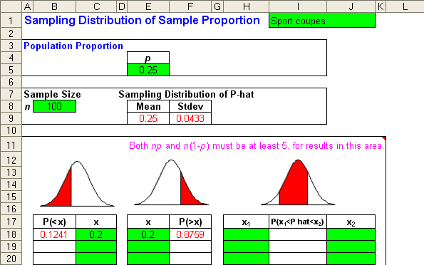
Sample Proportion (Example 5-3) – Template Solution
_{5-<number>}
In recent years, convertible sports coupes have become very popular in Japan. Toyota is currently shipping Celicas to Los Angeles, where a customizer does a roof lift and ships them back to Japan. Suppose that 25% of all Japanese in a given income and lifestyle category are interested in buying Celica convertibles. A random sample of 100 Japanese consumers in the category of interest is to be selected. What is the probability that at least 20% of those in the sample will express an interest in a Celica convertible?

Slide 29

5-4 Estimators and Their Properties
_{5-<number>}
An estimator of a population parameter is a sample statistic used to estimate the parameter. The most commonly-used estimator of the:
Population Parameter Sample Statistic
Mean (μ) is the Mean (X)
Variance (σ²) is the Variance (s²)
Standard Deviation (σ) is the Standard Deviation (s)
Proportion (p) is the Proportion ( )
Desirable properties of estimators include:
  Unbiasedness
  Efficiency
  Consistency
  Sufficiency

Slide 30
Unbiasedness
_{5-<number>}
An estimator is said to be unbiased if its expected value is equal to the population parameter it estimates.
For example, E(X)=μ, so the sample mean is an unbiased estimator of the population mean. Unbiasedness is an average or long-run property. The mean of any single sample will probably not equal the population mean, but the average of the means of repeated independent samples from a population will equal the population mean.
Any systematic deviation of the estimator from the population parameter of interest is called a bias.

Slide 31
Unbiased and Biased Estimators
_{5-<number>}
{
Bias
An unbiased estimator is on target on average.
A biased estimator is off target on average.

Slide 32
Efficiency
_{5-<number>}
An estimator is efficient if it has a relatively small variance (and standard deviation).
An efficient estimator is, on average, closer to the parameter being estimated..
An inefficient estimator is, on average, farther from the parameter being estimated.

Slide 33
Consistency and Sufficiency
_{5-<number>}
An estimator is said to be consistent if its probability of being close to the parameter it estimates increases as the sample size increases.
Consistency
n = 100
n = 10
An estimator is said to be sufficient if it contains all the information in the data about the parameter it estimates.

Slide 34
Properties of the Sample Mean
_{5-<number>}
For a normal population, both the sample mean and sample median are unbiased estimators of the population mean, but the sample mean is both more efficient (because it has a smaller variance), and sufficient. Every observation in the sample is used in the calculation of the sample mean, but only the middle value is used to find the sample median.
In general, the sample mean is the best estimator of the population mean. The sample mean is the most efficient unbiased estimator of the population mean. It is also a consistent estimator.

Slide 35
Properties of the Sample Variance
_{5-<number>}
The sample variance (the sum of the squared deviations from the sample mean divided by (n-1) is an unbiased estimator of the population variance. In contrast, the average squared deviation from the sample mean is a biased (though consistent) estimator of the population variance.
⎛
∑
(
x
−
x
)
2
⎞
E
(
s
2
)
=
E
⎜
⎟
=
σ
2
⎝
(
n
−
1
)
⎠
⎛
∑
(
x
−
x
)
2
⎞
E
⎜
⎟
<
σ
2
⎝
n
⎠

Slide 36
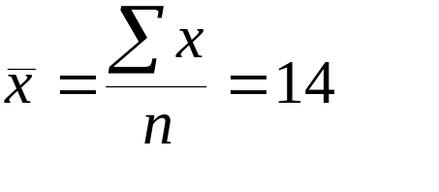
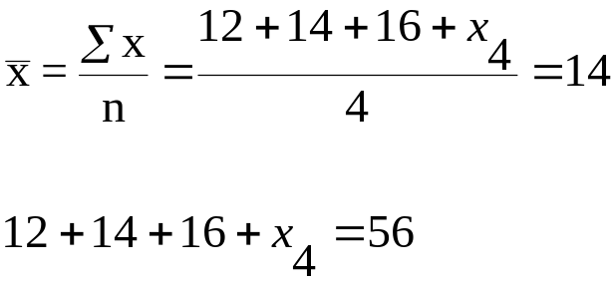
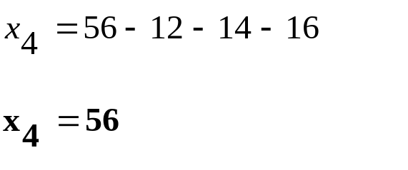
5-5 Degrees of Freedom
_{5-<number>}
Consider a sample of size n=4 containing the following data points:
x₁=10 x₂=12 x₃=16 x₄=?
and for which the sample mean is:
Given the values of three data points and the sample mean, the value of the fourth data point can be determined:
x₄ = 14

Slide 37

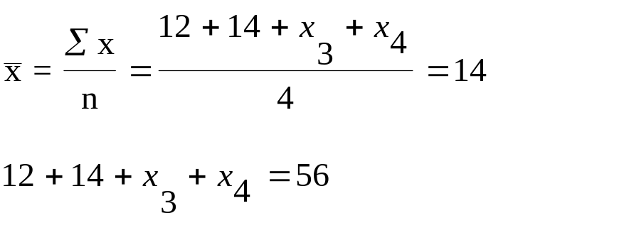
Degrees of Freedom (Continued)
_{5-<number>}
If only two data points and the sample mean are known:
x₁=10 x₂=12 x₃=? x₄=?
The values of the remaining two data points cannot be uniquely determined:

Slide 38
Degrees of Freedom (Continued)
_{5-<number>}
The number of degrees of freedom is equal to the total number of measurements (these are not always raw data points), less the total number of restrictions on the measurements. A restriction is a quantity computed from the measurements.
The sample mean is a restriction on the sample measurements, so after calculating the sample mean there are only (n-1) degrees of freedom remaining with which to calculate the sample variance. The sample variance is based on only (n-1) free data points:
∑
(
x
−
x
)
2
s
2
=
(
n
−
1
)

Slide 39

Example 5-4
_{5-<number>}
A sample of size 10 is given below. We are to choose three different numbers from which the deviations are to be taken. The first number is to be used for the first five sample points; the second number is to be used for the next three sample points; and the third number is to be used for the last two sample points.
Sample # | 1 | 2 | 3 | 4 | 5 | 6 | 7 | 8 | 9 | 10
Sample Point | 93 | 97 | 60 | 72 | 96 | 83 | 59 | 66 | 88 | 53
What three numbers should we choose in order to minimize the SSD (sum of squared deviations from the mean).?
Note:

Slide 40
Example 5-4 (continued)
_{5-<number>}
Solution: Choose the means of the corresponding sample points. These are: 83.6, 69.33, and 70.5.
Calculate the SSD with chosen numbers.
Solution: SSD = 2030.367. See table on next slide for calculations.
What is the df for the calculated SSD?
Solution: df = 10 – 3 = 7.
Calculate an unbiased estimate of the population variance.
Solution: An unbiased estimate of the population variance is SSD/df = 2030.367/7 = 290.05.

Slide 41
Example 5-4 (continued)
_{5-<number>}
Sample # | Sample Point | Mean | Deviations | Deviation Squared
1 | 93 | 83.6 | 9.4 | 88.36
2 | 97 | 83.6 | 13.4 | 179.56
3 | 60 | 83.6 | -23.6 | 556.96
4 | 72 | 83.6 | -11.6 | 134.56
5 | 96 | 83.6 | 12.4 | 153.76
6 | 83 | 69.33 | 13.6667 | 186.7778
7 | 59 | 69.33 | -10.3333 | 106.7778
8 | 66 | 69.33 | -3.3333 | 11.1111
9 | 88 | 70.5 | 17.5 | 306.25
10 | 53 | 70.5 | -17.5 | 306.25
 |  |  | SSD | 2030.367
 |  |  | SSD/df | 290.0524

Slide 42
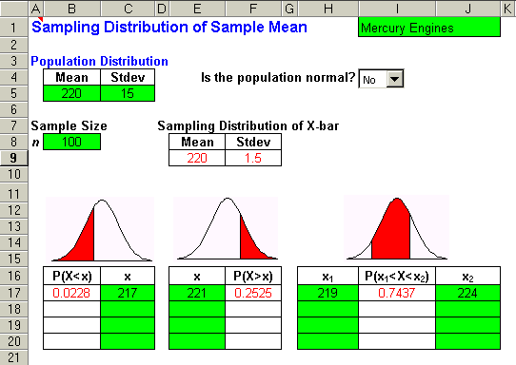
5-6 Using the Computer
Using the Template
_{5-<number>}
Sampling Distribution of a Sample Mean

Slide 43
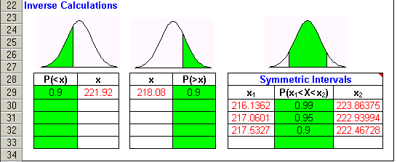
Using the Template
_{5-<number>}
Sampling Distribution of a Sample Mean (continued)

Slide 44
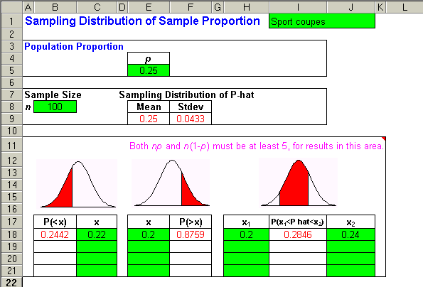
Using the Template
_{5-<number>}
Sampling Distribution of a Sample Proportion

Slide 45
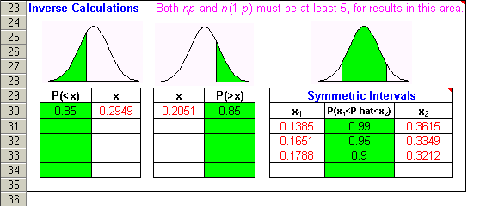
Using the Template
_{5-<number>}
Sampling Distribution of a Sample Proportion (continued)

Slide 46
Using Excel to Generate Random Data
_{5-<number>}
Constructing a sampling distribution of the mean from a uniform
population (n = 10) using EXCEL (use RANDBETWEEN(0, 1)
command to generate values to graph):
Histogram of Sample Means
CLASS MIDPOINT
FREQUENCY
250
0.15
0
0.2
0
0.25
3
200
0.3
26
0.35
64
0.4
113
0.45
183
150
0.5
213
Frequency
0.55
178
0.6
128
0.65
65
100
0.7
20
0.75
3
0.8
3
0.85
0
50
999
0
1
2
3
4
5
6
7
8
9
10
11
12
13
14
15
Sample Means (Class Midpoints)

Slide 47
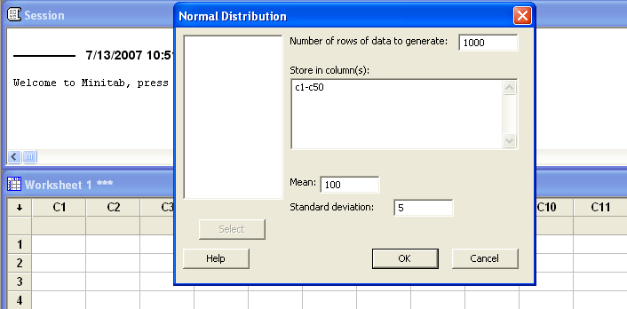
Using Minitab to Generate Random Data
_{5-<number>}
Constructing a sampling distribution of the mean from any distribution using MINITAB can be achieved by selecting CALC→RANDOM DATA and then generating the data from a selected distribution. For example, we can generate data from a normal distribution with mean = 100 and standard deviation = 5.

Slide 48
Using Minitab to Look at the Sampling Distribution of the sample Mean (n = 50)
_{5-<number>}
If we would like to look at the distribution of the sample means for the
previous simulation, we can select different sample sizes from the
columns (C1 to C50). If for instance we select samples of size n = 50, then
we will have 1000 of these based on the previous simulation.
In this simulation μ = 100 and σ = 5.
We can compute the row means for these 50 columns and save in
the next available columns.
Thus for the sampling distribution of the sample means, its mean will be 100
and standard deviation will be 5/√50 = 0.7071.
The next slide shows this situation. Observe that the distribution for these
simulated sample means is approximately normally distributed with a
mean of 100.02 and a standard deviation of 0.70. These values are very
close to the theoretical values.

Slide 49
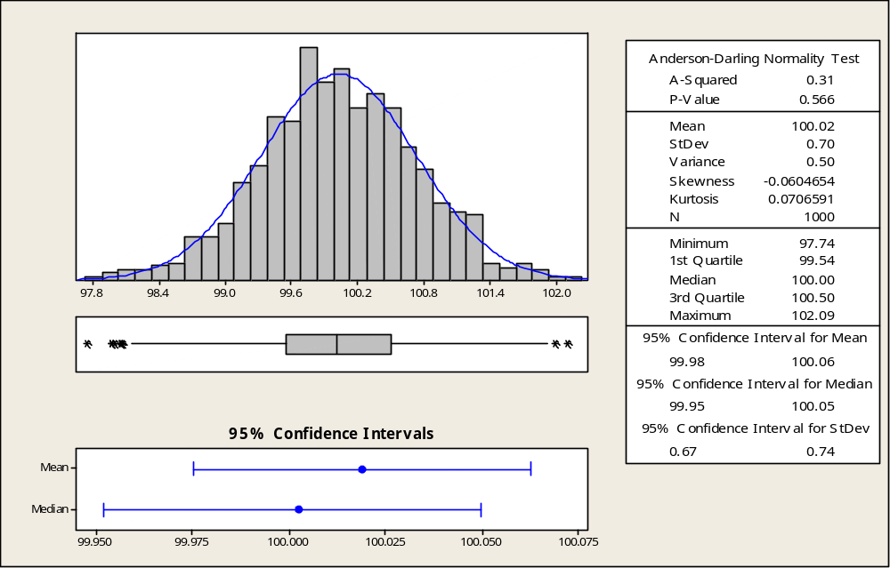
Using Minitab to Look at the Sampling Distribution of the sample Mean (n = 50)
_{5-<number>}

