Slide 1
COMPLETE
BUSINESS
STATISTICS
by
AMIR D. ACZEL
&
JAYAVEL SOUNDERPANDIAN
7th edition.
Prepared by Lloyd Jaisingh, Morehead State University
Chapter 6
Confidence Intervals
McGraw-Hill/Irwin
Copyright © 2009 by The McGraw-Hill Companies, Inc. All rights reserved.

Slide 2
_{6-<number>}
6
Confidence Intervals
Using Statistics
Confidence Interval for the Population Mean When the Population Standard Deviation is Known
Confidence Intervals for μ When σ is Unknown - The t Distribution
Large-Sample Confidence Intervals for the Population Proportion p
Confidence Intervals for the Population Variance
Sample Size Determination
The Templates

Slide 3
_{6-<number>}
6
LEARNING OBJECTIVES
After studying this chapter you should be able to:
Explain confidence intervals
Compute confidence intervals for population means
Compute confidence intervals for population proportions
Compute confidence intervals for population variances
Compute minimum sample sizes needed for an estimation
Compute confidence intervals for special types of sampling methods
Use templates for all confidence interval and sample size computations

Slide 4
6-1 Using Statistics
_{6-<number>}
Consider the following statements:
  x = 550
    A single-valued estimate that conveys little information about the actual value of the population mean.
  We are 99% confident that μ is in the interval [449,551]
    An interval estimate which locates the population mean within a narrow interval, with a high level of confidence.
  We are 90% confident that μ is in the interval [400,700]
    An interval estimate which locates the population mean within a broader interval, with a lower level of confidence.

Slide 5
Types of Estimators
_{6-<number>}
Point Estimate
  A single-valued estimate.
  A single element chosen from a sampling distribution.
  Conveys little information about the actual value of the population parameter, about the accuracy of the estimate.
Confidence Interval or Interval Estimate
  An interval or range of values believed to include the unknown population parameter.
  Associated with the interval is a measure of the confidence we have that the interval does indeed contain the parameter of interest.

Slide 6
Confidence Interval or Interval Estimate
_{6-<number>}
A confidence interval or interval estimate is a range or interval of numbers believed to include an unknown population parameter. Associated with the interval is a measure of the confidence we have
that the interval does indeed contain the parameter of interest.
A confidence interval or interval estimate has two components:
  A range or interval of values
  An associated level of confidence

Slide 7
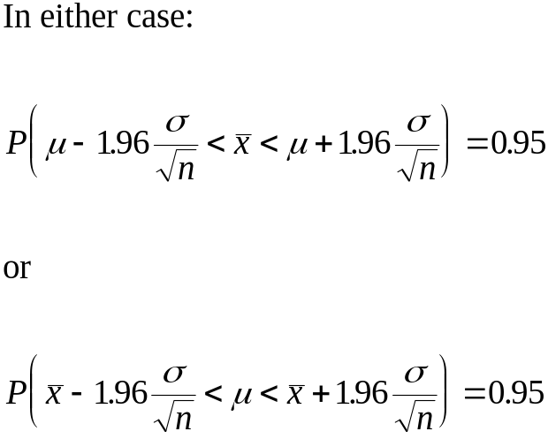
6-2 Confidence Interval for μ
When σ Is Known
_{6-<number>}
If the population distribution is normal, the sampling distribution of the mean is normal.
If the sample is sufficiently large, regardless of the shape of the population distribution, the sampling distribution is normal (Central Limit Theorem).
S
t
a
n
d
a
r
d
N
o
r
m
a
l
D
i
s
t
r
i
b
u
t
i
o
n
:
9
5
%
I
n
t
e
r
v
a
l
0
.
4
0
.
3
)
z
(
f
0
.
2
0
.
1
0
.
0
-
4
-
3
-
2
-
1
0
1
2
3
4
z

Slide 8
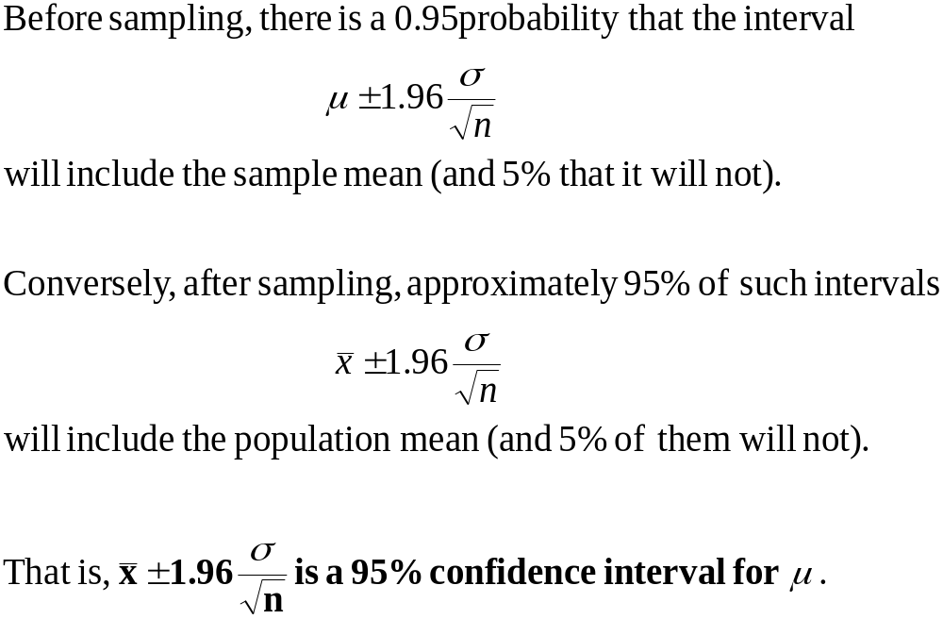
6-2 Confidence Interval for μ when σ is Known (Continued)
_{6-<number>}

Slide 9
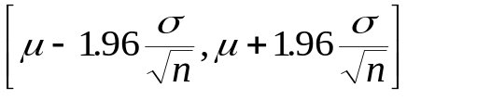

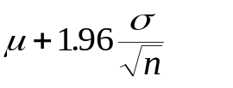

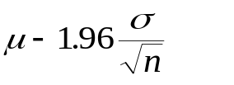
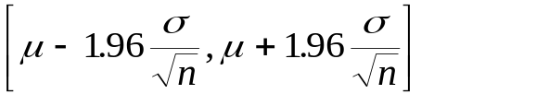
A 95% Interval around the Population Mean
_{6-<number>}
S
a
m
p
l
i
n
g
D
i
s
t
r
i
b
u
t
i
o
n
o
f
t
h
e
M
e
a
n
Approximately 95% of sample means can be expected to fall within the interval .
Conversely, about 2.5% can be expected to be above and 2.5% can be expected to be below
.
So 5% can be expected to fall outside the interval .
0
.
4
0
95%
.
3
)
x
0
.
(
2
f
0
.
1
2.5%
2.5%
0
.
0
x
μ
x
x
2.5% fall below the interval
x
x
x
x
2.5% fall above the interval
x
x
x
95% fall within the interval

Slide 10

95% Intervals around the Sample Mean
_{6-<number>}
S
a
m
p
l
i
n
g
D
i
s
t
r
i
b
u
t
i
o
n
o
f
t
h
e
M
e
a
n
Approximately 95% of the intervals
around the sample mean can be expected to include the actual value of the population mean, μ. (When the sample mean falls within the 95% interval around the population mean.)
*5% of such intervals around the sample mean can be expected not to include the actual value of the population mean. (When the sample mean falls outside the 95% interval around the population mean.)
0
.
4
0
95%
.
3
)
x
0
.
(
2
f
0
.
1
2.5%
2.5%
0
.
0
x
μ
x−1.96σ
x
x+1.96σ
x
x
*
x
x
x
x
x
*
x
x−1.96σ
x
x+1.96σ

Slide 11
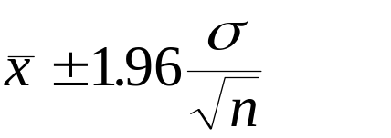
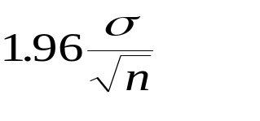
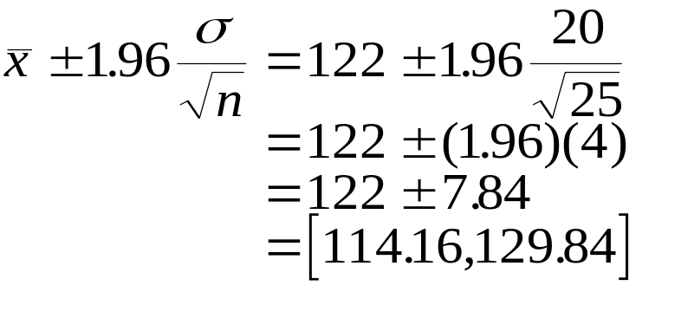

The 95% Confidence Interval for μ
_{6-<number>}
A 95% confidence interval for μ when σ is known and sampling is done from a normal population, or a large sample is used, is:
The quantity is often called the margin of error or the sampling error.
For example, if: n = 25
σ = 20
= 122
A 95% confidence interval:

Slide 12
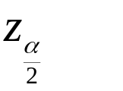
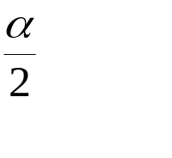


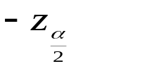
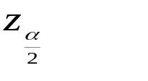
A (1-α )100% Confidence Interval for μ
_{6-<number>}
We define as the z value that cuts off a right-tail area of under the standard normal curve. (1-α) is called the confidence coefficient. α is called the error probability, and (1-α)100% is called the confidence level.
S
t
a
n
d
a
r
d
N
o
r
m
a
l
D
i
s
t
r
i
b
u
t
i
o
n
⎛
⎞
α/2
⎜
>
=
P
z
z
⎟
⎝
α
⎠
0
.
4
2
⎛
⎞
α/2
P
⎜
z
<
−
z
⎟
=
0
.
3
⎝
α
⎠
)
⎛
2
⎞
z
(
0
.
2
f
P
⎜
−
z
<
z
<
z
⎟
=
(
1
−
α
)
⎝
α
α
⎠
0
.
1
2
2
(1
-
α
)100% Conf
idence Int
erval:
0
.
0
σ
-
5
-
4
-
3
-
2
-
1
0
1
2
3
4
5
x
±
z
Z
α
n
2

Slide 13
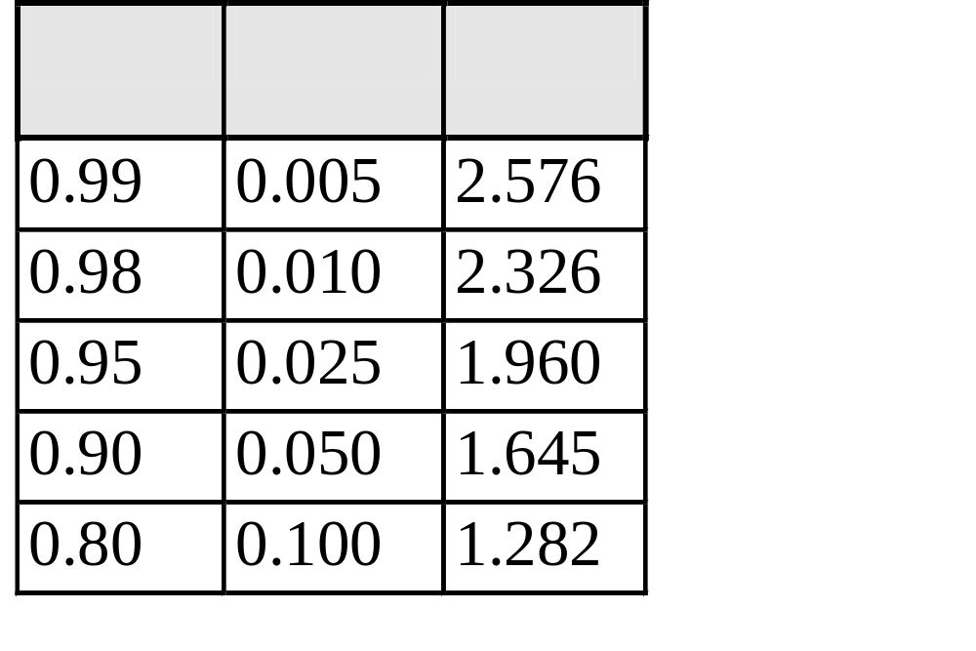
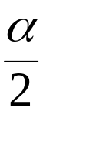
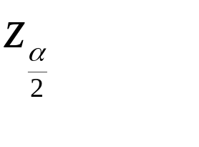
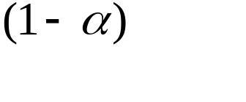
Critical Values of z and Levels of Confidence
_{6-<number>}
S
t
a
n
d
a
r
d
N
o
r
m
a
l
D
i
s
t
r
i
b
u
t
i
o
n
0
.
4
0
.
3
)
z
(
0
.
2
f
0
.
1
0
.
0
-
5
-
4
-
3
-
2
-
1
0
1
2
3
4
5
Z

Slide 14
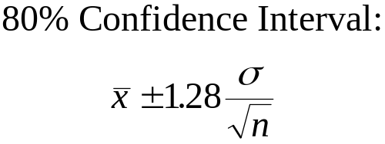
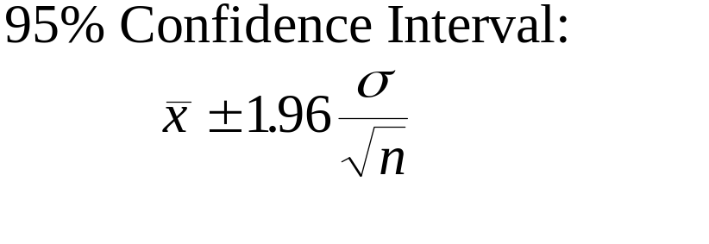
The Level of Confidence and the Width of the Confidence Interval
_{6-<number>}
When sampling from the same population, using a fixed sample size, the higher the confidence level, the wider the confidence interval.
S
t
a
n
d
a
r
d
N
o
r
m
a
l
D
i
s
t
r
i
b
u
t
i
o
n
S
t
a
n
d
a
r
d
N
o
r
m
a
l
D
i
s
t
r
i
b
u
t
i
o
n
0
.
4
0
.
4
0
.
3
0
.
3
)
)
z
z
(
0
.
2
(
f
f
0
.
2
0
.
1
0
.
1
0
.
0
0
.
0
-
5
-
4
-
3
-
2
-
1
0
1
2
3
4
5
-
5
-
4
-
3
-
2
-
1
0
1
2
3
4
5
Z
Z

Slide 15
The Sample Size and the Width of the Confidence Interval
_{6-<number>}
When sampling from the same population, using a fixed confidence level, the larger the sample size, n, the narrower the confidence interval.
S
a
m
p
l
i
n
g
D
i
s
t
r
i
b
u
t
i
o
n
o
f
t
h
e
M
e
a
n
S
a
m
p
l
i
n
g
D
i
s
t
r
i
b
u
t
i
o
n
o
f
t
h
e
M
e
a
n
0
.
4
0
.
9
0
.
8
0
.
0
7
.
3
0
.
6
)
)
0
.
x
0
x
5
.
(
2
(
f
f
0
.
4
0
.
0
3
.
1
0
.
2
0
.
1
0
.
0
0
.
0
x
x
95% Confidence Interval: n = 20
95% Confidence Interval: n = 40

Slide 16
Example 6-1
_{6-<number>}
Comcast, the computer services company, is planning to invest heavily in online television services. As part of the decision, the company wants to estimate the average number of online shows a family of four would watch per day. A random sample of n = 100 families is obtained, and in this sample the average number of shows viewed per day is 6.5 and the population standard deviation is known to be 3.2. Construct a 95% confidence interval for the average number of online television shows watched by the entire population of families of 4.

Slide 17
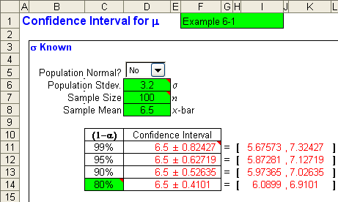
Example 6-1 (continued) - Using the Template
_{6-<number>}
Thus, Concast can be 95% confident that the average family of 4 within its population
Of subscribers will watch an average daily number of online TV shows between
5.87 and 7.13 shows.

Slide 18
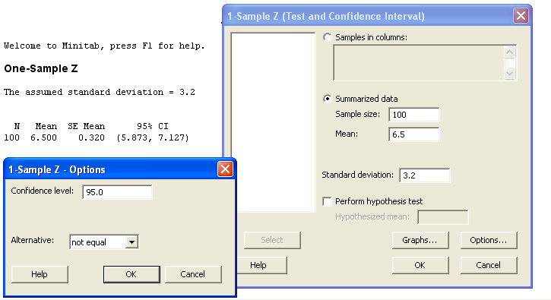
Example 6-1 (continued) - Using Minitab
_{6-<number>}
NOTE: In order to get the results on the left side of the screen you will
have to click on the OPTIONS button and type in 95 for the Confidence Level.
Also, make sure that you select not equal in the Alternative box.

Slide 19
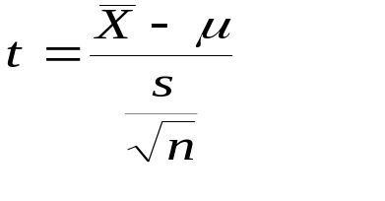
6-3 Confidence Interval or Interval Estimate for μ When σ Is Unknown - The t Distribution
_{6-<number>}
If the population standard deviation, σ, is not known, replace σ with the sample standard deviation, s. If the population is normal, the resulting statistic:
has a t distribution with (n - 1) degrees of freedom.
The t is a family of bell-shaped and symmetric distributions, one for each number of degree of freedom.
The expected value of t is 0.
For df > 2, the variance of t is df/(df-2). This is greater than 1, but approaches 1 as the number of degrees of freedom increases. The t is flatter and has fatter tails than does the standard normal.
The t distribution approaches a standard normal as the number of degrees of freedom increases
Standard normal
t, df = 20
t, df = 10
0
μ

Slide 20
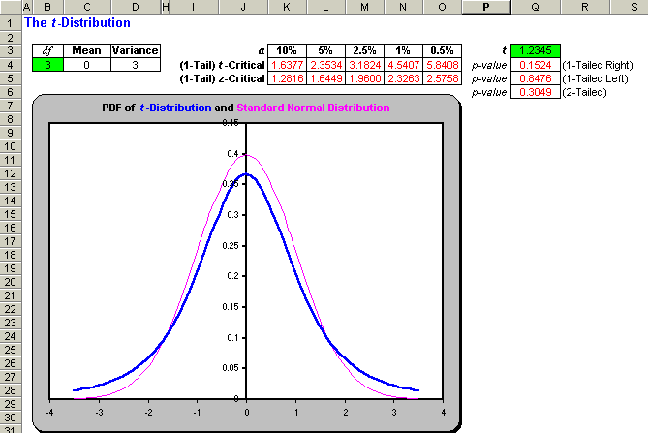
The t Distribution Template
_{6-<number>}

Slide 21
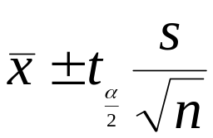
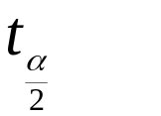
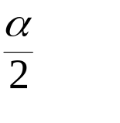
6-3 Confidence Intervals for μ when σ is Unknown- The t Distribution
_{6-<number>}
A (1-α)100% confidence interval for μ when σ is not known (assuming a normally distributed population) is given by:
where is the value of the t distribution with n-1 degrees of freedom that cuts off a tail area of to its right.

Slide 22
The t Distribution
_{6-<number>}
df t_{0.100} t_{0.050} t_{0.025} t_{0.010} t_{0.005}
--- ----- ----- ------ ------ ------
1 3.078 6.314 12.706 31.821 63.657
2 1.886 2.920 4.303 6.965 9.925
3 1.638 2.353 3.182 4.541 5.841
4 1.533 2.132 2.776 3.747 4.604
5 1.476 2.015 2.571 3.365 4.032
6 1.440 1.943 2.447 3.143 3.707
7 1.415 1.895 2.365 2.998 3.499
8 1.397 1.860 2.306 2.896 3.355
9 1.383 1.833 2.262 2.821 3.250
10 1.372 1.812 2.228 2.764 3.169
11 1.363 1.796 2.201 2.718 3.106
12 1.356 1.782 2.179 2.681 3.055
13 1.350 1.771 2.160 2.650 3.012
14 1.345 1.761 2.145 2.624 2.977
15 1.341 1.753 2.131 2.602 2.947
16 1.337 1.746 2.120 2.583 2.921
17 1.333 1.740 2.110 2.567 2.898
18 1.330 1.734 2.101 2.552 2.878
19 1.328 1.729 2.093 2.539 2.861
20 1.325 1.725 2.086 2.528 2.845
21 1.323 1.721 2.080 2.518 2.831
22 1.321 1.717 2.074 2.508 2.819
23 1.319 1.714 2.069 2.500 2.807
24 1.318 1.711 2.064 2.492 2.797
25 1.316 1.708 2.060 2.485 2.787
26 1.315 1.706 2.056 2.479 2.779
27 1.314 1.703 2.052 2.473 2.771
28 1.313 1.701 2.048 2.467 2.763
29 1.311 1.699 2.045 2.462 2.756
30 1.310 1.697 2.042 2.457 2.750
40 1.303 1.684 2.021 2.423 2.704
60 1.296 1.671 2.000 2.390 2.660
120 1.289 1.658 1.980 2.358 2.617
1.282 1.645 1.960 2.326 2.576
t
D
i
s
t
r
i
b
u
t
i
o
n
:
d
f
=
1
0
0
.
4
0
.
3
}
}
Area = 0.10
Area = 0.10
)
t
(
0
.
f
2
0
.
1
0
.
0
}
-1.372
1.372
}
-2.228
0
2.228
t
Area = 0.025
Area = 0.025
Whenever σ is not known (and the population is assumed normal), the correct distribution to use is the t distribution with n-1 degrees of freedom. Note, however, that for large degrees of freedom, the t distribution is approximated well by the Z distribution.

Slide 23


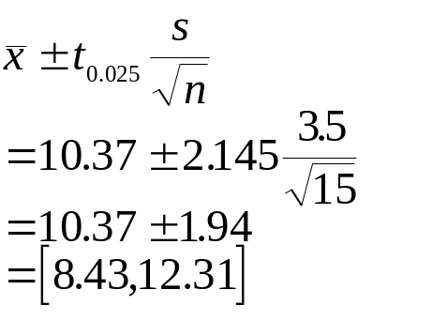
Example 6-2
_{6-<number>}
A stock market analyst wants to estimate the average return on a certain stock. A random sample of 15 days yields an average (annualized) return of and a standard deviation of s = 3.5%. Assuming a normal population of returns, give a 95% confidence interval for the average return on this stock.
df t_{0.100} t_{0.050} t_{0.025} t_{0.010} t_{0.005}
--- ----- ----- ------ ------ ------
1 3.078 6.314 12.706 31.821 63.657
. . . . . .
. . . . . .
. . . . . .
13 1.350 1.771 2.160 2.650 3.012
14 1.345 1.761 2.145 2.624 2.977
15 1.341 1.753 2.131 2.602 2.947
. . . . . .
. . . . . .
. . . . . .
The critical value of t for df = (n -1) = (15 -1) =14 and a right-tail area of 0.025 is:
The corresponding confidence interval or interval estimate is:

Slide 24
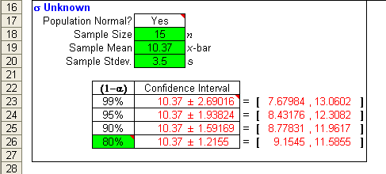
Example 6-2 (continued) - Using the Template
_{6-<number>}
Thus, the analyst can be 95% confident that the average annualized return
on the stock Is between 8.43% and 12.31%.

Slide 25
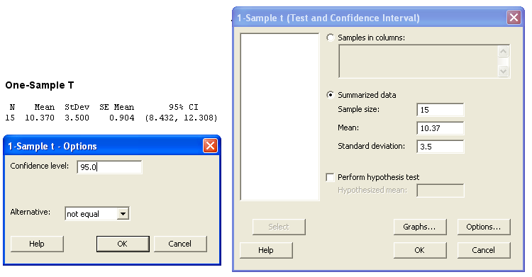
Example 6-2 (continued) - Using Minitab
_{6-<number>}
NOTE: In order to get the results on the left side of the screen you will
have to click on the OPTIONS button and type in 95 for the Confidence Level.
Also, make sure that you select not equal in the Alternative box.

Slide 26
Large Sample Confidence Intervals for the Population Mean
_{6-<number>}
df t_{0.100} t_{0.050} t_{0.025} t_{0.010} t_{0.005}
--- ----- ----- ------ ------ ------
1 3.078 6.314 12.706 31.821 63.657
. . . . . .
. . . . . .
. . . . . .
120 1.289 1.658 1.980 2.358 2.617
1.282 1.645 1.960 2.326 2.576
Whenever σ is not known (and the population is assumed normal), the correct distribution to use is the t distribution with n-1 degrees of freedom. Note, however, that for large degrees of freedom, the t distribution is approximated well by the Z distribution.

Slide 27
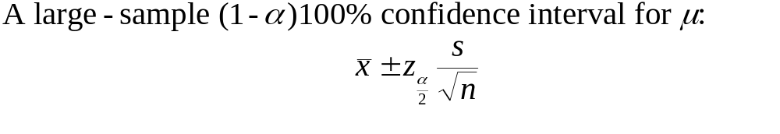
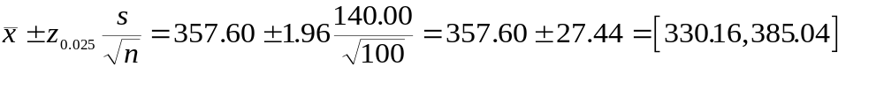
Large Sample Confidence Intervals for the Population Mean
_{6-<number>}
Example 6-3: An economist wants to estimate the average amount in checking accounts at banks in a given region. A random sample of 100 accounts gives x-bar = $357.60 and s = $140.00. Give a 95% confidence interval for μ, the average amount in any checking account at a bank in the given region.

Slide 28
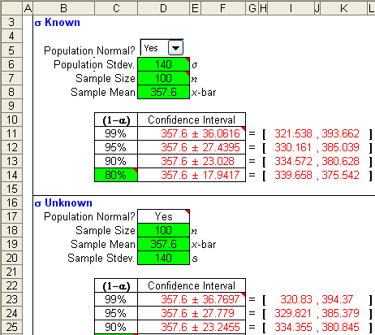
Example 6-3(continued) - Using the Template
_{6-<number>}
Observe that the
95% confidence
intervals are
approximately the same.

Slide 29
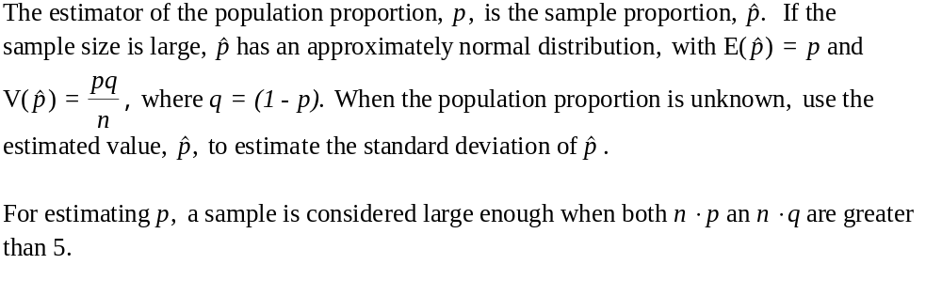
6-4 Large-Sample Confidence Intervals for the Population Proportion, p
_{6-<number>}

Slide 30
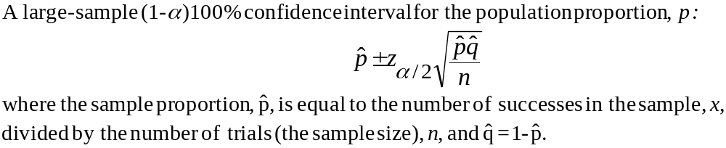
6-4 Large-Sample Confidence Intervals for the Population Proportion, p
_{6-<number>}

Slide 31
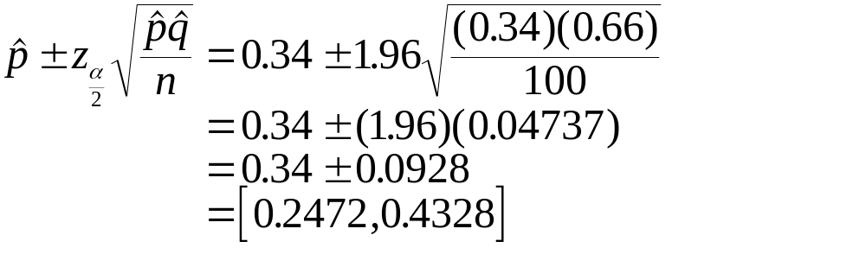
Example 6-4
_{6-<number>}
A marketing research firm wants to estimate the share that foreign companies have in the American market for certain products. A random sample of 100 consumers is obtained, and it is found that 34 people in the sample are users of foreign-made products; the rest are users of domestic products. Give a 95% confidence interval for the share of foreign products in this market.
Thus, the firm may be 95% confident that foreign manufacturers control
anywhere from 24.72% to 43.28% of the market.

Slide 32
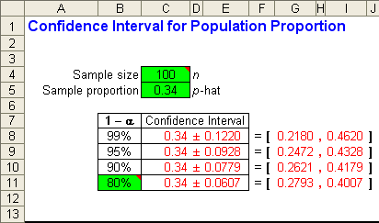
Example 6-4 – Using the Template
_{6-<number>}
Thus, the firm may be 95% confident that foreign manufacturers control
anywhere from 24.72% to 43.28% of the market.

Slide 33
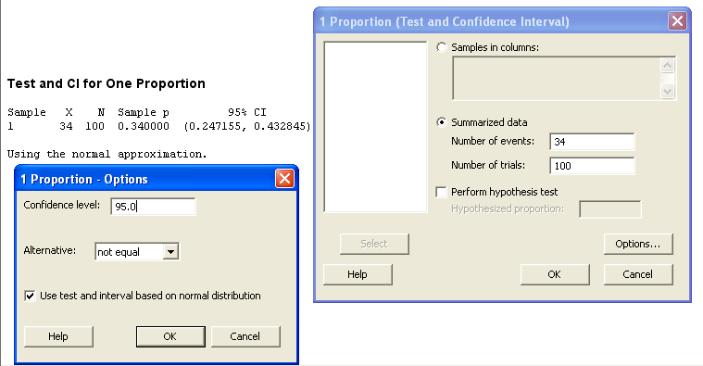
Example 6-4 – Using Minitab
_{6-<number>}
NOTE: In order to get the results on the left side of the screen you will
have to click on the OPTIONS button and type in 95 for the Confidence Level.
Also, make sure that you select not equal in the Alternative box. Also select the
Use test and interval based on the normal distribution.

Slide 34
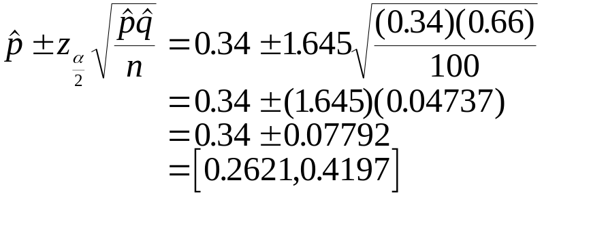
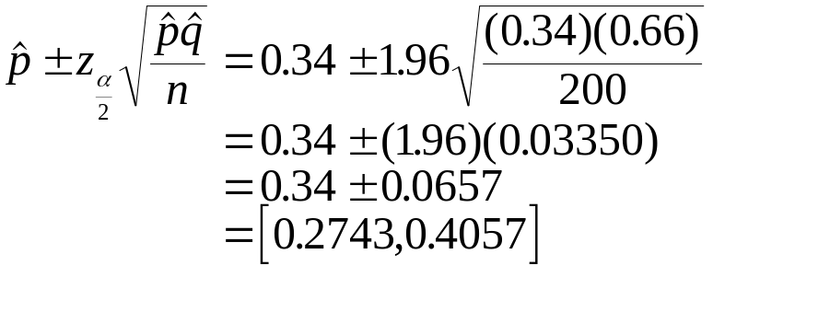
Reducing the Width of Confidence Intervals - The Value of Information
_{6-<number>}
The width of a confidence interval can be reduced only at the price of:
  a lower level of confidence (see the previous slide), or
  a larger sample.
Lower Level of Confidence
Larger Sample Size
90% Confidence Interval
Sample Size, n = 200

Slide 35
6-5 Confidence Intervals for the Population Variance: The Chi-Square (χ²) Distribution
_{6-<number>}
The sample variance, s², is an unbiased estimator of the population variance, σ².
Confidence intervals for the population variance are based on the chi-square (χ²) distribution.
  The chi-square distribution is the probability distribution of the sum of several independent, squared standard normal random variables.
  The mean of the chi-square distribution is equal to the degrees of freedom parameter, (E[χ²] = df). The variance of a chi-square is equal to twice the number of degrees of freedom, (V[χ²] = 2df).

Slide 36
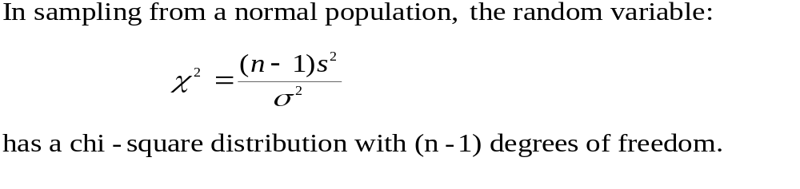
The Chi-Square (χ²) Distribution
_{6-<number>}
C
h
i
-
S
q
u
a
r
e
D
i
s
t
r
i
b
u
t
i
o
n
:
d
f
=
1
0
,
d
f
=
3
0
,
d
f
=
5
The chi-square random variable cannot be negative, so it is bound by zero on the left.
The chi-square distribution is skewed to the right.
The chi-square distribution approaches a normal as the degrees of freedom increase.
0
0
.
1
0
df = 10
0
.
0
9
0
.
0
8
0
.
0
7
0
.
0
)
6
df = 30
²
χ
0
5
.
(
0
f
0
.
0
4
0
df = 50
.
0
3
0
.
0
2
0
.
0
1
0
.
0
0
0
5
0
1
0
0
χ
²

Slide 37
Values and Probabilities of Chi-Square Distributions
_{6-<number>}
Area in Right Tail
.995 .990 .975 .950 .900 .100 .050 .025 .010 .005
Area in Left Tail
df .005 .010 .025 .050 .100 .900 .950 .975 .990 .995
1 0.0000393 0.000157 0.000982 0.000393 0.0158 2.71 3.84 5.02 6.63 7.88
2 0.0100 0.0201 0.0506 0.103 0.211 4.61 5.99 7.38 9.21 10.60
3 0.0717 0.115 0.216 0.352 0.584 6.25 7.81 9.35 11.34 12.84
4 0.207 0.297 0.484 0.711 1.06 7.78 9.49 11.14 13.28 14.86
5 0.412 0.554 0.831 1.15 1.61 9.24 11.07 12.83 15.09 16.75
6 0.676 0.872 1.24 1.64 2.20 10.64 12.59 14.45 16.81 18.55
7 0.989 1.24 1.69 2.17 2.83 12.02 14.07 16.01 18.48 20.28
8 1.34 1.65 2.18 2.73 3.49 13.36 15.51 17.53 20.09 21.95
9 1.73 2.09 2.70 3.33 4.17 14.68 16.92 19.02 21.67 23.59
10 2.16 2.56 3.25 3.94 4.87 15.99 18.31 20.48 23.21 25.19
11 2.60 3.05 3.82 4.57 5.58 17.28 19.68 21.92 24.72 26.76
12 3.07 3.57 4.40 5.23 6.30 18.55 21.03 23.34 26.22 28.30
13 3.57 4.11 5.01 5.89 7.04 19.81 22.36 24.74 27.69 29.82
14 4.07 4.66 5.63 6.57 7.79 21.06 23.68 26.12 29.14 31.32
15 4.60 5.23 6.26 7.26 8.55 22.31 25.00 27.49 30.58 32.80
16 5.14 5.81 6.91 7.96 9.31 23.54 26.30 28.85 32.00 34.27
17 5.70 6.41 7.56 8.67 10.09 24.77 27.59 30.19 33.41 35.72
18 6.26 7.01 8.23 9.39 10.86 25.99 28.87 31.53 34.81 37.16
19 6.84 7.63 8.91 10.12 11.65 27.20 30.14 32.85 36.19 38.58
20 7.43 8.26 9.59 10.85 12.44 28.41 31.41 34.17 37.57 40.00
21 8.03 8.90 10.28 11.59 13.24 29.62 32.67 35.48 38.93 41.40
22 8.64 9.54 10.98 12.34 14.04 30.81 33.92 36.78 40.29 42.80
23 9.26 10.20 11.69 13.09 14.85 32.01 35.17 38.08 41.64 44.18
24 9.89 10.86 12.40 13.85 15.66 33.20 36.42 39.36 42.98 45.56
25 10.52 11.52 13.12 14.61 16.47 34.38 37.65 40.65 44.31 46.93
26 11.16 12.20 13.84 15.38 17.29 35.56 38.89 41.92 45.64 48.29
27 11.81 12.88 14.57 16.15 18.11 36.74 40.11 43.19 46.96 49.65
28 12.46 13.56 15.31 16.93 18.94 37.92 41.34 44.46 48.28 50.99
29 13.12 14.26 16.05 17.71 19.77 39.09 42.56 45.72 49.59 52.34
30 13.79 14.95 16.79 18.49 20.60 40.26 43.77 46.98 50.89 53.67

Slide 38
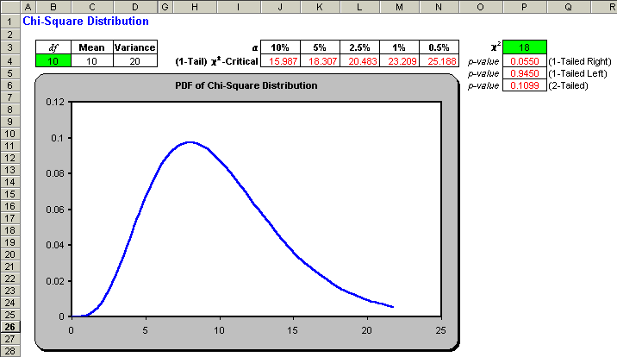
Template with Values and Probabilities of Chi-Square Distributions
_{6-<number>}

Slide 39
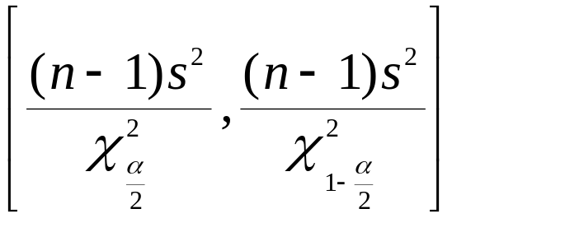
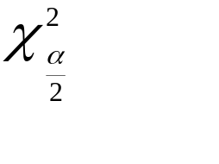
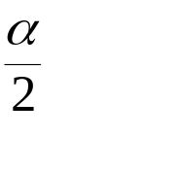
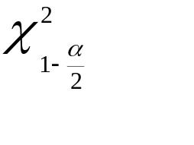
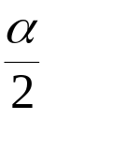
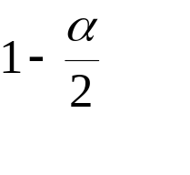
Confidence Interval for the Population Variance
_{6-<number>}
A (1-α)100% confidence interval for the population variance * (where the population is assumed normal) is:
where is the value of the chi-square distribution with n - 1 degrees of freedom that cuts off an area to its right and is the value of the distribution that cuts off an area of to its left (equivalently, an area of to its right).
* Note: Because the chi-square distribution is skewed, the confidence interval for the population variance is not symmetric

Slide 40
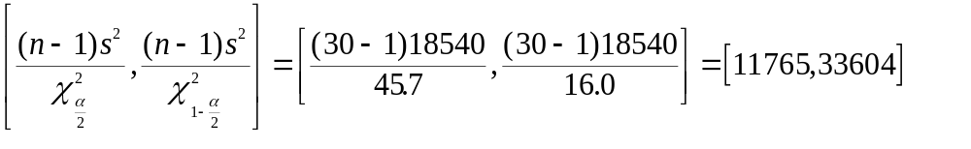
Example 6-5
_{6-<number>}
In an automated process, a machine fills cans of coffee. If the average amount filled is different from what it should be, the machine may be adjusted to correct the mean. If the variance of the filling process is too high, however, the machine is out of control and needs to be repaired. Therefore, from time to time regular checks of the variance of the filling process are made. This is done by randomly sampling filled cans, measuring their amounts, and computing the sample variance. A random sample of 30 cans gives an estimate s² = 18,540. Give a 95% confidence interval for the population variance, σ².

Slide 41


Example 6-5 (continued)
_{6-<number>}
Area in Right Tail
df .995 .990 .975 .950 .900 .100 .050 .025 .010 .005
. . . . . . . . . . .
. . . . . . . . . . .
. . . . . . . . . . .
28 12.46 13.56 15.31 16.93 18.94 37.92 41.34 44.46 48.28 50.99
29 13.12 14.26 16.05 17.71 19.77 39.09 42.56 45.72 49.59 52.34
30 13.79 14.95 16.79 18.49 20.60 40.26 43.77 46.98 50.89 53.67
C
h
i
-
S
q
u
a
r
e
D
i
s
t
r
i
b
u
t
i
o
n
:
d
f
=
2
9
0
.
0
6
0
.
0
5
0.95
0
.
0
)
4
²
χ
0
.
0
(
3
f
0
.
0
2
0.025
0
0.025
.
0
1
0
.
0
0
0
1
0
2
0
3
0
4
0
5
0
6
0
7
0
χ
²

Slide 42
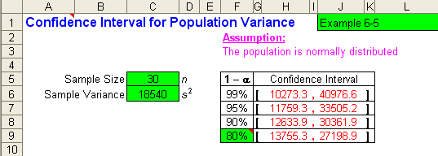
Example 6-5 Using the Template
_{6-<number>}
Observe that the template gives slightly different value.
This is due to the fact that the computer is using more decimal
Places in its computations.

Slide 43
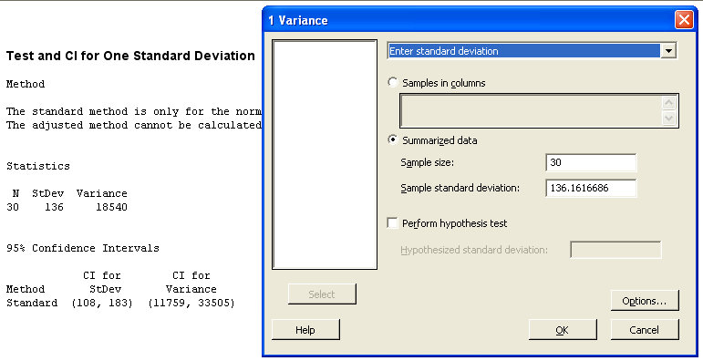
Example 6-5 Using Minitab
_{6-<number>}

Slide 44

6-6 Sample-Size Determination
_{6-<number>}
Before determining the necessary sample size, three questions must be answered:
How close do you want your sample estimate to be to the unknown parameter? (What is the desired bound, B?)
What do you want the desired confidence level (1-α) to be so that the distance between your estimate and the parameter is less than or equal to B?
What is your estimate of the variance (or standard deviation) of the population in question?
}
Bound, B

Slide 45
Sample Size and Standard Error
_{6-<number>}
The sample size determines the bound of a statistic, since the standard error of a statistic shrinks as the sample size increases:
Sample size = 2n
Standard error
of statistic
Sample size = n
Standard error
of statistic
μ

Slide 46
Minimum Sample Size: Mean and Proportion
_{6-<number>}
Minimum re
quired sam
ple size i
n estimati
ng the pop
ulation
mean,
μ
:
z
2
σ
2
α
n
=
2
B
2
Bound of e
stimate:
σ
B
=
z
α
n
2
Minimum re
quired sam
ple size i
n estimati
ng the pop
ulation
proportion
,
p

z
2
pq
α
n
=
2
B
2

Slide 47

Example 6-6
_{6-<number>}
A marketing research firm wants to conduct a survey to estimate the average amount spent on entertainment by each person visiting a popular resort. The people who plan the survey would like to determine the average amount spent by all people visiting the resort to within $120, with 95% confidence. From past operation of the resort, an estimate of the population standard deviation is
s = $400. What is the minimum required sample size?

Slide 48

Sample-Size for Proportion:
Example 6-7
_{6-<number>}
The manufacturers of a sports car want to estimate the proportion of people in a given income bracket who are interested in the model. The company wants to know the population proportion, p, to within 0.01 with 99% confidence. Current company records indicate that the proportion p may be around 0.25. What is the minimum required sample size for this survey?

Slide 49

6-7 The Templates – Optimizing Population Mean Estimates
_{6-<number>}

Slide 50

6-7 The Templates – Optimizing Population Proportion Estimates
_{6-<number>}

