Slide 1
Python for Data Science
Regular Expressions
Manish Gupta
Credits: Content borrowed from multiple course presentations, and videos.

Slide 2
Regular expressions
Regular expressions are text matching patterns described with a formal syntax. You'll often hear regular expressions referred to as 'regex' or 'regexp' in conversation. Regular expressions can include a variety of rules, for finding repetition, to text-matching, and much more.
Python regex syntax is very close to Perl regex syntax.
re is the module name for Python regexes.

Slide 3
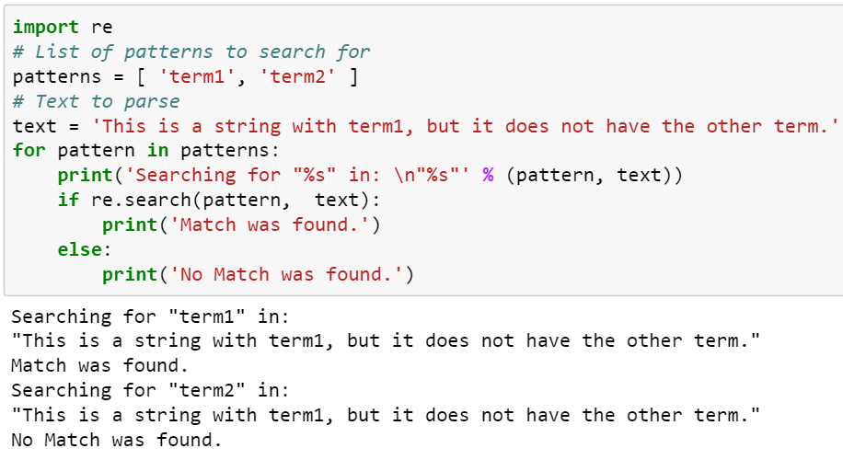
Searching for Patterns in Text
re.search() takes the pattern, scans the text, and then returns a Match object. If no pattern is found, a None is returned.

Slide 4
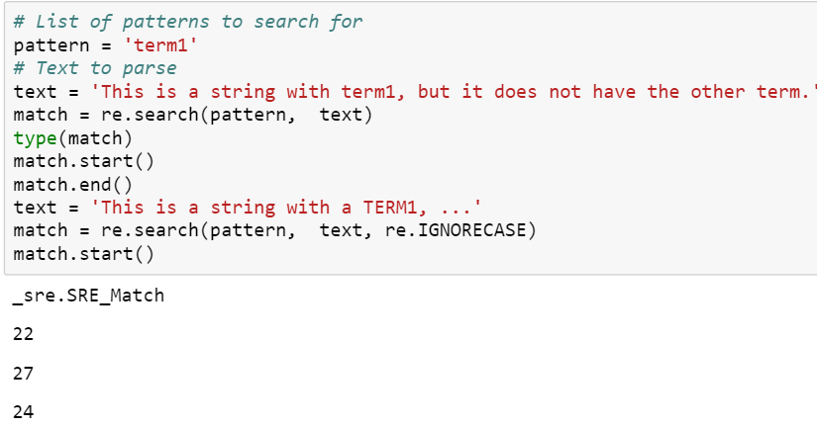
The match object, and IGNORECASE
re.search() returns a match object which also contains information about the start and end of the match.

Slide 5
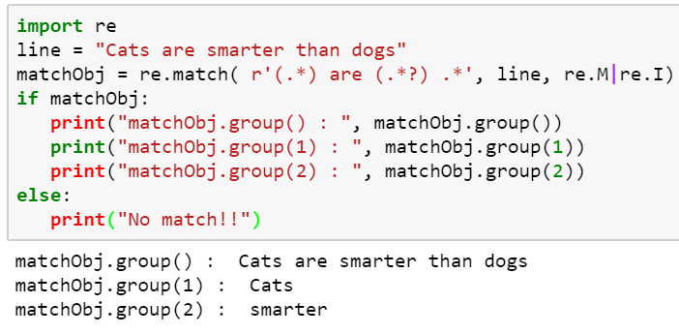
Groups()
We use group(num) or groups() function of match object to get matched expression.

Slide 6
Regular expression flags
re.DEBUG: Display debug information about compiled expression.
re.I, re.IGNORECASE: Perform case-insensitive matching
re.L, re.LOCALE: Make \w, \W, \b, \B, \s and \S dependent on the current locale.
re.M: re.MULTILINE: When specified, the pattern character '^' matches at the beginning of the string and at the beginning of each line (immediately following each newline); and the pattern character '$' matches at the end of the string and at the end of each line (immediately preceding each newline).
re.S, re.DOTALL: Make the '.' special character match any character at all, including a newline; without this flag, '.' will match anything except a newline.
re.U, re.UNICODE: Make the \w, \W, \b, \B, \d, \D, \s and \S sequences dependent on the Unicode character properties database.
re.X, re.VERBOSE: Permits "cuter" regular expression syntax. It ignores whitespace (except inside a set [] or when escaped by a backslash) and treats unescaped # as a comment marker.

Slide 7
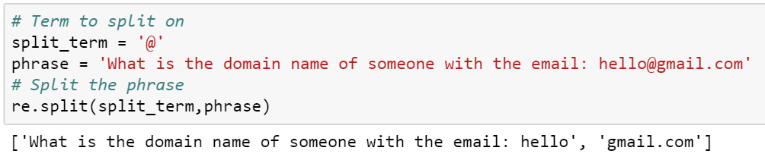
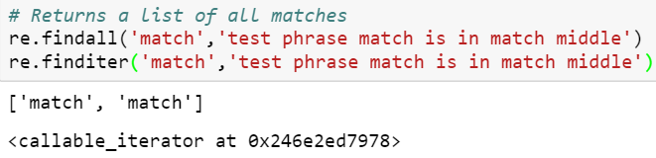
Split, findall, finditer
re.split() returns a list with the term to split on removed and the terms in the list are a split up version of the string.
You can use re.findall() to find all the instances of a pattern in a string.
finditer returns an iterator over all matches of the pattern in the string.

Slide 8
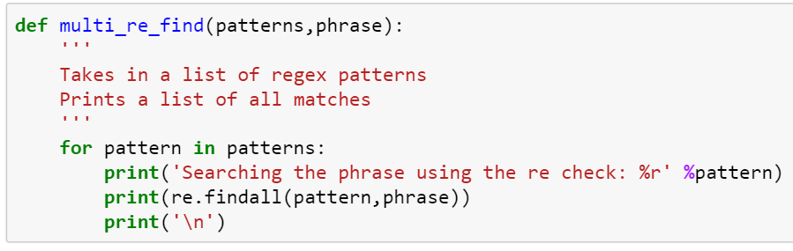
Patterns Syntax
Regular expressions supports a huge variety of patterns to find where a single string occurred.
Since we will be testing multiple re syntax forms, let's create a function that will print out results given a list of various regular expressions and a phrase to parse.

Slide 9
Repetition Syntax
A pattern followed by the meta-character * is repeated zero or more times.
Replace the * with + and the pattern must appear at least once.
Using ? means the pattern appears zero or one time.
For a specific number of occurrences, use {m} after the pattern, where m is replaced with the number of times the pattern should repeat.
Use {m,n} where m is the minimum number of repetitions and n is the maximum. Leaving out n ({m,}) means the value appears at least m times, with no maximum.

Slide 10
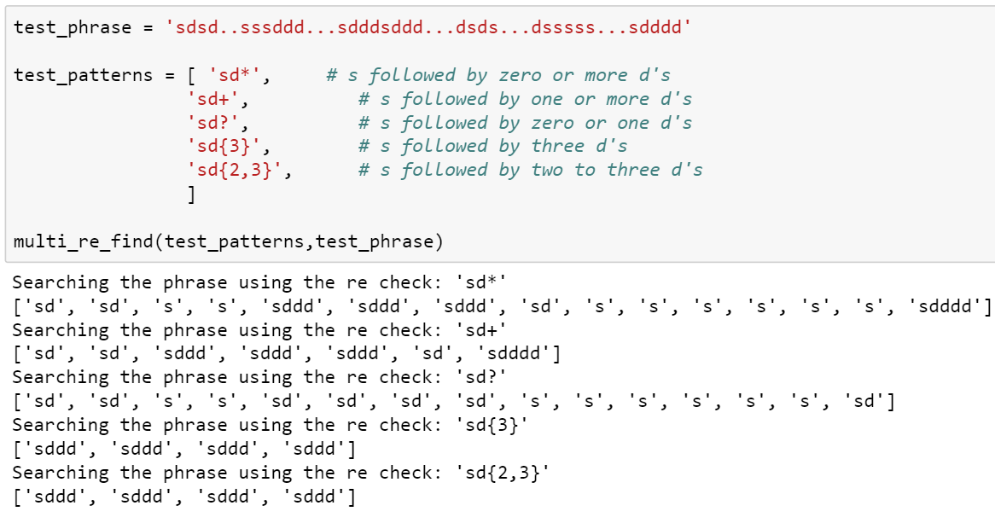
Pattern Examples

Slide 11
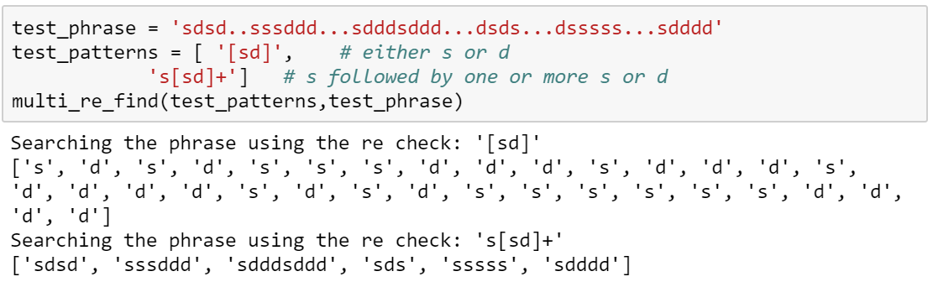
Character Sets
Character sets are used when you wish to match any one of a group of characters at a point in the input. Brackets are used to construct character set inputs. For example: the input [ab] searches for occurrences of either a or b.

Slide 12
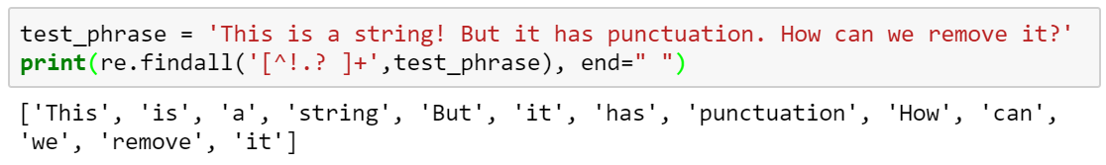
Exclusion
We can use ^ to exclude terms by incorporating it into the bracket syntax notation.
Use [^!.? ] to check for matches that are not a !,.,?, or space. Add the + to check that the match appears at least once, this basically translates to finding the words.

Slide 13
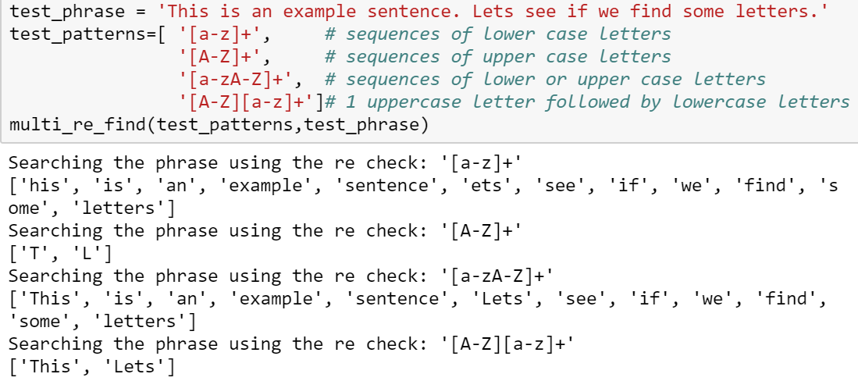
Character Ranges
As character sets grow larger, typing every character that should (or should not) match could become very tedious. A more compact format using character ranges lets you define a character set to include all of the contiguous characters between a start and stop point. The format used is [start-end].
Common use cases are to search for a specific range of letters in the alphabet, such [a-f] would return matches with any instance of letters between a and f.

Slide 14
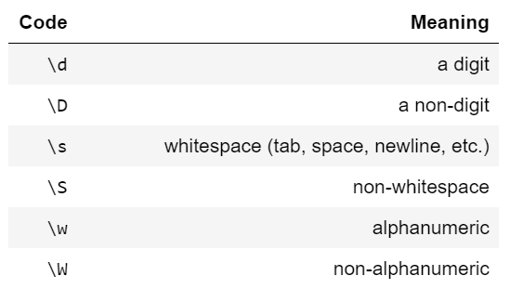
Escape Codes
Escapes are indicated by prefixing the character with a backslash (\).
Unfortunately, a backslash must itself be escaped in normal Python strings, and that results in expressions that are difficult to read.
Using raw strings, created by prefixing the literal value with r, for creating regular expressions eliminates this problem and maintains readability.

Slide 15
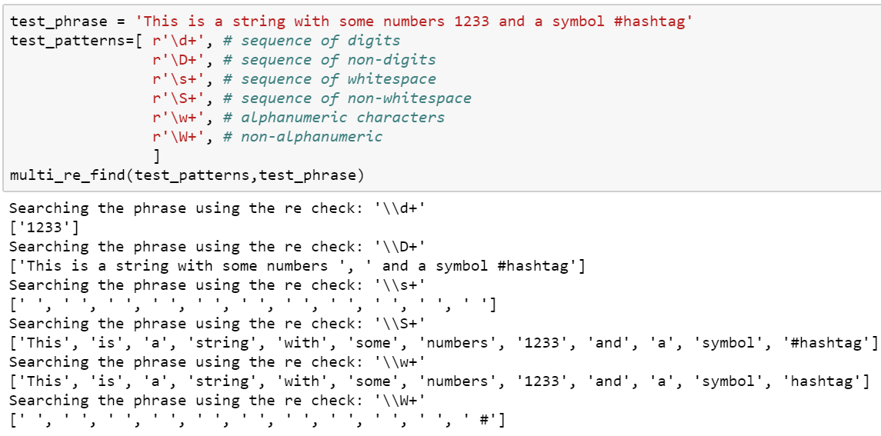
Escape Codes

Slide 16
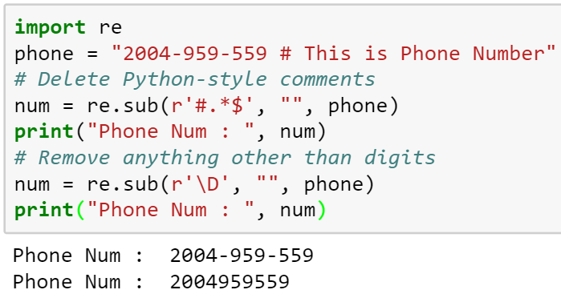
Substitution
re.sub(pattern, repl, string, max=0)
  This method replaces all occurrences of the RE pattern in string with repl, substituting all occurrences unless max provided. This method returns modified string

Slide 17
Greedy vs non-greedy matching
<.*> Greedy repetition: matches "<python>perl>“
<.*?> Nongreedy: matches "<python>" in "<python>perl>“
R(?i)uby Case-insensitive while matching "uby“
R(?i:uby) Same as above
rub(?:y|le) Group only without creating \1 backreference
Special Syntax with Parentheses

Slide 18
Backreferences
This matches a previously matched group again −
  ([Pp])ython&\1ails Match python&pails or Python&Pails
  ([‘”])([a-z])[^\1]*\2 Single or double-quoted string. \1 matches whatever the 1st group matched. \2 matches whatever the 2nd group matched, etc.
Python(?=!) Match "Python", if followed by an exclamation point.
Python(?!!) Match "Python", if not followed by an exclamation point.
Anchors

Slide 19
Regex patterns
^ Matches beginning of line.
$ Matches end of line.
. Matches any single character except newline. Using m option allows it to match newline as well.
[...] Matches any single character in brackets.
[^...] Matches any single character not in brackets
a| b Matches either a or b.
(re) Groups regular expressions and remembers matched text.
(?: re) Groups regular expressions without remembering matched text.
(?imx: re) Temporarily toggles on i, m, or x options within parentheses.
(?-imx: re) Temporarily toggles off i, m, or x options within parentheses.
(?imx) Temporarily toggles on i, m, or x options within a regular expression. If in parentheses, only that area is affected.
(?-imx) Temporarily toggles off i, m, or x options within a regular expression. If in parentheses, only that area is affected.

Slide 20
Regex patterns
(?= re) Specifies position using a pattern. Doesn't have a range.
(?! re) Specifies position using pattern negation. Doesn't have a range.
(?> re) Matches independent pattern without backtracking.
\A Matches beginning of string.
\Z Matches end of string. If a newline exists, it matches just before newline.
\z Matches end of string.
\G Matches point where last match finished.
\b Matches word boundaries when outside brackets. Matches backspace (0x08) when inside brackets.
\B Matches nonword boundaries.
\n, \t, etc. Matches newlines, carriage returns, tabs, etc.
\1...\9 Matches nth grouped subexpression.
\10 Matches nth grouped subexpression if it matched already. Otherwise refers to the octal representation of a character code.
(?#...) Comment.

Slide 21
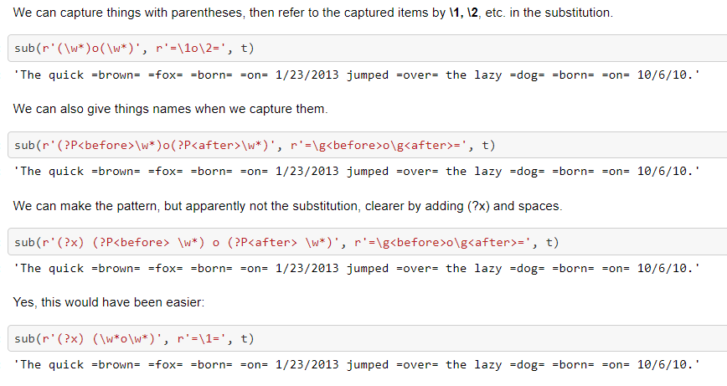
Capturing parts of the pattern match

Slide 22
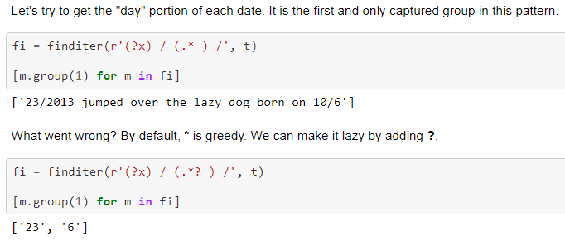
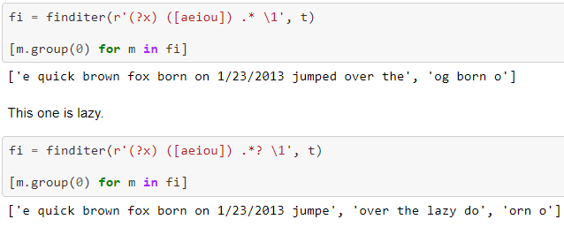
Greedy and lazy matching

Slide 23
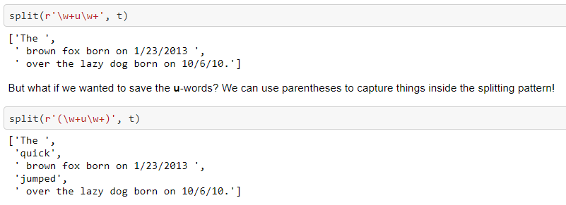
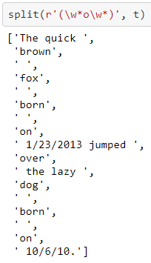
Capturing in the pattern for split

Slide 24
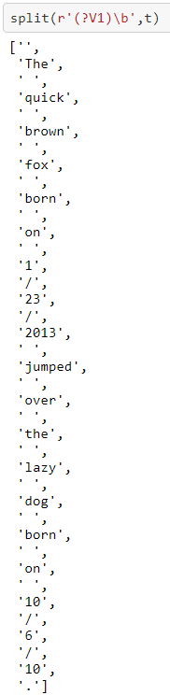
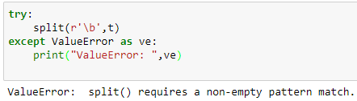
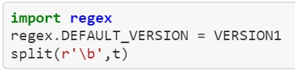
split and zero-width assertions
We want to split on word boundaries. \b is a zero-width assertion. It requires that certain characters be present, but it doesn't "consume" them.
The new regex module gets this right. To get the new behavior, we must add the "Version 1" option to the regular expression.
  Split(r’(?V1)\b’,t)
We can make life a little easier by setting the version globally.

Slide 25
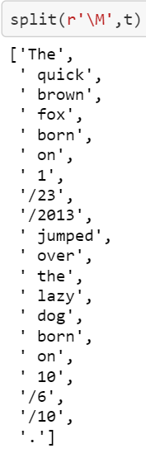
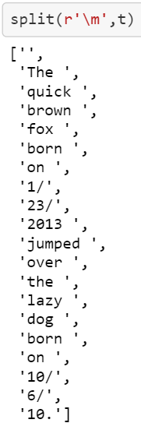
\m and \M are zero-width assertions that are true at the beginnings and ends of words

Slide 26
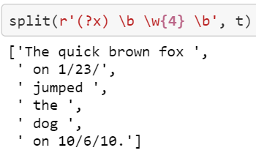
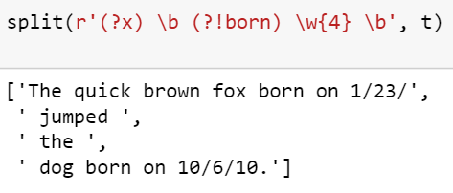
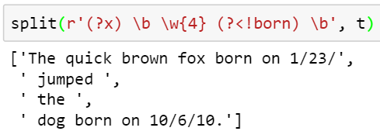
Look-arounds
We can split on any 4-letter word.
But what if we want to split on any 4-letter word but born? We can use a look-ahead assertion.
Look-aheads and look-behinds come in two flavors: positive and negative. All four are zero-width assertions. They require certain characters to be present or absent, but don't consume the characters.
Look-behind negative is denoted by ?<!

Slide 27
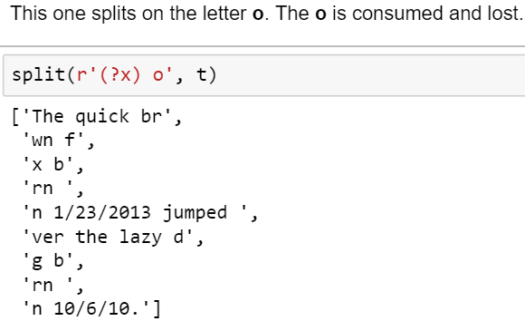
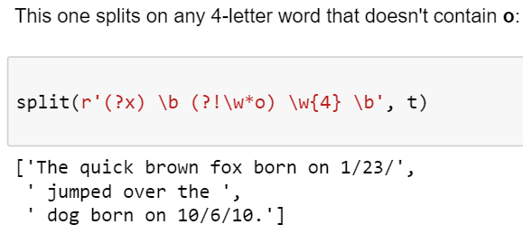
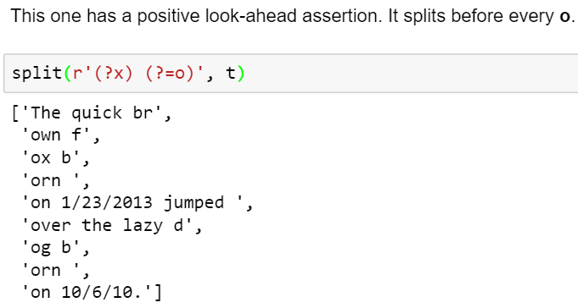
Look-arounds

Slide 28
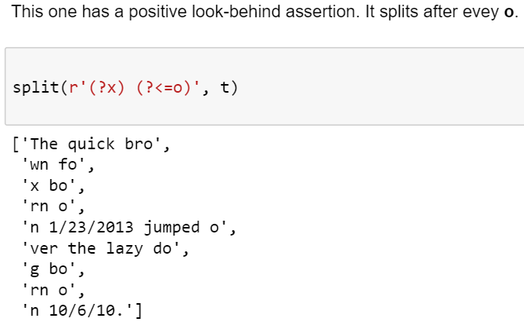
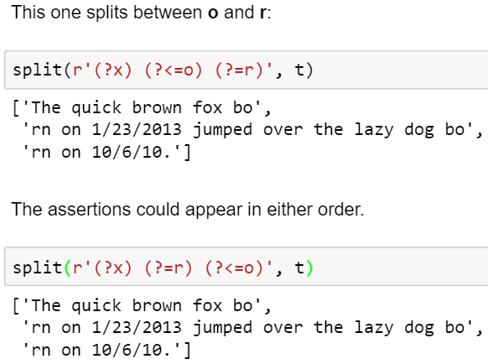
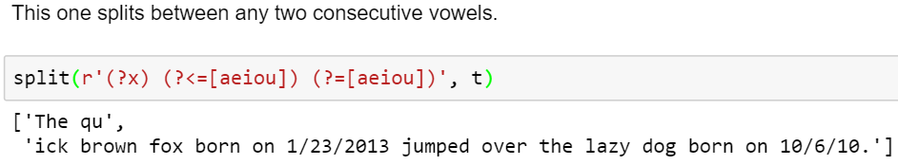
Look-arounds

Slide 29

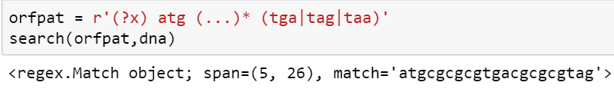
Fun with DNA: Open reading frames
DNA is a sequence of bases, A, C, G, or T. They are translated into proteins 3 bases at a time. Each 3-base sequence is called a codon. There is a special start codon ATG, and three stop codons, TGA, TAG, and TAA. The start and stop codons are highlighted below.
An opening reading frame or ORF consists of a start codon, followed by some more codons, and ending with a stop codon. (In real life, "some more" is usually hundreds or thousands.)
Actually, that's not quite right. The internal codons should not be stop codons.

Slide 30
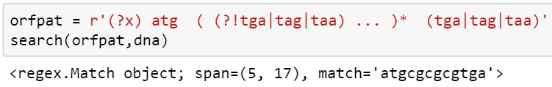
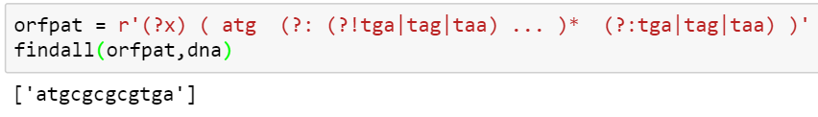
Fun with DNA: Open reading frames
We can handle that with a negative lookahead assertion.
We don't really want to capture the "some more codons" separately. In a minute that will get in the way. So we can use (?:...) to group without capturing

Slide 31
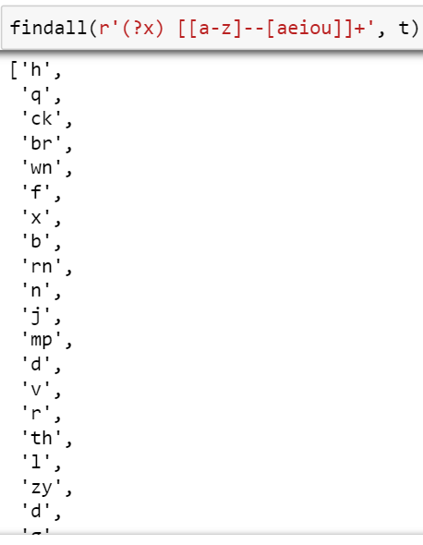
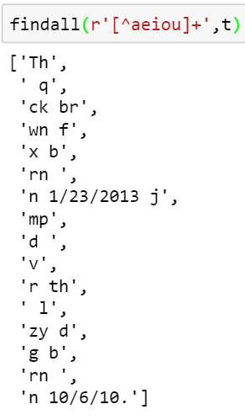
Nested Sets
The problem is that we get not just consonants, but spaces, digits, etc. The new regex module allows us to do arithmetic on sets
We have seen some character sets such as [aeiou] for all (lower-case) vowels. Suppose we want all lower-case consonants. One obvious way is to list them all. We might also be tempted to use set negation

Slide 32
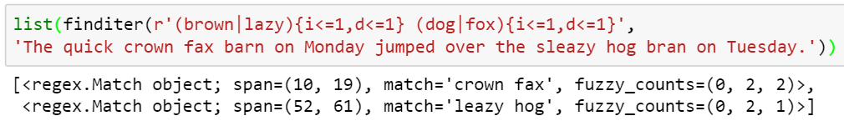
Fuzzy matching
With regex, you can specify that patterns need only be satisfied approximately. You can specify the number of insertions (i), number of deletions (d), and number of substitutions (s) as well as total number of errors (e). This example allows at most one insertion and at most one deletion for each pattern.
You can see that the match object reports the number of insertions, deletions, and substitutions as fuzzy_counts.

Slide 33
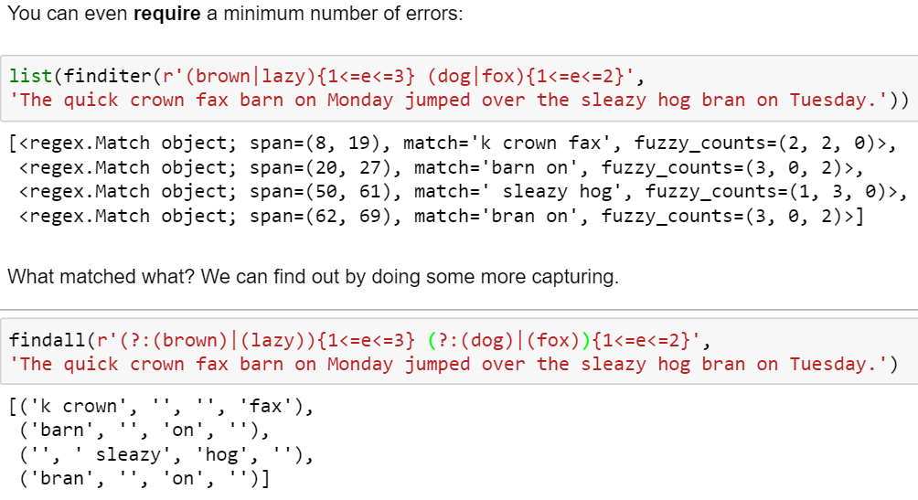
Fuzzy matching

Slide 34
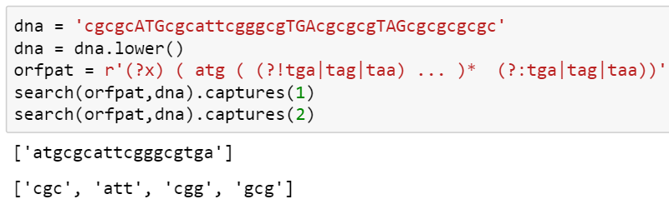
Multiple Captures
You can obtain information on all the successful matches of a repeated capture group, not just the last one. Use captures instead of group.

Slide 35
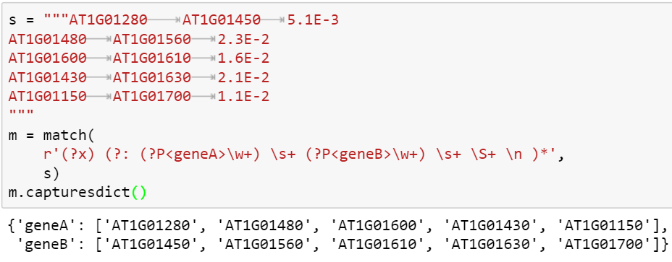
Multiple Captures
We can also capture things by name.

Slide 36
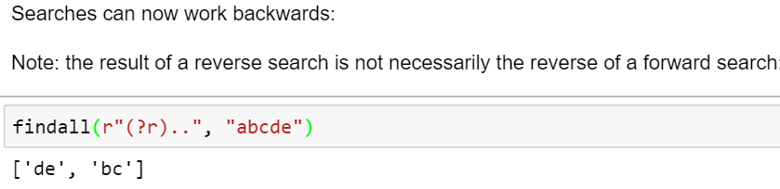
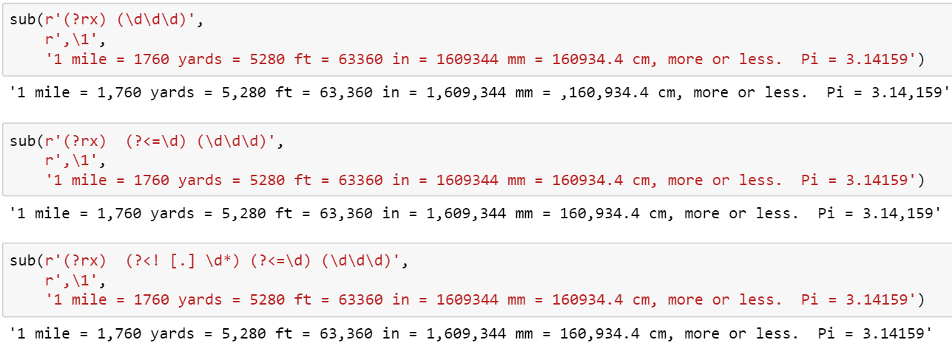
Reverse Searching

Slide 37
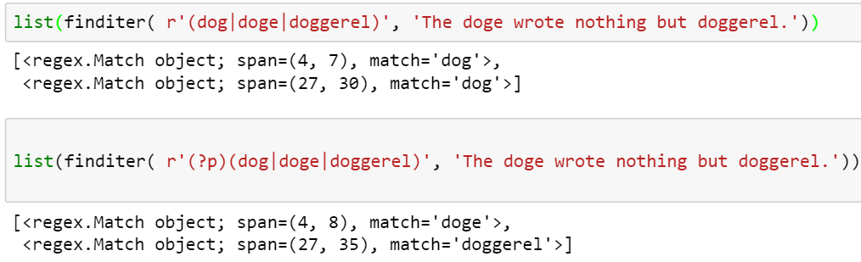
POSIX Matching (Leftmost Longest)
The default matching method for alternations is to match the first alternative that will match. The POSIX standard is to find the leftmost longest match. This can be turned on using the POSIX flag (?p).

Slide 38
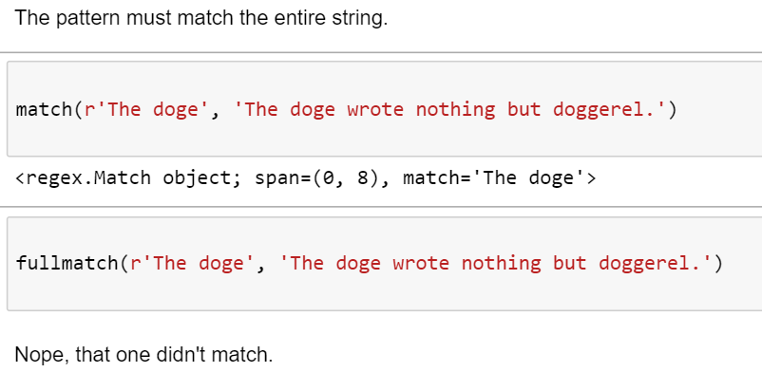
fullmatch

Slide 39
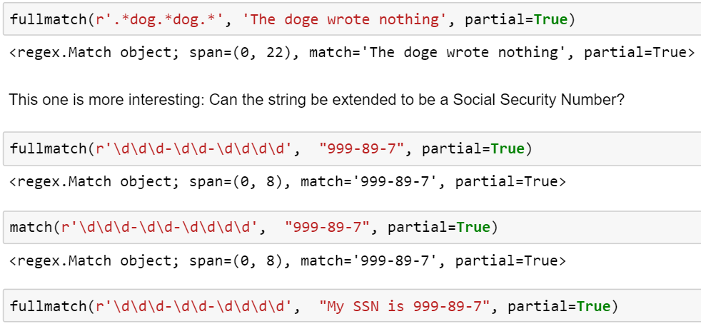
Partial matching
Can the target string be extended to match the pattern? The optional partial argument to match, search, and fullmatch can answer this question. This could be useful if you are validating input from the terminal, for example.

Slide 40
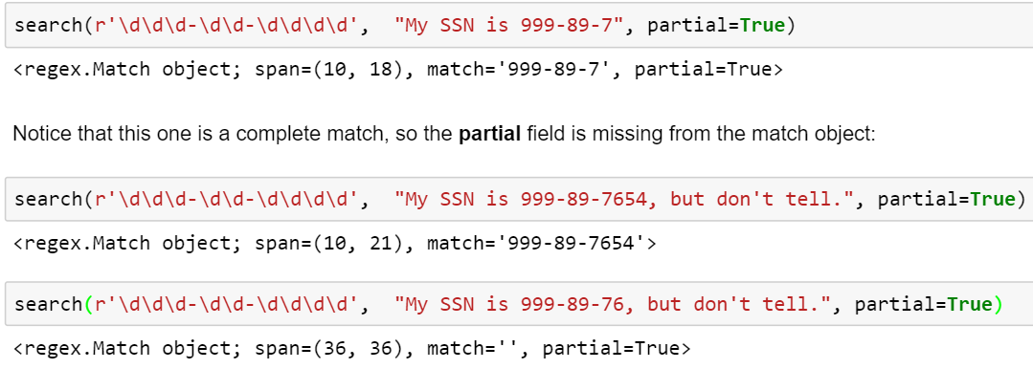
Partial matching

Slide 41
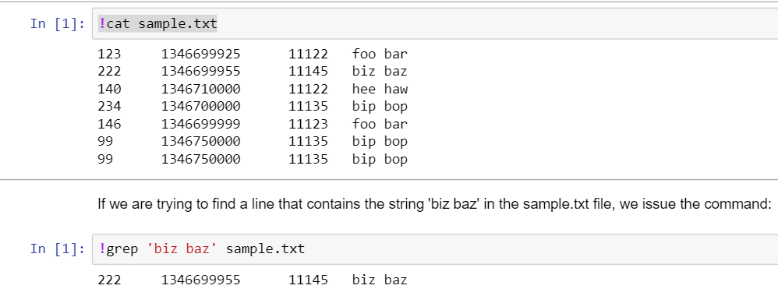
Regex using grep
Using regexes supported by the grep command in Linux.

Slide 42
References
https://github.com/rexdwyer/Splitsville/blob/master/Splitsville.ipynb
http://pages.stern.nyu.edu/~sbp345/websys/python_dwd/Session%203%20(Regular%20Expressions).ipynb

Slide 43
Thanks!
Manish Gupta
Write to me at manishg.iitb@gmail.com
Connect with me at https://www.linkedin.com/in/manishsgupta
Stay up to date with my research at https://sites.google.com/view/manishg/

