Slide 1
Session 1
Text Analytics
Adapted from Dan Jurafsky’s course slides on
https://web.stanford.edu/~jurafsky/NLPCourseraSlides.html
https://www.cse.iitb.ac.in/~nlp-ai/WSD.ppt

Slide 2
Tokenization

Slide 3
Tokenization
Issues in English tokenization
  Finland’s capital → Finland Finlands Finland’s ?
  what’re, I’m, isn’t → What are, I am, is not
  Hewlett-Packard → Hewlett Packard ?
  state-of-the-art → state of the art ?
  Lowercase → lower-case lowercase lower case ?
  San Francisco → one token or two?
  Acronyms: m.p.h., PhD. → ??
French
  L'ensemble → one token or two? L ? L’ ? Le ?
    La - feminine, Le - masculine, L' - starting a vowel, Les - plural, Un - masculine a, Une - feminine a, Des - plural a
German noun compounds are not segmented
  Lebensversicherungsgesellschaftsangestellter
  ‘life insurance company employee’
  German information retrieval needs compound splitter

Slide 4
Tokenization: Language issues
Chinese and Japanese no spaces between words:
  莎拉波娃现在居住在美国东南部的佛罗里达。
  莎拉波娃 现在 居住 在 美国 东南部 的 佛罗里达
  Sharapova now lives in US southeastern Florida
Further complicated in Japanese, with multiple alphabets intermingled
  Dates/amounts in multiple formats
  フォーチュン500社は情報不足のため時間あた$500K(約6,000万円)
Katakana
Hiragana
Kanji
Romaji
End-user can express query entirely in hiragana!

Slide 5
Word Tokenization in Chinese
Also called Word Segmentation
Chinese words are composed of characters
  Characters are generally 1 syllable and 1 morpheme.
  Average word is 2.4 characters long.
Standard baseline segmentation algorithm:
  Maximum Matching (also called Greedy)

Slide 6
Max-match segmentation illustration
Thecatinthehat
Thetabledownthere
Doesn’t generally work in English!
But works astonishingly well in Chinese
  莎拉波娃现在居住在美国东南部的佛罗里达。
  莎拉波娃 现在 居住 在 美国 东南部 的 佛罗里达
Modern probabilistic segmentation algorithms even better
  the cat in the hat
  the table down there
  theta bled own there

Slide 7
Maximum Matching
Word Segmentation Algorithm
Given a wordlist of Chinese, and a string.
Start a pointer at the beginning of the string
Find the longest word in dictionary that matches the string starting at pointer
Move the pointer over the word in string
Go to 2

Slide 8
Lemmatization and Stemming

Slide 9
Lemmatization
Reduce inflections or variant forms to base form
  am, are, is → be
  car, cars, car's, cars' → car
the boy's cars are different colors → the boy car be different color
Lemmatization: have to find correct dictionary headword form
Machine translation
  Spanish quiero (‘I want’), quieres (‘you want’) same lemma as querer ‘want’

Slide 10
Stemming
Reduce terms to their stems in information retrieval
Stemming is crude chopping of affixes
  language dependent
  e.g., automate(s), automatic, automation all reduced to automat.
for example compressed
and compression are both
accepted as equivalent to
compress.
for exampl compress and
compress ar both accept
as equival to compress

Slide 11
Porter’s algorithm
The most common English stemmer
Step 1a
  sses → ss caresses → caress
  ies → i ponies → poni
  ss → ss caress → caress
  s → ø cats → cat
Step 1b
  (*v*)ing → ø
  walking → walk
  sing → sing
  (*v*)ed → ø
  plastered → plaster
  …
Step 2 (for long stems)
  ational→ ate relational→ relate
  izer→ ize digitizer → digitize
  ator→ ate operator → operate
  …
Step 3 (for longer stems)
  al → ø revival → reviv
  able → ø adjustable → adjust
  ate → ø activate → activ
  …

Slide 12
Viewing morphology in a corpus
Why only strip –ing if there is a vowel?
  (*v*)ing → ø walking → walk
  sing → sing
1312 King
548 being
541 nothing
388 king
375 bring
358 thing
307 ring
152 something
145 coming
130 morning
548 being
541 nothing
152 something
145 coming
130 morning
122 having
120 living
117 loving
116 Being
102 going

Slide 13
Problems with stemming
Lack of domain-specificity and context can lead to occasional serious retrieval failures (which “stocking” is meant)
Stemmers are often difficult to understand and modify
Sometimes too aggressive in conflation
  e.g., “policy”/“police”, “execute”/“executive”, “university”/“universe”, “organization”/“organ” are conflated by Porter
Miss good conflations
  e.g., “European”/“Europe”, “matrices”/“matrix”, “machine”/“machinery” are not conflated by Porter
Produce stems that are not words and are often difficult for a user to interpret
  e.g., with Porter, “iteration” produces “iter” and “general” produces “gener”

Slide 14
Stemming vs lemmatization
Stemming:
  crude heuristic process
  chops off the ends of words in the hope of achieving this goal correctly most of the time.
Lemmatization:
  does things properly with the use of a vocabulary and morphological analysis of words
  normally aims to remove inflectional endings only
  returns the base or dictionary form of a word, which is known as the lemma.
For the token “saw”
  stemming might return just “s”
  lemmatization would attempt to return either “see” or “saw” depending on whether the use of the token was as a verb or a noun.

Slide 15
Sentence Segmentation

Slide 16
Sentence Segmentation
!, ? are relatively unambiguous
Period “.” is quite ambiguous
  Sentence boundary
  Abbreviations like Inc. or Dr.
  Numbers like .02% or 4.3
Build a binary classifier
  Looks at a “.”
  Decides EndOfSentence/NotEndOfSentence
  Classifiers: hand-written rules, regular expressions, or machine-learning

Slide 17
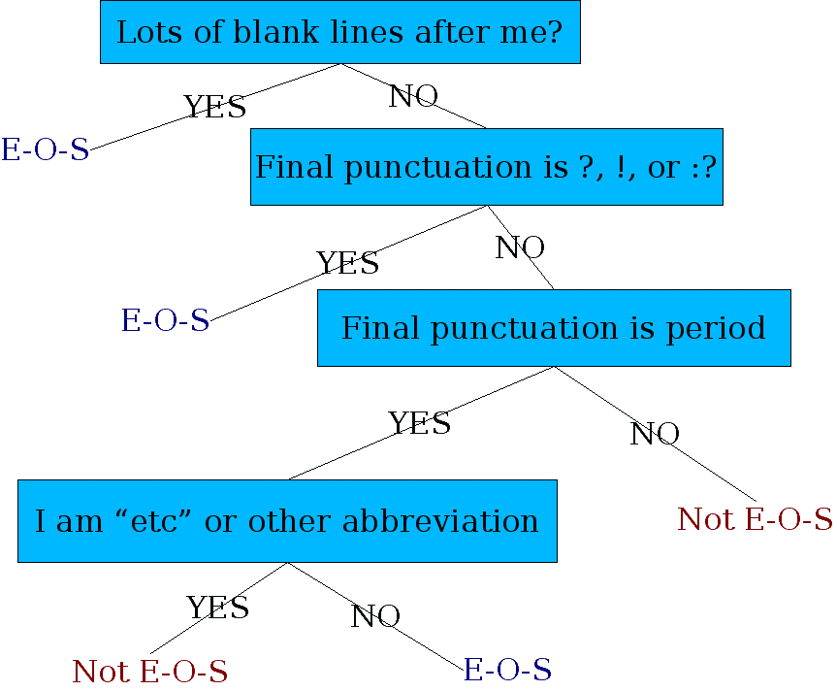
Determining if a Word is End-of-sentence: A Decision Tree
Other features
  Case of word with/after “.”: Upper, Lower, Cap, Number
  Length of word with “.”

Slide 18
Bag of words, TFIDF

Slide 19
The Classic Search Model
User task
Info need
Query
Search
engine
Query
refinement
Results
Collection

Slide 20
Query on Unstructured Data
Sec. 1.1
Which plays of Shakespeare contain the words Brutus AND Caesar but NOT Calpurnia?
One could grep all of Shakespeare’s plays for Brutus and Caesar, then strip out lines containing Calpurnia?
Why is that not the answer?
  Slow (for large corpora)
  NOT Calpurnia is non-trivial
  Other operations (e.g., find the word Romans near countrymen) not feasible
  Ranked retrieval (best documents to return)
Notes:
Grep is line-oriented; IR is document oriented.

Slide 21
Term-Document Incidence Matrices
Sec. 1.1
1 if play contains word, 0 otherwise
Brutus AND Caesar BUT NOT Calpurnia

Slide 22
Incidence Vectors
Sec. 1.1
So we have a 0/1 vector for each term.
To answer query: take the vectors for Brutus, Caesar and Calpurnia (complemented) ➔ bitwise AND.
  110100 AND 110111 AND 101111 = 100100

Slide 23
Bigger Collections
Sec. 1.1
Consider N = 1 million documents, each with about 1000 words.
Avg 6 bytes/word including spaces/punctuation
  6GB of data in the documents.
Say there are M = 500K distinct terms among these.
500K x 1M matrix has half-a-trillion 0’s and 1’s.
But it has no more than one billion 1’s.
  matrix is extremely sparse.
What’s a better representation?
  We only record the 1 positions.

Slide 24
Inverted Index
Sec. 1.2
For each term t, we must store a list of all documents that contain t.
  Identify each doc by a docID, a document serial number
Sorted by docID
Posting
Brutus
1
2
4
11
31
45
173
174
Caesar
1
2
4
5
6
16
57
132
Calpurnia
2
31
54
101
Dictionary
Postings

Slide 25
Ranked Retrieval
Ch. 6
Thus far, our queries have all been Boolean.
  Documents either match or don’t.
Good for expert users with precise understanding of their needs and the collection.
  Also good for applications: Applications can easily consume 1000s of results.
Not good for the majority of users.
  Most users are incapable of writing Boolean queries.
  Most users don’t want to wade through 1000s of results.
    This is particularly true of web search.

Slide 26
Binary Term-Document Incidence Matrix
Sec. 6.2
Each document is represented by a binary vector ∈ {0,1}^{|V|}

Slide 27
Term-Document Count Matrices
Sec. 6.2
Consider the number of occurrences of a term in a document
  Each document is a count vector in ℕ^{v}: a column below

Slide 28
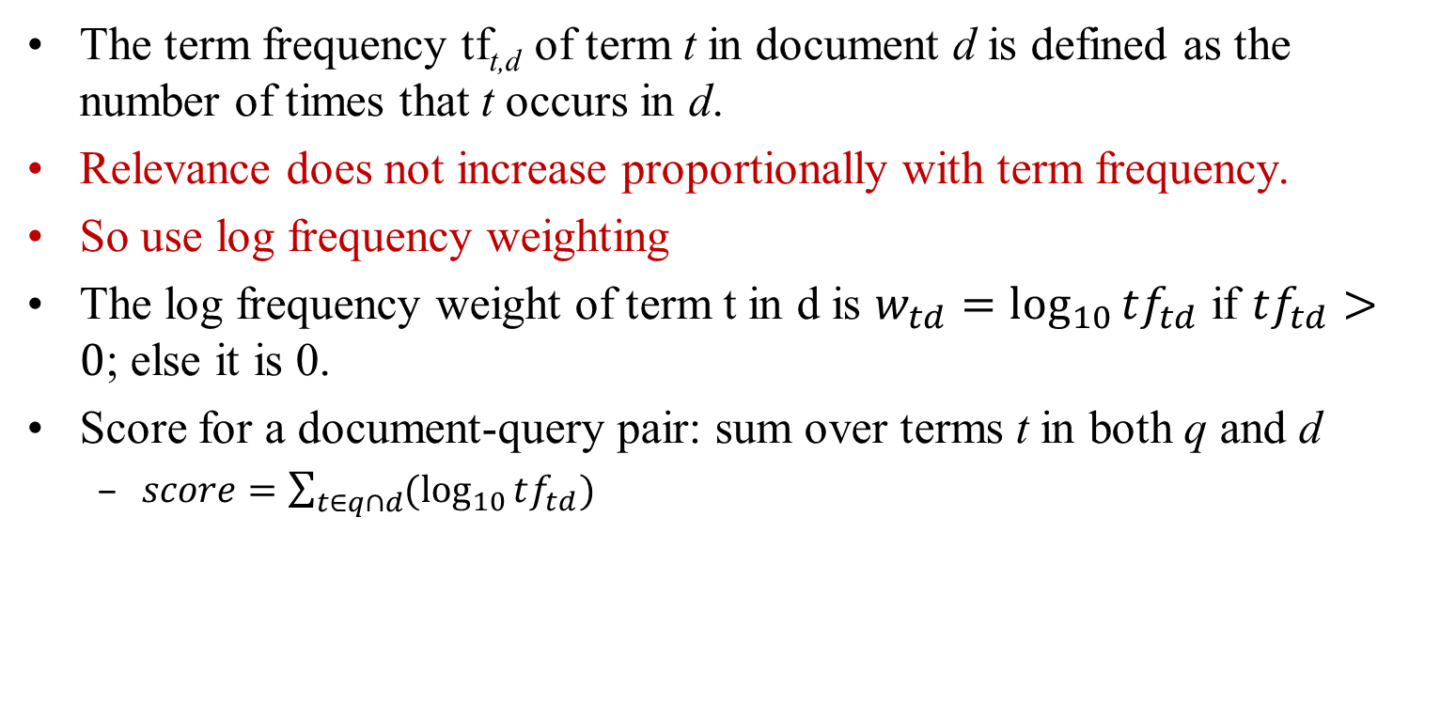
Term Frequency TF
The term frequency tf_{t,d} of term t in document d is defined as the number of times that t occurs in d.
Relevance does not increase proportionally with term frequency.
So use log frequency weighting
The log frequency weight of term t in d is $w_{td}=\log_{10}{tf_{td}}$ if $tf_{td}>0$; else it is 0.
Score for a document-query pair: sum over terms t in both q and d
  $score=\sum_{t∈q∩d}{(\log_{10}{tf_{td})}}$

Slide 29
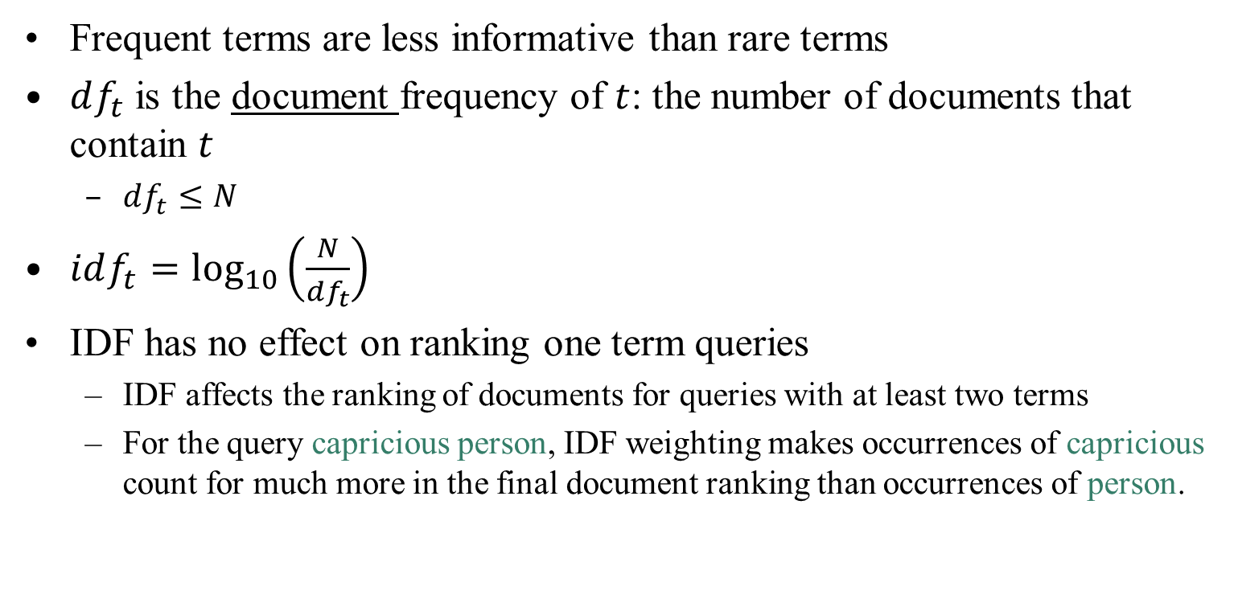
Inverse Document Frequency IDF
Sec. 6.2.1
Frequent terms are less informative than rare terms
$df_{t}$ is the document frequency of $t$: the number of documents that contain $t$
  $df_{t}≤N$
$idf_{t}=\log_{10}\left(\frac{N}{df_{t}}\right)$
IDF has no effect on ranking one term queries
  IDF affects the ranking of documents for queries with at least two terms
  For the query capricious person, IDF weighting makes occurrences of capricious count for much more in the final document ranking than occurrences of person.

Slide 30
TF-IDF Weighting
Sec. 6.2.2
The tf-idf weight of a term is the product of its tf weight and its idf weight.
Score for a document given a query
There are many variants
  How “tf” is computed (with/without logs)
  Whether the terms in the query are also weighted
  …

Slide 31
Binary → Count → Weight Matrix
Sec. 6.3
Each document is now represented by a real-valued vector of tf-idf weights ∈ R^{|V|}

Slide 32
Ranking in Vector Space Model
Represent both query and document as vectors in the |V|-dimensional space
Use cosine similarity as the similarity measure
  Incorporates length normalization automatically (longer vs shorter documents)
q_{i} is the tf-idf weight of term i in the query
d_{i} is the tf-idf weight of term i in the document

Slide 33
N-gram models

Slide 34
Next Word Prediction
From a NY Times story...
  Stocks ...
  Stocks plunged this ….
  Stocks plunged this morning, despite a cut in interest rates
  Stocks plunged this morning, despite a cut in interest rates by the Federal Reserve, as Wall ...
  Stocks plunged this morning, despite a cut in interest rates by the Federal Reserve, as Wall Street began

Slide 35
Next Word Prediction
  Stocks plunged this morning, despite a cut in interest rates by the Federal Reserve, as Wall Street began trading for the first time since last …
  Stocks plunged this morning, despite a cut in interest rates by the Federal Reserve, as Wall Street began trading for the first time since last Tuesday's terrorist attacks.

Slide 36
Human Word Prediction
Clearly, at least some of us have the ability to predict future words in an utterance.
How?
  Domain knowledge: red blood vs. red hat
  Syntactic knowledge: the…<adj|noun>
  Lexical knowledge: baked <potato vs. chicken>
A useful part of the knowledge needed to allow Word Prediction can be captured using simple statistical techniques
In particular, we'll be interested in the notion of the probability of a sequence (of letters, words,…)

Slide 37
Applications of word prediction
Why do we want to predict a word, given some preceding words?
  Rank the likelihood of sequences containing various alternative hypotheses
  Assess the likelihood/goodness of a sentence
Spelling checkers
  They are leaving in about fifteen minuets to go to her house
  The study was conducted mainly be John Black.
  I need to notified the bank of this problem.
Mobile phone texting
  He is trying to fine out.
  Hopefully, all with continue smoothly in my absence.
Speech recognition
  Theatre owners say popcorn/unicorn sales have doubled...
Handwriting recognition
Disabled users
Machine Translation

Slide 38
How to do next word prediction?
Use the previous N-1 words in a sequence to predict the next word
Language Model (LM)
  unigrams, bigrams, trigrams,…
How do we train these models?
  Very large corpora
  Corpora are online collections of text and speech
    Wall Street Journal
    Newswire

Slide 39
N-grams
Assume a language has T word types in its lexicon, how likely is word x to follow word y?
  Simplest model of word probability: 1/T
  Alternative 1: estimate likelihood of x occurring in new text based on its general frequency of occurrence estimated from a corpus (unigram probability)
    popcorn is more likely to occur than unicorn
  Alternative 2: condition the likelihood of x occurring in the context of previous words (bigrams, trigrams,…)
    mythical unicorn is more likely than mythical popcorn

Slide 40
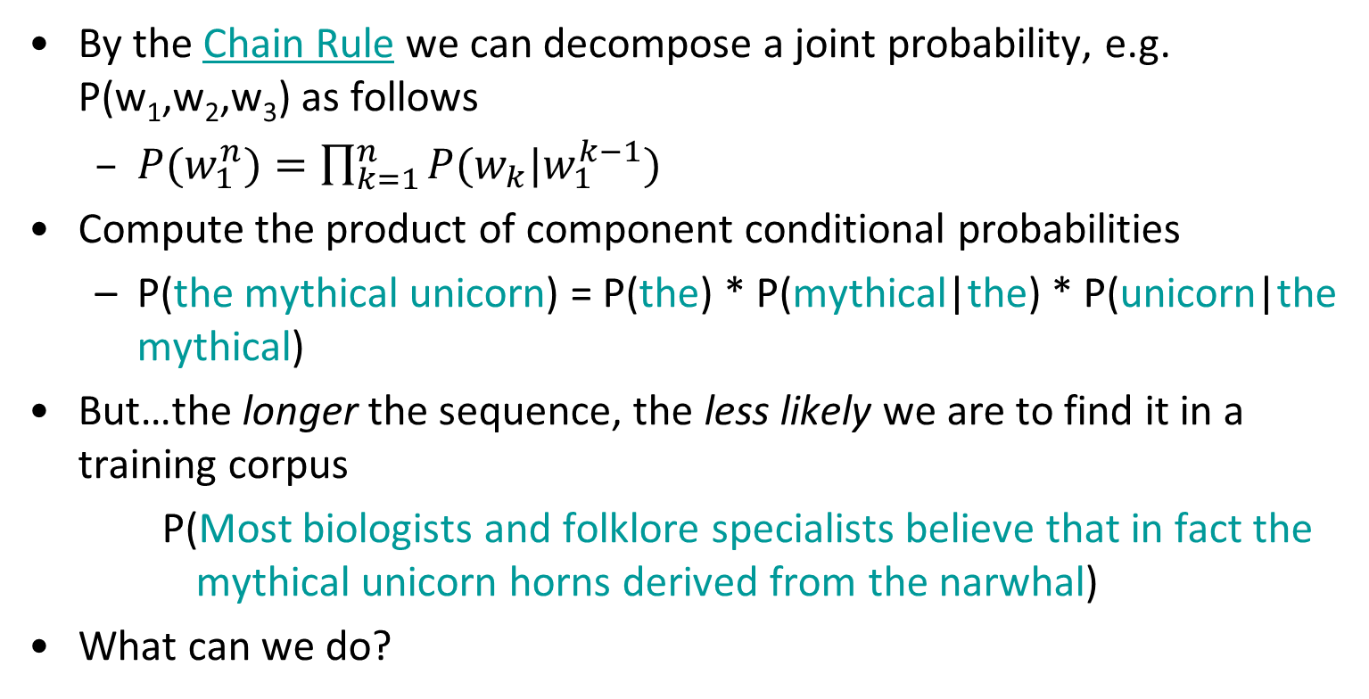
Prob of a word sequence
By the Chain Rule we can decompose a joint probability, e.g. P(w₁,w₂,w₃) as follows
  $P(w_{1}^{n})=\prod_{k=1}^{n}{P(w_{k}|w_{1}^{k−1})}$
Compute the product of component conditional probabilities
  P(the mythical unicorn) = P(the) * P(mythical|the) * P(unicorn|the mythical)
But…the longer the sequence, the less likely we are to find it in a training corpus
    P(Most biologists and folklore specialists believe that in fact the mythical unicorn horns derived from the narwhal)
What can we do?

Slide 41
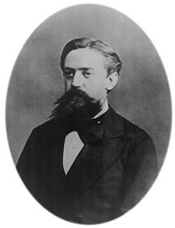
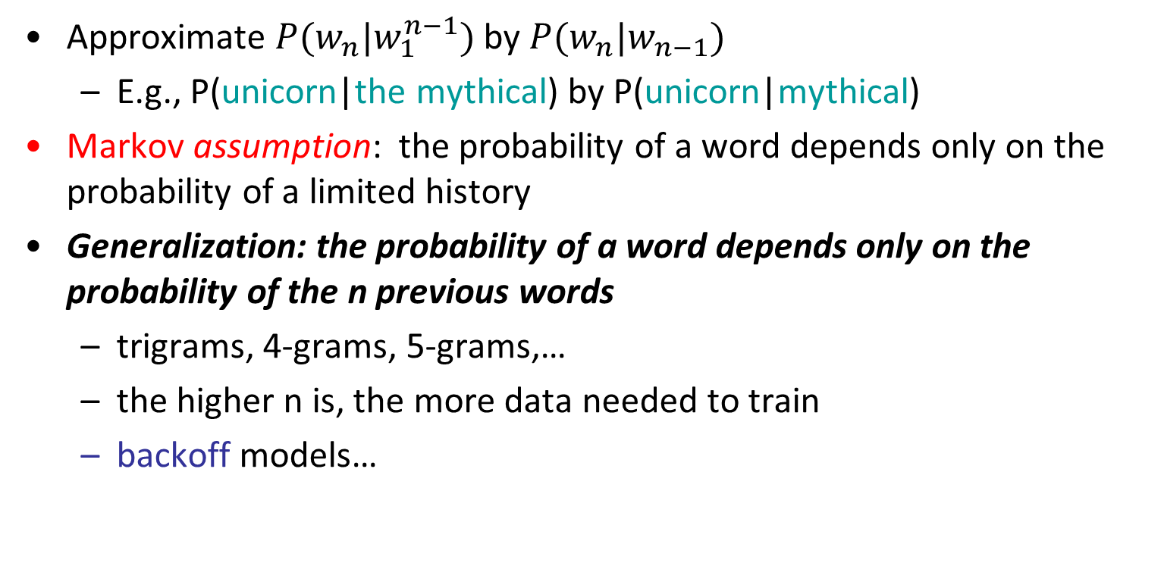
Bigram Model
Approximate $P(w_{n}|w_{1}^{n−1})$ by $P(w_{n}|w_{n−1})$
  E.g., P(unicorn|the mythical) by P(unicorn|mythical)
Markov assumption: the probability of a word depends only on the probability of a limited history
Generalization: the probability of a word depends only on the probability of the n previous words
  trigrams, 4-grams, 5-grams,…
  the higher n is, the more data needed to train
  backoff models…
Andrei Markov

Slide 42
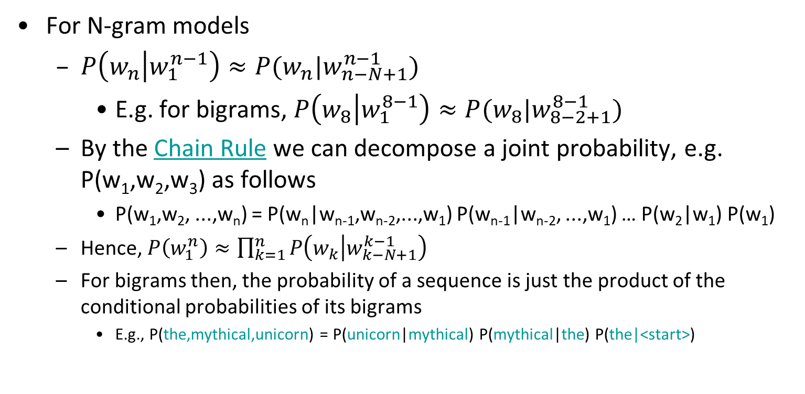
Using n-grams
For N-gram models
  $P\left(w_{n} | w_{1}^{n−1}\right)≈P(w_{n}|w_{n−N+1}^{n−1})$
    E.g. for bigrams, $P\left(w_{8} | w_{1}^{8−1}\right)≈P(w_{8}|w_{8−2+1}^{8−1})$
  By the Chain Rule we can decompose a joint probability, e.g. P(w₁,w₂,w₃) as follows
    P(w₁,w₂, ...,w_{n}) = P(w_{n}|w_{n-1},w_{n-2},...,w₁) P(w_{n-1}|w_{n-2}, ...,w₁) … P(w₂|w₁) P(w₁)
  Hence, $P\left(w_{1}^{n}\right)≈\prod_{k=1}^{n}{P\left(w_{k} | w_{k−N+1}^{k−1}\right)}$
  For bigrams then, the probability of a sequence is just the product of the conditional probabilities of its bigrams
    E.g., P(the,mythical,unicorn) = P(unicorn|mythical) P(mythical|the) P(the|<start>)

Slide 43
Sample Bigram Probabilities
Eat on
.16
Eat Thai
.03
Eat some
.06
Eat breakfast
.03
Eat lunch
.06
Eat in
.02
Eat dinner
.05
Eat Chinese
.02
Eat at
.04
Eat Mexican
.02
Eat a
.04
Eat tomorrow
.01
Eat Indian
.04
Eat dessert
.007
Eat today
.03
Eat British
.001
<start> I
.25
Want some
.04
<start> I’d
.06
Want Thai
.01
<start> Tell
.04
To eat
.26
<start> I’m
.02
To have
.14
I want
.32
To spend
.09
I would
.29
To be
.02
I don’t
.08
British food
.60
I have
.04
British restaurant
.15
Want to
.65
British cuisine
.01
Want a
.05
British lunch
.01

Slide 44
Further Reading
Books
  Foundations of Statistical Natural Language Processing: Christopher D. Manning, Hinrich Schütze
  Speech and Language Processing, 2nd Edition: Daniel Jurafsky, James H. Martin
ChengXiang Zhai. Statistical Language Models for Information Retrieval. Synthesis Lectures on Human Language Technologies. 2008. Morgan & Claypool Publishers.
http://web.stanford.edu/class/cs276a/handouts/lecture12.pdf
https://github.com/rexdwyer/Splitsville/blob/master/Splitsville.ipynb
http://pages.stern.nyu.edu/~sbp345/websys/python_dwd/Session%203%20(Regular%20Expressions).ipynb

