Slide 1
Topic Models
Manish Gupta
Slides borrowed (and modified) from
http://knight.cis.temple.edu/~yates/cis8538/sp11/slides/intro-to-lsa-lda.ppt
http://home.etf.rs/~vm/tutorial/Coimbra/slides/3_Jelisavcic.pptx
http://mallet.cs.umass.edu/mallet-tutorial.pdf
http://www.cse.ust.hk/~lzhang/teach/6931a/slides/lda-zhou.pdf

Slide 2
What are topic models? Why do you need them?

Slide 3
Discover Topics from a Corpus
PRINTING
PAPER
PRINT
PRINTED
TYPE
PROCESS
INK
PRESS
IMAGE
PRINTER
PRINTS
PRINTERS
COPY
COPIES
FORM
OFFSET
GRAPHIC
SURFACE
PRODUCED
CHARACTERS
PLAY
PLAYS
STAGE
AUDIENCE
THEATER
ACTORS
DRAMA
SHAKESPEARE
ACTOR
THEATRE
PLAYWRIGHT
PERFORMANCE
DRAMATIC
COSTUMES
COMEDY
TRAGEDY
CHARACTERS
SCENES
OPERA
PERFORMED
TEAM
GAME
BASKETBALL
PLAYERS
PLAYER
PLAY
PLAYING
SOCCER
PLAYED
BALL
TEAMS
BASKET
FOOTBALL
SCORE
COURT
GAMES
TRY
COACH
GYM
SHOT
JUDGE
TRIAL
COURT
CASE
JURY
ACCUSED
GUILTY
DEFENDANT
JUSTICE
EVIDENCE
WITNESSES
CRIME
LAWYER
WITNESS
ATTORNEY
HEARING
INNOCENT
DEFENSE
CHARGE
CRIMINAL
HYPOTHESIS
EXPERIMENT
SCIENTIFIC
OBSERVATIONS
SCIENTISTS
EXPERIMENTS
SCIENTIST
EXPERIMENTAL
TEST
METHOD
HYPOTHESES
TESTED
EVIDENCE
BASED
OBSERVATION
SCIENCE
FACTS
DATA
RESULTS
EXPLANATION
STUDY
TEST
STUDYING
HOMEWORK
NEED
CLASS
MATH
TRY
TEACHER
WRITE
PLAN
ARITHMETIC
ASSIGNMENT
PLACE
STUDIED
CAREFULLY
DECIDE
IMPORTANT
NOTEBOOK
REVIEW

Slide 4
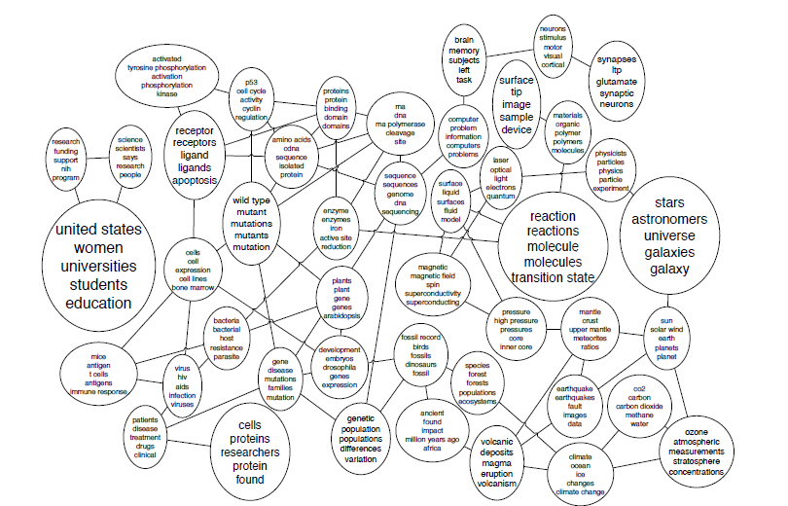
Model Connections between Topics

Slide 5
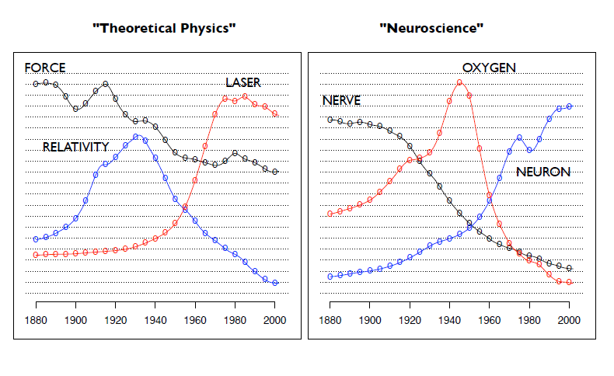
Model the Evolution of Topics over Time

Slide 6
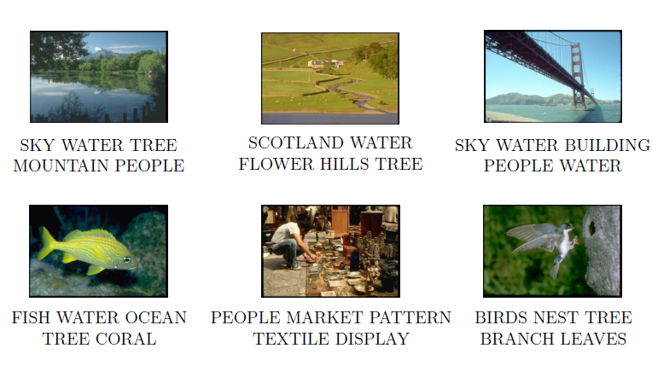
Annotate Documents according to these Topics

Slide 7
Plate diagrams, unigram models, mixture of unigrams

Slide 8
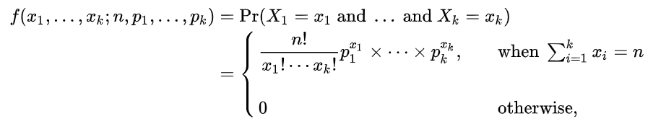
Multinomial Distribution
Suppose one does an experiment of extracting n balls of k different colors from a bag, replacing the extracted ball after each draw.
Balls from the same color are equivalent.
Denote the variable which is the number of extracted balls of color i (i = 1, ..., k) as X_{i}, and denote as p_{i} the probability that a given extraction will be in color i.
The probability mass function of this multinomial distribution is:

Slide 9
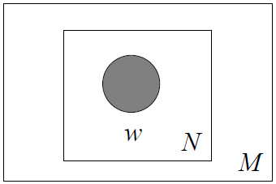
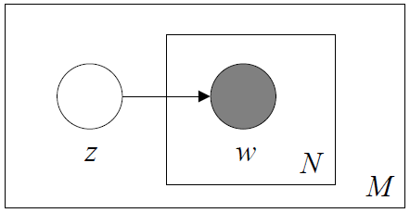
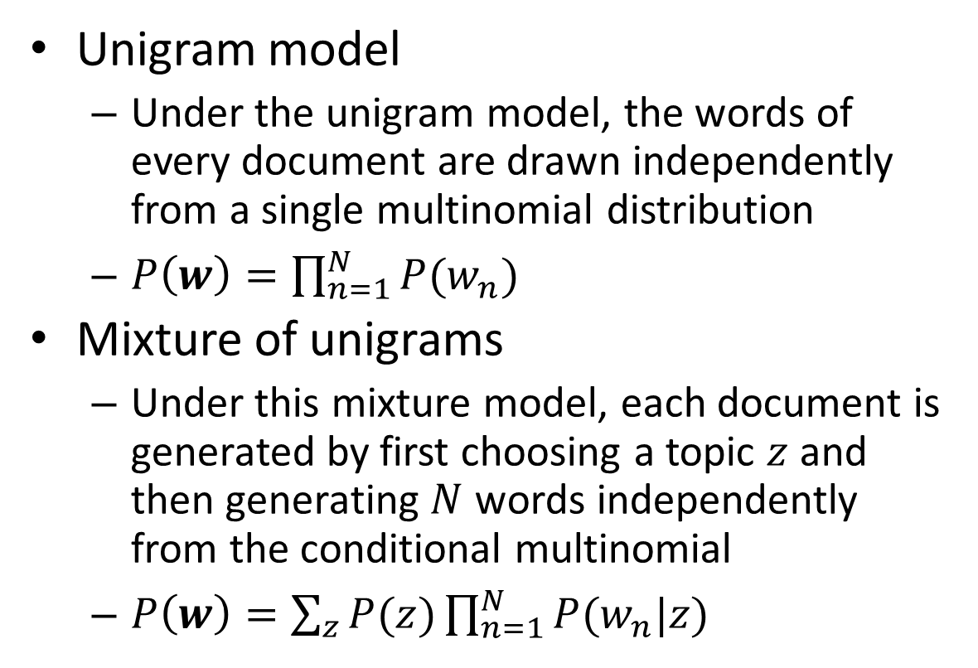
Unigram Model & Mixture of Unigrams
Unigram model
  Under the unigram model, the words of every document are drawn independently from a single multinomial distribution
  $P\left(w\right)=\prod_{n=1}^{N}{P(w_{n})}$
Mixture of unigrams
  Under this mixture model, each document is generated by first choosing a topic $z$ and then generating $N$ words independently from the conditional multinomial
  $P\left(w\right)=\sum_{z}{P(z)}\prod_{n=1}^{N}{P(w_{n}|z)}$
_{Zi}
w_{i1}
w_{2i}
w_{3i}
w_{4i}

Slide 10
SVD and LSI/LSA

Slide 11
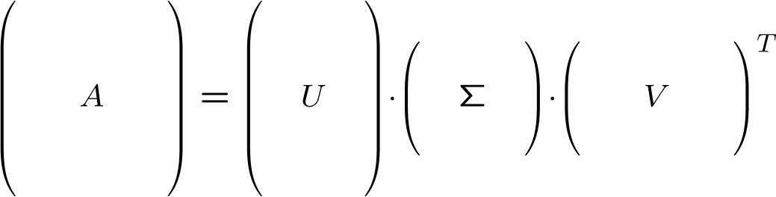
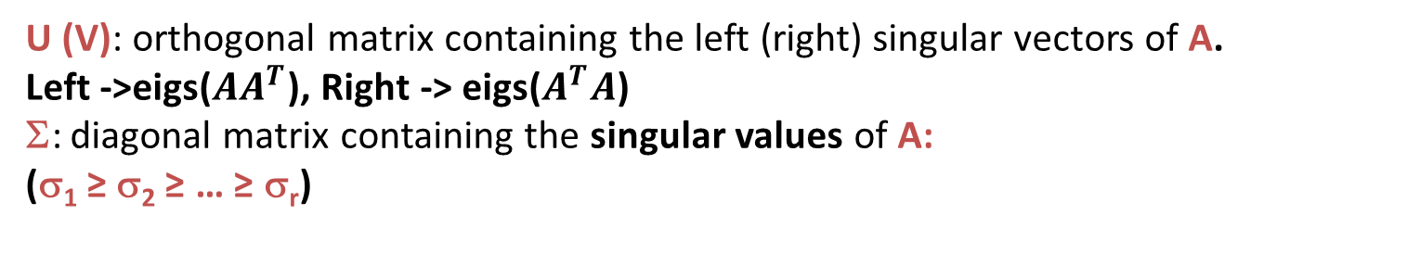
The Singular Value Decomposition (SVD)
0
0
n x d
n x r
r x r
r x d
U (V): orthogonal matrix containing the left (right) singular vectors of A.
Left ->eigs($AA^{T}$), Right -> eigs($A^{T}A$)
Σ: diagonal matrix containing the singular values of A:
(σ₁ ≥ σ₂ ≥ … ≥ σ_{r})

Slide 12
Deficiencies with Word-based Indexing
Bag of Words methods: A document is only "about" the words in it
But people interpret documents in a richer context
  a document is about some domain and concepts in it
  reflected in the vocabulary but not limited to it
Synonymy: Various words and phrases refer to the same concept
Latent semantic indexing helps to find synonyms using SVD.
  Latent: Not visible on the surface
  Semantic: Word meanings
auto
engine
bonnet
tires
lorry
boot
car
emissions
hood
make
model
trunk
Synonymy: Will have small cosine but are related

Slide 13
Word Co-Occurrences
Bag of words approaches assume meaning is carried by vocabulary
Next step is to look at vocabulary groups; what words tend to occur together?
Still a statistical approach, but richer representation than single terms
E.g., Looking for articles about Tiger Woods in an API newswire database could bring up stories about the golfer, followed by articles about golf tournaments that don't mention his name.
  So we are need to recognize that Tiger Woods is about golf.

Slide 14
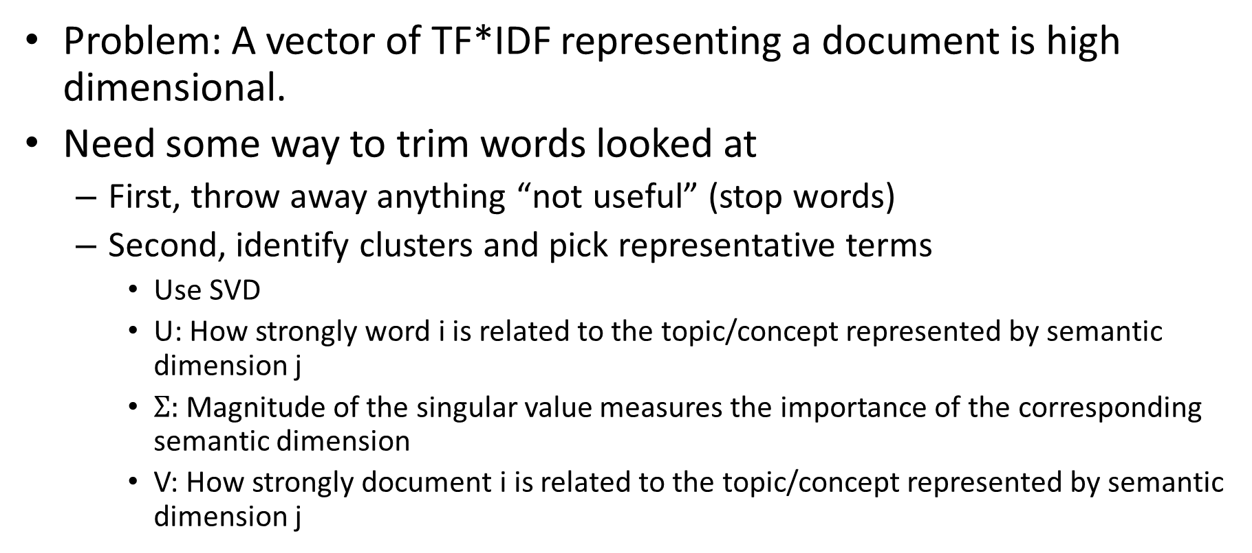
LSI/LSA: SVD for text
Problem: A vector of TF*IDF representing a document is high dimensional.
Need some way to trim words looked at
  First, throw away anything “not useful” (stop words)
  Second, identify clusters and pick representative terms
    Use SVD
    U: How strongly word i is related to the topic/concept represented by semantic dimension j
    $Σ$: Magnitude of the singular value measures the importance of the corresponding semantic dimension
    V: How strongly document i is related to the topic/concept represented by semantic dimension j

Slide 15
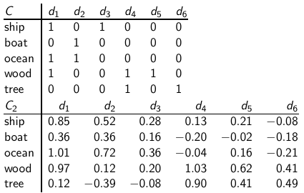
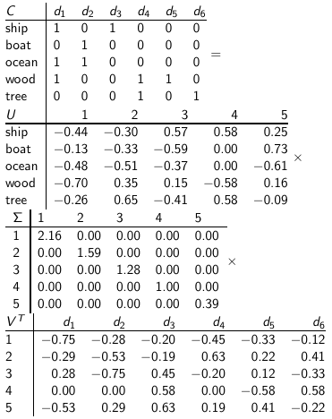
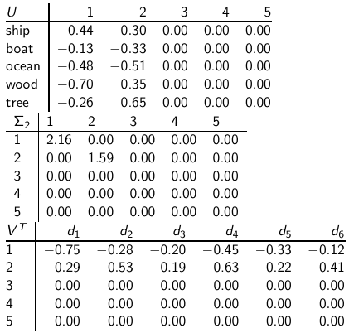
  LSA Example
Reducing dimensionality to 2
Similarity of d2 and d3 in the original space: 0.
Similarity of d2 und d3 in the reduced space: 0.52 * 0.28 + 0.36 * 0.16 + 0.72 * 0.36 + 0.12 * 0.20 + - 0.39 * - 0.08 ≈ 0.52
“boat” and “ship” are semantically similar. The “reduced” similarity measure reflects this.

Slide 16
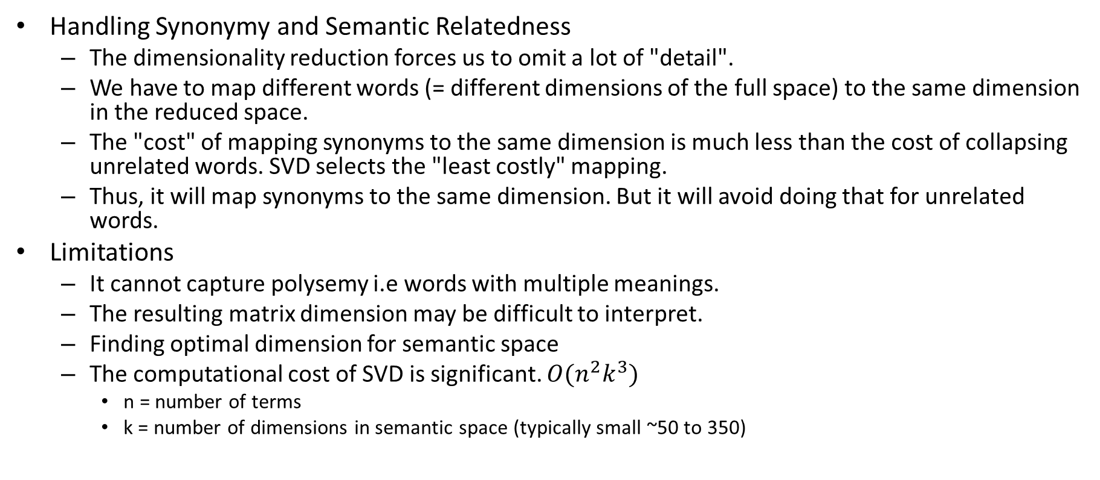
Properties of LSI
Handling Synonymy and Semantic Relatedness
  The dimensionality reduction forces us to omit a lot of "detail".
  We have to map different words (= different dimensions of the full space) to the same dimension in the reduced space.
  The "cost" of mapping synonyms to the same dimension is much less than the cost of collapsing unrelated words. SVD selects the "least costly" mapping.
  Thus, it will map synonyms to the same dimension. But it will avoid doing that for unrelated words.
Limitations
  It cannot capture polysemy i.e words with multiple meanings.
  The resulting matrix dimension may be difficult to interpret.
  Finding optimal dimension for semantic space
  The computational cost of SVD is significant. $O(n^{2}k^{3})$
    n = number of terms
    k = number of dimensions in semantic space (typically small ~50 to 350)

Slide 17
Probabilistic Latent Semantic Analysis (PLSA)

Slide 18
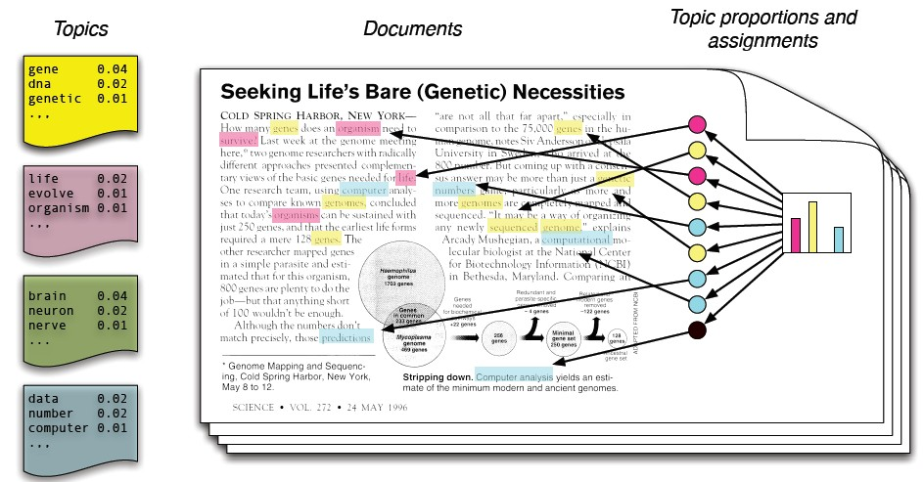
Topic models: Intuitive Representation

Slide 19
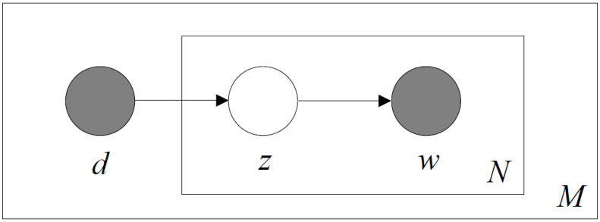



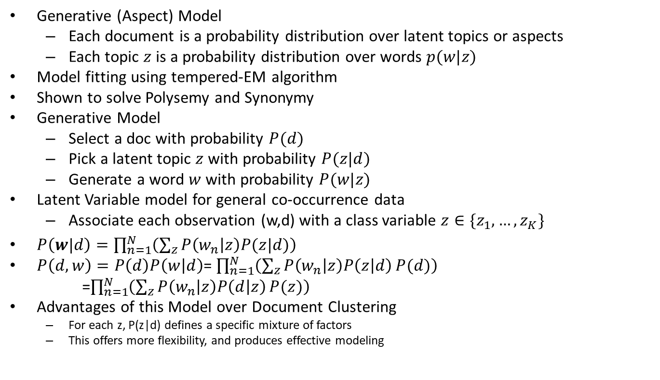



Probabilistic Latent Semantic Analysis
Generative (Aspect) Model
  Each document is a probability distribution over latent topics or aspects
  Each topic $z$is a probability distribution over words $p(w|z)$
Model fitting using tempered-EM algorithm
Shown to solve Polysemy and Synonymy
Generative Model
  Select a doc with probability $P(d)$
  Pick a latent topic $z$ with probability $P(z|d)$
  Generate a word $w$ with probability $P(w|z)$
Latent Variable model for general co-occurrence data
  Associate each observation (w,d) with a class variable $z∈\{z_{1},…,z_{K}\}$
$P\left(w|d\right)=\prod_{n=1}^{N}{\left(\sum_{z}{P\left(w_{n} | z\right)P(z|d)}\right)}$
$P\left(d,w\right)=P\left(d\right)P\left(w | d\right)$= $\prod_{n=1}^{N}{\left(\sum_{z}{P\left(w_{n} | z\right)P\left(z | d\right)}P(d)\right)}$
=$\prod_{n=1}^{N}{\left(\sum_{z}{P\left(w_{n} | z\right)P\left(d | z\right)}P(z)\right)}$
Advantages of this Model over Document Clustering
  For each z, P(z|d) defines a specific mixture of factors
  This offers more flexibility, and produces effective modeling
Doc
$$z_{1}$$
$$z_{2}$$
$$z_{K}$$
$$w_{1}$$
$$w_{2}$$
$$w_{N}$$

Slide 20
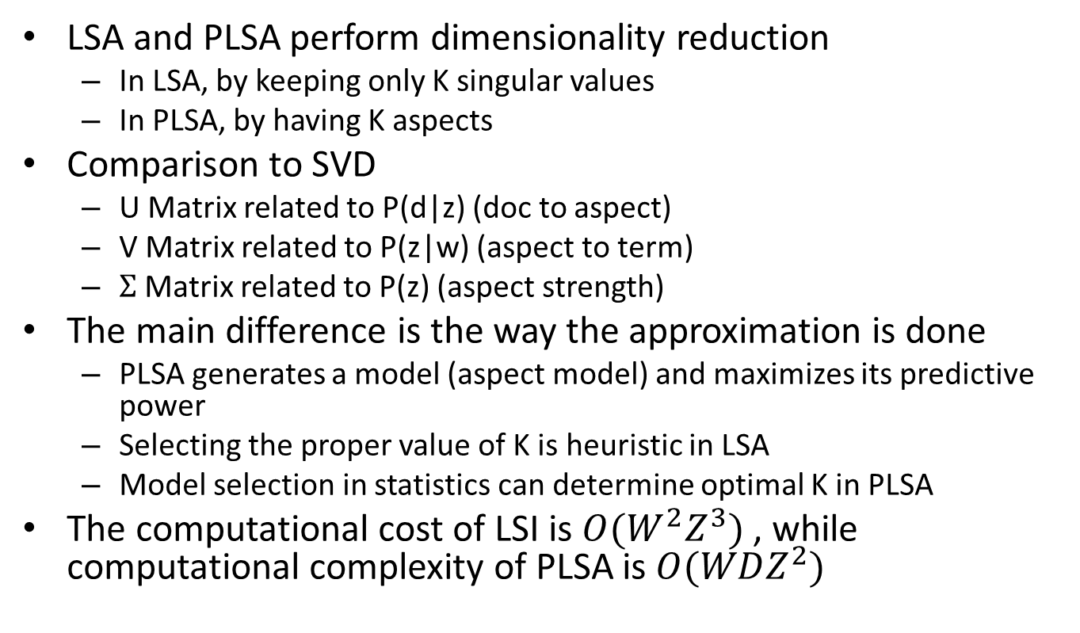
Comparing PLSA and LSA
LSA and PLSA perform dimensionality reduction
  In LSA, by keeping only K singular values
  In PLSA, by having K aspects
Comparison to SVD
  U Matrix related to P(d|z) (doc to aspect)
  V Matrix related to P(z|w) (aspect to term)
  $Σ$ Matrix related to P(z) (aspect strength)
The main difference is the way the approximation is done
  PLSA generates a model (aspect model) and maximizes its predictive power
  Selecting the proper value of K is heuristic in LSA
  Model selection in statistics can determine optimal K in PLSA
The computational cost of LSI is $O(W^{2}Z^{3})$ , while computational complexity of PLSA is $O(WDZ^{2})$

Slide 21
Motivation for LDA

Slide 22
Motivations for LDA
Problem of PLSA
  There is no natural way to use it to assign probability to a previously unseen document
  The linear growth in parameters suggests that the model is prone to overfitting
We would like to be Bayesian about our topic mixture proportions, rather than fix a single one.

Slide 23
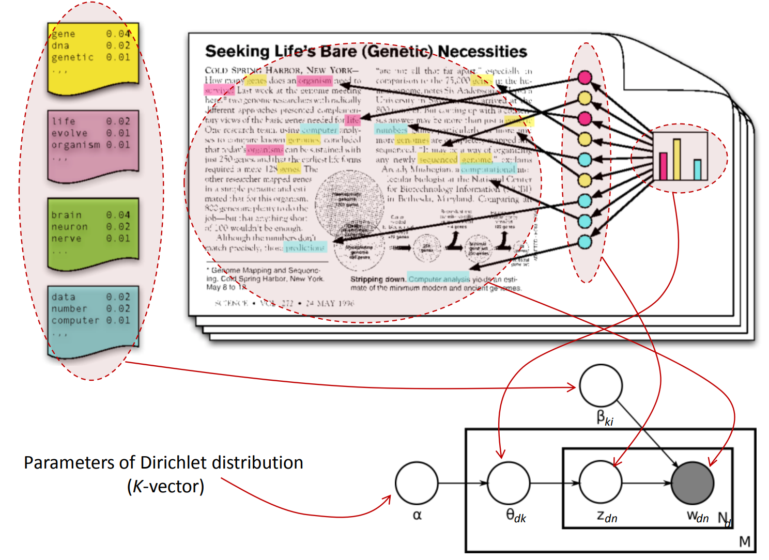
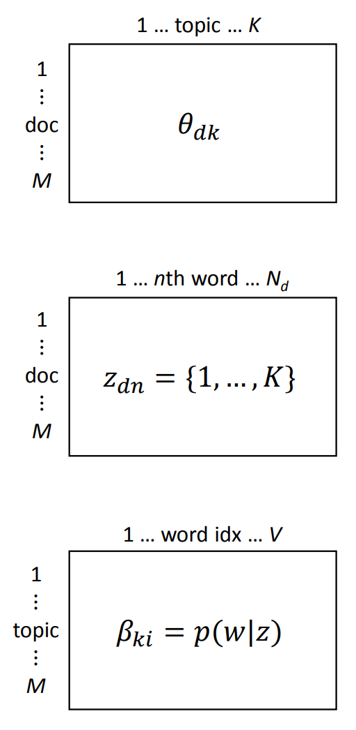
LDA Intuitive Representation

Slide 24
Dirichlet Distributions

Slide 25
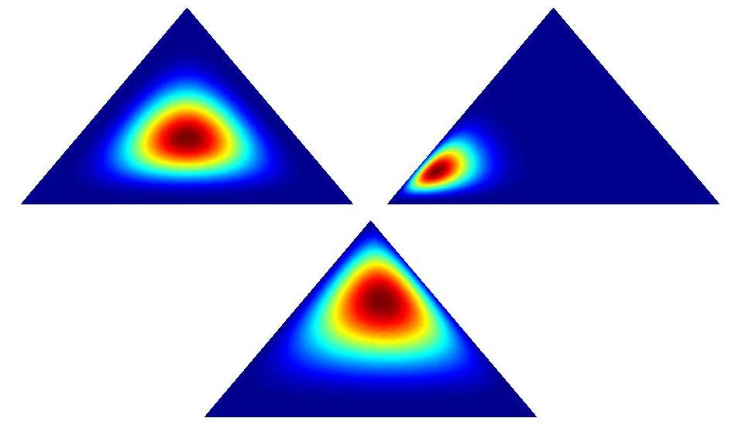
Dirichlet Distributions
In the LDA model, we would like to say that the topic mixture proportions for each document are drawn from some distribution.
So, we want to put a distribution on multinomials. That is, k-tuples of non-negative numbers that sum to one.
The space of all of these multinomials has a nice geometric interpretation as a (k-1)-simplex, which is just a generalization of a triangle to (k-1) dimensions.

Slide 26
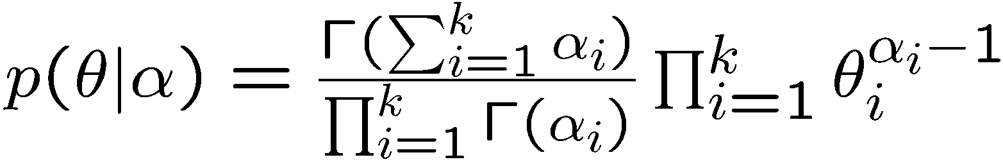
Dirichlet Distributions
Useful Facts:
  This distribution is defined over a (k-1)-simplex. That is, it takes k non-negative arguments which sum to one. Consequently it is a natural distribution to use over multinomial distributions.
  In fact, the Dirichlet distribution is the conjugate prior to the multinomial distribution. (This means that if our likelihood is multinomial with a Dirichlet prior, then the posterior is also Dirichlet!)
  The Dirichlet parameter α_{i} can be thought of as a prior count of the i^{th} topic.

Slide 27
LDA Model Details

Slide 28
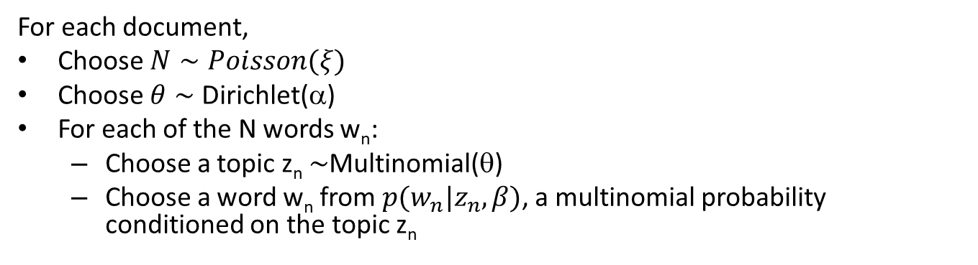
The LDA Model
For each document,
Choose $N∼Poisson(ξ)$
Choose $θ∼$ Dirichlet(α)
For each of the N words w_{n}:
  Choose a topic z_{n} $∼$Multinomial(θ)
  Choose a word w_{n} from $p(w_{n}|z_{n},β)$, a multinomial probability conditioned on the topic z_{n}
Note Multinomial is also called as
Discrete
α
θ
θ
θ
z₁
z₂
z₃
z₄
z₁
z₂
z₃
z₄
z₁
z₂
z₃
z₄
w₁
w₂
w₃
w₄
w₁
w₂
w₃
w₄
w₁
w₂
w₃
w₄
β

Slide 29
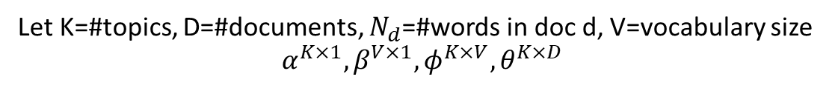
Latent Dirichlet Allocation
Let K=#topics, D=#documents, $N_{d}$=#words in doc d, V=vocabulary size
$$α^{K×1}, β^{V×1}, φ^{K×V},θ^{K×D}$$
α
distribution over topics
for each document
Dirichlet priors
θ ^{(d)}
θ ^{(d)} ∼ Dirichlet(α)
β
distribution over words
for each topic
topic assignment
for each word
φ ^{(j)} ∼ Dirichlet(β)
φ ^{(j)}
z_{i}
z_{i} ∼ Discrete(θ ^{(d)} )
T
word generated from
assigned topic
w_{i}
w_{i} ∼ Discrete(φ ^{(zi)} )
N_{d}
D

Slide 30
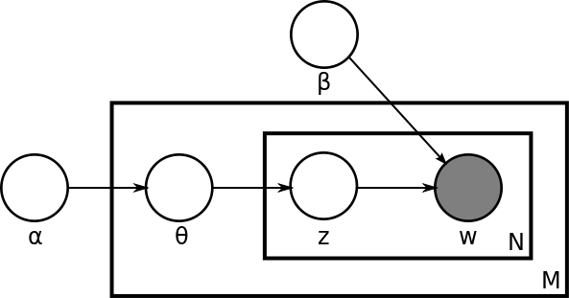
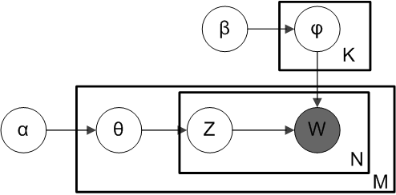
Parameters and Variables in Latent Dirichlet Allocation
There are three levels to LDA representation
  α, β are corpus-level parameters
  θ_{d} are document-level variables
  z_{dn}, w_{dn} are word-level variables
LDA
Smoothed LDA

Slide 31
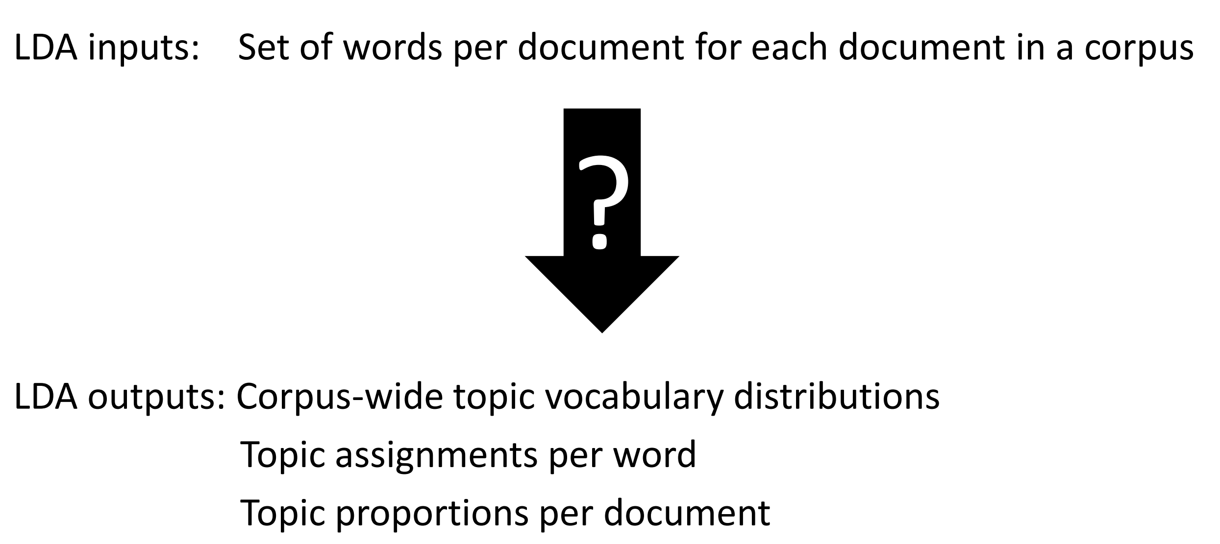
LDA: Goal of Inference

Slide 32
Comparison between various topic models: unigrams, mixture of unigrams, PLSI, LDA

Slide 33
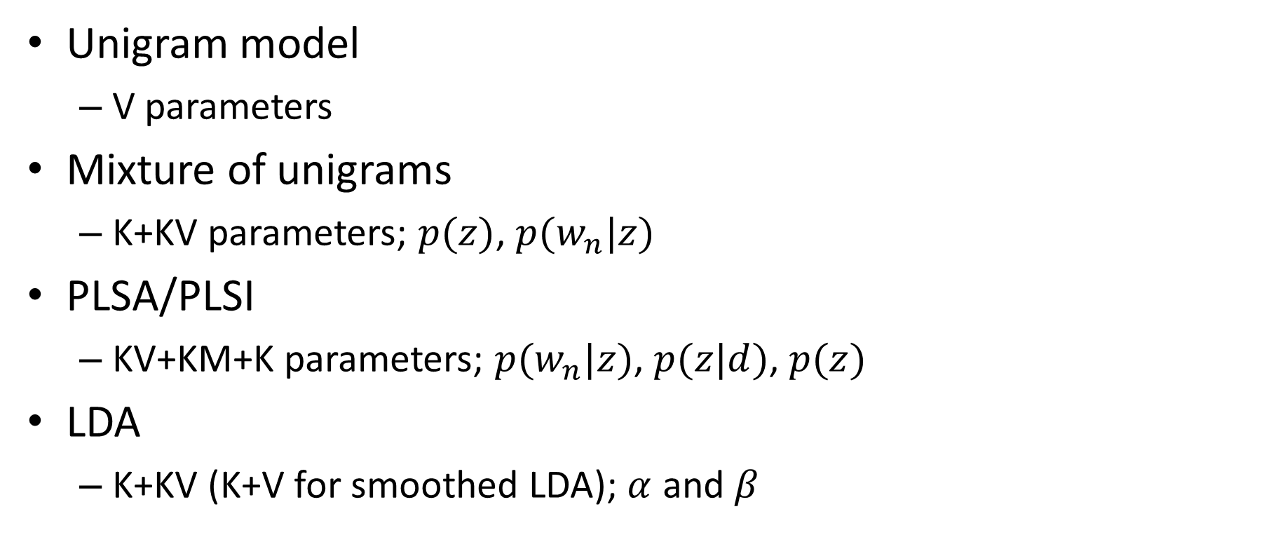
Number of Parameters
Unigram model
  V parameters
Mixture of unigrams
  K+KV parameters; $p(z)$, $p(w_{n}|z)$
PLSA/PLSI
  KV+KM+K parameters; $p(w_{n}|z)$, $p(z|d)$, $p(z)$
LDA
  K+KV (K+V for smoothed LDA); $α$ and $β$

Slide 34
LDA Hyper-parameters

Slide 35
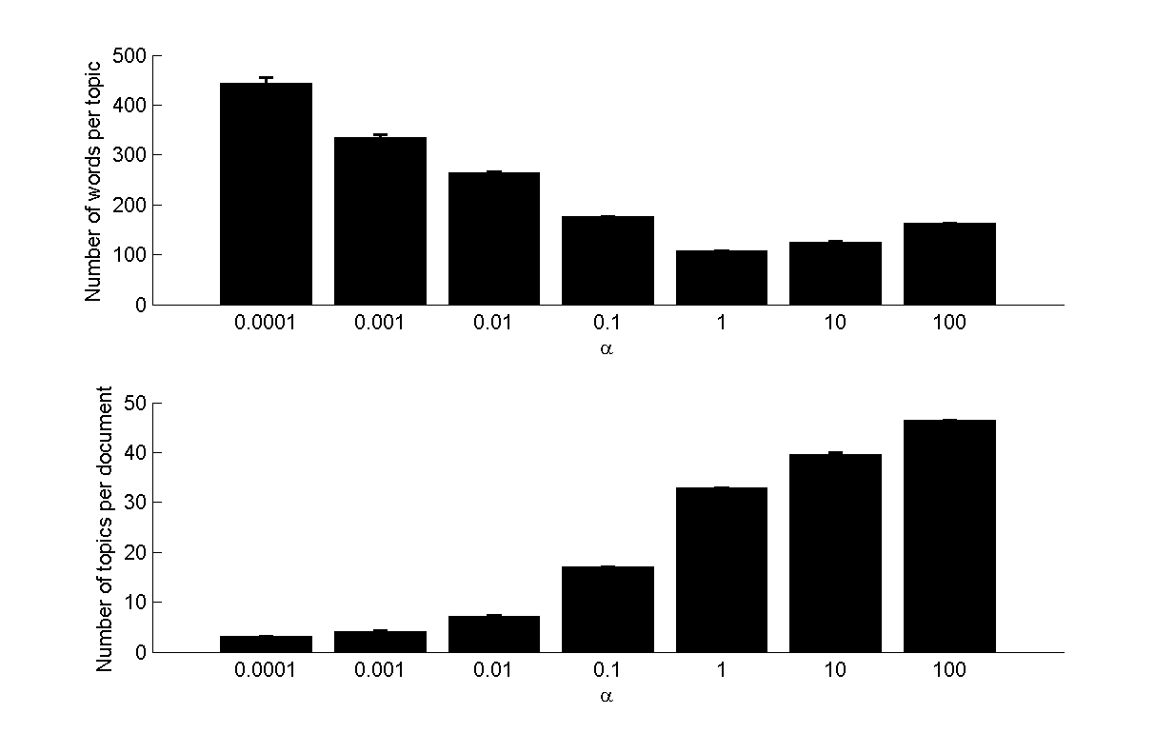
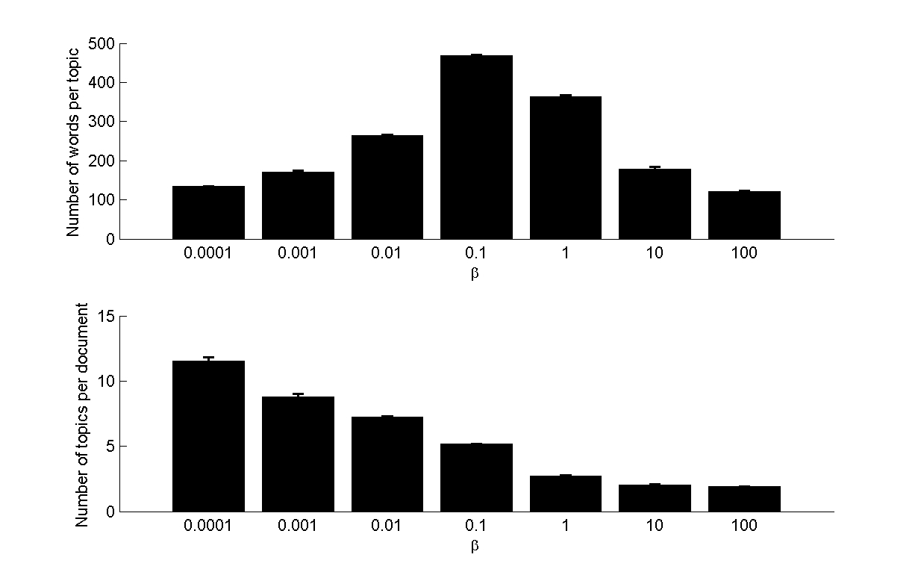
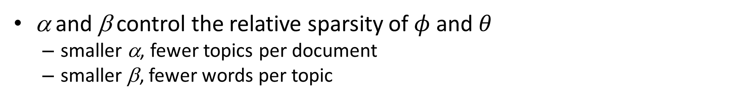
Effects of Hyperparameters
α and β control the relative sparsity of $φ$ and $θ$
  smaller α, fewer topics per document
  smaller β, fewer words per topic
Varying α
Varying β

Slide 36
Further Reading
Thomas Hofmann, Probabilistic Latent Semantic Analysis. Proceedings of the Fifteenth Conference on Uncertainty in Artificial Intelligence (UAI'99) http://www.cs.brown.edu/~th/papers/Hofmann-UAI99.pdf
D. M. Blei et al., “Latent Dirichlet allocation,” Journal of Machine Learning Research, 3, pp. 993–1022, January 2003.
D. Blei and J. Lafferty, “Topic models,” in A. Srivastava and M. Sahami, (eds.), Text Mining: Theory and Applications. Taylor and Francis, 2009.
D. Blei. "Introduction to Probabilistic Topic Models," http://www.cs.princeton.edu/~blei/papers/Blei2011.pdf

