Slide 1
Named Entity Recognition
Adapted from https://gate.ac.uk/sale/talks/ne-tutorial.ppt

Slide 2
What is NER?

Slide 3
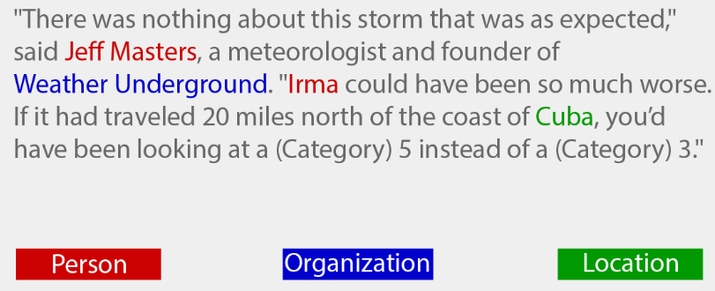
Named Entity Recognition
NER involves
  identification of proper names in texts, and
  classification into a set of predefined categories of interest
Key part of Information Extraction system
Robust handling of proper names essential for many applications
Pre-processing for different classification tasks

Slide 4
What are Named Entities?
Person names
Organizations (companies, government organisations, committees, etc)
Locations (cities, countries, rivers, etc)
Date and time expressions
Other common types: measures (percent, money, weight etc), email addresses, Web addresses, street addresses, etc.
Some domain-specific entities: names of drugs, medical conditions, names of ships, bibliographic references etc.

Slide 5
What are NOT NEs?
Common nouns, referring to named entities – the company, the committee
Adjectives derived from names – Bulgarian, Chinese
Numbers which are not times, dates, percentages, and money amounts

Slide 6
Why is NER challenging?

Slide 7
Problems in NE Task Definition
NE category definitions are intuitively quite clear, but there are many gray areas.
  Metonymy: substitution of the name of an attribute for that of the thing meant
Many of these gray areas are caused by metonymy.
  Person vs. Artefact: “The Chicken sandwich wants his bill.” vs. “Bring me a Chicken sandwich.”
  Organisation vs. Location : “Australia won the World Cup” vs. “The World Cup took place in Australia”.
  Company vs. Artefact: “shares in MTV” vs. “watching MTV”
  Location vs. Organisation: “she met him at Heathrow” vs. “the Heathrow authorities”

Slide 8
(first cut) Solutions
The task definition must be very clearly specified at the outset.
Some consortia on NER essentially adopted simplistic approach of disregarding metonymous uses of words,
  e.g. “England” was always identified as a location.
  However, this is not always useful for practical applications of NER (e.g. football/Cricket domain).
Idealistic solutions, on the other hand, are not always practical to implement,
  e.g. making distinctions based on world knowledge.

Slide 9
Basic Problems in NE
Variation of NEs – e.g. John Smith, Mr Smith, John.
Ambiguity of NE types
  John Smith (company vs. person)
  May (person vs. month)
  Washington (person vs. location)
  1945 (date vs. time)
Ambiguity with common words, e.g. "may"

Slide 10
Applications of NER

Slide 11
Applications
Can help summarisation, Speech Recognition and Machine Translation
Question Answering
  NER is extremely useful for systems that read text and answer queries.
  E.g., tasks such as “Name all the colleges in Bombay listed in the document”
Information Extraction
  E.g., to find out and tag the subject of a web page
  E.g., to extract the names of all the companies in a particular document
Intelligent document access
  Browse document collections by the entities that occur in them
  Formulate more complex queries than IR can answer
  Example application domains:
    News
    Scientific articles, e.g, MEDLINE abstracts

Slide 12
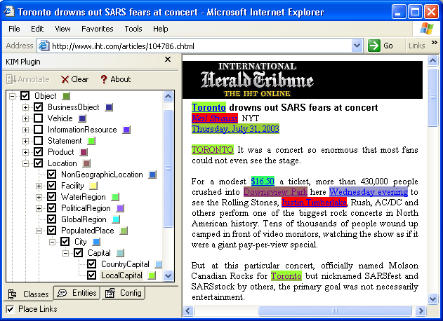
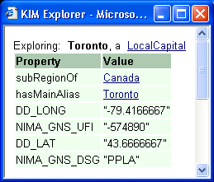
Application Example - KIM
Browsing by entity and ontology: http://www.ontotext.com/kim

Slide 13
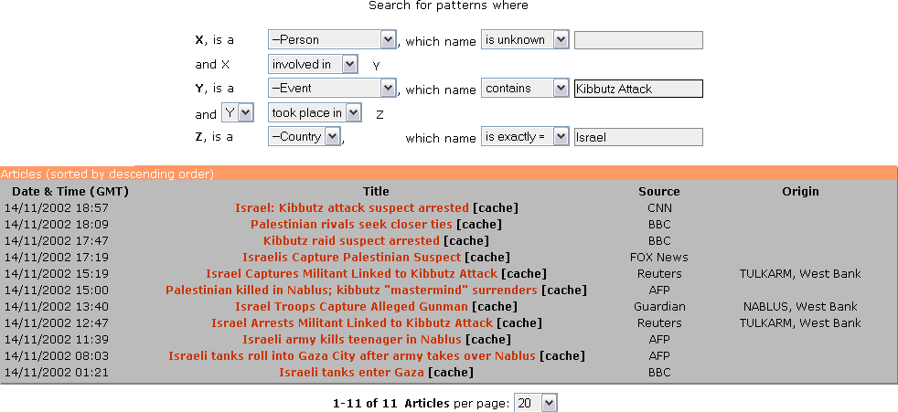
Application Example - KIM

Slide 14
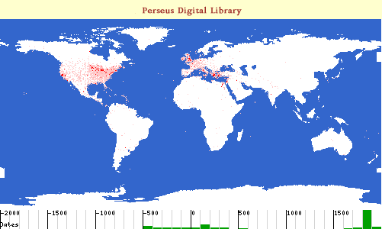
Application Example - Perseus
Time-line and geographic visualization: http://www.perseus.tufts.edu/

Slide 15
Annotation and Evaluation for NER

Slide 16
The Evaluation Metric
Standard metrics such as Precision, Recall, F-Measure
We may also want to take account of partially correct answers:
    Precision =
    Correct + ½ Partially correct
    Correct + Incorrect + Partial
    Recall =
    Correct + ½ Partially correct
    Correct + Missing + Partial
  Why: NE boundaries are often misplaced, so, some partially correct results!
Scoring program – implements the metric and provides performance measures
  For each document and over the entire corpus
  For each type of NE

Slide 17
Corpora and System Development
Corpora are divided typically into a training, validation and testing portion
Rules/Learning algorithms are trained on the training part
Tuned on the development/validation portion in order to optimise
  Rule priorities, rules effectiveness, etc.
  Parameters of the learning algorithm and the features used
Test/Evaluation set – the best system configuration is run on this data and the system performance is obtained
No further tuning once evaluation set is used!

Slide 18
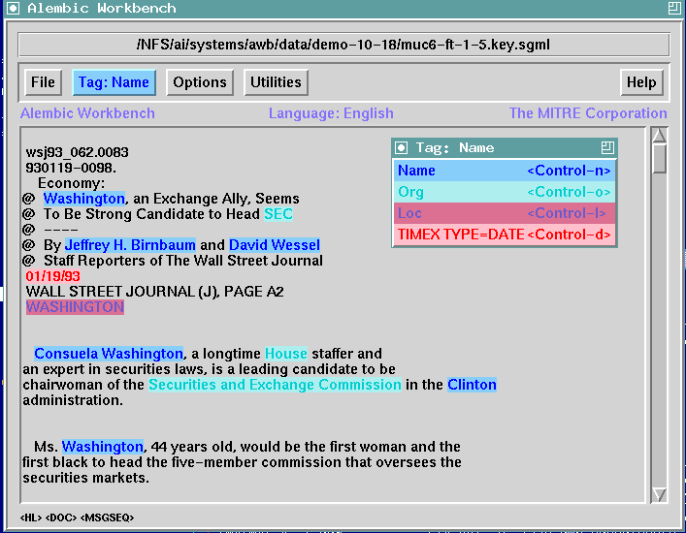
NE Annotation Tools - Alembic

Slide 19
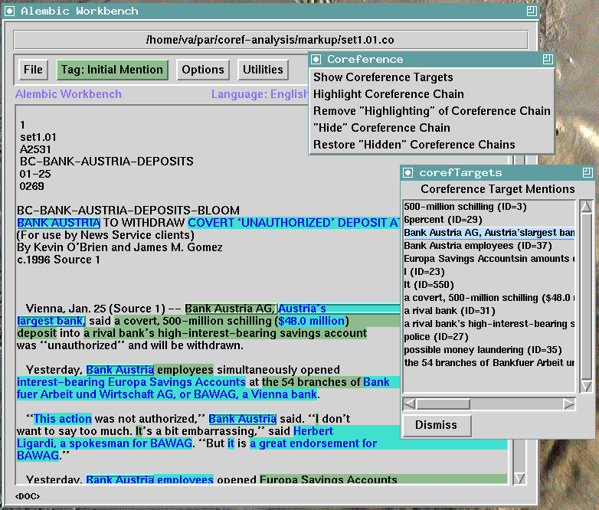
NE Annotation Tools – Alembic (2)

Slide 20
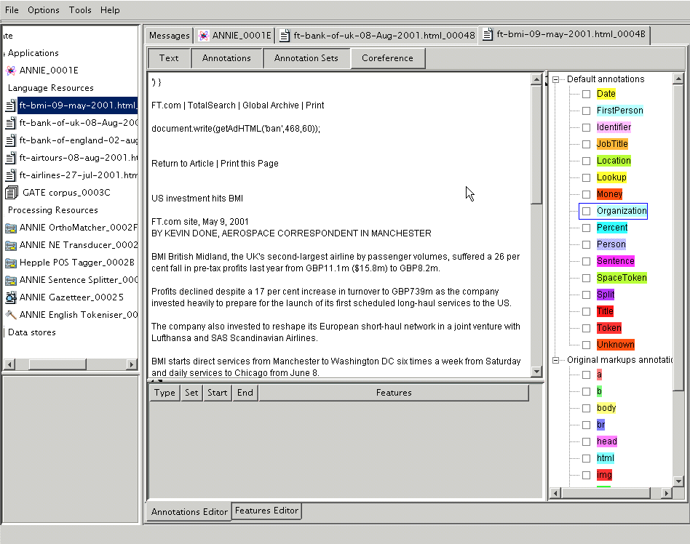
NE Annotation Tools - GATE

Slide 21
Some NE Annotated Corpora
MUC-6 and MUC-7 corpora – English (American newswire)
  7 entities: Person, Location, Organization, Time, Date, Percent, Money
CONLL shared task corpora (British newswire)
  http://cnts.uia.ac.be/conll2003/ner/ - NEs in English and German
  http://cnts.uia.ac.be/conll2002/ner/ - NEs in Spanish and Dutch
  4 entities: Person, Location, Organization, Misc
TIDES surprise language exercise (NEs in Cebuano and Hindi)
ACE – English - http://www.ldc.upenn.edu/Projects/ACE/
  7 entities: Location, Organization, Person, FAC (Facilities), GPE (Geographical/Social/Political), Vehicle, Weapon.
BBN (Penn Treebank)
  12 named entity types (Person, Facility, Organization, GPE, Location, Nationality, Product, Event, Work of Art, Law, Language, and Contact-Info), nine nominal entity types (Person, Facility, Organization, GPE, Product, Plant, Animal, Substance, Disease and Game), and seven numeric types (Date, Time, Percent, Money, Quantity, Ordinal and Cardinal).
  https://catalog.ldc.upenn.edu/LDC2005T33

Slide 22
Broad Approaches for NER

Slide 23
Pre-processing for NE Recognition
Format detection
Word segmentation (for languages like Chinese)
Tokenisation
Sentence splitting
POS tagging

Slide 24
Two kinds of NE Approaches
Rule based
Knowledge Engineering
developed by experienced language engineers
make use of human intuition
requires only small amount of training data
development could be very time consuming
some changes may be hard to accommodate
Statistics or machine-learning based
Learning Systems
developers do not need language engineering expertise
requires large amounts of annotated training data
some changes may require re-annotation of the entire training corpus
annotators are cheap

Slide 25
Rule based Approaches for NER
List lookup approach

Slide 26
List Lookup Approach
System that recognises only entities stored in its lists (gazetteers).
Advantages - Simple, fast, language independent, easy to retarget (just create lists)
Disadvantages – impossible to enumerate all names, collection and maintenance of lists, cannot deal with name variants, cannot resolve ambiguity

Slide 27
Creating Gazetteer Lists
Online phone directories and yellow pages for person and organisation names
Locations lists
  US GEOnet Names Server (GNS) data – 3.9 million locations with 5.37 million names
  UN site: http://unstats.un.org/unsd/citydata
  Global Discovery database from Europa technologies Ltd, UK
Automatic collection from annotated training data
Many data sources like Wikipedia, data.gov.in, linked open cloud data http://lod-cloud.net/

Slide 28
Rule based Approaches for NER
Shallow parsing approach

Slide 29
Shallow Parsing Approach (Internal Structure)
Internal evidence – names often have internal structure. These components can be either stored or guessed, e.g. location:
Cap. Word + {City, Forest, Center, River}
e.g. Sahara City, Tyda Forest
Cap. Word + {Street, Boulevard, Avenue, Crescent, Road}
e.g. Preder Ghast Road, Wall Street

Slide 30
Problems with the Shallow Parsing Approach
Ambiguously capitalized words (first word in sentence)
[All Union Bank] vs. All [State Police]
Semantic ambiguity
“John F. Kennedy” = airport (location)
“Philip Morris” = organization
Structural ambiguity
[Cable and Wireless] vs. [Microsoft] and [Dell];
[Center for Computational Linguistics] vs. message from [City Hospital] for [John Smith]

Slide 31
Rule based Approaches for NER
Shallow parsing approach with context

Slide 32
Shallow Parsing Approach with Context
Use of context-based patterns is helpful in ambiguous cases
“David Walton” and “Goldman Sachs” are indistinguishable
But with the phrase “David Walton of Goldman Sachs” and the Person entity “David Walton” recognised, we can use the pattern “[Person] of [Organization]” to identify “Goldman Sachs” correctly.

Slide 33
Examples of Context Patterns
[PERSON] earns [MONEY]
[PERSON] joined [ORGANIZATION]
[PERSON] left [ORGANIZATION]
[PERSON] joined [ORGANIZATION] as [JOBTITLE]
[ORGANIZATION]'s [JOBTITLE] [PERSON]
[ORGANIZATION] [JOBTITLE] [PERSON]
the [ORGANIZATION] [JOBTITLE]
part of the [ORGANIZATION]
[ORGANIZATION] headquarters in [LOCATION]
price of [ORGANIZATION]
sale of [ORGANIZATION]
investors in [ORGANIZATION]
[ORGANIZATION] is worth [MONEY]
[JOBTITLE] [PERSON]
[PERSON], [JOBTITLE]

Slide 34
Identification of Contextual Information
Find windows of context around entities
Search for repeated contextual patterns of either strings, other entities, or both
Manually post-edit list of patterns, and incorporate useful patterns into new rules
Repeat with new entities

Slide 35
Gazetteer Lists + Rule-based NE
Need to store the indicator strings for the internal structure and context rules
Internal location indicators – e.g., {river, mountain, forest} for natural locations; {street, road, crescent, place, square, …}for address locations
Internal organisation indicators – e.g., company designators {GmbH, Ltd, Inc, …}
Produces lookup results of the given kind

Slide 36
Learning based Approaches for NER

Slide 37
Learning Based Models
Machine learning approaches
  Generative Models – Hidden Markov Models (HMM)
  Conditional Models – Maximum Entropy Markov Models (MeMM), Conditional Random Fields (CRF)

Slide 38
Machine Learning Approaches
ML approaches break down the NE task in two parts:
  Recognising the entity boundaries
  Classifying the entities in the NE categories
Tokens in text are often coded with the IOB scheme
  O – outside, B-XXX – first word in NE, I-XXX – all other words in NE
  India B-LOC
  played O
  with O
  South B-LOC
  Africa I-LOC

Slide 39
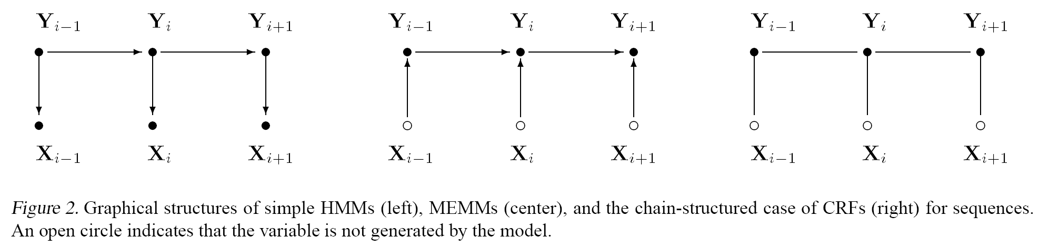
Graphical comparison: HMMs, MEMMs, CRFs
HMM MEMM CRF
 | Speed | Discrim vs. Generative | Normalization
HMM | very fast | generative | local
MEMM | mid-range | discriminative | local
CRF | kinda slow | discriminative | global

Slide 40
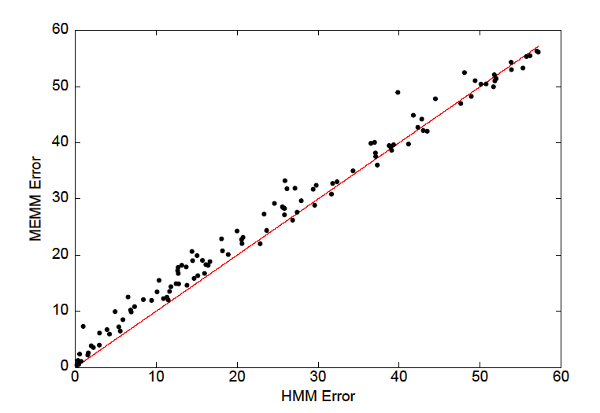
MEMM vs. HMM
The HMM outperforms the MEMM

Slide 41
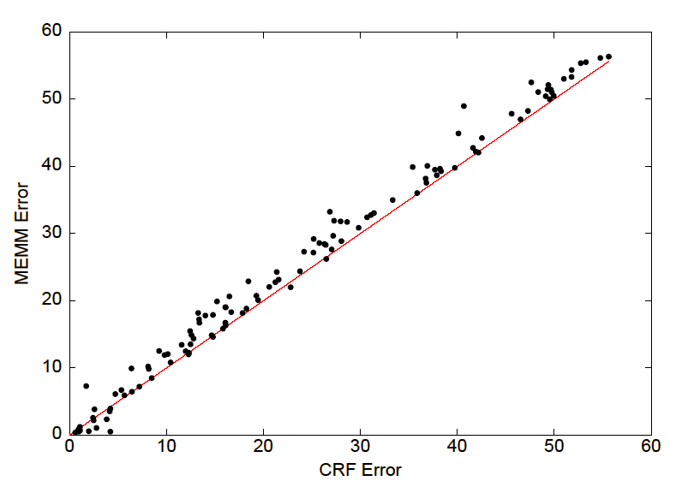
MEMM vs. CRF
CRF usually outperforms the MEMM

Slide 42
Take-aways
NER is related to identifying entities of certain types given a piece of text.
NER is useful for many applications.
NER systems are of two types:
  rule-based.
  machine learning based
    Generative: HMMs
    Discriminative/Conditional: MeMMs, CRFs

Slide 43
Further Reading
Aberdeen J., Day D., Hirschman L., Robinson P. and Vilain M. 1995. MITRE: Description of the Alembic System Used for MUC-6. MUC-6 proceedings. Pages141-155. Columbia, Maryland. 1995.
Black W.J., Rinaldi F., Mowatt D. Facile: Description of the NE System Used For MUC-7. Proceedings of 7th Message Understanding Conference, Fairfax, VA, 19 April - 1 May, 1998.
Borthwick. A. A Maximum Entropy Approach to Named Entity Recognition.
PhD Dissertation. 1999
Bikel D., Schwarta R., Weischedel. R. An algorithm that learns what’s in a name. Machine Learning 34, pp.211-231, 1999
Carreras X., Màrquez L., Padró. 2002. Named Entity Extraction using AdaBoost.
The 6th Conference on Natural Language Learning. 2002
Chang J.S., Chen S. D., Zheng Y., Liu X. Z., and Ke S. J. Large-corpus-based methods for Chinese personal name recognition. Journal of Chinese Information Processing, 6(3):7-15, 1992
Chen H.H., Ding Y.W., Tsai S.C. and Bian G.W. Description of the NTU System Used for MET2. Proceedings of 7th Message Understanding Conference, Fairfax, VA, 19 April - 1 May, 1998.
Chinchor. N. MUC-7 Named Entity Task Definition Version 3.5.
Available by from ftp.muc.saic.com/pub/MUC/MUC7-guidelines, 1997

Slide 44
Further reading (2)
Collins M., Singer Y. Unsupervised models for named entity classification
In Proceedings of the Joint SIGDAT Conference on Empirical Methods in Natural Language Processing and Very Large Corpora, 1999
Collins M. Ranking Algorithms for Named-Entity Extraction: Boosting and the Voted Perceptron. Proceedings of the 40th Annual Meeting of the ACL, Philadelphia, pp. 489-496, July 2002 Gotoh Y., Renals S. Information extraction from broadcast news, Philosophical Transactions of the Royal Society of London, series A: Mathematical, Physical and Engineering Sciences, 2000.
Grishman R. The NYU System for MUC-6 or Where's the Syntax? Proceedings of the MUC-6 workshop, Washington. November 1995.
[Ign03a] C. Ignat and B. Pouliquen and A. Ribeiro and R. Steinberger. Extending and Information Extraction Tool Set to Eastern-European Languages. Proceedings of Workshop on Information Extraction for Slavonic and other Central and Eastern European Languages (IESL'03). 2003.
Krupka G. R., Hausman K. IsoQuest Inc.: Description of the NetOwlTM Extractor System as Used for MUC-7. Proceedings of 7th Message Understanding Conference, Fairfax, VA, 19 April - 1 May, 1998.
McDonald D. Internal and External Evidence in the Identification and Semantic Categorization of Proper Names. In B.Boguraev and J. Pustejovsky editors: Corpus Processing for Lexical Acquisition. Pages21-39. MIT Press. Cambridge, MA. 1996
Mikheev A., Grover C. and Moens M. Description of the LTG System Used for MUC-7. Proceedings of 7th Message Understanding Conference, Fairfax, VA, 19 April - 1 May, 1998
Miller S., Crystal M., et al. BBN: Description of the SIFT System as Used for MUC-7. Proceedings of 7th Message Understanding Conference, Fairfax, VA, 19 April - 1 May, 1998

Slide 45
Further reading (3)
Palmer D., Day D.S. A Statistical Profile of the Named Entity Task. Proceedings of the Fifth Conference on Applied Natural Language Processing, Washington, D.C., March 31- April 3, 1997.
Sekine S., Grishman R. and Shinou H. A decision tree method for finding and classifying names in Japanese texts. Proceedings of the Sixth Workshop on Very Large Corpora, Montreal, Canada, 1998
Sun J., Gao J.F., Zhang L., Zhou M., Huang C.N. Chinese Named Entity Identification Using Class-based Language Model. In proceeding of the 19th International Conference on Computational Linguistics (COLING2002), pp.967-973, 2002.
Takeuchi K., Collier N. Use of Support Vector Machines in Extended Named Entity Recognition. The 6th Conference on Natural Language Learning. 2002
D.Maynard, K. Bontcheva and H. Cunningham. Towards a semantic extraction of named entities. Recent Advances in Natural Language Processing, Bulgaria, 2003.
M. M. Wood and S. J. Lydon and V. Tablan and D. Maynard and H. Cunningham. Using parallel texts to improve recall in IE. Recent Advances in Natural Language Processing, Bulgaria, 2003.
D.Maynard, V. Tablan and H. Cunningham. NE recognition without training data on a language you don't speak. ACL Workshop on Multilingual and Mixed-language Named Entity Recognition: Combining Statistical and Symbolic Models, Sapporo, Japan, 2003.

Slide 46
Further reading (4)
H. Saggion, H. Cunningham, K. Bontcheva, D. Maynard, O. Hamza, Y. Wilks. Multimedia Indexing through Multisource and Multilingual Information Extraction; the MUMIS project. Data and Knowledge Engineering, 2003.
D. Manov and A. Kiryakov and B. Popov and K. Bontcheva and D. Maynard, H. Cunningham. Experiments with geographic knowledge for information extraction. Workshop on Analysis of Geographic References, HLT/NAACL'03, Canada, 2003.
H. Cunningham, D. Maynard, K. Bontcheva, V. Tablan. GATE: A Framework and Graphical Development Environment for Robust NLP Tools and Applications. Proceedings of the 40th Anniversary Meeting of the Association for Computational Linguistics (ACL'02). Philadelphia, July 2002.
H. Cunningham. GATE, a General Architecture for Text Engineering. Computers and the Humanities, volume 36, pp. 223-254, 2002.
D. Maynard, H. Cunningham, K. Bontcheva, M. Dimitrov. Adapting A Robust Multi-Genre NE System for Automatic Content Extraction. Proc. of the 10th International Conference on Artificial Intelligence: Methodology, Systems, Applications (AIMSA 2002), 2002.
E. Paskaleva and G. Angelova and M.Yankova and K. Bontcheva and H. Cunningham and Y. Wilks. Slavonic Named Entities in GATE. 2003. CS-02-01.
K. Pastra, D. Maynard, H. Cunningham, O. Hamza, Y. Wilks. How feasible is the reuse of grammars for Named Entity Recognition? Language Resources and Evaluation Conference (LREC'2002), 2002.

