Slide 1
Text Classification and Sentiment Analysis
Dr. Manish Gupta
Adapted from http://infolab.stanford.edu/~ullman/mining/2009/PageRank.ppt

Slide 2
Agenda
Text Classification

Slide 3
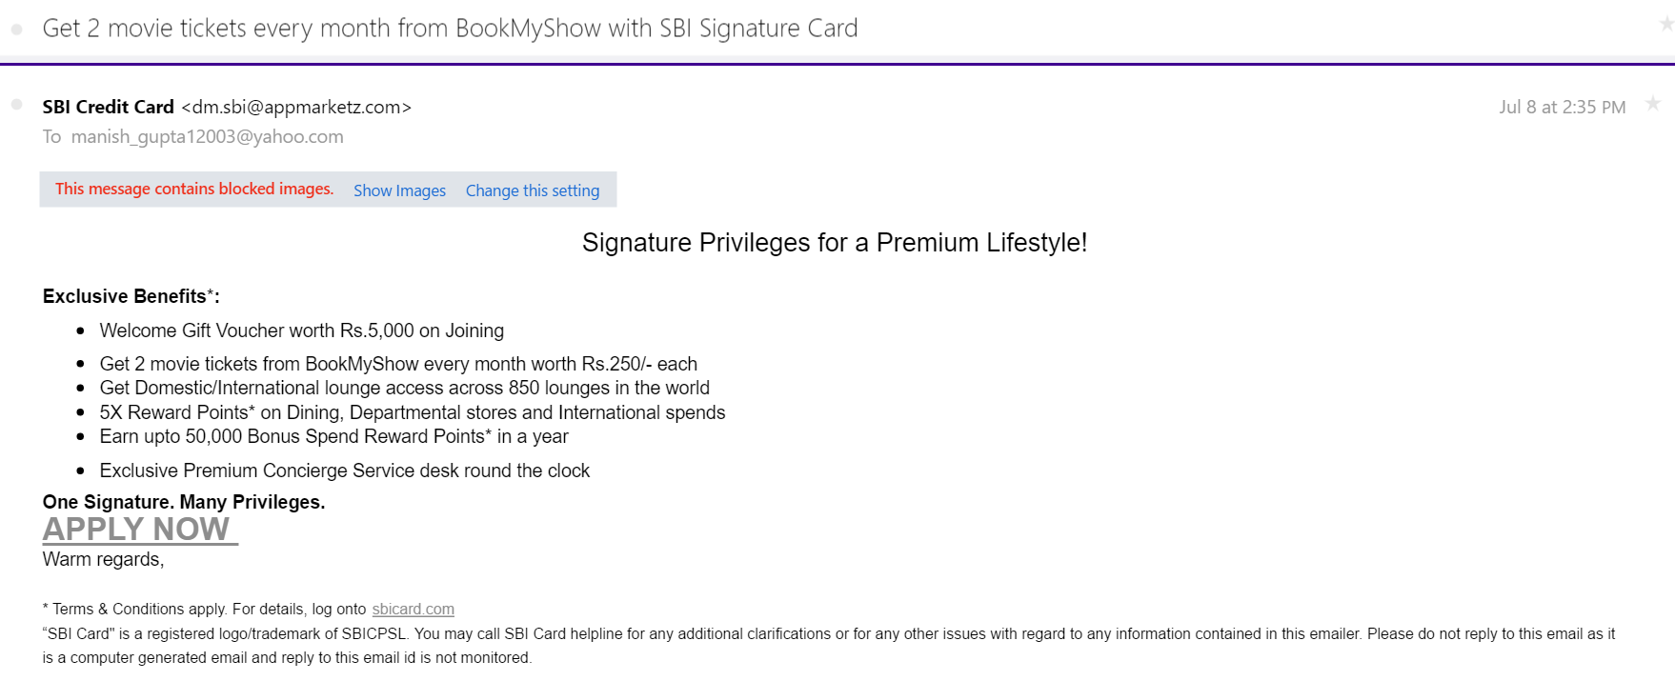
Is this spam?

Slide 4
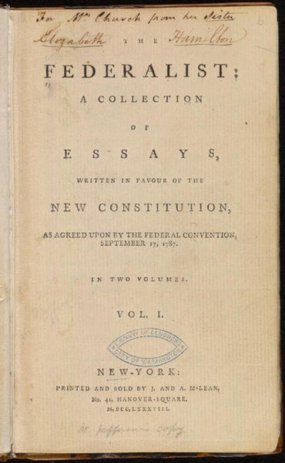
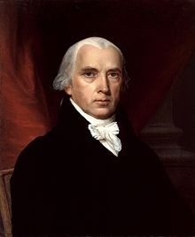
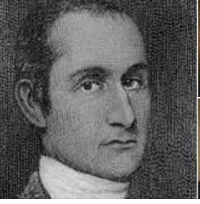
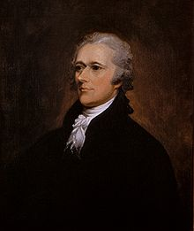
Who wrote which Federalist papers?
1787-1788: anonymous essays try to convince New York to ratify U.S Constitution: Jay, Madison, Hamilton.
Authorship of 12 of the letters in dispute
1963: solved by Mosteller and Wallace using Bayesian methods
James Madison
John Jay
Alexander Hamilton

Slide 5
Male or female author?
By 1925 present-day Vietnam was divided into three parts under French colonial rule. The southern region embracing Saigon and the Mekong delta was the colony of Cochin-China; the central area with its imperial capital at Hue was the protectorate of Annam…
Clara never failed to be astonished by the extraordinary felicity of her own name. She found it hard to trust herself to the mercy of fate, which had managed over the years to convert her greatest shame into one of her greatest assets…
S. Argamon, M. Koppel, J. Fine, A. R. Shimoni, 2003. “Gender, Genre, and Writing Style in Formal Written Texts,” Text, volume 23, number 3, pp. 321–346
Notes:
#1: Saigon. Grey, Anthony
#2: Jerusalem the Golden. Drabble, Margaret
From shlomo argamon

Slide 6


Positive or negative movie review?
unbelievably disappointing
Full of zany characters and richly applied satire, and some great plot twists
this is the greatest screwball comedy ever filmed
It was pathetic. The worst part about it was the boxing scenes.

Slide 7
What is the subject of this article?
MeSH Subject Category Hierarchy
MEDLINE Article
Antogonists and Inhibitors
Blood Supply
Chemistry
Drug Therapy
Embryology
Epidemiology
…
?

Slide 8
Text Classification
Assigning subject categories, topics, or genres
Spam detection
Authorship identification
Age/gender identification
Language Identification
Sentiment analysis
…

Slide 9
Text Classification: definition
Input:
  a document d
  a fixed set of classes C = {c₁, c₂,…, c_{J}}
Output: a predicted class c ∈ C

Slide 10
Classification Methods: Hand-coded rules
Rules based on combinations of words or other features
  spam: black-list-address OR (“dollars” AND “have been selected”)
Accuracy can be high
  If rules carefully refined by expert
But building and maintaining these rules is expensive

Slide 11
Classification Methods: Supervised ML
Input:
  a document d
  a fixed set of classes C = {c₁, c₂,…, c_{J}}
  A training set of m hand-labeled documents (d₁,c₁),....,(d_{m},c_{m})
Output:
  a learned classifier γ:d → c

Slide 12
Classification Methods: Supervised ML
Any kind of classifier
  Naïve Bayes
  Logistic regression
  Support-vector machines
  k-Nearest Neighbors
  …

Slide 13
Text Classification and Naïve Bayes
Naïve Bayes (I)

Slide 14
Naïve Bayes Intuition
Simple (“naïve”) classification method based on Bayes rule
Relies on very simple representation of document
  Bag of words

Slide 15
The bag of words representation
I love this movie! It's sweet, but with satirical humor. The dialogue is great and the adventure scenes are fun… It manages to be whimsical and romantic while laughing at the conventions of the fairy tale genre. I would recommend it to just about anyone. I've seen it several times, and I'm always happy to see it again whenever I have a friend who hasn't seen it yet.
γ(
)=c

Slide 16
The bag of words representation
I love this movie! It's sweet, but with satirical humor. The dialogue is great and the adventure scenes are fun… It manages to be whimsical and romantic while laughing at the conventions of the fairy tale genre. I would recommend it to just about anyone. I've seen it several times, and I'm always happy to see it again whenever I have a friend who hasn't seen it yet.
γ(
)=c

Slide 17
The bag of words representation: using a subset of words
x love xxxxxxxxxxxxxxxx sweet xxxxxxx satirical xxxxxxxxxx xxxxxxxxxxx great xxxxxxx xxxxxxxxxxxxxxxxxxx fun xxxx xxxxxxxxxxxxx whimsical xxxx romantic xxxx laughing xxxxxxxxxxxxxxxxxxxxxxxxxxxxxxxxxxxxxxxxxxxx recommend xxxxx xxxxxxxxxxxxxxxxxxxxxxxxxxxxxxxx several xxxxxxxxxxxxxxxxx xxxxx happy xxxxxxxxx again xxxxxxxxxxxxxxxxxxxxxxxxxxxxxxxxxxxxxxxxxxxxxxx
γ(
)=c

Slide 18
The bag of words representation
great | 2
love | 2
recommend | 1
laugh | 1
happy | 1
... | ...
γ(
)=c

Slide 19
Bag of words for document classification
?
Test
document
Machine Learning
NLP
Garbage
Collection
Planning
GUI
parser
language
label
translation
…
learning
training
algorithm
shrinkage
network...
parser
tag
training
translation
language...
garbage
collection
memory
optimization
region...
planning
temporal
reasoning
plan
language...
...

Slide 20
Text Classification and Naïve Bayes
Formalizing the Naïve Bayes Classifier

Slide 21
Bayes’ Rule Applied to Documents and Classes
For a document d and a class c

Slide 22
Naïve Bayes Classifier (I)
MAP is “maximum a posteriori” = most likely class
Bayes Rule
Dropping the denominator

Slide 23
Naïve Bayes Classifier (II)
Document d represented as features x1..xn

Slide 24
Naïve Bayes Classifier (IV)
  O(|X|^{n}•|C|) parameters
How often does this class occur?
  Could only be estimated if a very, very large number of training examples was available.
We can just count the relative frequencies in a corpus

Slide 25
Multinomial Naïve Bayes Independence Assumptions
Bag of Words assumption: Assume position doesn’t matter
Conditional Independence: Assume the feature probabilities P(x_{i}|c_{j}) are independent given the class c.

Slide 26
Multinomial Naïve Bayes Classifier

Slide 27
Applying Multinomial Naive Bayes Classifiers to Text Classification
positions ← all word positions in test document

Slide 28
Text Classification and Naïve Bayes
Naïve Bayes: Learning

Slide 29
Learning the Multinomial Naïve Bayes Model
Sec.13.3
First attempt: maximum likelihood estimates
  simply use the frequencies in the data

Slide 30
Parameter estimation
fraction of times word w_{i} appears
among all words in documents of topic c_{j}
Create mega-document for topic j by concatenating all docs in this topic
  Use frequency of w in mega-document

Slide 31
Problem with Maximum Likelihood
Sec.13.3
What if we have seen no training documents with the word fantastic and classified in the topic positive (thumbs-up)?
Zero probabilities are bad!

Slide 32
Laplace (add-1) smoothing for Naïve Bayes

Slide 33
Multinomial Naïve Bayes: Learning
From training corpus, extract Vocabulary
Calculate P(c_{j}) terms
  For each c_{j} in C do
    docs_{j} ← all docs with class =c_{j}
Calculate P(w_{k} | c_{j}) terms
  Text_{j} ← single doc containing all docs_{j}
  For each word w_{k} in Vocabulary
    n_{k} ← # of occurrences of w_{k} in Text_{j}

Slide 34
 | Doc | Words | Class
Training | 1 | Chinese Beijing Chinese | c
 | 2 | Chinese Chinese Shanghai | c
 | 3 | Chinese Macao | c
 | 4 | Tokyo Japan Chinese | j
Test | 5 | Chinese Chinese Chinese Tokyo Japan | ?
Priors:
P(c)=
P(j)=
3
4
1
4
Choosing a class:
P(c|d5)
P(j|d5)
Conditional Probabilities:
P(Chinese|c) =
P(Tokyo|c) =
P(Japan|c) =
P(Chinese|j) =
P(Tokyo|j) =
P(Japan|j) =
  3/4 * (3/7)³ * 1/14 * 1/14
  ≈ 0.0003
(5+1) / (8+6) = 6/14 = 3/7
(0+1) / (8+6) = 1/14
(0+1) / (8+6) = 1/14
(1+1) / (3+6) = 2/9
  1/4 * (2/9)³ * 2/9 * 2/9
  ≈ 0.0001
(1+1) / (3+6) = 2/9
(1+1) / (3+6) = 2/9

Slide 35
Summary: Naive Bayes is Not So Naive
Very Fast, low storage requirements
Robust to Irrelevant Features
  Irrelevant Features cancel each other without affecting results
Very good in domains with many equally important features
  Decision Trees suffer from fragmentation in such cases – especially if little data
Optimal if the independence assumptions hold: If assumed independence is correct, then it is the Bayes Optimal Classifier for problem
A good dependable baseline for text classification

Slide 36
Agenda
Applications of Sentiment Analysis

Slide 37
Why Sentiment Analysis
Also called as Opinion extraction, Opinion mining, Sentiment mining, Subjectivity analysis
Applications
  Movie: is this review positive or negative?
  Products: what do people think about the new iPhone?
  Politics: what do people think about this candidate or issue?
  Prediction: predict election outcomes or market trends from sentiment

Slide 38


Positive or Negative Movie Review?
unbelievably disappointing
Full of zany characters and richly applied satire, and some great plot twists
this is the greatest screwball comedy ever filmed
It was pathetic. The worst part about it was the boxing scenes.

Slide 39
Product Search

Slide 40
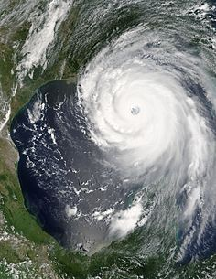
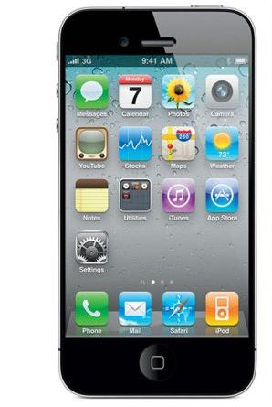
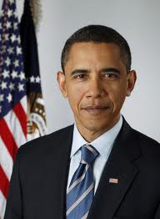
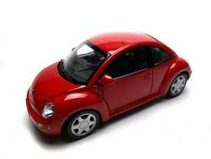






Online opinions cover all kinds of topics
Topics:
People
Events
Products
Services, …
…
Sources:
Blogs
Microblogs
Forums
Reviews ,…
45M reviews
53M blogs
1307M posts
65M msgs/day
115M users
10M groups
…

Slide 41
Opinion Question Answering
    Q: What is the international reaction to the reelection of Robert Mugabe as President of Zimbabwe?
    A: African observers generally approved of his victory while Western Governments denounced it.
Notes:
For opinion-questions a range of opinions needs to be offered. There is no single right answer.
As in the answer to this example, it is → not uncommon to find two or more sentiments expressed within a sentence.

Slide 42
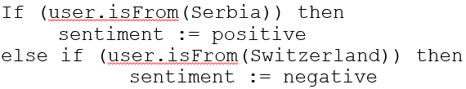

Sentiment Analysis
Simplest task:
  Is the attitude of this text positive or negative?
More complex:
  Rank the attitude of this text from 1 to 5
Advanced:
  Detect the target, source, or complex attitude types (moods, comparison)
This is a good book.
Opinion Holder
Opinion
Object

Slide 43
Agenda
Applications of Sentiment Analysis
Word-based Classification Approach

Slide 44
IMDB data in the Pang and Lee database (2002)
✓
✗
when _star wars_ came out some twenty years ago , the image of traveling throughout the stars has become a commonplace image . […]
when han solo goes light speed , the stars change to bright lines , going towards the viewer in lines that converge at an invisible point .
cool .
_october sky_ offers a much simpler image–that of a single white dot , traveling horizontally across the night sky . [. . . ]
“ snake eyes ” is the most aggravating kind of movie : the kind that shows so much potential then becomes unbelievably disappointing .
it’s not just because this is a brian depalma film , and since he’s a great director and one who’s films are always greeted with at least some fanfare .
and it’s not even because this was a film starring nicolas cage and since he gives a brauvara performance , this film is hardly worth his talents .

Slide 45
Word-based Classification Approach
Tokenization of words in review
Feature Extraction
Classification using different classifiers
  Naïve Bayes – will use this one today
  MaxEnt
  SVM
  MaxEnt and SVM tend to do better than Naïve Bayes

Slide 46
Sentiment Tokenization Issues
Deal with HTML and XML markup
Twitter mark-up (user names, hash tags)
Slang: Lol, rofl, omg! ….., Gr8, IMHO, …
Capitalization (preserve words in all caps)
Phone numbers, dates
Emoticons
Useful code:
  Christopher Potts sentiment tokenizer
  Brendan O’Connor twitter tokenizer

Slide 47
Extracting Features for Sentiment Classification
How to handle negation
  “I didn’t like this movie” vs “I really like this movie”
  Add NOT_ to every word between negation and following punctuation:
    didn’t like this movie , but I
    didn’t NOT_like NOT_this NOT_movie but I
Which words to use?
  Only adjectives
  All words
    All words turns out to work better, at least on this data

Slide 48
Naïve Bayes
In Naïve Bayes, prob of assigning a document to class c is computed as follows:
$$P\left(w_{i} | c_{j}\right)=\frac{count\left(w_{i},c_{j}\right)+1}{count\left(c\right)+|V|}$$

Slide 49
Binarized (Boolean feature) Multinomial Naïve Bayes
Intuition:
  For sentiment
  Word occurrence may matter more than word frequency
    The occurrence of the word fantastic tells us a lot
    The fact that it occurs 5 times may not tell us much more.
  Boolean Multinomial Naïve Bayes
    Clips all the word counts in each document at 1

Slide 50
Boolean Multinomial Naïve Bayes: Learning
From training corpus, extract Vocabulary
Calculate P(c_{j}) terms
  For each c_{j} in C do
    docs_{j} ← all docs with class =c_{j}
Calculate P(w_{k} | c_{j}) terms
  Text_{j} ← single doc containing all docs_{j}
  For each word w_{k} in Vocabulary
    n_{k} ← # of occurrences of w_{k} in Text_{j}
  Remove duplicates in each doc:
    For each word type w in doc_{j}
      Retain only a single instance of w

Slide 51
Boolean Multinomial Naïve Bayes on test doc d
First remove all duplicate words from d
Then compute NB using the same equation:

Slide 52
Normal vs. Boolean Multinomial NB
Normal | Doc | Words | Class
Training | 1 | Chinese Beijing Chinese | c
 | 2 | Chinese Chinese Shanghai | c
 | 3 | Chinese Macao | c
 | 4 | Tokyo Japan Chinese | j
Test | 5 | Chinese Chinese Chinese Tokyo Japan | ?
Boolean | Doc | Words | Class
Training | 1 | Chinese Beijing | c
 | 2 | Chinese Shanghai | c
 | 3 | Chinese Macao | c
 | 4 | Tokyo Japan Chinese | j
Test | 5 | Chinese Tokyo Japan | ?
Binary seems to work better than full word counts

Slide 53
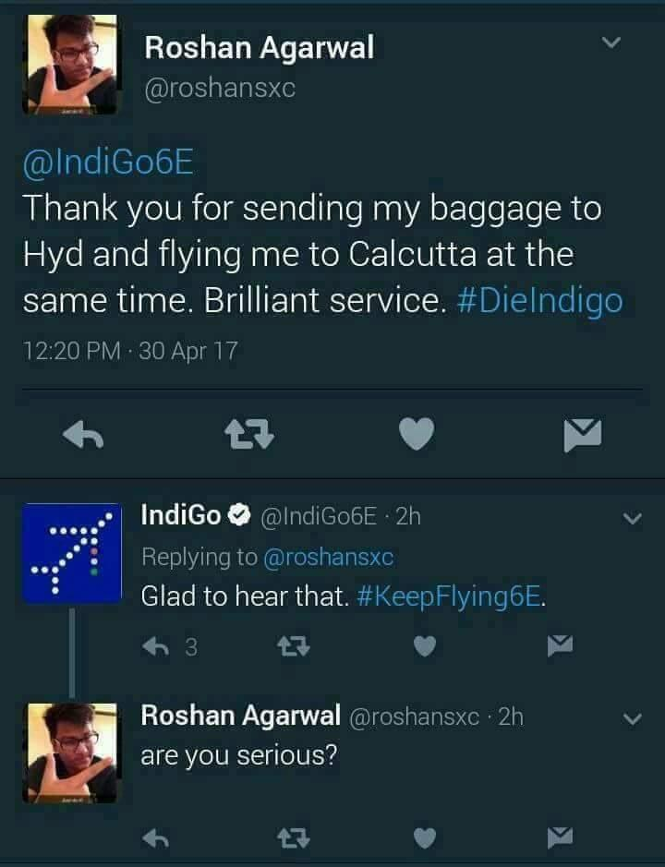
Problems: What makes reviews hard to classify?
Perfume review in Perfumes: the Guide: “If you are reading this because it is your darling fragrance, please wear it at home exclusively, and tape the windows shut.”
  Negative review but very difficult to figure out using just positive or negative words.

Slide 54
Problems: What makes reviews hard to classify?
“This film should be brilliant. It sounds like a great plot, the actors are first grade, and the supporting cast is good as well, and Stallone is attempting to deliver a good performance. However, it can’t hold up.”
  Seems like a positive review but it is not.
Well as usual Keanu Reeves is nothing special, but surprisingly, the very talented Laurence Fishbourne is not so good either, I was surprised.
  Ordering effect
  Multiple sentiments within same sentence.
(Almost) No resources and tools for low/scarce resource languages like Indian languages.

Slide 55
Sample Review 1
(This, that and this)
‘Touch screen’ today signifies
a positive feature.
Will it be the same in the future?
Comparing old products
The confused conclusion
From: www.mouthshut.com
FLY E300 is a good mobile which i purchased recently with lots of hesitation. Since this Brand is not familiar in Market as well known as Sony Ericsson. But i found that E300 was cheap with almost all the features for a good mobile. Any other brand with the same set of features would come around 19k Indian Ruppees.. But this one is only 9k.
Touch Screen, good resolution, good talk time, 3.2Mega Pixel camera, A2DP, IRDA and so on...
BUT BEWARE THAT THE CAMERA IS NOT THAT GOOD, THOUGH IT FEATURES 3.2 MEGA PIXEL, ITS NOT AS GOOD AS MY PREVIOUS MOBILE SONY ERICSSION K750i which is just 2Mega Pixel.
Sony ericsson was excellent with the feature of camera. So if anyone is thinking for Camera, please excuse. This model of FLY is not apt for you.. Am fooled in this regard..
Audio is not bad, infact better than Sony Ericsson K750i.
FLY is not user friendly probably since we have just started to use this Brand.

Slide 56
Sample Review 2 (Noise)
Lack of punctuation marks,
Grammatical errors
From: www.mouthshut.com
Hi,
I have Haier phone.. It was good when i was buing this phone.. But I invented A lot of bad features by this phone those are It’s cost is low but Software is not good and Battery is very bad..,,Ther are no signals at out side of the city..,, People can’t understand this type of software..,, There aren’t features in this phone, Design is better not good..,, Sound also bad..So I’m not intrest this side.They are giving heare phones it is good. They are giving more talktime and validity these are also good.They are giving colour screen at display time it is also good because other phones aren’t this type of feature.It is also low wait.

Slide 57
Sample Review 3 (Alternating sentiments)
From: www.mouthshut.com
I suggest that instead of fillings songs in tunes you should fill tunes (not made of songs) only. The phone has good popularity in old age people. Third i had tried much for its data cable but i find it nowhere. It should be supplied with set with some extra cost.
Good features of this phone are its cheapest price and durability . It should have some features more than nokia 1200. it is easily available in market and repair is also available

Slide 58
Sample Review 4
(Subject-centric or not?)
From: www.mouthshut.com
I have this personal experience of using this cell phone. I bought it one and half years back. It had modern features that a normal cell phone has, and the look is excellent. I was very impressed by the design. I bought it for Rs. 8000. It was a gift for someone. It worked fine for first one month, and then started the series of multiple faults it has. First the speaker didnt work, I took it to the service centre (which is like a govt. office with no work). It took 15 days to repair the handset, moreover they charged me Rs. 500. Then after 15 days again the mike didnt work, then again same set of time was consumed for the repairs and it continued. Later the camera didnt work, the speakes were rubbish, it used to hang. It started restarting automatically. And the govt. office had staff which I doubt have any knoledge of cell phones??
These multiple faults continued for as long as one year, when the warranty period ended. In this period of time I spent a considerable amount on the petrol, a lot of time (as the service centre is a govt. office). And at last the phone is still working, but now it works as a paper weight. The company who produces such items must be sacked. I understand that it might be fault with one prticular handset, but the company itself never bothered for replacement and I have never seen such miserable cust service. For a comman man like me, Rs. 8000 is a big amount. And I spent almost the same amount to get it work, if any has a good suggestion and can gude me how to sue such companies, please guide.
For this the quality team is faulty, the cust service is really miserable and the worst condition of any organisation I have ever seen is with the service centre for Fly and Sony Erricson, (it’s near Sancheti hospital, Pune). I dont have any thing else to say.

Slide 59
Agenda
Applications of Sentiment Analysis
Word-based Classification Approach
Sentiment Lexicons and Negation Words

Slide 60
Sentiment Lexicons
Positive words: abide, ability, able, abound, absolve, absorbent, …
Negative words: abandon, abandonment, abate, abdicate, abhor, abject, …
Available lexicons
  General Inquirer: 1915 positive words and 2291 negative words
  LIWC (Linguistic Inquiry and Word Count): 2300 words, >70 classes
  MPQA Subjectivity Cues Lexicon: 2718 positive words and 4912 negative words. Each word annotated for intensity (strong, weak)
  Bing Liu Opinion Lexicon: 2006 positive words and 4783 negative words
  SentiWordNet: All WordNet synsets automatically annotated for degrees of positivity, negativity, and neutrality/objectiveness, 1.7M words
    [estimable(J,3)] “may be computed or estimated”: Pos=0, Neg=0, Obj=1
    [estimable(J,1)] “deserving of respect or high regard”: Pos=0.75, Neg=0, Obj=0.25

Slide 61
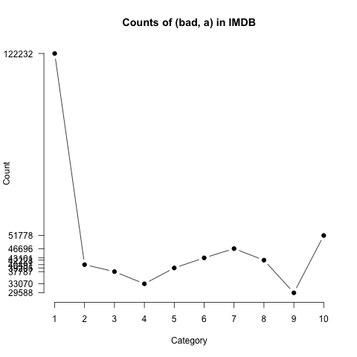
Analyzing the Polarity of each Word in IMDB
How likely is each word to appear in each sentiment class?
Count(“bad”) in 1-star, 2-star, 3-star, etc.
But can’t use raw counts: count(10)>count(2) because there are many 10 star reviews and very few 2 star ones
Instead, likelihood:
Make them comparable between words
  Scaled likelihood:
Potts, Christopher. 2011. On the negativity of negation. SALT 20, 636-659.
Notes:
Thanks to Chris Potts for permission to use figure

Slide 62
Analyzing the Polarity of each Word in IMDB
Potts, Christopher. 2011. On the negativity of negation, 636-659.
Scaled likelihood
P(w|c)/P(w)
Scaled likelihood
P(w|c)/P(w)
Notes:
Thanks to Chris Potts for permission to use figures

Slide 63
Other Sentiment Feature: Logical Negation
Is logical negation (no, not, never) associated with negative sentiment?
  Count negation (not, n’t, no, never) in online reviews
  Regress against the review rating
More negation in negative sentiment
Scaled likelihood
P(w|c)/P(w)

Slide 64
Agenda
Applications of Sentiment Analysis
Word-based Classification Approach
Sentiment Lexicons and Negation Words
Learning Sentiment Lexicons

Slide 65
Semi-supervised Learning of Lexicons
Use a small amount of information
  A few labeled examples
  A few hand-built patterns
To bootstrap a lexicon using this small amount of information
  Just increase lexicon size
  Adapt lexicon to another domain

Slide 66
Using “and” and “but”
Adjectives conjoined by “and” have same polarity
  Fair and legitimate, corrupt and brutal – high frequency
  *fair and brutal, *corrupt and legitimate – low frequency
Adjectives conjoined by “but” do not
  fair but brutal – high frequency
Step 1: Label seed set of 1336 adjectives (all >20 in 21 million word WSJ corpus): 657 positive and 679 negative

Slide 67
Using “and” and “but”: Step 2
Expand seed set to conjoined adjectives
nice, helpful
nice, classy

Slide 68
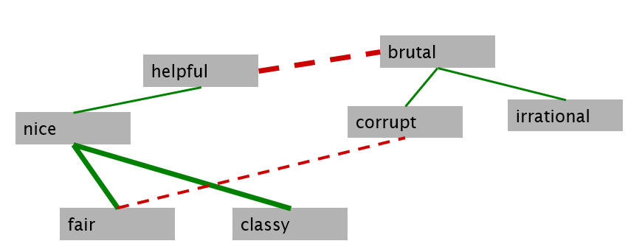
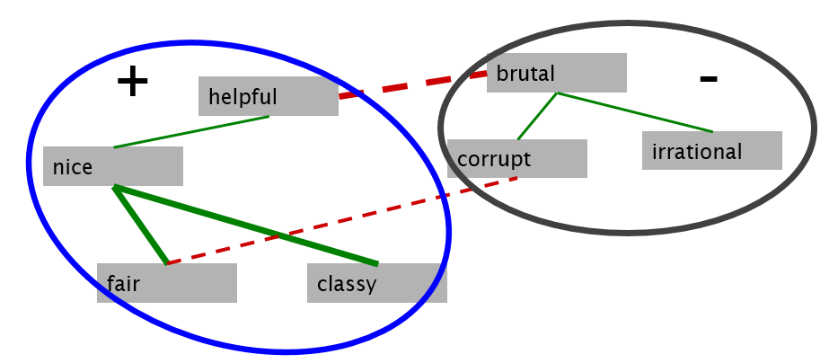
Using “and” and “but”
Step 3: Supervised classifier assigns “polarity similarity” to each word pair, resulting in graph:
  Features are count(and), count(but), …
Step 4: Clustering for partitioning the graph into two

Slide 69
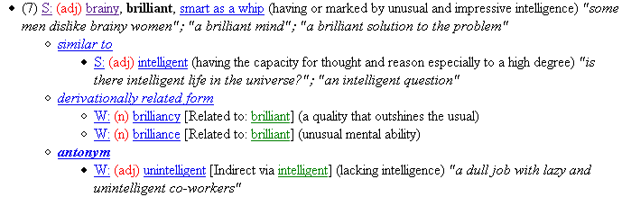
WordNet
Notes:
We can consult a dictionary. WordNet is the standard lexical resource used in NLP. So what can we find here?

Slide 70
WordNet

Slide 71
WordNet relations
Notes:
Similar words.

Slide 72
WordNet relations
Notes:
Antonyms (opposites)

Slide 73
Using WordNet to Learn Polarity
WordNet: online thesaurus.
Create positive (“good”) and negative seed-words (“terrible”)
Find Synonyms and Antonyms
  Positive Set: Add synonyms of positive words (“well”) and antonyms of negative words
  Negative Set: Add synonyms of negative words (“awful”) and antonyms of positive words (“evil”)
Repeat, following chains of synonyms
Filter out bad examples or wrong word senses.

Slide 74




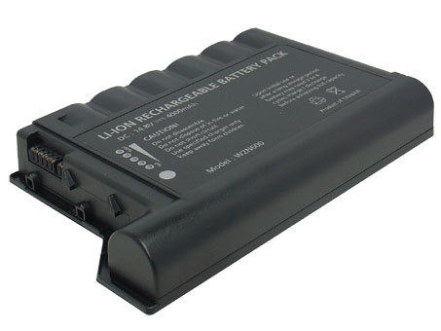


Sentiments are domain dependent and aspect dependent
Domain = Movie
Aspect = Screen
“large”
“unpredictable”
Aspect = Battery
Domain = Laptop
Domain = Laptop

Slide 75
A new and harder problem:
constructing aspect-dependent sentiment lexicon
Input:
“Aspect-Adj” candidates
Laptop domain
Screen-large ?
Screen-great ?
Battery-large ?
… …
+
Output:
“Aspect-Adj”: sentiment_score
Screen-large +1
Screen-great +1
Battery-large -1
… …
A harder problem:
due to increased sparseness

Slide 76
Turney Algorithm
Extract a phrasal lexicon from reviews
Learn polarity of each phrase
Rate a review by the average polarity of its phrases
First Word | Second Word | Third Word (not extracted)
JJ | NN or NNS | anything
RB, RBR, RBS | JJ | Not NN nor NNS
JJ | JJ | Not NN or NNS
NN or NNS | JJ | Nor NN nor NNS
RB, RBR, or RBS | VB, VBD, VBN, VBG | anything
JJ=adjective, NN=noun, NNS=plural noun, RB=adverb, VB=verb

Slide 77
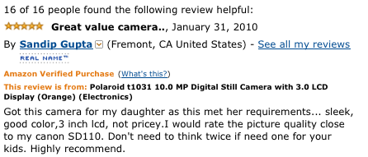








Extracting Phrases using Dependency Parse
intuitive
flash
controls
battery
...
large
controls
Review sentence dependency parses
Extracted features
natural
“The controls are intuitive.”
“There are large controls on the top.”
nsubj
nsubj
amod
“The controls feel natural.”
advmod

Slide 78
How to Measure Polarity of a Phrase?
Positive phrases co-occur (on the web) more with “excellent”
Negative phrases co-occur (on the web) more with “poor”
But how to measure co-occurrence?
  PMI between two words measures how much more do two words co-occur than if they were independent.
    $PMI\left(w_{1},w_{2}\right)=\log_{2}{\frac{P(w_{1}w_{2})}{P\left(w_{1}\right)P(w_{2})}}$
    Estimate P(w) by issuing “w” as a query to search engine and looking at #results
    Estimate P($w_{1}w_{2}$) by issuing “$w_{1} w_{2}$” as a query to search engine and looking at #results
Polarity of phrase = PMI(phrase, “excellent”) $−$ PMI(phrase, “poor”)

Slide 79




Classifying Opinions
Synonymous words have high Web-PMI with each other
great +
poor -
excellent +
terrible -
...
intuitive
camera
unknown adjective
context
Web-PMI
known-polarity adjectives
HITS(“camera” near adj, great)
HITS(“camera” NEAR adj) x HITS(“camera” NEAR great)
WebPMI(adj, great) =
+/-
(:)
training
words
classifier
+/-
F1 Scores: 0.78(+) 0.76(-)
WebPMI feature vector

Slide 80
Phrases from a Thumbs-Up Review
Phrases from a
Thumbs-Down Review
Phrase | POS tags | Polarity
online service | JJ NN | 2.8
online experience | JJ NN | 2.3
direct deposit | JJ NN | 1.3
local branch | JJ NN | 0.42
…
low fees | JJ NNS | 0.33
other bank | JJ NN | -0.85
inconveniently located | JJ NN | -1.5
Average |  | 0.32
Phrase | POS tags | Polarity
direct deposits | JJ NNS | 5.8
online web | JJ NN | 1.9
very handy | RB JJ | 1.4
…
virtual monopoly | JJ NN | -2.0
other problems | JJ NNS | -2.8
low funds | JJ NNS | -6.8
unethical practices | JJ NNS | -8.5
Average |  | -1.2

Slide 81
Results of Turney Algorithm
410 reviews from Epinions (http://www.epinions.com/ review website)
  170 (41%) negative
  240 (59%) positive
Majority class baseline: 59%
Turney algorithm: 74%
Phrases rather than words
Semi-supervised algorithms like Turney’s help us learn domain-specific information

Slide 82
Summary on Learning Lexicons
Advantages
  Can be domain-specific
  Can be more robust (more words)
Intuition
  Start with a seed set of words (‘good’, ‘poor’)
  Find other words that have similar polarity:
    Using “and” and “but”
    Using words that occur nearby in the same document (“poor” or “excellent”)
    Using WordNet synonyms and antonyms

Slide 83
Take-aways
Sentiment analysis is very useful for many web portals.
Word-based classification works reasonably well.
There are standard sentiment lexicons for word-based sentiment classification algorithms
Using semi-supervised learning one can grow a small sentiment lexicon into larger ones.
Sentiment analysis demo: http://nlp.stanford.edu:8080/sentiment/rntnDemo.html

Slide 84
Further Reading
Book on Sentiment Analysis and Opinion Mining
  https://www.cs.uic.edu/~liub/FBS/SentimentAnalysis-and-OpinionMining.pdf
Philip J. Stone, Dexter C Dunphy, Marshall S. Smith, Daniel M. Ogilvie. 1966. The General Inquirer: A Computer Approach to Content Analysis. MIT Press
Pennebaker, J.W., Booth, R.J., & Francis, M.E. (2007). Linguistic Inquiry and Word Count: LIWC 2007. Austin, TX
Theresa Wilson, Janyce Wiebe, and Paul Hoffmann (2005). Recognizing Contextual Polarity in
Phrase-Level Sentiment Analysis. Proc. of HLT-EMNLP-2005.
Riloff and Wiebe (2003). Learning extraction patterns for subjective expressions. EMNLP-2003.

Slide 85
Further Reading
Minqing Hu and Bing Liu. Mining and Summarizing Customer Reviews. ACM SIGKDD-2004.
Stefano Baccianella, Andrea Esuli, and Fabrizio Sebastiani. 2010 SENTIWORDNET 3.0: An Enhanced Lexical Resource for Sentiment Analysis and Opinion Mining. LREC-2010
Potts, Christopher. 2011. On the negativity of negation. SALT 20, 636-659.
Vasileios Hatzivassiloglou and Kathleen R. McKeown. 1997. Predicting the Semantic Orientation of Adjectives. ACL, 174–181
Turney (2002): Thumbs Up or Thumbs Down? Semantic Orientation Applied to Unsupervised Classification of Reviews
S.M. Kim and E. Hovy. 2004. Determining the sentiment of opinions. COLING 2004
M. Hu and B. Liu. Mining and summarizing customer reviews. In Proceedings of KDD, 2004

