Slide 1
Automatic Text Summarization
Manish Gupta
Credits: Automated Text summarization Tutorial — COLING/ACL’98. Eduard Hovy and Daniel Marcu.
https://en.wikipedia.org/wiki/Automatic_summarization

Slide 2
What is Summarization? What are its applications?

Slide 3
What is summarization?
...put a book on the scanner, turn the dial to ‘2 pages’, and read the result...
...download 1000 documents from the web, send them to the summarizer, and select the best ones by reading the summaries of the clusters...
Summarization System:
An information access technology that given a document or sets of related documents, extracts the most important content from the source(s) taking into account the user or task at hand, and presents this content in a well formed and concise text

Slide 4
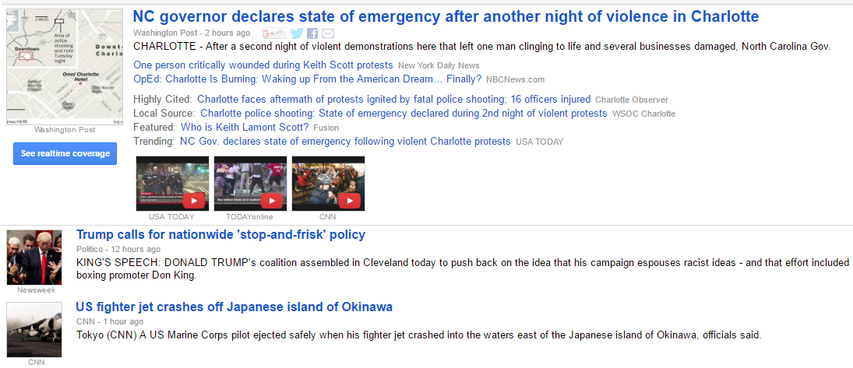
Headline news — informing

Slide 5
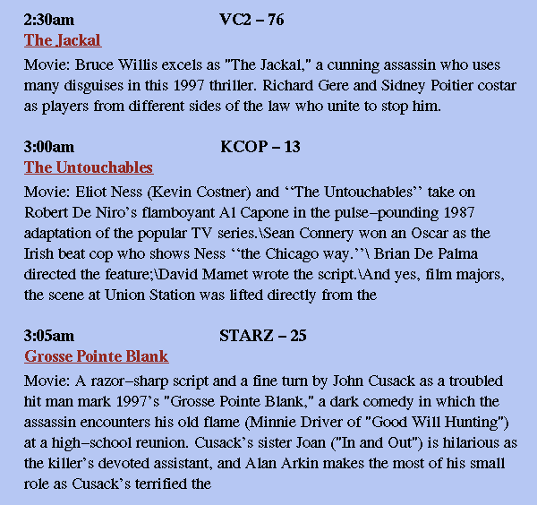
TV-GUIDES — decision making

Slide 6
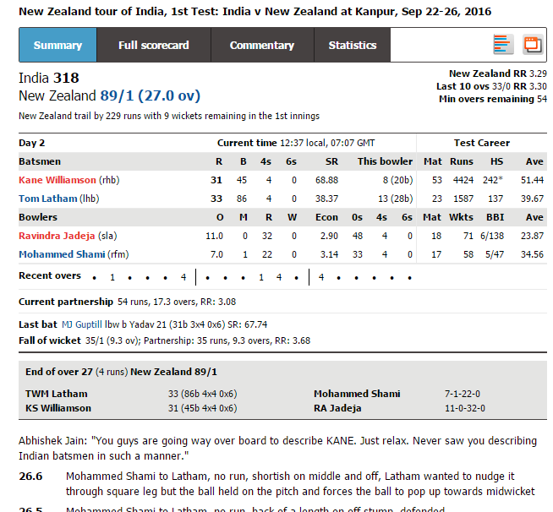
Examples of summaries – sports results

Slide 7
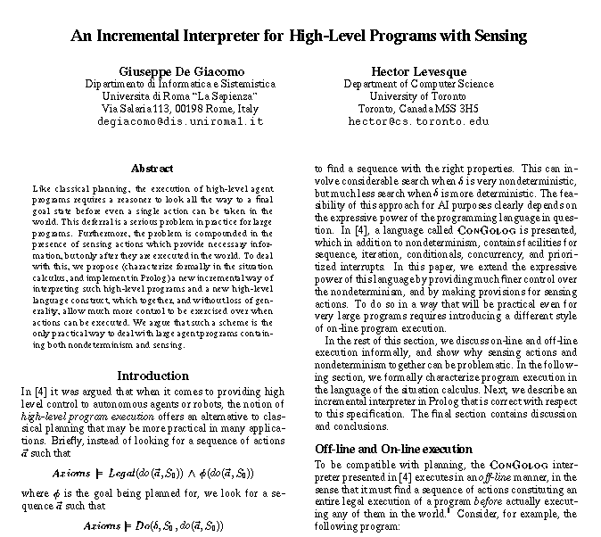
Abstracts of papers — time saving

Slide 8
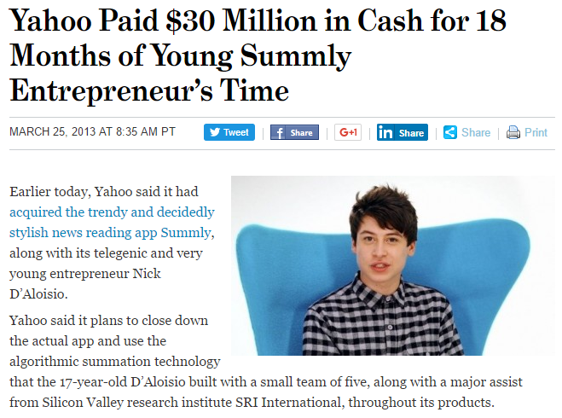
Summly News summarization

Slide 9
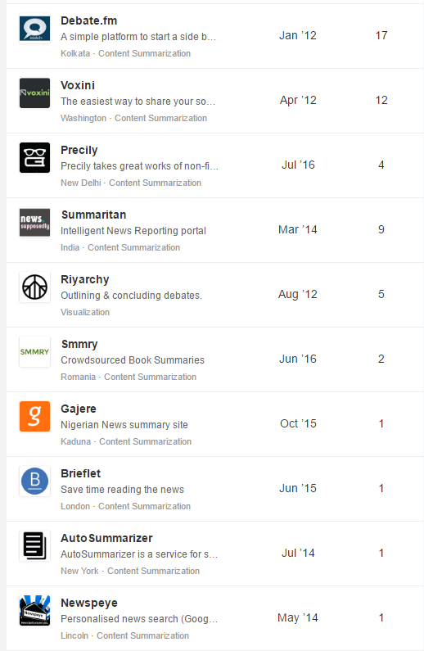
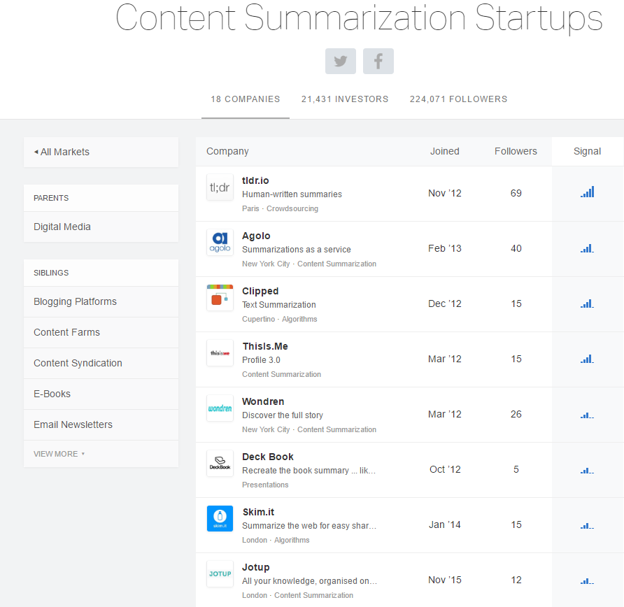
Summarization Startups https://angel.co/content-summarization

Slide 11
Genres and Types of Summaries

Slide 12
‘Genres’ of Summary?
extract vs abstract
  fragments from the document
  newly re-written text
generic vs query-based vs user-focused
  all major topics equal coverage
  based on a question “what are the causes of the war?”
  users interested in chemistry
for novice vs for expert
  background
  Just the new information
single-document vs multi-document
  research paper
  proceedings of a conference
in textual form vs items vs tabular vs structured
  paragraph
  list of main points
  numeric information in a table
in the language of the document vs in other language
  monolingual
  cross-lingual

Slide 13
Examples of Genres
Exercise: summarize the following texts for the following readers:
text1: Coup Attempt
text2: childrens’ story
reader1: your friend, who knows nothing about South Africa.
reader2: someone who lives in South Africa and knows the political position.
reader3: your 4-year-old niece.
reader4: the Library of Congress.

Slide 14
90 Soldiers Arrested After Coup Attempt In Tribal Homeland
MMABATHO, South Africa (AP)
About 90 soldiers have been arrested and face possible death sentences stemming from a coup attempt in Bophuthatswana, leaders of the tribal homeland said Friday.
Rebel soldiers staged the takeover bid Wednesday, detaining homeland President Lucas Mangope and several top Cabinet officials for 15 hours before South African soldiers and police rushed to the homeland, rescuing the leaders and restoring them to power.
At least three soldiers and two civilians died in the uprising.
Bophuthatswana's Minister of Justice G. Godfrey Mothibe told a news conference that those arrested have been charged with high treason and if convicted could be sentenced to death. He said the accused were to appear in court Monday.
All those arrested in the coup attempt have been described as young troops, the most senior being a warrant officer.
During the coup rebel soldiers installed as head of state Rocky Malebane-Metsing, leader of the opposition Progressive Peoples Party.
Malebane-Metsing escaped capture and his whereabouts remained unknown, officials said. Several unsubstantiated reports said he fled to nearby Botswana.
Warrant Officer M.T.F. Phiri, described by Mangope as one of the coup leaders, was arrested Friday in Mmabatho, capital of the nominally independent homeland, officials said.
Bophuthatswana, which has a population of 1.7 million spread over seven separate land blocks, is one of 10 tribal homelands in South Africa. About half of South Africa's 26 million blacks live in the homelands, none of which are recognized internationally.
Hennie Riekert, the homeland's defense minister, said South African troops were to remain in Bophuthatswana but will not become a ``permanent presence.''
Bophuthatswana's Foreign Minister Solomon Rathebe defended South Africa's intervention.
``The fact that ... the South African government (was invited) to assist in this drama is not anything new nor peculiar to Bophuthatswana,'' Rathebe said. ``But why South Africa, one might ask? Because she is the only country with whom Bophuthatswana enjoys diplomatic relations and has formal agreements.''
Mangope described the mutual defense treaty between the homeland and South Africa as ``similar to the NATO agreement,'' referring to the Atlantic military alliance. He did not elaborate.
Asked about the causes of the coup, Mangope said, ``We granted people freedom perhaps ... to the extent of planning a thing like this.''
The uprising began around 2 a.m. Wednesday when rebel soldiers took Mangope and his top ministers from their homes to the national sports stadium.
On Wednesday evening, South African soldiers and police stormed the stadium, rescuing Mangope and his Cabinet.
South African President P.W. Botha and three of his Cabinet ministers flew to Mmabatho late Wednesday and met with Mangope, the homeland's only president since it was declared independent in 1977.
The South African government has said, without producing evidence, that the outlawed African National Congress may be linked to the coup.
The ANC, based in Lusaka, Zambia, dismissed the claims and said South Africa's actions showed that it maintains tight control over the homeland governments. The group seeks to topple the Pretoria government.
The African National Congress and other anti-government organizations consider the homelands part of an apartheid system designed to fragment the black majority and deny them political rights in South Africa.

Slide 15
If You Give a Mouse a Cookie
Laura Joffe Numeroff © 1985
If you give a mouse a cookie,he’s going to ask for a glass of milk.
When you give him the milk, he’ll probably ask you for a straw.
When he’s finished, he’ll ask for a napkin.
Then he’ll want to look in the mirror to make sure he doesn’t have a milk mustache.
When he looks into the mirror, he might notice his hair needs a trim.
So he’ll probably ask for a pair of nail scissors.
When he’s finished giving himself a trim, he’ll want a broom to sweep up.
He’ll start sweeping.
He might get carried away and sweep every room in the house.
He may even end up washing the floors as well.
When he’s done, he’ll probably want to take a nap.
You’ll have to fix up a little box for him with a blanket and a pillow.
He’ll crawl in, make himself comfortable, and fluff the pillow a few times.
He’ll probably ask you to read him a story.
When you read to him from one of your picture books, he'll ask to see the pictures.
When he looks at the pictures, he’ll get so excited that he’ll want to draw one of his own. He’ll ask for paper and crayons.
He’ll draw a picture. When the picture is finished, he’ll want to sign his name, with a pen.
Then he’ll want to hang his picture on your refrigerator. Which means he’ll need Scotch tape.
He’ll hang up his drawing and stand back to look at it. Looking at the refrigerator will remind him that he’s thirsty.
So…he’ll ask for a glass of milk.
And chances are that if he asks for a glass of milk, he’s going to want a cookie to go with it.
Notes:
Library of Congress summary:
Relating the cycle of requests a
mouse is likely to make after you
give him a cookie takes the
reader through a young boy’s day.

Slide 16
Typology
ATTENTION: Earthquake in Turkey!!!!
Indicative
  indicates types of information
  “alerts”
Informative
  includes quantitative/qualitative information
  “informs”
Critic/evaluative
  evaluates the content of the document
Earthquake in the town of Cat in Turkey. It measured 5.1 in the Richter scale. 4 people dead confirmed.
Earthquake in the town of Cat in Turkey was the most devastating in the region.

Slide 17
Types of summarization
Extraction-based summarization: extracts objects from the entire collection, without modifying the objects themselves.
  keyphrase extraction: select individual words or phrases to "tag" a document
  document summarization: select whole sentences to create a short paragraph summary.
  image collection summarization: extracts images from the collection without modifying the images themselves.
Abstraction-based summarization: involves paraphrasing sections of the source document. In general, abstraction can condense a text more strongly than extraction, but the programs that can do this are harder to develop.
Aided summarization: Apart from Fully Automated Summarizers (FAS), there are
  Systems that aid users with the task of summarization (MAHS = Machine Aided Human Summarization), for example by highlighting candidate passages to be included in the summary,
  Systems that depend on post-processing by a human (HAMS = Human Aided Machine Summarization).

Slide 19
Position-based, cue phrase-based and word frequency-based approaches for extractive summarization

Slide 20
Overview of Extraction Methods
Position in the text
  lead method; optimal position policy
  title/heading method
Cue phrases in sentences
Word frequencies throughout the text
Cohesion: links among words
  word co-occurrence
  coreference
  lexical chains
Discourse structure of the text
Information Extraction: parsing and analysis

Slide 21
Position-based method
Claim: Important sentences occur at the beginning (and/or end) of texts.
  paragraph#: 1,2, ..., 10, last, last-1, ..., last-4
  in paragraph: initial, middle, final
  First sentence of document, first sentence of paragraph, last sentence of document, etc.
Lead method: just take first sentence(s)!
Optimum Position Policy (OPP)
  Important sentences are located at positions that are genre-dependent; these positions can be determined automatically through training (Lin and Hovy, 97).
    Corpus: 13000 newspaper articles (ZIFF corpus).
    Step 1: For each article, determine overlap between sentences and the index terms for the article.
    Step 2: Determine a partial ordering over the locations where sentences containing important words occur
    OPP for ZIFF corpus: (T) > (P2,S1) > (P3,S1) > (P2,S2) > {(P4,S1),(P5,S1),(P3,S2)} >… (where T=title; P=paragraph; S=sentence)
    10%-extracts cover 91% of the salient words.
Title-based method
  Words in titles and headings are positively relevant to summarization.

Slide 22
Cue-Phrase method
Claim 1: Important sentences contain ‘bonus phrases’, such as significantly, In this paper we show, and In conclusion, while non-important sentences contain ‘stigma phrases’ such as hardly and impossible.
Cue = a predefined list of words with associated weights
Method: Add to sentence score if it contains a bonus phrase, penalize if it contains a stigma phrase.

Slide 23
Word-frequency-based method
Word
frequency
Claim: Important sentences contain words that occur “somewhat” frequently.
Method: Increase sentence score for each frequent word.
Stemming should be used
“stop words” (i.e.”the”, “a”, “for”, “is”) are ignord
The resolving power
of words
words
(Luhn, 59)

Slide 25
Lex Rank

Slide 26
LexRank
LexRank does document summarization by estimating sentence importance using random walks and eigenvector centrality.
A graph is constructed by creating a vertex for each sentence in the document.
The edges between sentences are based on some form of semantic similarity or content overlap. While LexRank uses cosine similarity of TF-IDF vectors, TextRank uses a very similar measure based on the number of words two sentences have in common (normalized by the sentences' lengths).
Sentences are ranked by applying PageRank to the resulting graph. A summary is formed by combining the top ranking sentences, using a threshold or length cutoff to limit the size of the summary.

Slide 27
LexRank
LexRank was used as part of a larger summarization system (MEAD) that combines the LexRank score (stationary probability) with other features like sentence position and length using a linear combination with either user-specified or automatically tuned weights.
For multi-document summarization, to avoid duplicate sentences, LexRank applies a heuristic post-processing step that builds up a summary by adding sentences in rank order, but discards any sentences that are too similar to ones already placed in the summary. The method used is called Cross-Sentence Information Subsumption (CSIS).

Slide 29
Problems with Extractive Summarization Methods

Slide 30
Problems with extracts
Lack of cohesion
A single-engine airplane crashed Tuesday into a ditch beside a dirt road on the outskirts of Albuquerque, killing all five people aboard, authorities said.
Four adults and one child died in the crash, which witnesses said occurred about 5 p.m., when it was raining, Albuquerque police Sgt. R.C. Porter said.
The airplane was attempting to land at nearby Coronado Airport, Porter said.
It aborted its first attempt and was coming in for a second try when it crashed, he said…
Four adults and one child died in the crash, which witnesses said occurred about 5 p.m., when it was raining, Albuquerque police Sgt. R.C. Porter said.
It aborted its first attempt and was coming in for a second try when it crashed, he said.
source
extract

Slide 31
Problems with extracts
Lack of coherence
  Supermarket A announced a big profit for the third quarter of the year. The directory studies the creation of new jobs. Meanwhile, B’s supermarket sales drop by 10% last month. The company is studying closing down some of its stores.
  Supermarket A announced a big profit for the third quarter of the year. The company is studying closing down some of its stores.
source
extract

Slide 33
Cohesion-based Methods

Slide 34
Cohesion-based methods
Claim: Important sentences/paragraphs are the highest connected entities in more or less elaborate semantic structures.
Classes of approaches
  word co-occurrences;
  co-reference;
  lexical similarity (WordNet, lexical chains);
  combinations of the above.

Slide 35
Word co-occurrences
Link two sentences if
  they contain words related by repetition, synonymy, class/superclass (hypernymy), paraphrase
    destruct ~ destruction
  use thesaurus (i.e., related words)
Pruning: links(s_{i}, s_{j}) > threshold => bond (s_{i}, s_{j})
Classify sentences as
  start topic, middle topic, end of topic, according to the number of links
  this is based on the number of links to and from a given sentence
Summaries are obtained by extracting sentences that open-continue-end a topic
middle
close
close
start
A
B
D
E

Slide 36
Connected paragraph selection
Construct a graph of paragraphs. Strength of link is the cosine similarity
Use threshold to decide upon similar paragraphs
Identify regions where paragraphs are well connected
Paragraph selection heuristics
  bushy path
    select paragraphs with many connections with other paragraphs and present them in text order
    may not lead to coherence since paras may not be connected
  depth-first path
    select one paragraph with many connections; select a connected paragraph (in text order) which is also well connected; continue
  segmented bushy path
    follow the bushy path strategy but locally including paragraphs from all “segments of text”: a bushy path is created for each segment

Slide 38
Lexical Chains Method for Extractive Summarization

Slide 39
Lexical chain
  Method for creating chain:
    Select a set of candidate words from the text.
    For each of the candidate words, find an appropriate chain, relying on a relatedness criterion among members of the chains and the candidate words.
    If such a chain is found, insert the word in this chain and update it accordingly; else create a new chain.
  Scoring the chains :
    synonym =10, antonym=7, hyponym=4
  Strong chain must be selected
  Sentence selection for summary
    H1: select the first sentence that contains a member of a strong chain
    H2: select the first sentence that contains a “representative” (frequency) member of the chain
    H3: identify a text segment where the chain is highly dense (density is the proportion of words in the segment that belong to the chain)

Slide 40
Cohesion: Lexical chains method
But Mr. Kenny’s move speeded up work on a machine which uses
micro-computers to control the rate at which an anaesthetic is pumped
into the blood of patients undergoing surgery. Such machines are nothing
new. But Mr. Kenny’s device uses two personal-computers to achieve
much closer monitoring of the pump feeding the anaesthetic into the
patient. Extensive testing of the equipment has sufficiently impressed
the authorities which regulate medical equipment in Britain, and, so far,
four other countries, to make this the first such machine to be licensed
for commercial sale to hospitals.
Lexical chain: word sequence in a text where the words are related by repetition, synonymy, class/superclass (hypernymy), paraphrase
A chain C represents a “concept” in WordNet
  Financial institution “bank”
  Side of the river “bank”
Assumes that important sentences are those that are ‘traversed’ by strong chains (Barzilay and Elhadad, 97).
  For each chain, choose the first sentence that is traversed by the chain and that uses a representative set of concepts from that chain.
  Compute lexical chains; score lexical chains as a function of their members; select sentences according to membership to lexical chains of words in sentence

Slide 41
Cohesion: Coreference method
Build co-reference chains (noun/event identity, part-whole relations) between
  query and document - In the context of query-based summarization
  title and document
  sentences within document
Important sentences are those traversed by a large number of chains:
  a preference is imposed on chains (query > title > doc)

Slide 43
Information Extraction based Method for Extractive Summarization

Slide 44
Information extraction Method (1)
Idea: content selection using templates
  Predefine a template, whose slots specify what is of interest.
  Use a canonical IE system to extract from a (set of) document(s) the relevant information; fill the template.
  Generate the content of the template as the summary.
    Templates for natural disasters, political visits
    templates for business.
    templates for news.

Slide 45
Information Extraction method (2)
Example template:
MESSAGE:ID TSL-COL-0001
SECSOURCE:SOURCE Reuters
SECSOURCE:DATE 26 Feb 93
Early afternoon
INCIDENT:DATE 26 Feb 93
INCIDENT:LOCATION World Trade Center
INCIDENT:TYPE Bombing
HUM TGT:NUMBER AT LEAST 5

Slide 46
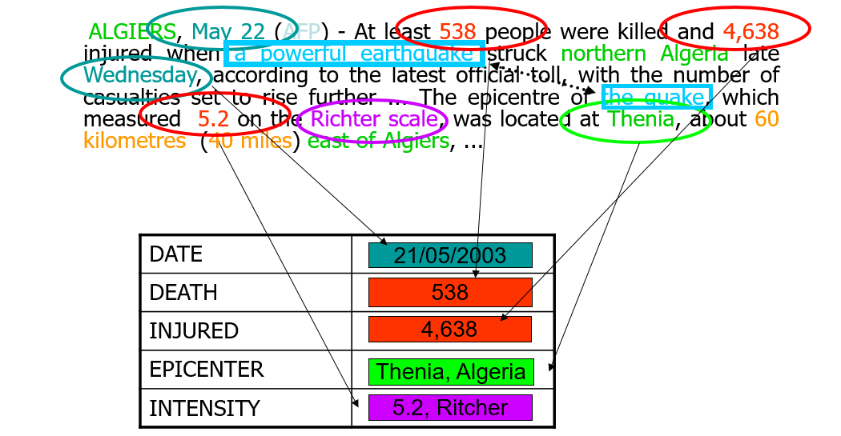
Information extraction for natural calamities
a small earthquake shook several Southern Illinois counties Monday night, the National Earthquake Information Service in Golden, Colo., reported. Spokesman Don Finley said the quake measured 3.2 on the Richter scale, “probably not enough to do any damage or cause any injuries.” The quake occurred about 7:48 p.m. CST and was centered about 30 miles east of Mount Vernon, Finlay said. It was felt in Richland, Clay, Jasper, Effington, and Marion Counties.
There was an earthquake in Illinois with a 3.2 Richter scale.

Slide 48
Interpretation Methods for Summarization

Slide 49
Topic Interpretation
xx xxx xxxx x xx xxxx
xxx xx xxx xx xxxxx x
xxx xx xxx xx x xxx xx
xx xxx x xxx xx xxx x
xx x xxxx xxxx xxxx xx
xx xxxx xxx
xxx xx xx xxxx x xxx
xx x xx xx xxxxx x x xx
xxx xxxxxx xxxxxx x x
xxxxxxx xx x xxxxxx
xxxx
xx xx xxxxx xxx xx x xx
xx xxxx xxx xxxx xx
xxx xx xxx xxxx xx
xxx x xxxx x xx xxxx
xx xxx xxxx xx x xxx
xxx xxxx x xxx x xxx
xx xx xxxxx x x xx
xxxxxxx xx x xxxxxx
xxxx
xx xx xxxxx xxx xx
xxx xx xxxx x xxxxx
xx xxxxx x
From extract to abstract:
topic interpretation or concept fusion.
Experiment (Marcu, 98):
  Got 10 newspaper texts, with human abstracts.
  Asked 14 judges to extract corresponding clauses from texts, to cover the same content.
  Compared word lengths of extracts to abstracts: extract_length = 2.76 × abstract_length !!

Slide 50
Some Types of Interpretation
Concept generalization:
  Sue ate apples, pears, and bananas ⇒ Sue ate fruit
Meronymy replacement:
  Both wheels, the pedals, saddle, chain… ⇒ the bike
Script identification: (Schank and Abelson, 77)
  He sat down, read the menu, ordered, ate, paid, and left ⇒ He ate at the restaurant
Metonymy:
  A spokesperson for the US Government announced that… ⇒ Washington announced that...
Meronyms: a term which denotes part of something but which is used to refer to the whole of it
Metonym: a word, name, or expression used as a substitute for something else with which it is closely associated.

Slide 51
NLP for summarization
detecting syntactic structure for condensation
  I: Solomon, a sophomore at Heritage School in Convers, is accused of opening fire on schoolmates.
  O: Solomon is accused of opening fire on schoolmates.
meaning to support condensation
  I: 25 people have been killed in an explosion in the Iraqi city of Basra.
  O: Scores died in Iraq explosion
discourse interpretation/coreference
  I: And as a conservative Wall Street veteran, Rubin brought market credibility to the Clinton administration.
  O: Rubin brought market credibility to the Clinton administration.
  I: Victoria de los Angeles died in a Madrid hospital today. She was the most acclaimed Spanish soprano of the century. She was 81.
  O: Spanish soprano De los Angeles died at 81.

Slide 52
General Aspects of Interpretation
Interpretation occurs at the conceptual level...
  …words alone are polysemous (bat = animal and sports instrument) and combine for meaning (alleged murderer ≠ murderer).
For interpretation, you need world knowledge...
  …the fusion inferences are not in the text!

Slide 54
Multi-document Summarization

Slide 55
Multi-document summarization Challenges
Redundancy of information
  the destruction of Rome by the Barbarians in 410....
  Rome was destroyed by Barbarians.
  Barbarians destroyed Rome in the V Century
  In 410, Rome was destroyed. The Barbarians were responsible.
fragmentary information
  D1=“earthquake in Turkey”; D2=“measured 6.5”
contradictory information
  D1=“killed 3”; D2= “killed 4”
relations between documents
  inter-document-coreference
  D1=“Tony Blair visited Bush”; D2=“UK Prime Minister visited Bush”

Slide 56
Centroid-based summarization (Radev&al’00;Saggion&Gaizauskas’04)
given a set of documents create a centroid of the cluster
  centroid = set of words in the cluster considered “statistically” significant
  centroid is a set of terms and weights
centroid score = similarity between a sentence and the centroid
combine the centroid score with document features such as position
detect and eliminate sentence redundancy using a similarity metric
  Remove sentences if one is subsumed by the other

Slide 57
Sentence ordering
simplest strategy is to present sentences in temporal order when date of document is known
important for both single and multi-document summarization (Barzilay, Elhadad, McKeown’02)
some strategies
  Majority order
  Chronological order
  Combination
probabilistic model (Lapata’03)
  the model learns order constraints in a particular domain
  the main component is a probability table
    P(S_{i}|S_{i-1}) for sentences S
    the representation of each sentence is a set of features for
      verbs, nouns, and dependencies

Slide 59
Evaluating Summaries – Extrinsic vs Intrinsic

Slide 60
Intrinsic vs extrinsic Evaluation
Intrinsic evaluation
  Summary evaluated on its own or comparing it with the source
    Is the text cohesive and coherent?
    Does it contain the main topics of the document?
    Are important topics omitted?
    Compare summary with ideal summaries
  Given a machine summary (P) compare to one or more human summaries (M) using a scoring function score(P,M), aggregate the scores per system, use the aggregated score to rank systems
Evaluation in an specific task
  Can the summary be used instead of the document?
    Can the document be classified by reading the summary?
    Can we answer questions by reading the summary?

Slide 61
Evaluation of extracts
 | System
Human | + | -
+ | TP | FN
- | FP | TN
precision (P)
recall (R)
F-score (F)
Accuracy (A)

Slide 62
Evaluation of extracts (instance)
N | Human | System
1 | + | +
2 | - | +
3 | + | -
4 | - | -
5 | + | -
 | S
H | + | -
+ | 1 | 2
- | 1 | 1
precision = 1/2
recall = 1/3

Slide 63
How can You Evaluate a Summary?
When you already have a summary…
...then you can compare a new one to it:
  1. choose a granularity (clause; sentence; paragraph),
  2. create a similarity measure for that granularity (word overlap; multi-word overlap, perfect match),
  3. measure the similarity of each unit in the new to the most similar unit(s) in the gold standard,
  4. measure Recall and Precision.
  e.g., (Kupiec et al., 95).
……………..…. but when you don’t?

Slide 64
Q&A Evaluation
Can you focus on the important stuff?
  The Q&A Game—can be tailored to your interests!
Measure core info. capture by Q&A game:
  Some people (questioners) see text, must create questions about most important content.
  Other people (answerers) see:
    1. nothing—but must try to answer questions (baseline),
    2. then: summary, must answer same questions,
    3. then: full text, must answer same questions again.
  Information retention: % answers correct.

Slide 65
SUMMAC Categorization Test
Procedure (SUMMAC, 98):
  1. 1000 newspaper articles from each of 5 categories.
  2. Systems summarize each text (generic summary).
  3. Humans categorize summaries into 5 categories.
  4. Testers measure Recall and Precision, combined into F: How correctly are the summaries classified, compared to the full texts?
  (many other measures as well)

Slide 67
Evaluating Summaries – ROUGE and BLEU

Slide 68
ROUGE
ROUGE, or Recall-Oriented Understudy for Gisting Evaluation, is a set of metrics and a software package used for evaluating automatic summarization.
The metrics compare an automatically produced summary or translation against a reference or a set of references (human-produced) summary or translation.
The following five evaluation metrics are available.
  ROUGE-N: N-gram based co-occurrence statistics.
  ROUGE-L: Longest Common Subsequence (LCS) based statistics.
  ROUGE-W: Weighted LCS-based statistics that favors consecutive LCSes .
  ROUGE-S: Skip-bigram based co-occurrence statistics. Skip-bigram is any pair of words in their sentence order.
  ROUGE-SU: Skip-bigram plus unigram-based co-occurrence statistics.
ROUGE can be downloaded from http://www.berouge.com/Pages/DownloadROUGE.aspx

Slide 69
Example (R-1 and R-L)
Generated summary: At least 13 sailors have been killed in a mine attack on a convoy in north-western Sri Lanka, officials say.
Human-1: Tamil Tiger guerrillas have blown up a navy bus in northeastern Sri Lanka, killing at least 10 sailors and wounding 17 others.
Human-2: Blasts blamed on Tamil Tiger rebels killed 13 people on Wednesday in Sri Lanka's northeast and dozens more were injured, officials said, raising fears planned peace talks may be cancelled and a civil war could restart.
  ROUGE-1
  Generated has 21 1-grams (x2 = 42)
  Human-1 has 22
  Human-2 has 37 (total = 59)
  1-grams hits 16
  1-gram recall 0.27(=16/59)
  1-gram precision 0.38=(16/42)
  1-gram f-score 0.31
  ROUGE-L
  LCS: have a in sri lanka
  LCS: killed on in sri lanka officials
  Generated has 21 words (x2 = 42)
  Human-1 has 22
  Human-2 has 37 (total = 59)
  LCS-hits is 11
  LCS recall 0.18 (=11/59)
  LCS precision 0.26 (=11/42)
  LCS f-score 0.21

Slide 70
BLEU
BLEU (bilingual evaluation understudy) is an algorithm for evaluating the quality of summarization and machine-translation.
Quality is considered to be the correspondence between a machine's output and that of a human.
Scores are calculated for individual translated segments—generally sentences—by comparing them with a set of good quality reference translations.
Intelligibility or grammatical correctness are not taken into account.
BLEU’s output is always a number between 0 and 1. This value indicates how similar the candidate and reference texts are.
Example of poor machine translation output with high precision
  Candidate the the the the the the the
  Reference 1 the cat is on the mat
  Reference 2 there is a cat on the mat
Of the seven words in the candidate translation, all of them appear in the reference translations. Thus the candidate text is given a unigram precision of p=7/7=1, which is unfair. BLEU: For each word in the candidate translation, the algorithm takes its maximum total count, max, in any of the reference translations. In the example above, the word "the" appears twice in reference 1, and once in reference 2. Thus max = 2.
For the candidate translation, the count of each word is clipped to a maximum of max for that word. In this case, "the" has count = 7 and max=2, thus count is clipped to 2. This count is then summed over all words in the candidate. This sum is then divided by the total number of words in the candidate translation. In the above example, the modified unigram precision score would be: 2/7

Slide 71
BLEU
In practice, however, using individual words as the unit of comparison is not optimal. Instead, BLEU computes the same modified precision metric using n-grams. The unigram scores are found to account for the adequacy of the translation, or how much information is retained. The longer n-gram scores account for the fluency of the translation, or to what extent it reads like "good English".
BLEU scores tend to favor short translations, which can produce very high precision scores, even using modified precision. An example of a candidate translation for the same references as above might be: "the cat". Modified unigram precision would be, 1/2+1/2=1.
To produce a score for the whole corpus the modified precision scores for the segments are combined using the geometric mean multiplied by a brevity penalty to prevent very short candidates from receiving too high a score. Let r be the total length of the reference corpus, and c the total length of the translation corpus. If c<r, the brevity penalty applies, defined to be e^{(1-r/c)}.

Slide 72
ROUGE vs BLEU
Bleu measures precision: how much the words (and/or n-grams) in the machine generated summaries appeared in the human reference summaries.
Rouge measures recall: how much the words (and/or n-grams) in the human reference summariesappeared in the machine generated summaries.
You could use the F1 measure to make the metrics work together: F1 = 2 * (Bleu * Rouge) / (Bleu + Rouge)

