Slide 1
UNIT -2
Transaction Management and Concurrency Control

Slide 2
Transaction
A transaction is a sequence of operations performed (using one or more SQL statements) on a database as a single logical unit of work.

Slide 3
Transaction Property/ACID property
A transaction is a single logical unit of work which accesses and possibly modifies the contents of a database. Transactions access data using read and write operations.
In order to maintain consistency in a database, before and after the transaction, certain properties are followed. These are called ACID properties.
Atomicity
Consistency
Isolation
Durability:

Slide 4
Atomicity
By this, we mean that either the entire transaction takes place at once or doesn’t happen at all. There is no midway i.e. transactions do not occur partially. Each transaction is considered as one unit and either runs to completion or is not executed at all. It involves the following two operations. —Abort: If a transaction aborts, changes made to database are not visible. —Commit: If a transaction commits, changes made are visible. Atomicity is also known as the ‘All or nothing rule’.

Slide 5
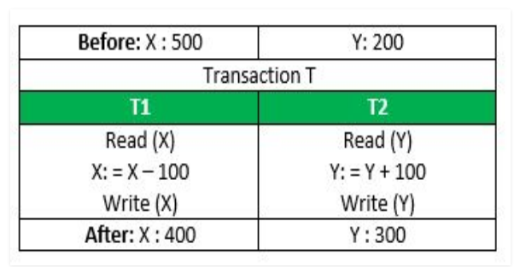
Consider the following transaction T consisting of T1 and T2: Transfer of 100 from account X to account Y
If the transaction fails after completion of T1 but before completion of T2.( say, after write(X) but before write(Y)), then amount has been deducted from X but not added to Y. This results in an inconsistent database state. Therefore, the transaction must be executed in entirety in order to ensure correctness of database state.

Slide 6
Consistency
This means that integrity constraints must be maintained so that the database is consistent before and after the transaction.
It refers to the correctness of a database. Referring to the example above, The total amount before and after the transaction must be maintained. Total before T occurs = 500 + 200 = 700. Total after T occurs = 400 + 300 = 700. Therefore, database is consistent. Inconsistency occurs in case T1 completes but T2 fails. As a result T is incomplete.

Slide 7
Isolation
This property ensures that multiple transactions can occur concurrently without leading to the inconsistency of database state.
Transactions occur independently without interference. Changes occurring in a particular transaction will not be visible to any other transaction until that particular change in that transaction is written to memory or has been committed.
This property ensures that the execution of transactions concurrently will result in a state that is equivalent to a state achieved these were executed serially in some order. Let X= 500, Y = 500.

Slide 8
Durability
This property ensures that once the transaction has completed execution, the updates and modifications to the database are stored in and written to disk and they persist even if a system failure occurs.
These updates now become permanent and are stored in non-volatile memory. The effects of the transaction, thus, are never lost.

Slide 9
serializability
When multiple transactions are running concurrently then there is a possibility that the database may be left in an inconsistent state. Serializability is a concept that helps us to check which schedules are serializable.
A serializable schedule is the one that always leaves the database in consistent state.

Slide 10
A serializable schedule always leaves the database in consistent state. A serial schedule is always a serializable schedule because in serial schedule, a transaction only starts when the other transaction finished execution. However a non-serial schedule needs to be checked for Serializability.
A non-serial schedule of n number of transactions is said to be serializable schedule, if it is equivalent to the serial schedule of those n transactions. A serial schedule doesn’t allow concurrency, only one transaction executes at a time and the other starts when the already running transaction finished.

Slide 11
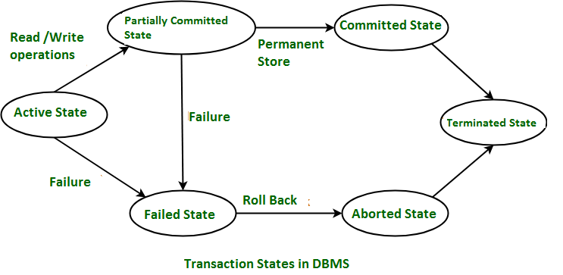
States of Transaction

Slide 12
Active State – When the instructions of the transaction are running then the transaction is in active state. If all the ‘read and write’ operations are performed without any error then it goes to the “partially committed state”; if any instruction fails, it goes to the “failed state”.
Partially Committed – After completion of all the read and write operation the changes are made in main memory or local buffer. If the changes are made permanent on the Data Base then the state will change to “committed state” and in case of failure it will go to the “failed state”.
Failed State – When any instruction of the transaction fails, it goes to the “failed state” or if failure occurs in making a permanent change of data on Data Base.

Slide 13
Aborted State – After having any type of failure the transaction goes from “failed state” to “aborted state” and since in previous states, the changes are only made to local buffer or main memory and hence these changes are deleted or rolled-back.
Committed State – It is the state when the changes are made permanent on the Data Base and the transaction is complete and therefore terminated in the “terminated state”.
Terminated State – If there isn’t any roll-back or the transaction comes from the “committed state”, then the system is consistent and ready for new transaction and the old transaction is terminated.

Slide 14
Concurrency control
Concurrency Control is the management procedure that is required for controlling concurrent execution of the operations that take place on a database.
In a multi-user system, multiple users can access and use the same database at one time, which is known as the concurrent execution of the database. It means that the same database is executed simultaneously on a multi-user system by different users.
While working on the database transactions, there occurs the requirement of using the database by multiple users for performing different operations, and in that case, concurrent execution of the database is performed.
The thing is that the simultaneous execution that is performed should be done in an interleaved manner, and no operation should affect the other executing operations, thus maintaining the consistency of the database. Thus, on making the concurrent execution of the transaction operations, there occur several challenging problems that need to be solved.

Slide 15
In a multiprogramming environment where multiple transactions can be executed simultaneously, it is highly important to control the concurrency of transactions.
We have concurrency control protocols to ensure atomicity, isolation, and serializability of concurrent transactions.
Concurrency control protocols can be broadly divided into two categories −
1)Lock based protocols
2) Time stamp based protocols
3) Optimistic protocol

Slide 16
Locking levels\ lock granularity
Database level locking
Table level locking
Page level locking(disk –bock)
Row (tuple) level locking
Attributes(fields) level locking

Slide 17
Lock-based Protocols
Database systems equipped with lock-based protocols use a mechanism by which any transaction cannot read or write data until it acquires an appropriate lock on it. Locks are of two kinds −
Binary Locks − A lock on a data item can be in two states; it is either locked or unlocked.
Shared/exclusive − This type of locking mechanism differentiates the locks based on their uses.
If a lock is acquired on a data item to perform a write operation, it is an exclusive lock.
Allowing more than one transaction to write on the same data item would lead the database into an inconsistent state.
Read locks are shared because no data value is being changed.

Slide 18
There are four types of lock protocols available :
Simplistic Lock Protocol
Pre-claiming Lock Protocol
Two-Phase Locking 2PL
Strict Two-Phase Locking

Slide 19
1.Simplistic Lock Protocol
Simplistic lock-based protocols allow transactions to obtain a lock on every object before a 'write' operation is performed. Transactions may unlock the data item after completing the ‘write’ operation.
It is the simplest way of locking the data while transaction. Simplistic lock-based protocols allow all the transactions to get the lock on the data before insert or delete or update on it. It will unlock the data item after completing the transaction.

Slide 20
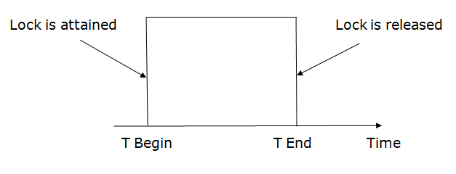
2.Pre-claiming Lock Protocol
Pre-claiming Lock Protocols evaluate the transaction to list all the data items on which they need locks.
Before initiating an execution of the transaction, it requests DBMS for all the lock on all those data items.
If all the locks are granted then this protocol allows the transaction to begin. When the transaction is completed then it releases all the lock.
If all the locks are not granted then this protocol allows the transaction to rolls back and waits until all the locks are granted.

Slide 21
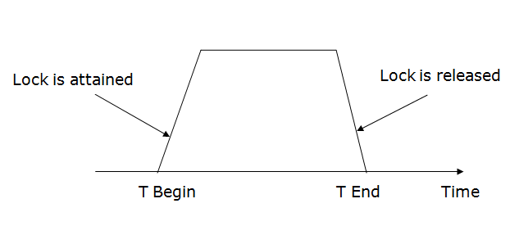
3. Two-phase locking (2PL)
The two-phase locking protocol divides the execution phase of the transaction into three parts.
In the first part, when the execution of the transaction starts, it seeks permission for the lock it requires.
In the second part, the transaction acquires all the locks. The third phase is started as soon as the transaction releases its first lock(growing phase).
In the third phase, the transaction cannot demand any new locks. It only releases the acquired locks(shrinking phase).

Slide 22
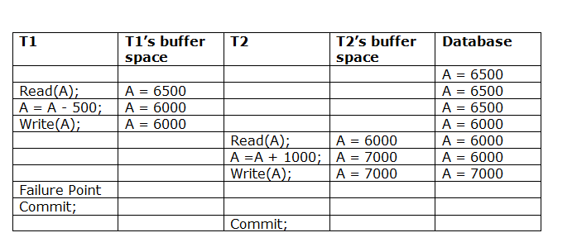
Irrecoverable schedule
The schedule will be irrecoverable if Tj reads the updated value of Ti and Tj committed before Ti commit.
The above table 2 shows a schedule with two transactions. Transaction T1 reads and writes A, and that value is read and written by transaction T2. But later on, T1 fails.
Due to this, we have to rollback T1. T2 should be rollback because T2 has read the value written by T1. As it has not committed before T1 commits so we can rollback transaction T2 as well. So it is recoverable with cascade rollback.

Slide 23
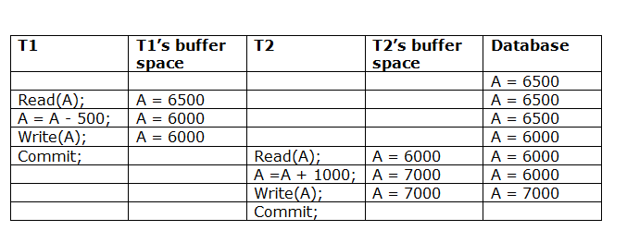
Recoverable with cascading rollback:
The schedule will be recoverable with cascading rollback if Tj reads the updated value of Ti. Commit of Tj is delayed till commit of Ti.
The below Table shows a schedule with two transactions. Transaction T1 reads and write A and commits, and that value is read and written by T2. So this is a cascade less recoverable schedule.

Slide 24
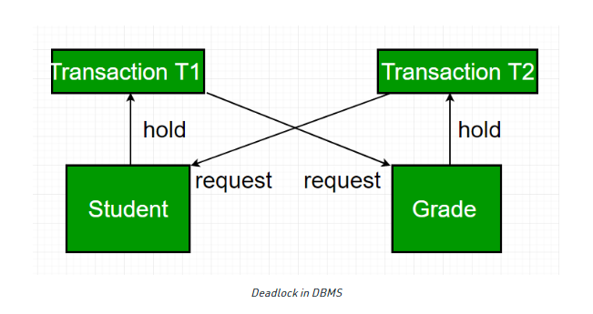
Deadlock

Slide 25
In a database, a deadlock is an unwanted situation in which two or more transactions are waiting indefinitely for one another to give up locks.
Deadlock is said to be one of the most feared complications in DBMS as it brings the whole system to a Halt.
Example –
let us understand the concept of Deadlock with an example : Suppose, Transaction T1 holds a lock on some rows in the Students table and needs to update some rows in the Grades table.
Simultaneously, Transaction T2 holds locks on those very rows (Which T1 needs to update) in the Grades table but needs to update the rows in the Student table held by Transaction T1.
Now, the main problem arises. Transaction T1 will wait for transaction T2 to give up the lock, and similarly, transaction T2 will wait for transaction T1 to give up the lock. As a consequence, All activity comes to a halt and remains at a standstill forever unless the DBMS detects the deadlock and aborts one of the transactions.

Slide 26
Deadlock Avoidance
When a database is stuck in a deadlock, It is always better to avoid the deadlock rather than restarting or aborting the database.
Deadlock avoidance method is suitable for smaller databases whereas the deadlock prevention method is suitable for larger databases. One method of avoiding deadlock is using application-consistent logic.
In the above given example, Transactions that access Students and Grades should always access the tables in the same order.
In this way, in the scenario described above, Transaction T1 simply waits for transaction T2 to release the lock on Grades before it begins.
When transaction T2 releases the lock, Transaction T1 can proceed freely. Another method for avoiding deadlock is to apply both row-level locking mechanism and READ COMMITTED isolation level.
However, It does not guarantee to remove deadlocks completely.

Slide 27
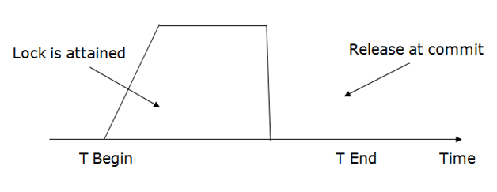
4. Strict Two-phase locking (Strict-2PL)
The first phase of Strict-2PL is similar to 2PL. In the first phase, after acquiring all the locks, the transaction continues to execute normally.
The only difference between 2PL and strict 2PL is that Strict-2PL does not release a lock after using it.
Strict-2PL waits until the whole transaction to commit, and then it releases all the locks at a time.
Strict-2PL protocol does not have shrinking phase of lock release.

Slide 28
Timestamp Ordering Protocol
The Timestamp Ordering Protocol is used to order the transactions based on their Timestamps. The order of transaction is nothing but the ascending order of the transaction creation.
The priority of the older transaction is higher that's why it executes first. To determine the timestamp of the transaction, this protocol uses system time or logical counter.
The lock-based protocol is used to manage the order between conflicting pairs among transactions at the execution time. But Timestamp based protocols start working as soon as a transaction is created.
Let's assume there are two transactions T1 and T2. Suppose the transaction T1 has entered the system at 7:00 times and transaction T2 has entered the system at 9:00 times. T1 has the higher priority, so it executes first as it is entered the system first.
The timestamp ordering protocol also maintains the timestamp of last 'read' and 'write' operation on a data.

Slide 29
Basic Timestamp ordering protocol works as follows:
1. Check the following condition whenever a transaction Ti issues a Read (X) operation:
If W_TS(X) >TS(Ti) then the operation is rejected.
If W_TS(X) <= TS(Ti) then the operation is executed.
Timestamps of all the data items are updated.
2. Check the following condition whenever a transaction Ti issues a Write(X) operation:
If TS(Ti) < R_TS(X) then the operation is rejected.
If TS(Ti) < W_TS(X) then the operation is rejected and Ti is rolled back otherwise the operation is executed.

Slide 30
Where, TS(Ti) denotes the timestamp of the transaction Ti.
R_TS(X) denotes the Read time-stamp of data-item X.
W_TS(X) denotes the Write time-stamp of data-item X.

Slide 31
Following are the three basic variants of timestamp-based methods of concurrency control:
• Total timestamp ordering :
Total Timestamp Ordering The total timestamp ordering algorithm depends on maintaining access to granules in timestamp order by aborting one of the transactions involved in any conflicting access.
No distinction is made between Read and Write access, so only a single value is required for each granule timestamp.
• Partial timestamp ordering :
Partial Timestamp Ordering In a partial timestamp ordering, only non-permutable actions are ordered to improve upon the total timestamp ordering. In this case, both Read and Write granule timestamps are stored.
The algorithm allows the granule to be read by any transaction younger than the last transaction that updated the granule. A transaction is aborted if it tries to update a granule that has previously been accessed by a younger transaction.
The partial timestamp ordering algorithm aborts fewer transactions than the total timestamp ordering algorithm, at the cost of extra storage for granule timestamps.
• Multiversion timestamp ordering :
Multiversion Timestamp Ordering The multiversion timestamp ordering algorithm stores several versions of an updated granule, allowing transactions to see a consistent set of versions for all granules it accesses.
So, it reduces the conflicts that result in transaction restarts to those where there is a Write-Write conflict. Each update of a granule creates a new version, with an associated granule timestamp.
A transaction that requires read access to the granule sees the youngest version that is older than the transaction. That is, the version having a timestamp equal to or immediately below the transaction's timestamp.

Slide 32
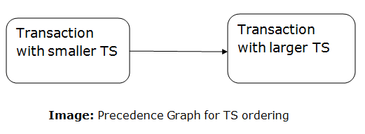
Advantages and Disadvantages of TO protocol: TO protocol ensures serializability since the precedence graph is as follows:
TS protocol ensures freedom from deadlock that means no transaction ever waits.
But the schedule may not be recoverable and may not even be cascade- free.

Slide 33
Optimistic Methods
Validation phase is also known as optimistic concurrency control technique. In the validation based protocol, the transaction is executed in the following three phases:
Read phase: In this phase, the transaction T is read and executed. It is used to read the value of various data items and stores them in temporary local variables. It can perform all the write operations on temporary variables without an update to the actual database.
Validation phase: In this phase, the temporary variable value will be validated against the actual data to see if it violates the serializability and consistency.
Write phase: If the validation of the transaction is validated, then the temporary results are written to the database or system otherwise the transaction is rolled back.

Slide 34
Log-based Recovery
Log is a sequence of records, which maintains the records of actions performed by a transaction. It is important that the logs are written prior to the actual modification and stored on a stable storage media, which is failsafe.
Log-based recovery works as follows −
The log file is kept on a stable storage media.
When a transaction enters the system and starts execution, it writes a log about it.
<T_{n}, Start> When the transaction modifies an item X, it write logs as follows −
<T_{n}, X, V₁, V₂> It reads T_{n} has changed the value of X, from V₁ to V₂.
When the transaction finishes, it logs −
<T_{n}, commit> The database can be modified using two approaches −
Deferred database modification − All logs are written on to the stable storage and the database is updated when a transaction commits.
Immediate database modification − Each log follows an actual database modification. That is, the database is modified immediately after every operation.

Slide 35
Recovery with Concurrent Transactions
When more than one transaction are being executed in parallel, the logs are interleaved. At the time of recovery, it would become hard for the recovery system to backtrack all logs, and then start recovering. To ease this situation, most modern DBMS use the concept of 'checkpoints'.

Slide 36
Checkpoint
Keeping and maintaining logs in real time and in real environment may fill out all the memory space available in the system.
As time passes, the log file may grow too big to be handled at all.
Checkpoint is a mechanism where all the previous logs are removed from the system and stored permanently in a storage disk.
Checkpoint declares a point before which the DBMS was in consistent state, and all the transactions were committed.

Slide 37
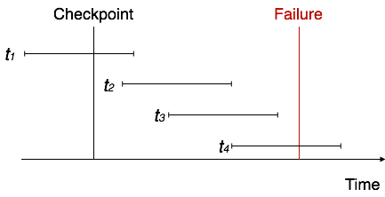
When a system with concurrent transactions crashes and recovers, it behaves in the following manner −

Slide 38
The recovery system reads the logs backwards from the end to the last checkpoint.
It maintains two lists, an undo-list and a redo-list.
If the recovery system sees a log with <T_{n}, Start> and <T_{n}, Commit> or just <T_{n}, Commit>, it puts the transaction in the redo-list.
If the recovery system sees a log with <T_{n}, Start> but no commit or abort log found, it puts the transaction in undo-list.
All the transactions in the undo-list are then undone and their logs are removed. All the transactions in the redo-list and their previous logs are removed and then redone before saving their logs.

Slide 39
Transaction failure
A transaction has to abort when it fails to execute or when it reaches a point from where it can’t go any further. This is called transaction failure where only a few transactions or processes are hurt.

Slide 40
System Crash:
There are problems − external to the system − that may cause the system to stop abruptly and cause the system to crash. For example, interruptions in power supply may cause the failure of underlying hardware or software failure.
Examples may include operating system errors.
Disk Failure:
In early days of technology evolution, it was a common problem where hard-disk drives or storage drives used to fail frequently.
Disk failures include formation of bad sectors, unreachability to the disk, disk head crash or any other failure, which destroys all or a part of disk storage.

Slide 41
Storage Structure
We have already described the storage system. In brief, the storage structure can be divided into two categories −
Volatile storage − As the name suggests, a volatile storage cannot survive system crashes. Volatile storage devices are placed very close to the CPU; normally they are embedded onto the chipset itself. For example, main memory and cache memory are examples of volatile storage. They are fast but can store only a small amount of information.
Non-volatile storage − These memories are made to survive system crashes. They are huge in data storage capacity, but slower in accessibility. Examples may include hard-disks, magnetic tapes, flash memory, and non-volatile (battery backed up) RAM.

Slide 42
Logical errors − Where a transaction cannot complete because it has some code error or any internal error condition.
System errors − Where the database system itself terminates an active transaction because the DBMS is not able to execute it, or it has to stop because of some system condition. For example, in case of deadlock or resource unavailability, the system aborts an active transaction

