Slide 1
DAY 32
docker and Kubernetes – Journey

Slide 2
AGENDA
Recap/Any query from previous session
PV and PVC Data dependencies, use case & Advantages
static vs dynamic provisioning, PVC assignment in deployments, daemonset and statefulSet objects
pv and pvc demo
Storage Classes
statefulSet understanding and use cases
StatefulSet Demo

Slide 3
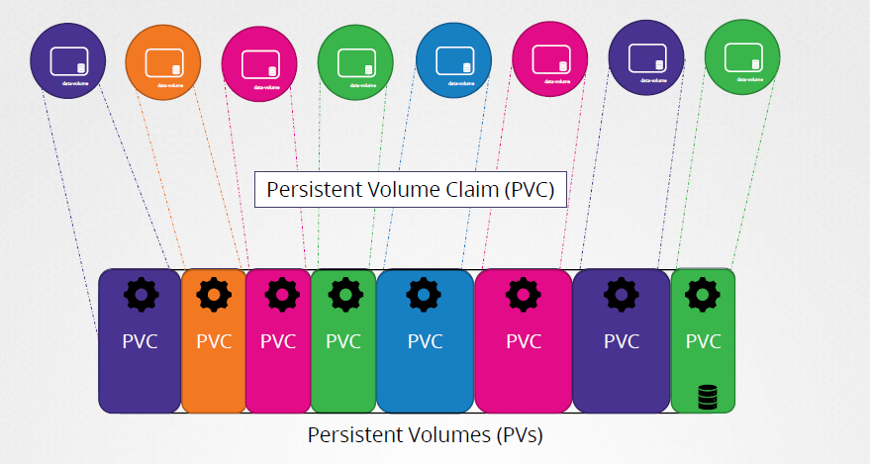
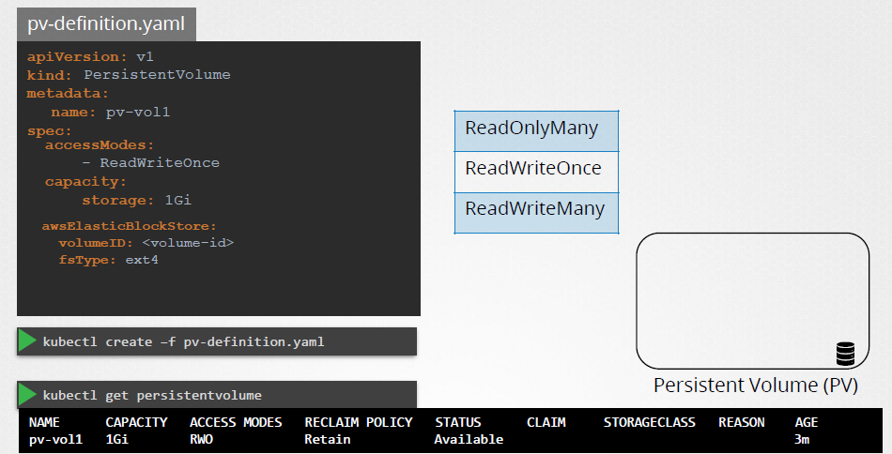
Persistent Volume

Slide 4
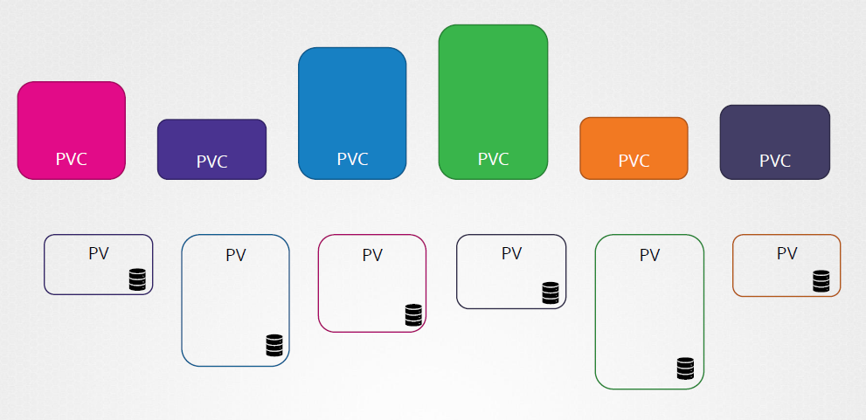
Persistent Volume Claim

Slide 5
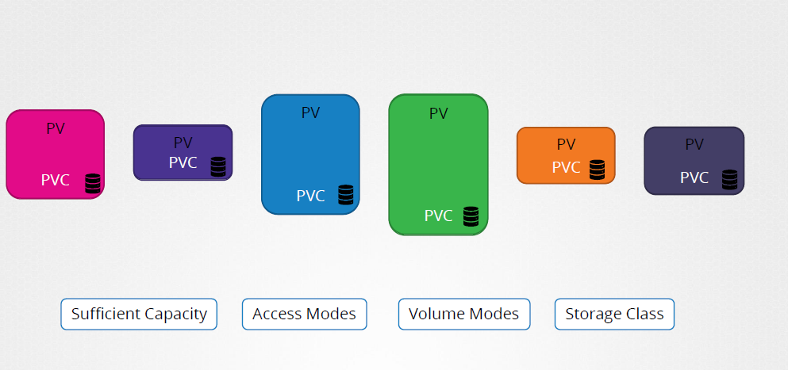
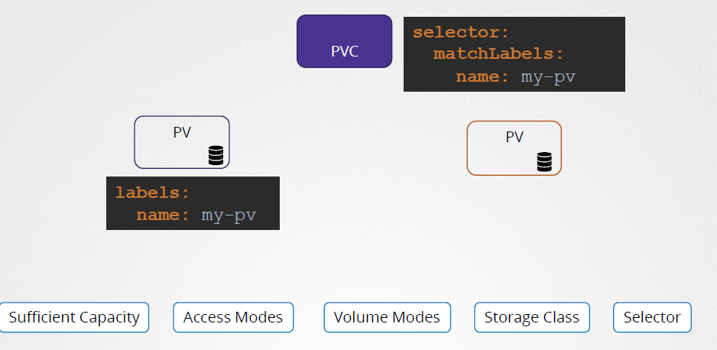
PVC - Binding

Slide 6
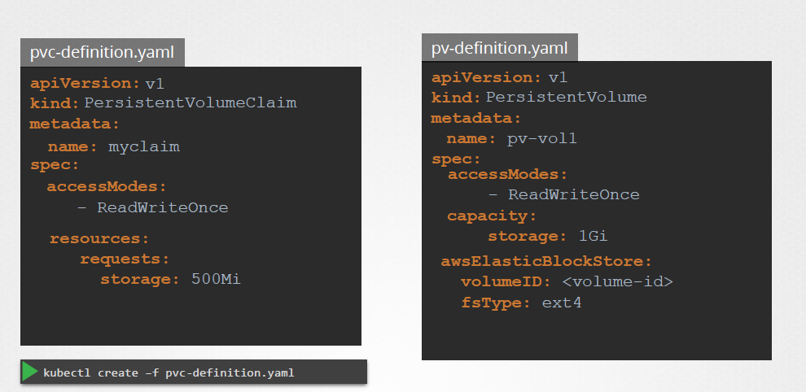
PVC - Details

Slide 7
Artifacts
Persistent Volumes in Kubernetes world:
https://kubernetes.io/docs/concepts/storage/persistent-volumes/
https://kubernetes.io/docs/tasks/configure-pod-container/configure-persistent-volume-storage/
https://bluexp.netapp.com/blog/cvo-blg-kubernetes-persistent-volume-claims-explained
https://www.digihunch.com/2021/06/kubernetes-storage-explained/

