Slide 1
DAY 14
docker and Kubernetes – Journey

Slide 2
AGENDA
Any query from previous session
Docker Compose – Demo
Example voting app
Docker compose helpful commands
Docker-compose second level – v2/v3
Docker compose file – brief
Individual components
Application deployment
Build process
Container Orchestration Need

Slide 3
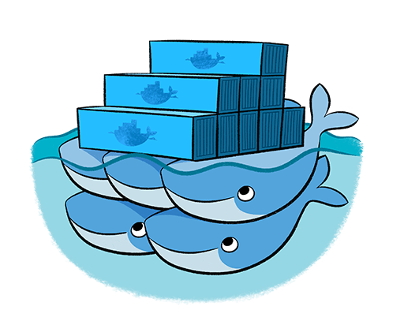
CONTAINER ORCHESTRATION – DOCKER SWARM
Native Clustering System
Clustering (management) for Docker
Manage multiple Docker daemons
Distribute workloads

Slide 4
Artifacts
Docker compose command Executed reference guide
Docker Compose Small App
Official Docker
Docker Compose Awesome Examples
https://github.com/docker/awesome-compose
Docker Compose Demo in details
Voting App Example - https://github.com/dockersamples/example-voting-app

