Slide 1
DAY 21
docker and Kubernetes – Journey

Slide 2
AGENDA
Recap/Any query from previous session
Docker
Docker-Compose
Docker-swarm
Kubernetes – The Way Forward
Kubernetes – Intro/Overview
Docker Swarm Vs Kubernetes

Slide 3
KUBERNETES – Intro/Overview
Advantages
Service Discovery/Load Balancing
Automatic Bin Packing
Self Healing
Secret/Config Maps
Automatic Rollouts/Rollbacks
Storage Orchestration
Kubernetes is a powerful open-source system, developed by google, for managing containerized applications in a clustered environment.
Kubernetes provides better ways of managing related, distributed components and services across varied infrastructure
Kubernetes platform designed to manage life cycle of containerized application and services by using predictability, scalability & high availability
Kubernetes brings together individual physical or virtual machines into cluster using shared network, all resources configured on platform

Slide 4
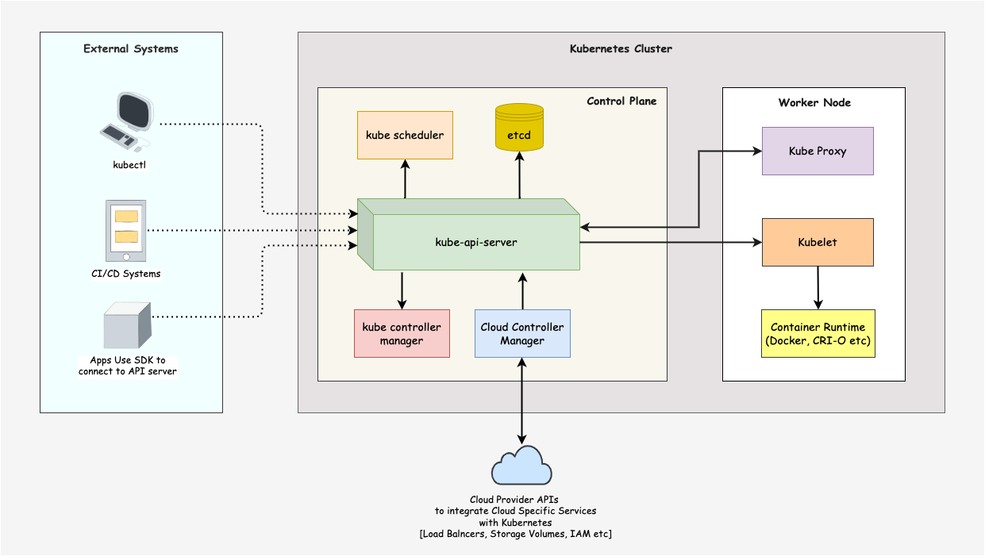
KUBERNETES - ARCHITECTURE

Slide 5
Artifacts
Kubernetes Market Share
https://newsletter.cote.io/p/kubernetes-marketshare-across-cloud
Docker Swarm Vs Kubernetes
https://circleci.com/blog/docker-swarm-vs-kubernetes/
https://www.freecodecamp.org/news/kubernetes-vs-docker-swarm-what-is-the-difference/

