Slide 1
DAY 22
docker and Kubernetes – Journey

Slide 2
AGENDA
Recap/Any query from previous session
Kubernetes – The Way Forward
Docker Swarm Vs Kubernetes
Kubernetes Market Share
Kubernetes Architecture – High Level Design
Kubernetes Architecture – Low Level Design
Kubernetes Components overview
Kubernetes Objects
Kubernetes Supported platform
Kubernetes Eco System

Slide 3
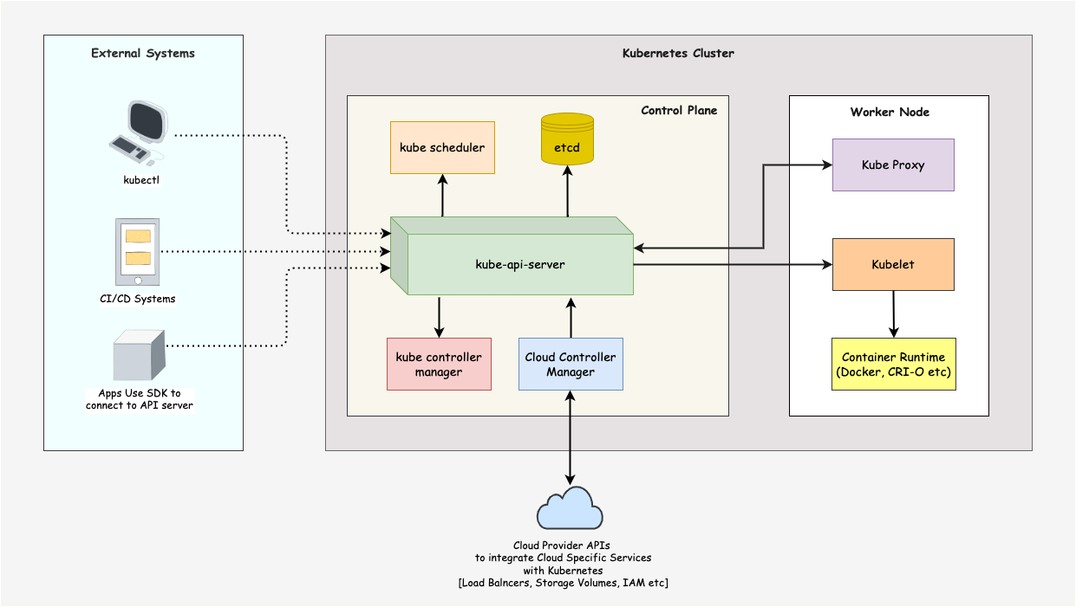
KUBERNETES - ARCHITECTURE

Slide 4
KUBERNETES – CORE COMPONENTS
Control Plane: The control plane is responsible for container orchestration and maintaining the desired state of the cluster. It has the following components.
kube-apiserver
etcd
kube-scheduler
kube-controller-manager
Worker Node: The Worker nodes are responsible for running containerized applications. The worker Node has the following components.
kubelet
kube-proxy
Container runtime

Slide 5
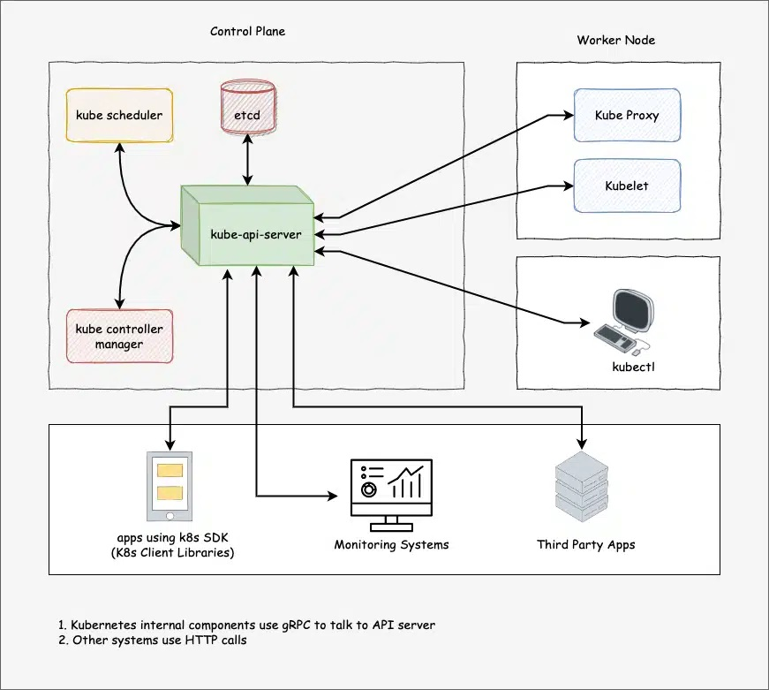
KUBERNETES – CONTROLER NODE ARCHITECTURE
Kube-apiserver: Central hub of K8S cluster & expose all K8S API, responsible for API management, authentication, processing API request & communicate with etcd
etcd: It is brain of K8S cluster, Kubernetes distribute system is managed by etcd and it stored data in strongly consistent key value pair
Kube-scheduler: Responsible for scheduling pods on worker nodes
Kube controller manger: It manages all the K8S controllers. K8S resources/objects like pods, namespaces, jobs, replicaset are managed by designated controllers. Kube-scheduler also controlled by controller manager

Slide 6
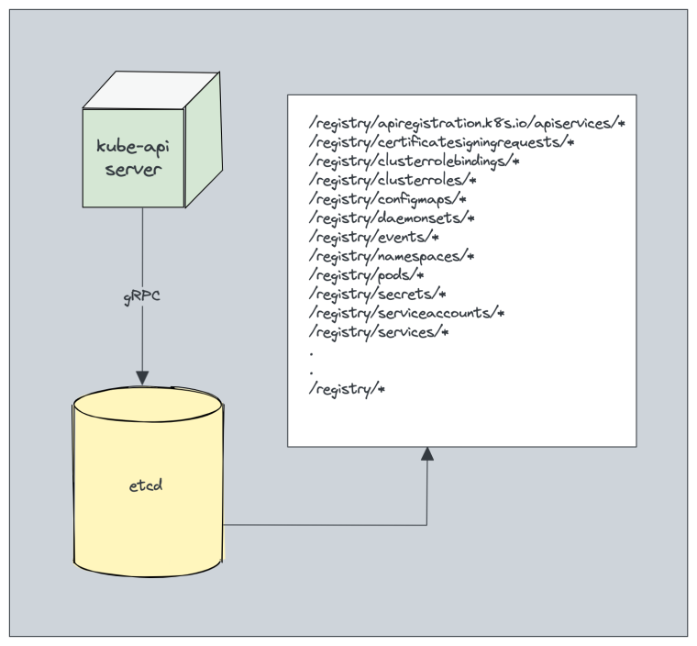
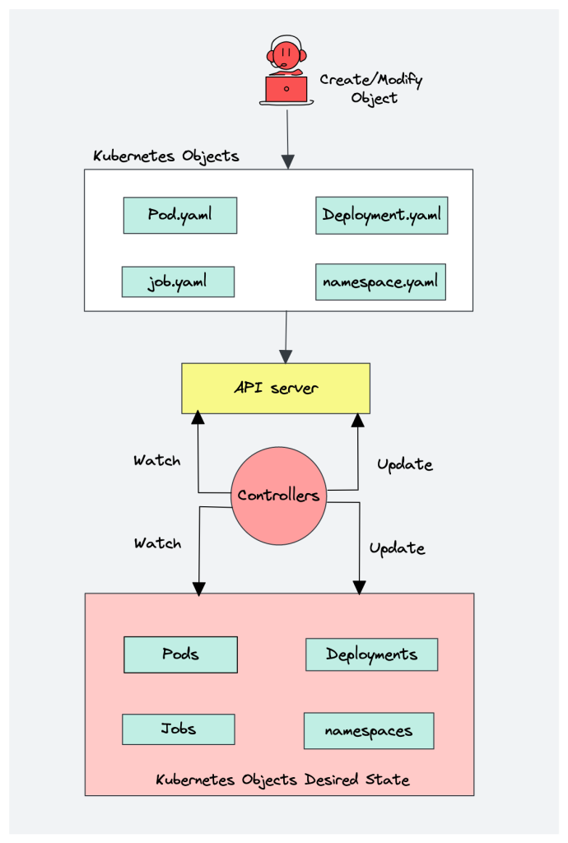
KUBERNETES – CONTROLER NODE – CONTROLER/ETCD ARCHITECTURE

Slide 7
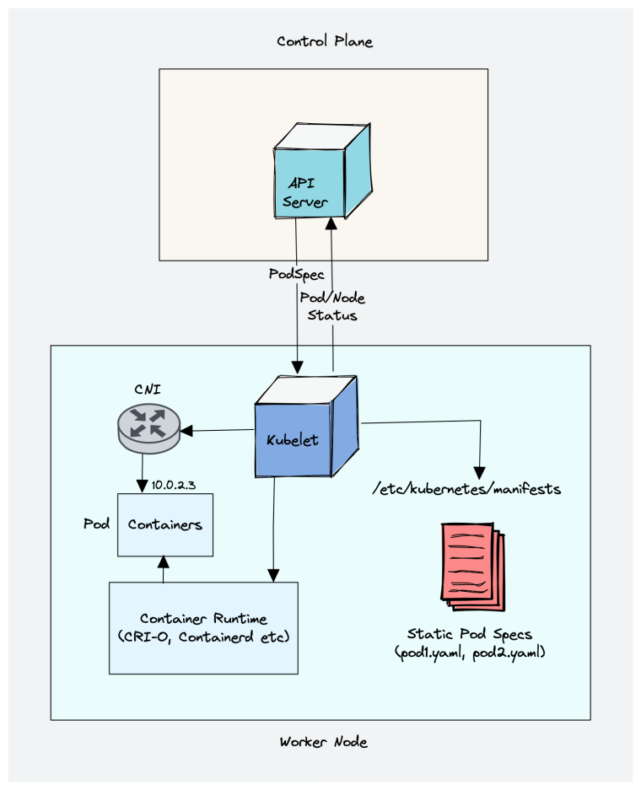
KUBERNETES – WORKER NODE – KUBELET ARCHITECTURE
Kubelet is an agent component that runs on every node in cluster, run as daemon & managed by system.
Responsible for registering worker node with API server
Create, modify & delete containers for the pod
Responsible for liveliness, readiness & startup probe
Responsible for mounting volumes & required operations on host
Collect and report node and pod status via API server
Working with podSpec (pod specification– YAML/JSON) from API server
podSpec defines the container configuration item that run inside the pod, their resources – CPU & Memory limits, environment variables, volumes & labels

Slide 8
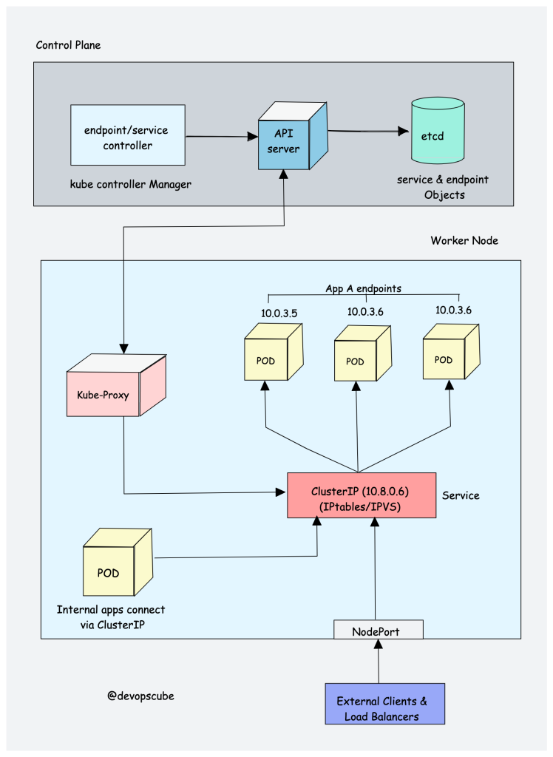
KUBERNETES – WORKER NODE – KUBEP-ROXY ARCHITECTURE
Kube-proxy is daemon that runs on every node as a daemonset
Kube-proxy is responsible for exposing pods services/endpoints both internally and externally
Kube-proxy handles service discovery and load balancing
Kube-proxy interact with API-server for any change in services (clusterIP) & endpoints

Slide 9
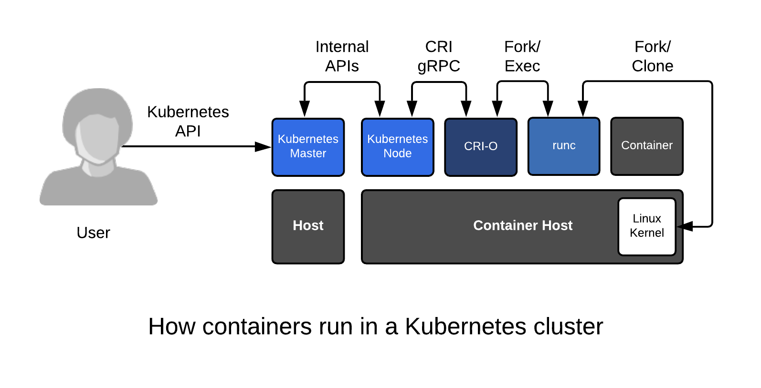
KUBERNETES – WORKER NODE – CONTAINER RUNTIME ARCHITECTURE
Container Runtime is required for running of a container
Responsible for pulling images from container registries, running container, allocating & isolating container resources and manage lifecycle of container on a host
Container runtime interface (CRI): it is a set of APIs that allows Kubernetes to interact with different container runtimes
CRI defines the API for creating, starting, stopping & deleting containers. It manage images and container network
Open Container initiative (OCI): It is set of standard for container format and runtime

Slide 10
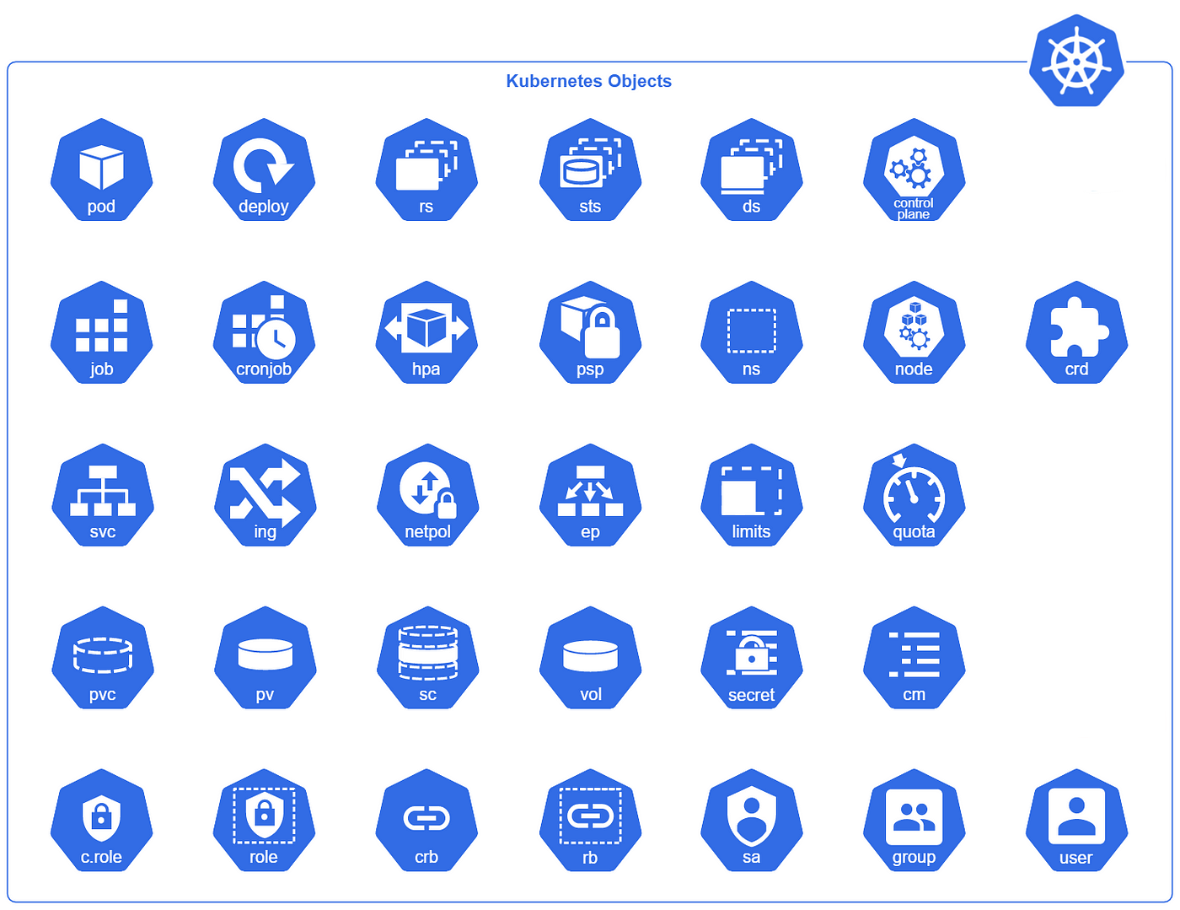
KUBERNETES – OBJECTS

Slide 11
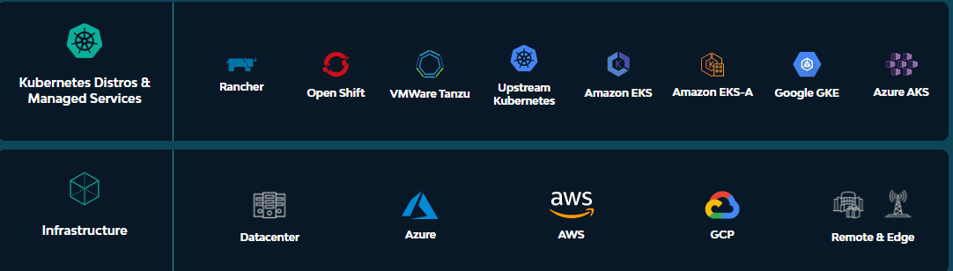
KUBERNETES – SUPPORTED PLATFORMS

Slide 12
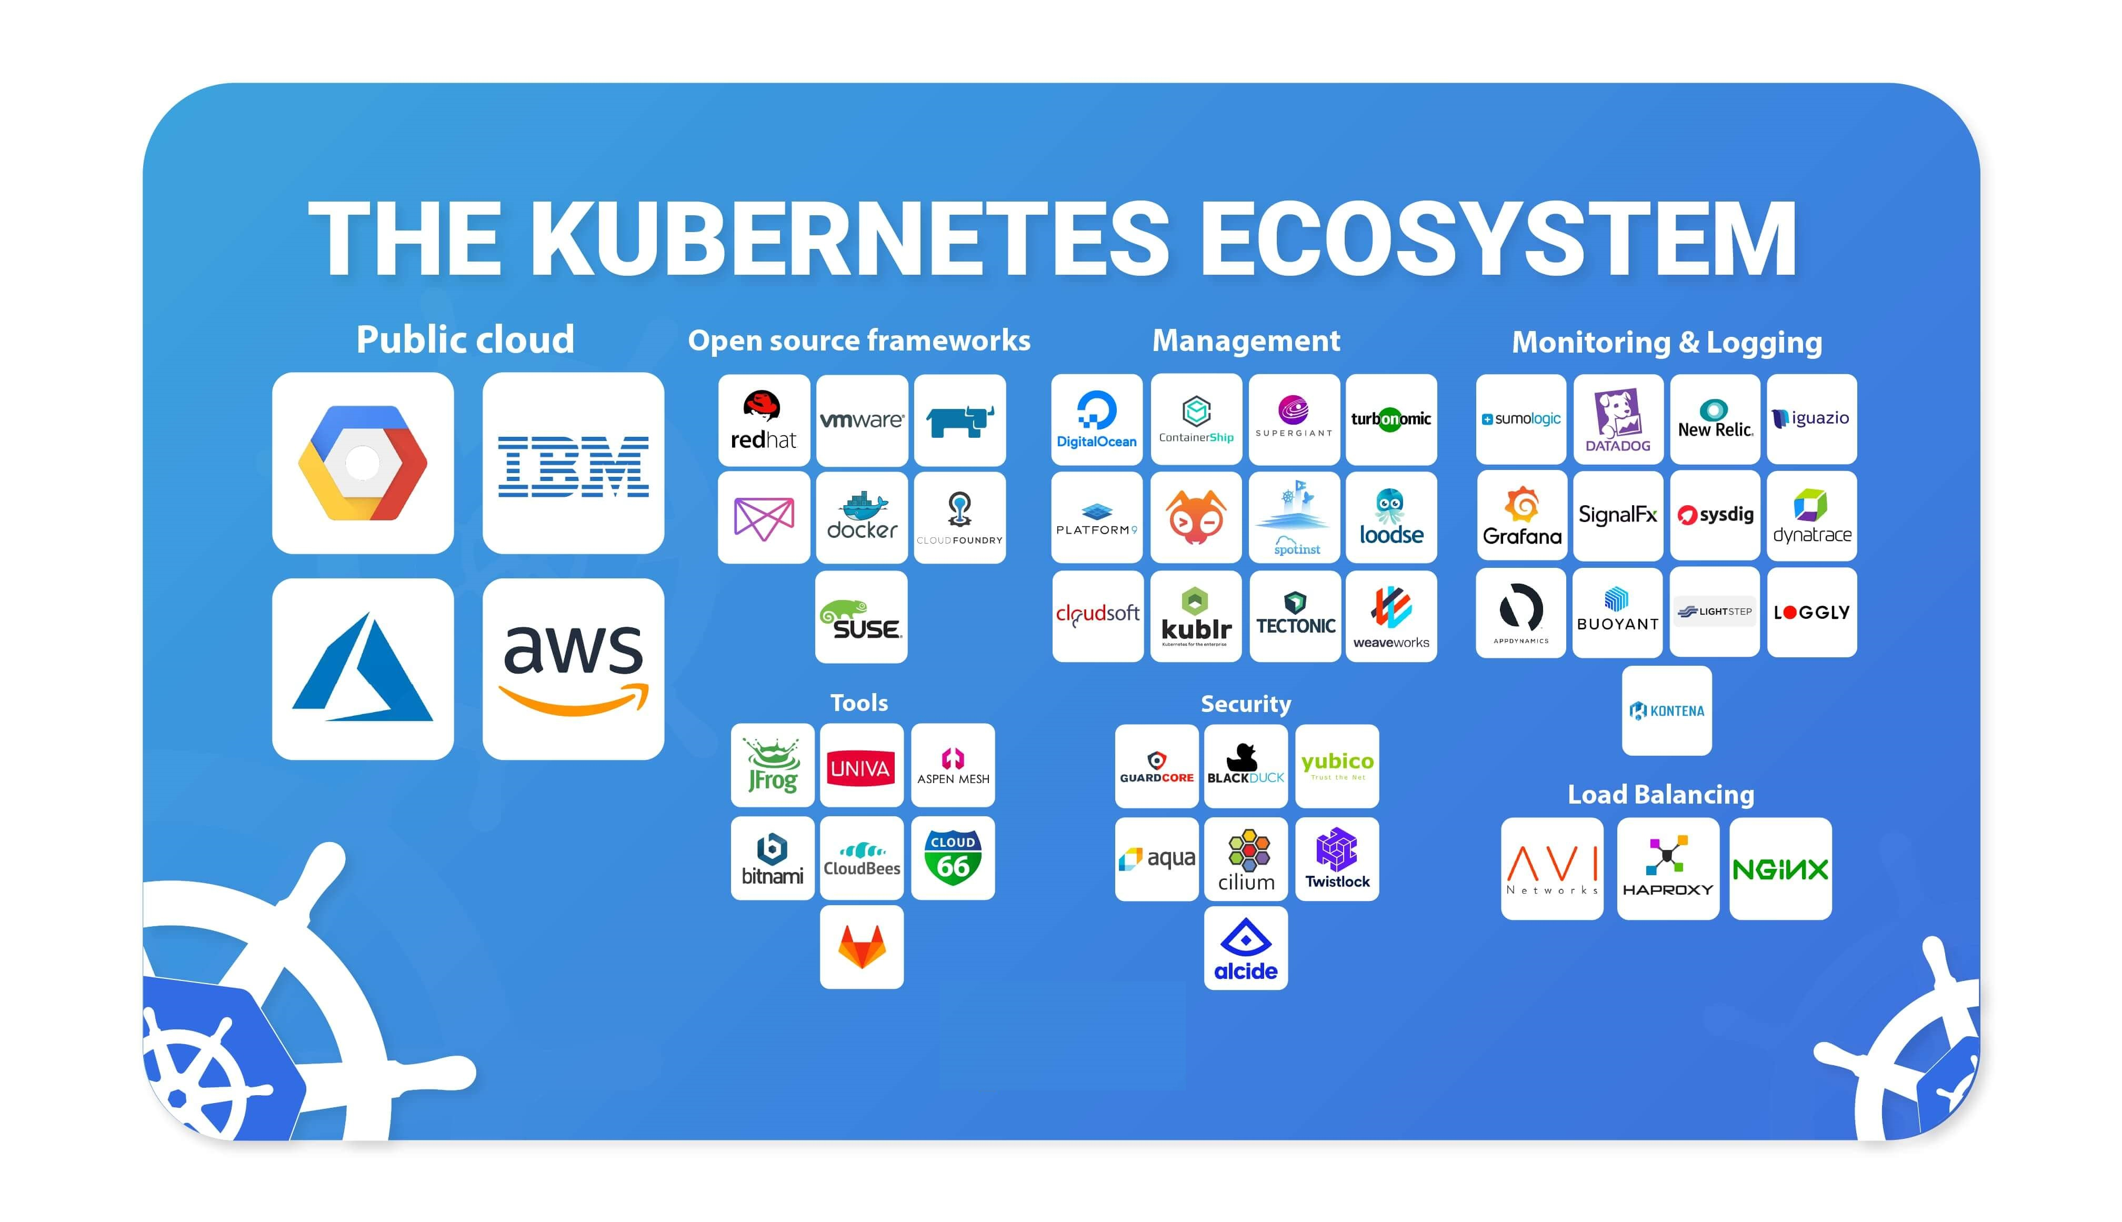
KUBERNETES – ECOSYSTEM

Slide 13
Artifacts
Kubernetes Market Share
https://newsletter.cote.io/p/kubernetes-marketshare-across-cloud
Docker Swarm Vs Kubernetes
https://circleci.com/blog/docker-swarm-vs-kubernetes/
https://www.freecodecamp.org/news/kubernetes-vs-docker-swarm-what-is-the-difference/

