Slide 1
DAY 10
docker and Kubernetes – Journey

Slide 2
AGENDA
Any query from previous session
Docker Volume – tmpfs, mount
Volume share between running containers
Docker Multi Stage Build

Slide 3
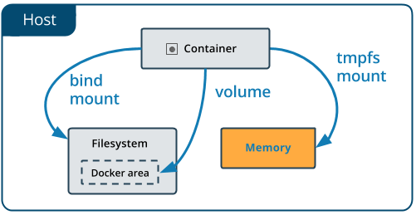
Tmpfs mounts
Tmpfs nature – not persistent data
Useful to store sensitive files
Remove with container lifecycle
Not able to share b/w containers
Only available for Docker running on Linux
docker run -d -it --name tmptest --tmpfs /app nginx:latest

Slide 4
Artifacts
Docker Volume details
https://docs.docker.com/engine/reference/commandline/volume_create/
https://www.baeldung.com/ops/docker-volumes
https://www.freecodecamp.org/news/docker-mount-volume-guide-how-to-mount-a-local-directory/
Tmpfs
https://bobcares.com/blog/tmpfs-docker-and-its-function/
https://docs.docker.com/storage/tmpfs/
Multi Stage build
https://www.freecodecamp.org/news/docker-mount-volume-guide-how-to-mount-a-local-directory/
https://docs.docker.com/build/building/multi-stage/
Docker command Executed reference guide

