Slide 1
DAY 16
docker and Kubernetes – Journey

Slide 2
AGENDA
Any query from previous session
Docker Native Clustering – Swarm Mode
Docker Swarm Architecture
Docker Swarm Key Components
Docker Swarm Execution Platform

Slide 3
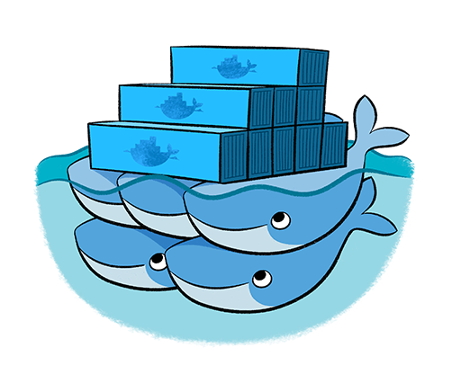
CONTAINER ORCHESTRATION – DOCKER SWARM
Native Clustering System
Clustering (management) for Docker
Manage multiple Docker daemons
Distribute workloads

Slide 4
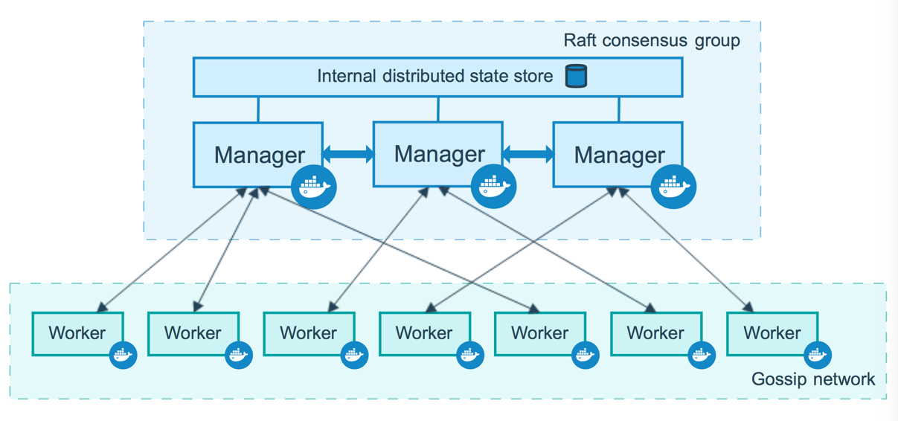
Docker Swarm Architecture

Slide 5
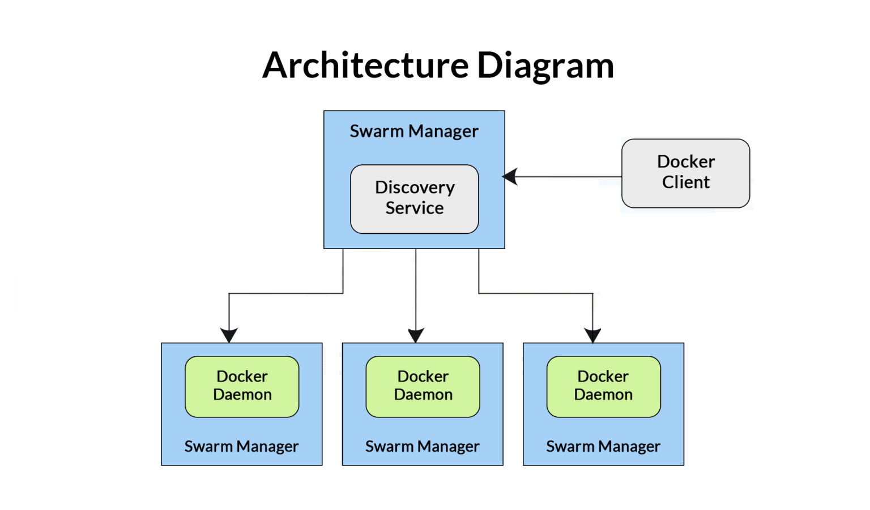
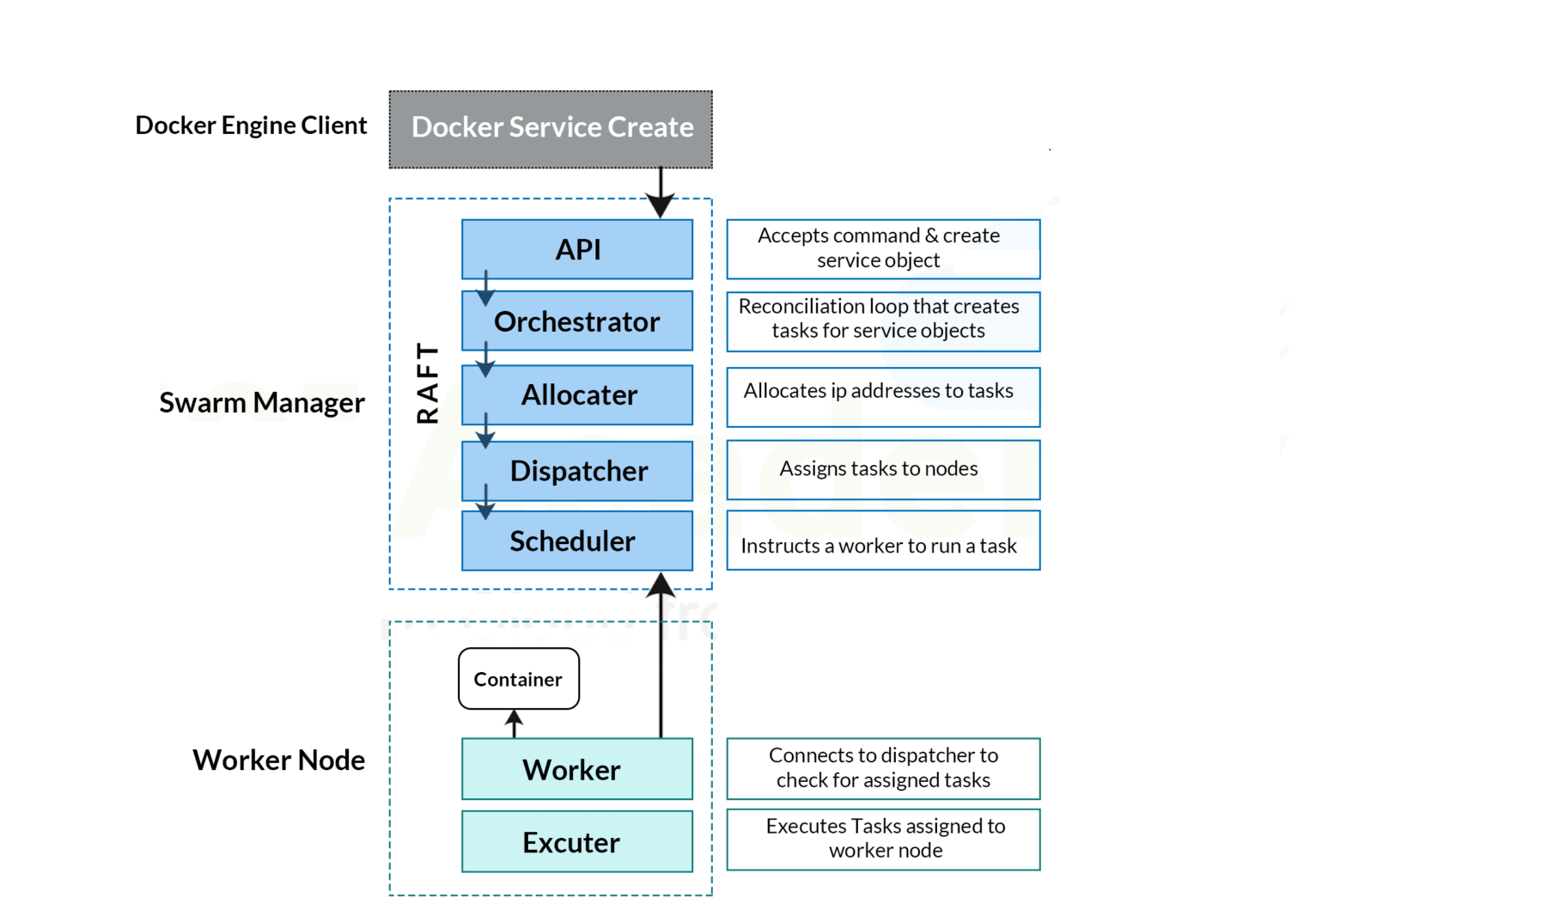
Docker Swarm Architecture – In Detail

Slide 6
Docker Swarm – Components/Feature
Components:
Docker Node:
A Swarm node is an instance of the Docker engine.
It is possible to run multiple nodes on a single server. But in production deployments, nodes are distributed across various devices.
Manager Node: Manager nodes are basically liable for all of the container management and orchestration tasks needed to regulate the system in a specific state, like servicing the swarm mode HTTP endpoints, scheduling of the services, and maintaining the state of the cluster.
Worker Node: Receives and executes tasks from the manager node
Features:
Decentralized design: Swarm makes it very easy for teams to access and manage the environment
Declarative service model: Define desired state of various services in your app stack
Scaling: For each service, you can declare the number of tasks you want to run
Desired state reconciliation: The swarm manager node constantly monitors the cluster state and reconciles any differences between the actual state and your expressed desired state
Multi-host networking: You can specify an overlay network for your services
Service discovery: Swarm manager nodes assign each service in the swarm a unique DNS name and load balances running containers
Load balancing: You can expose the ports for services to an external load balancer
Secure by default: better security integration
Rolling updates: deployment completed in an incremental manner
Roll-back a task: rollback to previous stage

Slide 7
Docker Swarm – More Insight
Key Concepts – Services & task: https://docs.docker.com/engine/swarm/key-concepts/
Deploy to Swarm - https://docs.docker.com/get-started/swarm-deploy/
Swarm Mode - https://docs.docker.com/engine/swarm/
How Nodes work in Swarm mode - https://docs.docker.com/engine/swarm/how-swarm-mode-works/nodes/
How Service work - https://docs.docker.com/engine/swarm/how-swarm-mode-works/services/
Security with Docker Swarm - https://docs.docker.com/engine/swarm/how-swarm-mode-works/pki/
Swarm Task State - https://docs.docker.com/engine/swarm/how-swarm-mode-works/swarm-task-states/
Docker Swarm Networking concept: https://docs.docker.com/engine/swarm/networking/

Slide 8
Artifacts
Docker Swarm - Overview
Docker Swarm Architecture in details
Docker official links for reference

