Slide 1
DAY 15
docker and Kubernetes – Journey

Slide 2
AGENDA
Any query from previous session
Need of container orchestration/Production grade clustering
Docker Native Clustering – Swarm Mode
Docker Swarm Architecture
Docker Swarm Key Components
Docker Swarm Execution Platform

Slide 3
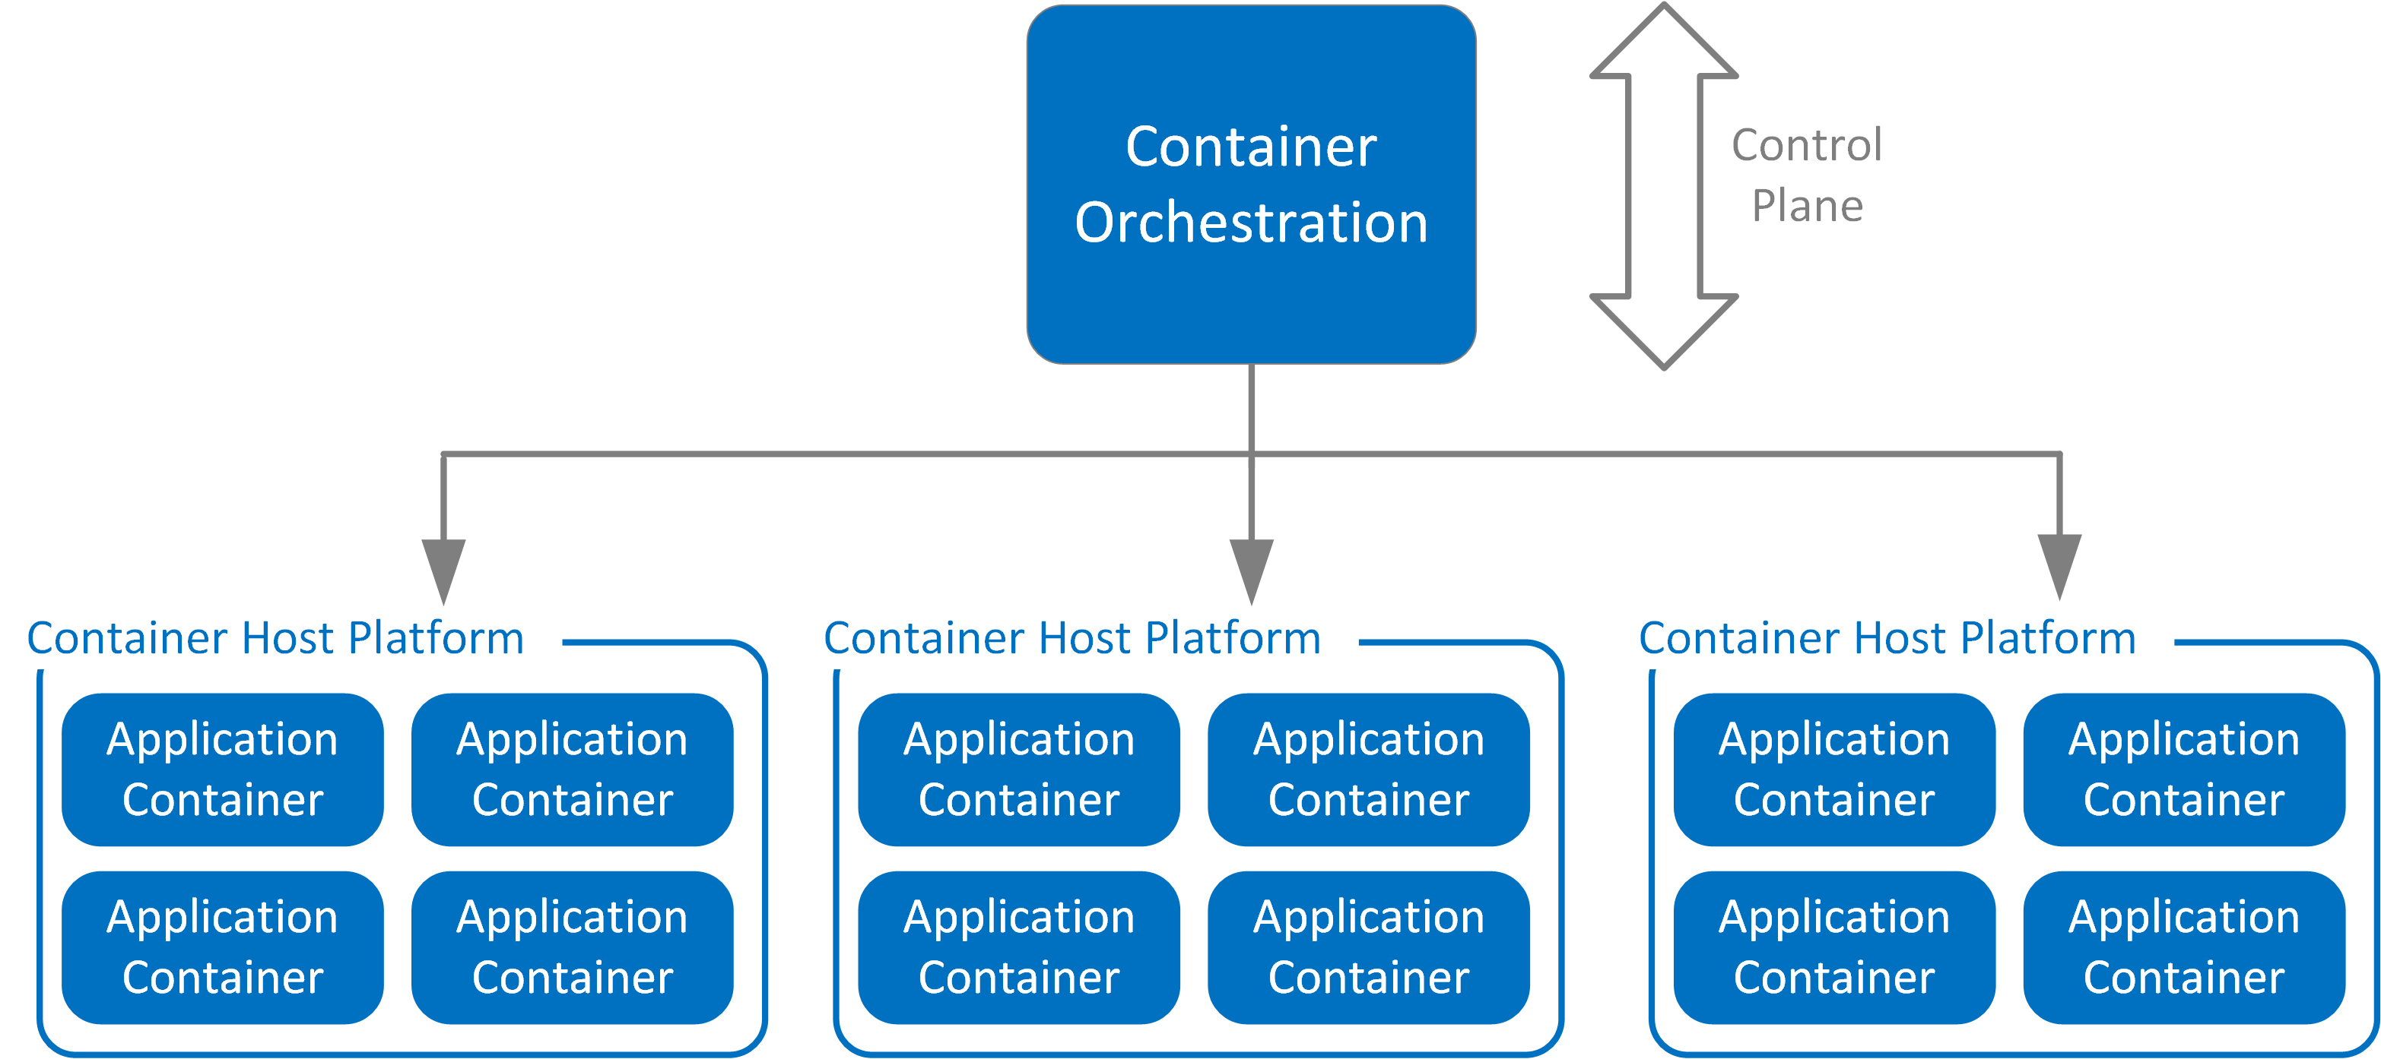
Need of Container Orchestration
Need
Move away from Development area to environment grade deployments
Container orchestration enables automated deployments, management, scaling and container networking
Container orchestration remove/reduce manual intervention
Container orchestration reduce operational overhead because of self management and better control
Deployment on environments based on project/application need without thinking of platform redesign.

Slide 4
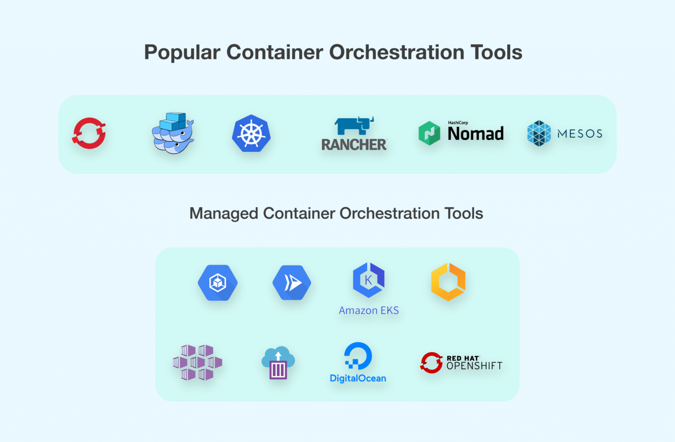
Container Orchestration - More
Benefit and Use
Efficient resource management
Provisioning and deployment
Configuration and scheduling
Container availability/agility
Scaling or removing containers based on balancing workloads across your infrastructure
Load balancing and traffic routing
Monitoring container health
Configuring applications based on the container in which they will run
Keeping interactions between containers secure
Best fit for Microservice Architecture

Slide 5
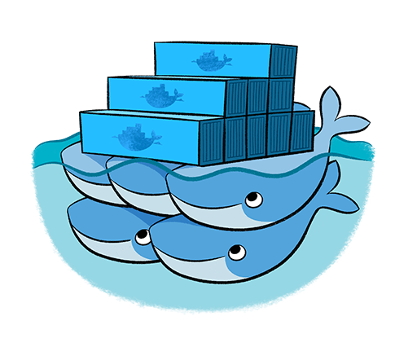
CONTAINER ORCHESTRATION – DOCKER SWARM
Native Clustering System
Clustering (management) for Docker
Manage multiple Docker daemons
Distribute workloads

Slide 6
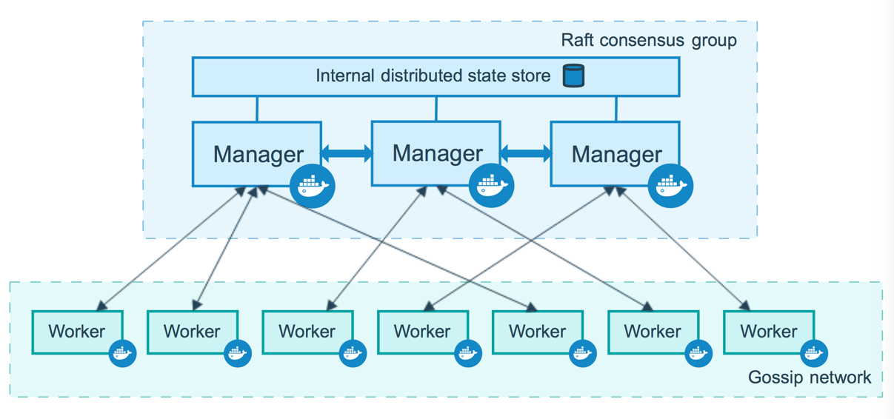
Docker Swarm Architecture

Slide 7
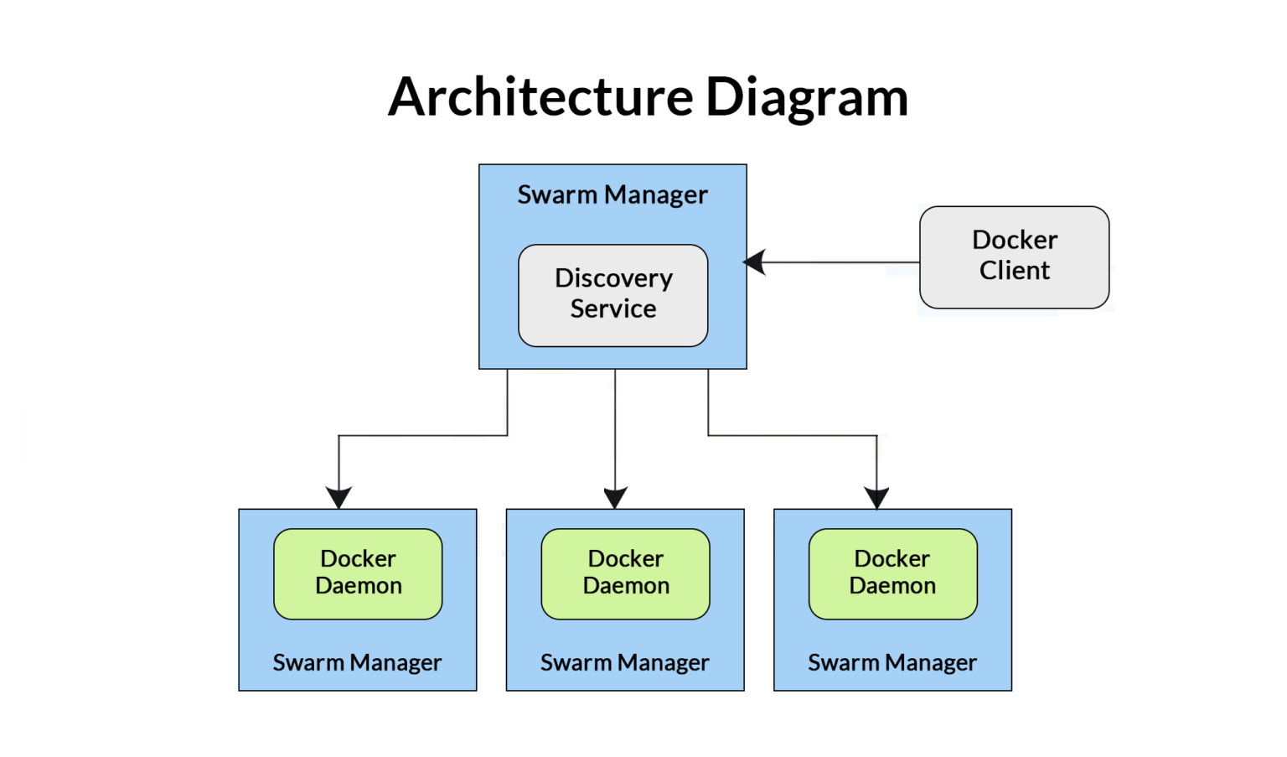
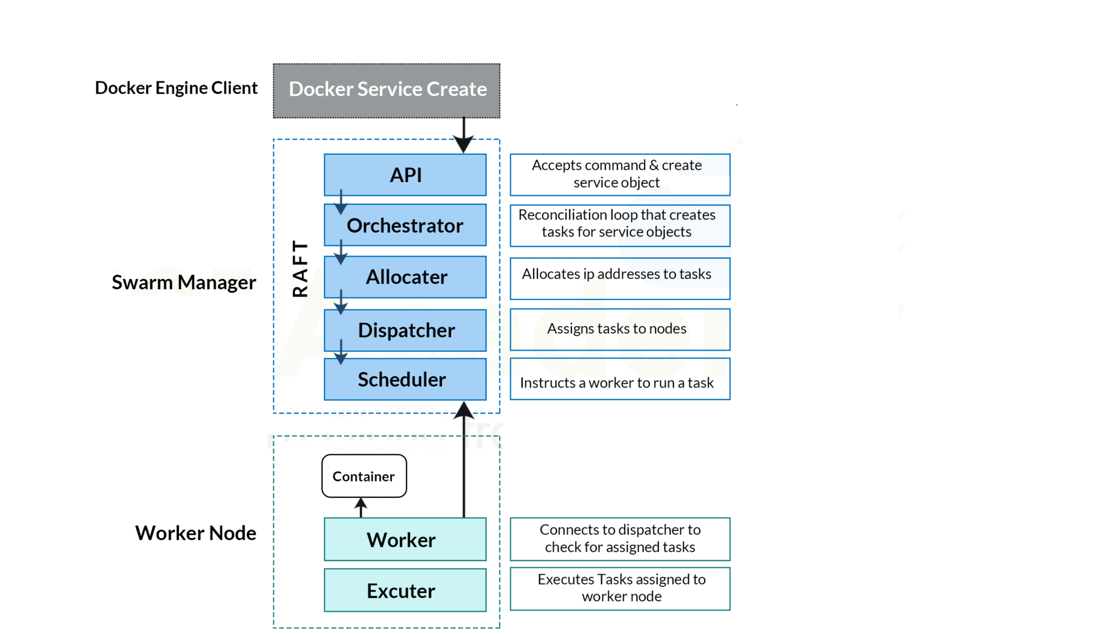
Docker Swarm Architecture – In Detail

Slide 8
Docker Swarm – Components/Feature
Components:
Docker Node:
A Swarm node is an instance of the Docker engine.
It is possible to run multiple nodes on a single server. But in production deployments, nodes are distributed across various devices.
Manager Node: Manager nodes are basically liable for all of the container management and orchestration tasks needed to regulate the system in a specific state, like servicing the swarm mode HTTP endpoints, scheduling of the services, and maintaining the state of the cluster.
Worker Node: Receives and executes tasks from the manager node
Features:
Decentralized design: Swarm makes it very easy for teams to access and manage the environment
Declarative service model: Define desired state of various services in your app stack
Scaling: For each service, you can declare the number of tasks you want to run
Desired state reconciliation: The swarm manager node constantly monitors the cluster state and reconciles any differences between the actual state and your expressed desired state
Multi-host networking: You can specify an overlay network for your services
Service discovery: Swarm manager nodes assign each service in the swarm a unique DNS name and load balances running containers
Load balancing: You can expose the ports for services to an external load balancer
Secure by default: better security integration
Rolling updates: deployment completed in an incremental manner
Roll-back a task: rollback to previous stage

Slide 9
Docker Swarm – More Insight
Key Concepts – Services & task: https://docs.docker.com/engine/swarm/key-concepts/
Deploy to Swarm - https://docs.docker.com/get-started/swarm-deploy/
Swarm Mode - https://docs.docker.com/engine/swarm/
How Nodes work in Swarm mode - https://docs.docker.com/engine/swarm/how-swarm-mode-works/nodes/
How Service work - https://docs.docker.com/engine/swarm/how-swarm-mode-works/services/
Security with Docker Swarm - https://docs.docker.com/engine/swarm/how-swarm-mode-works/pki/
Swarm Task State - https://docs.docker.com/engine/swarm/how-swarm-mode-works/swarm-task-states/
Docker Swarm Networking concept: https://docs.docker.com/engine/swarm/networking/

Slide 10
Artifacts
Docker Swarm - Overview
Docker Swarm Architecture in details
Docker official links for reference

