Slide 1
DAY 30
docker and Kubernetes – Journey

Slide 2
AGENDA
Recap/Any query from previous session
Daemon set understanding, use-cases
Daemon set Demo
Stateful set understanding and use-cases
Stateful set Demo

Slide 3
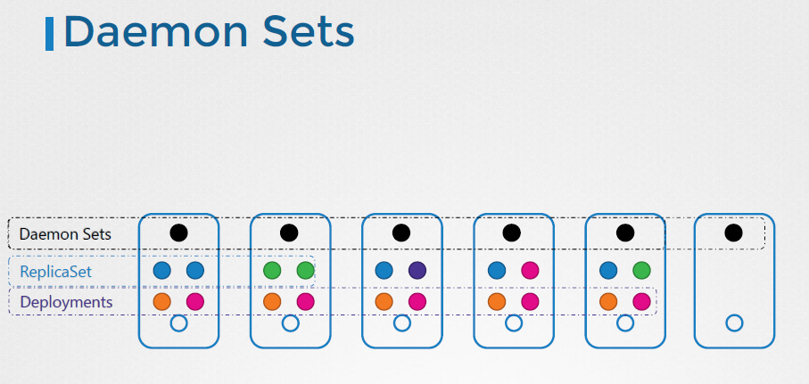
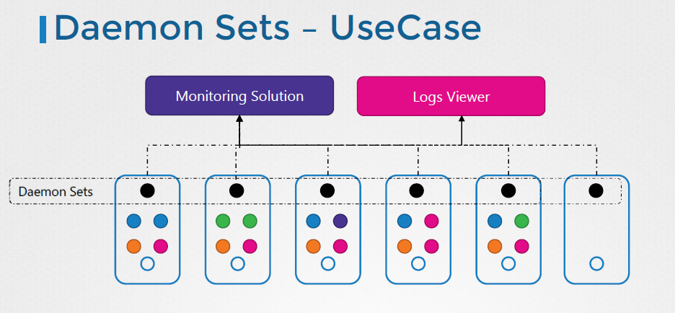
Daemon sets - Understanding

Slide 4
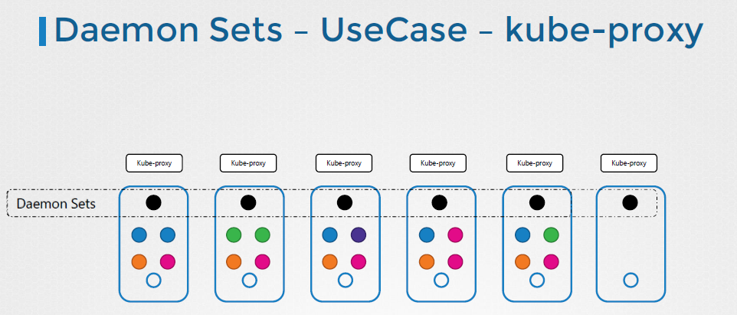
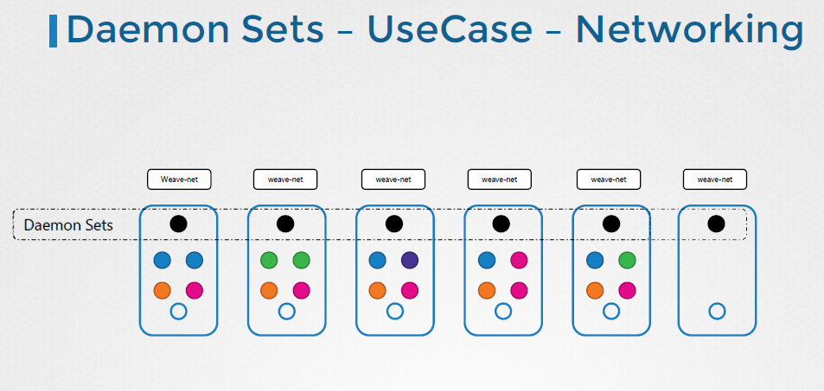
Daemon sets – Use Cases

Slide 5
Artifacts
Daemonset:
https://kubernetes.io/docs/concepts/workloads/controllers/daemonset/
Statefulset:
https://kubernetes.io/docs/concepts/workloads/controllers/statefulset/
https://sysdig.com/learn-cloud-native/kubernetes-101/kubernetes-statefulsets-overview/
Static Pods and Daemonset:
https://medium.com/google-cloud/daemon-sets-static-pods-bf43b10efe97

