Slide 1
DAY 10
docker and Kubernetes – Journey

Slide 2
AGENDA
Any query from previous session
Docker Volume – tmpfs, mount
Docker Multi Stage Build
YAML understanding
Need of Docker Compose
Docker Compose file – Example/Brief
Docker Network
Docker compose - Demo

Slide 3
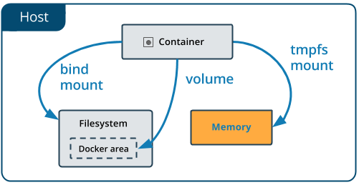
Tmpfs mounts
Tmpfs nature – not persistent data
Useful to store sensitive files
Remove with container lifecycle
Not able to share b/w containers
Only available for Docker running on Linux
docker run -d -it --name tmptest --tmpfs /app nginx:latest

Slide 4
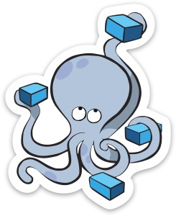
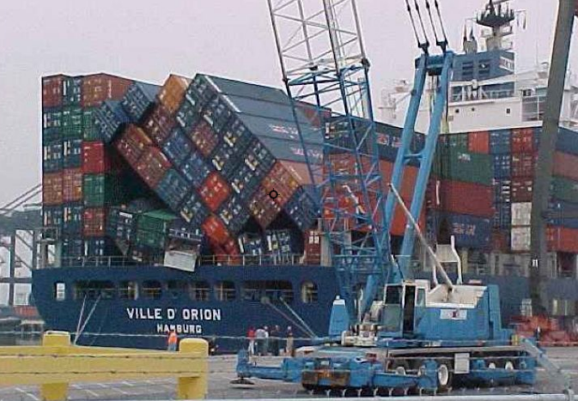
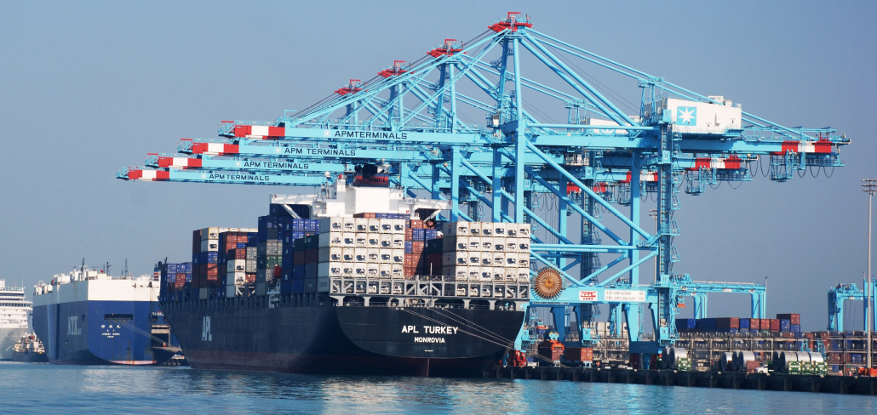
DOCKER COMPOSE – NEED OF ORCHESTRATION
Problems with standalone Docker Running a server cluster on a set of Docker containers, on a single Docker host is vulnerable to single point of failure !!!

Slide 5
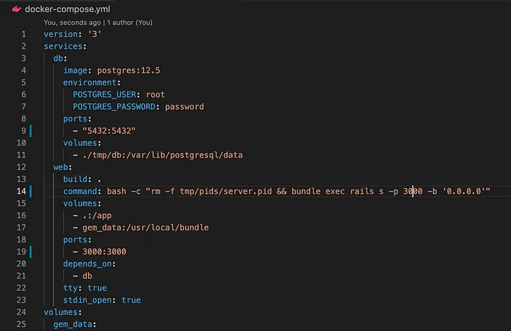
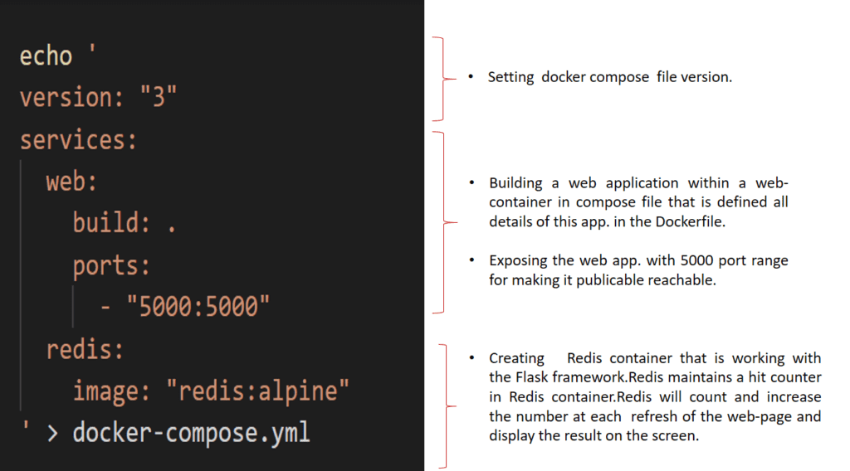
DOCKER COMPOSE
Tool for defining and running multi-container
applications with Docker in a single file
Fast, isolated development environments using Docker.
Quick and easy to start

Slide 6
Artifacts
Docker Volume details
https://docs.docker.com/engine/reference/commandline/volume_create/
https://www.baeldung.com/ops/docker-volumes
https://www.freecodecamp.org/news/docker-mount-volume-guide-how-to-mount-a-local-directory/
Tmpfs - https://bobcares.com/blog/tmpfs-docker-and-its-function/
Multi Stage build
https://www.freecodecamp.org/news/docker-mount-volume-guide-how-to-mount-a-local-directory/
YAML Quick Reference - https://www.cloudbees.com/blog/yaml-tutorial-everything-you-need-get-started
JSON to YAML conversion
Docker Compose Details
Docker Network Details
Docker command Executed reference guide

