Slide 1
DAY 5
docker and Kubernetes – Journey

Slide 2
AGENDA
Any query from previous session
Docker Cleanup/Installation with debugging steps
Docker info/version
Standalone container
Play with Docker
Images, PS, container, start, stop, attach, rm, rmi, network
Operations inside containers – attach, interactive, exec (default shell)
Commit image
Docker registry setup and push images

Slide 3
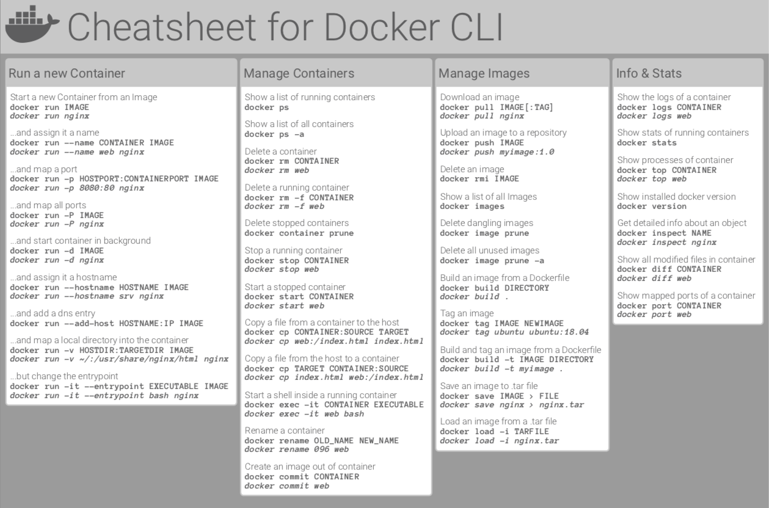
DOCKER COMMANDS

Slide 4
Artifacts
Docker clean-up – installed via Snap during Ubuntu installation
Docker installation steps
Docker helpful command
Docker cheat sheets

