Slide 1
DAY 30
docker and Kubernetes – Journey

Slide 2
AGENDA
Recap/Any query from previous session
Ephermal vs persistent storage
Volumes - emptyDir, Hostpath, downwardAPI & NFS with Demo
Volumes - downwardApi & Hostpath - Demo
Peristent volume (PV) and Persistent volume claim (PVC)
PV and PVC Data dependencies, use case & Advantages
static vs dynamic provisoning, PVC assignment in deployments, daemonset and statefulSet objects
PV and pvc demo
statefulSet Understanding

Slide 3
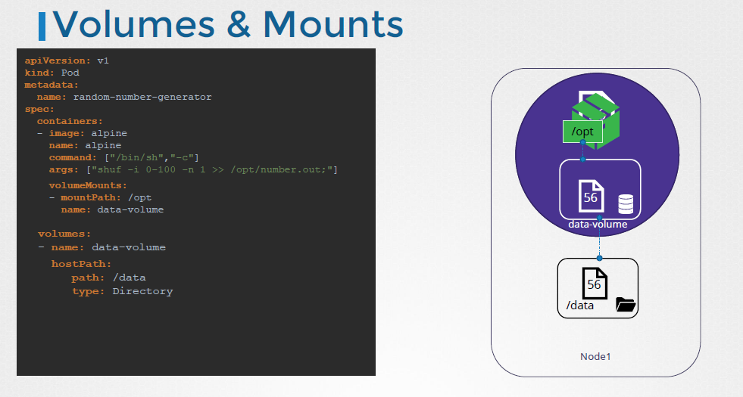
Volume & Mounts

Slide 4
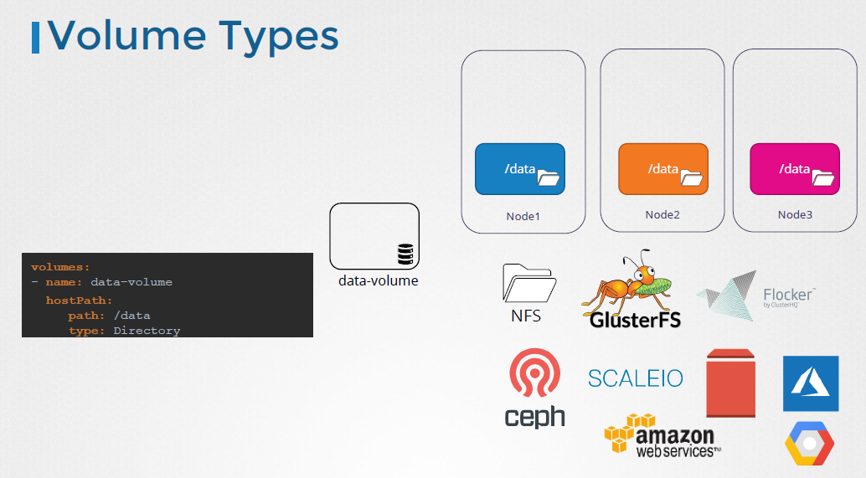
Volume Types

Slide 5
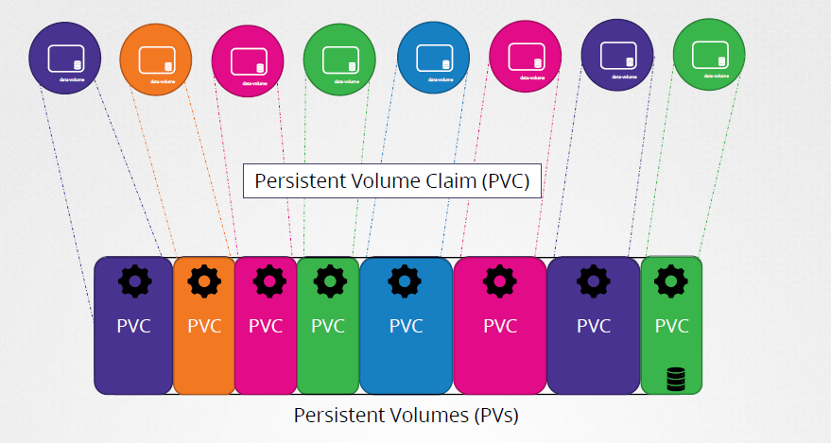
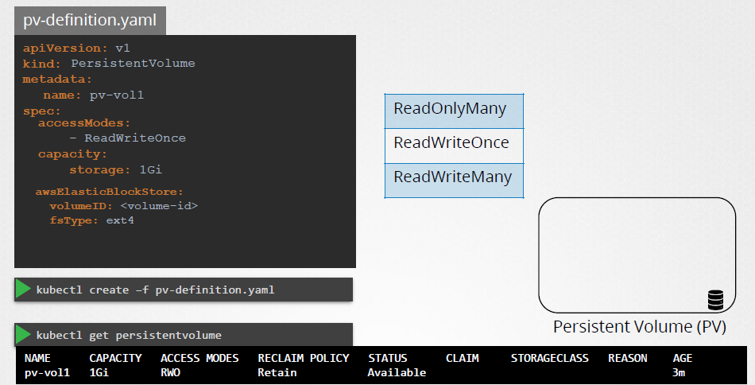
Persistent Volume

Slide 6
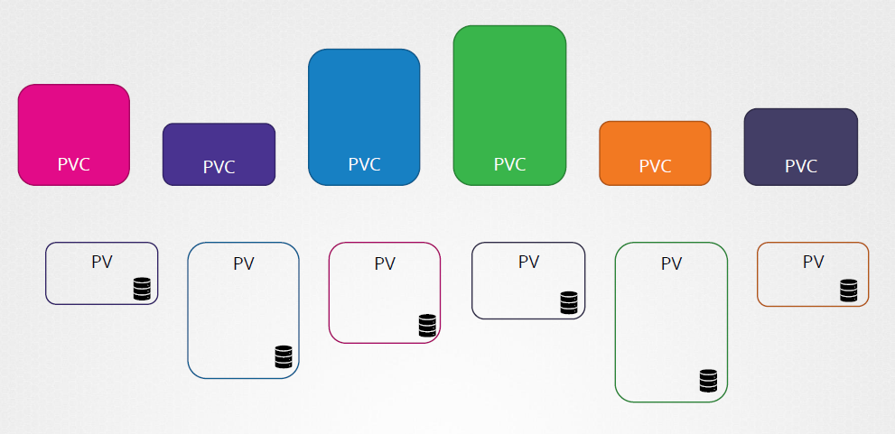
Persistent Volume Claim

Slide 7
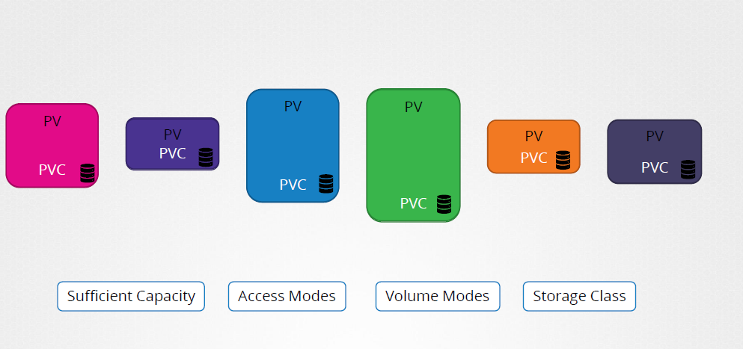
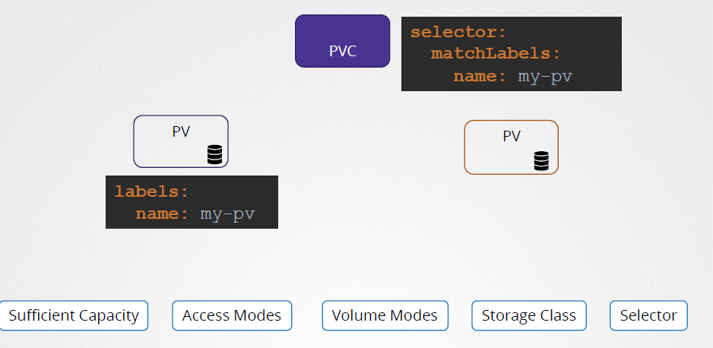
PVC - Binding

Slide 8
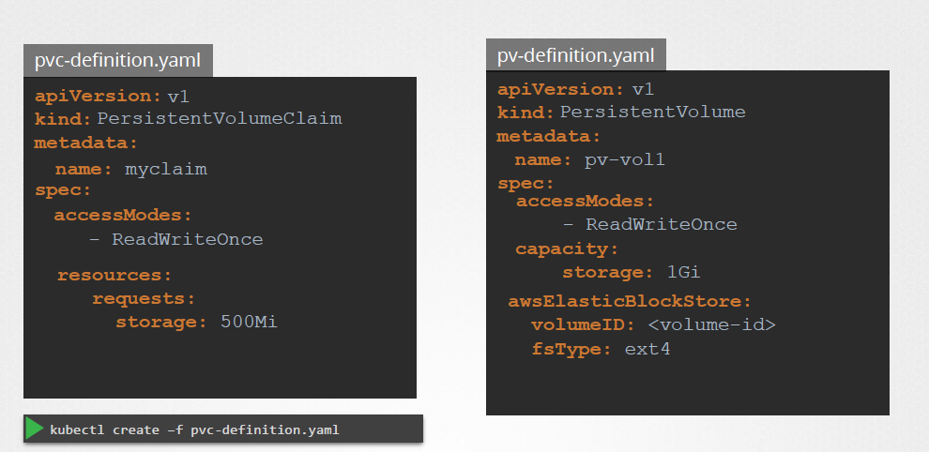
PVC - Details

Slide 9
Artifacts
Volumes/Persistent Volumes in Kubernetes world:
https://kubernetes.io/docs/concepts/storage/volumes/
https://kubernetes.io/docs/concepts/storage/persistent-volumes/
https://kubernetes.io/docs/concepts/storage/ephemeral-volumes/
https://kubernetes.io/docs/concepts/storage/projected-volumes/
https://kubernetes.io/docs/tasks/configure-pod-container/configure-persistent-volume-storage/
https://bluexp.netapp.com/blog/cvo-blg-kubernetes-persistent-volume-claims-explained
https://www.digihunch.com/2021/06/kubernetes-storage-explained/

