Slide 1
DAY 11
docker and Kubernetes – Journey

Slide 2
AGENDA
Any query from previous session
Docker Network
Default/Bridge/None/Host/Overlay
Customized bridge network
YAML understanding
Need of Docker Compose
Docker Compose evolution - Versions
Docker Compose file – Example/Brief
Docker compose - Demo

Slide 3
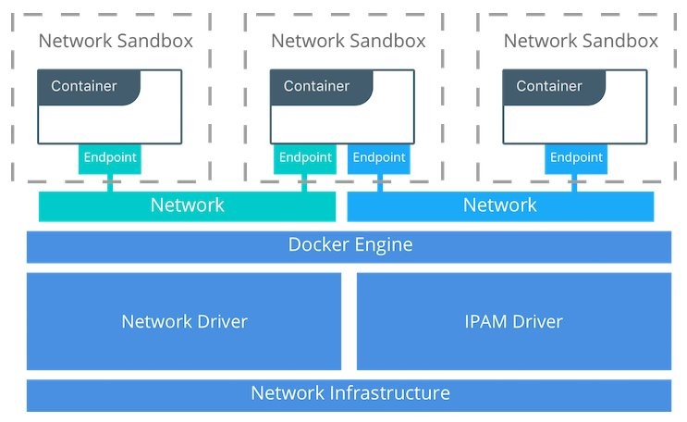
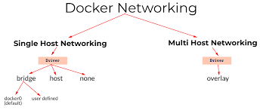
DOCKER NETWORKS
Docker Network Drivers
Bridge N/W: Private default n/w, container linked to internal IP addresses
Host N/W: Public n/w, utilize host IP addresses
None: No external interface, for disabling container n/w
Overlay: For Docker Swarm cluster, internal private n/w to the Docker nodes
Macvlan: For simplified communication b/w containers using MAC address

Slide 4

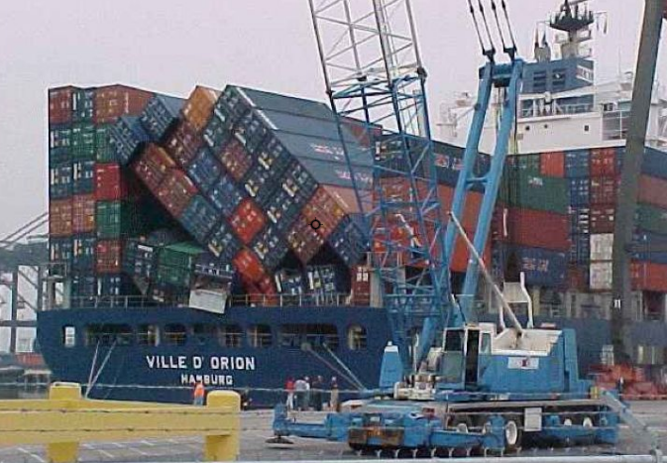
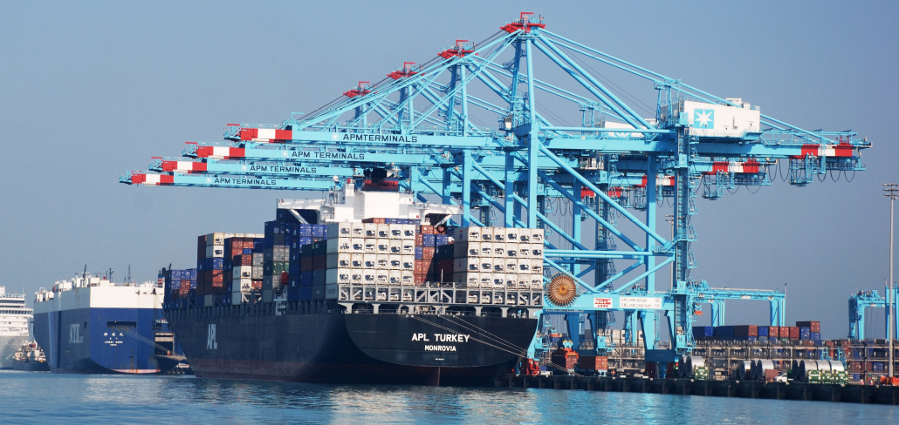
DOCKER COMPOSE – NEED OF ORCHESTRATION
Problems with standalone Docker Running a server cluster on a set of Docker containers, on a single Docker host is vulnerable to single point of failure !!!

Slide 5
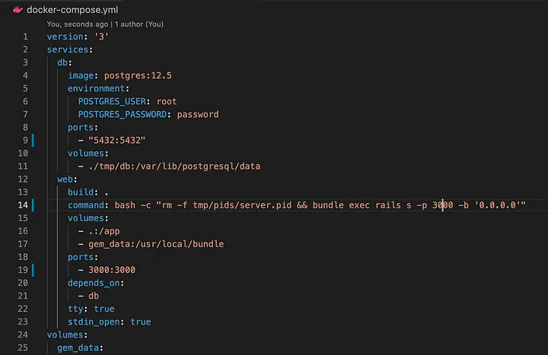
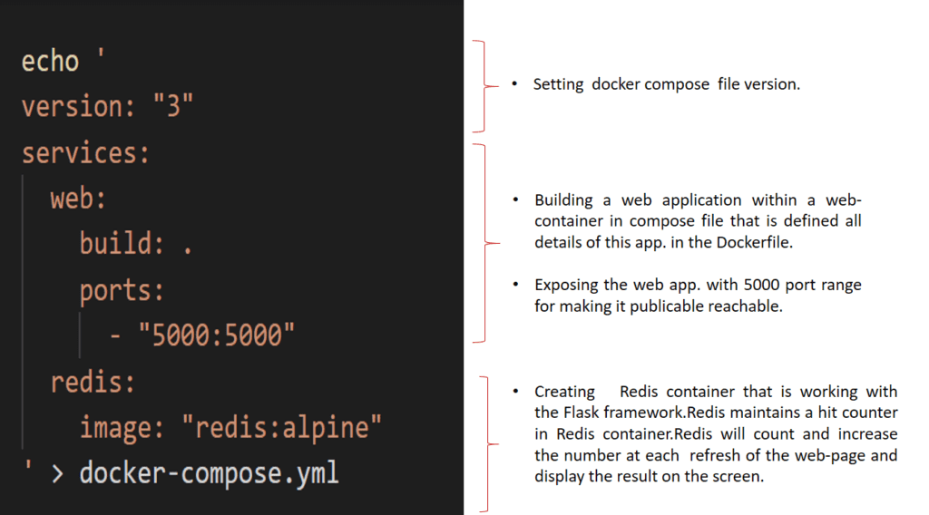
DOCKER COMPOSE
Tool for defining and running multi-container
applications with Docker in a single file
Fast, isolated development environments using Docker.
Quick and easy to start

Slide 6
Artifacts
Docker command Executed reference guide
Docker Network Details
https://itnext.io/a-beginners-guide-to-networking-in-docker-ca5b822fb935
YAML Quick Reference –
https://www.cloudbees.com/blog/yaml-tutorial-everything-you-need-get-started
https://www.javatpoint.com/yaml
Docker Compose – Reference links
https://docs.docker.com/compose/compose-v2/
https://sreeninet.wordpress.com/2017/03/28/comparing-docker-compose-versions/
Docker Compose Details

