Slide 1
DAY 21
docker and Kubernetes – Journey

Slide 2
AGENDA
Recap/Any query from previous session
Docker
Docker-Compose
Docker-swarm
Kubernetes – The Way Forward
Kubernetes – Intro/Overview
Docker Swarm Vs Kubernetes
Kubernetes Market Share
Kubernetes Architecture – High Level Design
Kubernetes Architecture – Low Level Design
Kubernetes Components overview

Slide 3
KUBERNETES – Intro/Overview
Advantages
Service Discovery/Load Balancing
Automatic Bin Packing
Self Healing
Secret/Config Maps
Automatic Rollouts/Rollbacks
Storage Orchestration
Kubernetes is a powerful open-source system, developed by google, for managing containerized applications in a clustered environment.
Kubernetes provides better ways of managing related, distributed components and services across varied infrastructure
Kubernetes platform designed to manage life cycle of containerized application and services by using predictability, scalability & high availability
Kubernetes brings together individual physical or virtual machines into cluster using shared network, all resources configured on platform

Slide 4
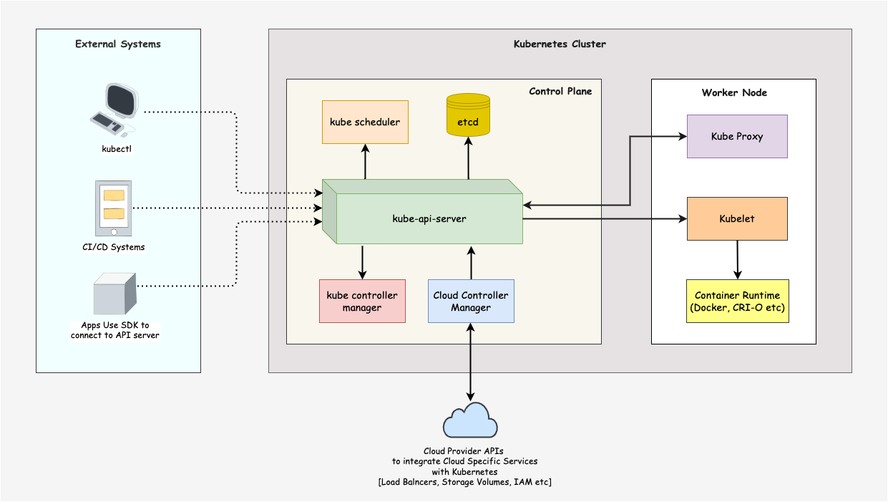
KUBERNETES - ARCHITECTURE

Slide 5
KUBERNETES – CORE COMPONENTS
Control Plane: The control plane is responsible for container orchestration and maintaining the desired state of the cluster. It has the following components.
kube-apiserver
etcd
kube-scheduler
kube-controller-manager
Worker Node: The Worker nodes are responsible for running containerized applications. The worker Node has the following components.
kubelet
kube-proxy
Container runtime

Slide 6
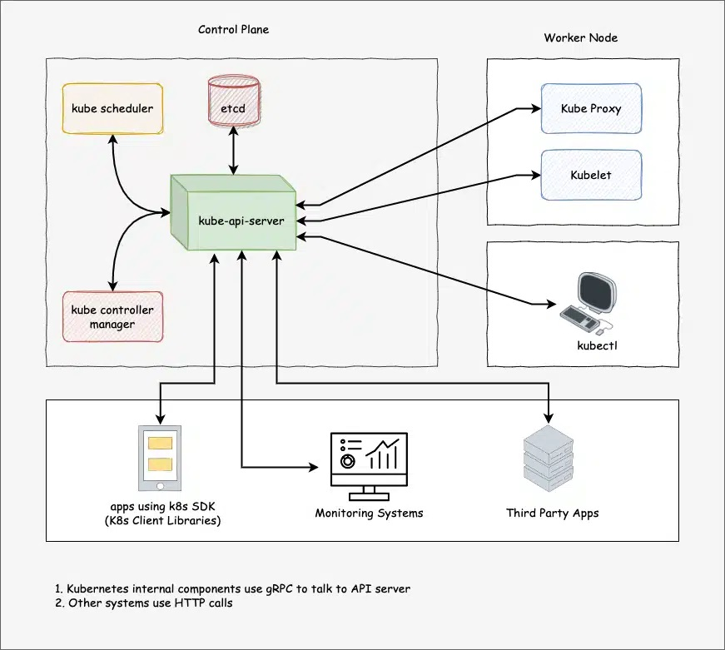
KUBERNETES – CONTROLER NODE ARCHITECTURE
Kube-apiserver: Central hub of K8S cluster & expose all K8S API, responsible for API management, authentication, processing API request & communicate with etcd
etcd: It is brain of K8S cluster, Kubernetes distribute system is managed by etcd and it stored data in strongly consistent key value pair
Kube-scheduler: Responsible for scheduling pods on worker nodes
Kube controller manger: It manages all the K8S controllers. K8S resources/objects like pods, namespaces, jobs, replicaset are managed by designated controllers. Kube-scheduler also controlled by controller manager

Slide 7
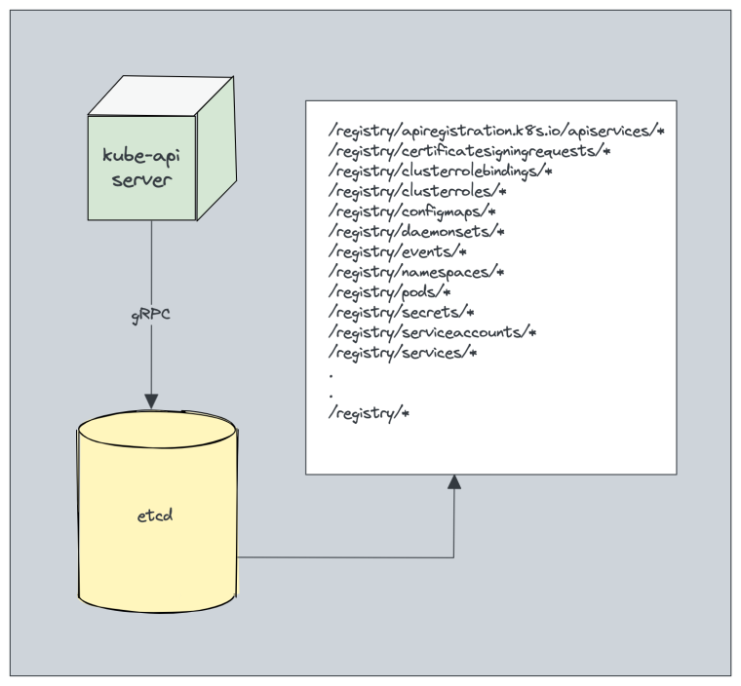
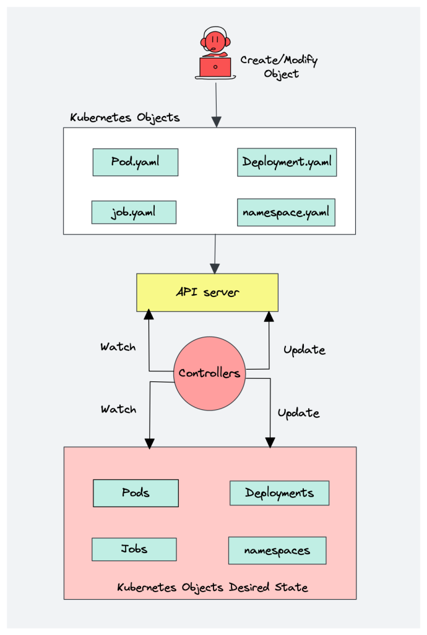
KUBERNETES – CONTROLER NODE – CONTROLER/ETCD ARCHITECTURE

Slide 8
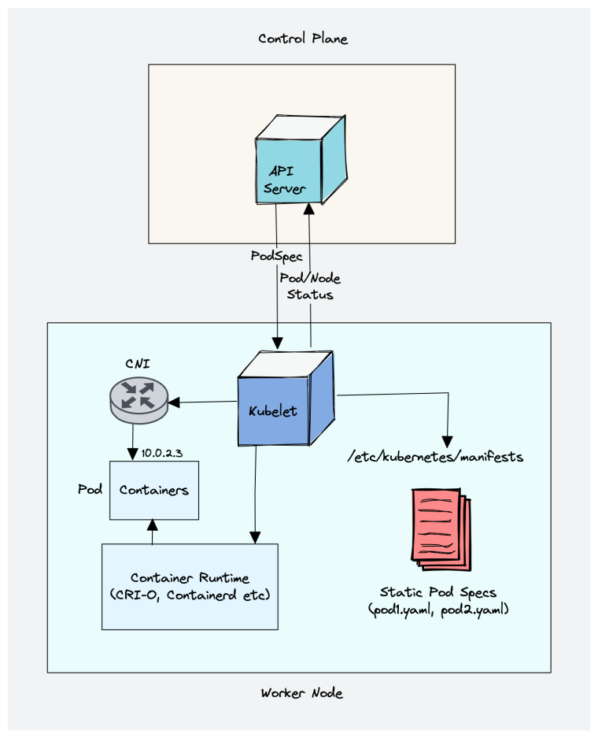
KUBERNETES – WORKER NODE – KUBELET ARCHITECTURE
Kubelet is an agent component that runs on every node in cluster, run as daemon & managed by system.
Responsible for registering worker node with API server
Create, modify & delete containers for the pod
Responsible for liveliness, readiness & startup probe
Responsible for mounting volumes & required operations on host
Collect and report node and pod status via API server
Working with podSpec (pod specification– YAML/JSON) from API server
podSpec defines the container configuration item that run inside the pod, their resources – CPU & Memory limits, environment variables, volumes & labels

Slide 9
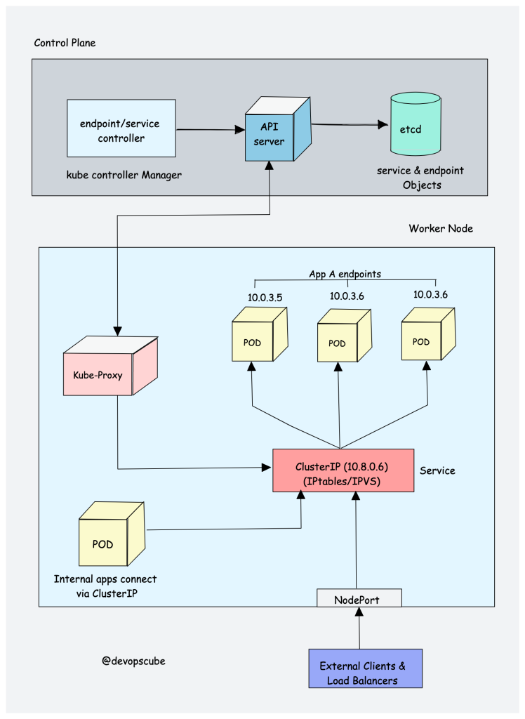
KUBERNETES – WORKER NODE – KUBEP-ROXY ARCHITECTURE
Kube-proxy is daemon that runs on every node as a daemonset
Kube-proxy is responsible for exposing pods services/endpoints both internally and externally
Kube-proxy handles service discovery and load balancing
Kube-proxy interact with API-server for any change in services (clusterIP) & endpoints

Slide 10
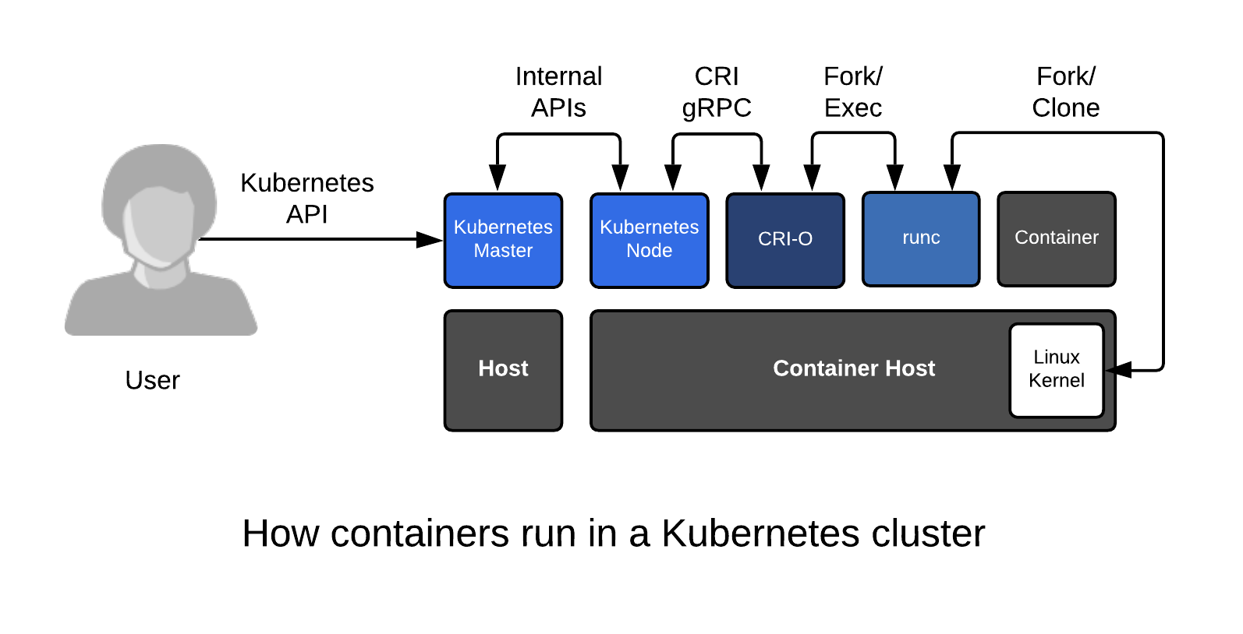
KUBERNETES – WORKER NODE – CONTAINER RUNTIME ARCHITECTURE
Container Runtime is required for running of a container
Responsible for pulling images from container registries, running container, allocating & isolating container resources and manage lifecycle of container on a host
Container runtime interface (CRI): it is a set of APIs that allows Kubernetes to interact with different container runtimes
CRI defines the API for creating, starting, stopping & deleting containers. It manage images and container network
Open Container initiative (OCI): It is set of standard for container format and runtime

Slide 11
Artifacts
Kubernetes Market Share
https://newsletter.cote.io/p/kubernetes-marketshare-across-cloud
Docker Swarm Vs Kubernetes
https://circleci.com/blog/docker-swarm-vs-kubernetes/
https://www.freecodecamp.org/news/kubernetes-vs-docker-swarm-what-is-the-difference/

