Slide 1
DAY 10
docker and Kubernetes – Journey

Slide 2
AGENDA
Any query from previous session
YAML understanding
Need of Docker Compose
Docker Compose file – Example/Brief
Docker Network
Docker compose - Demo

Slide 3

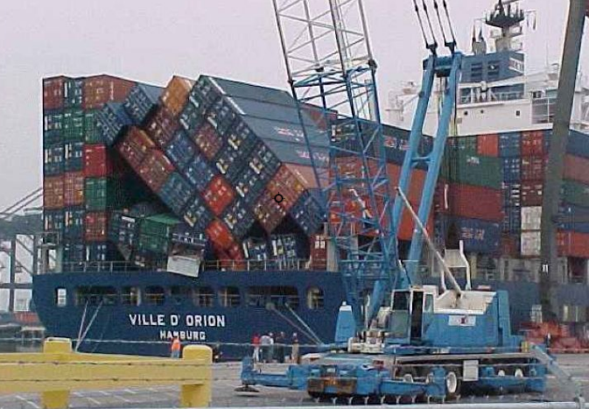
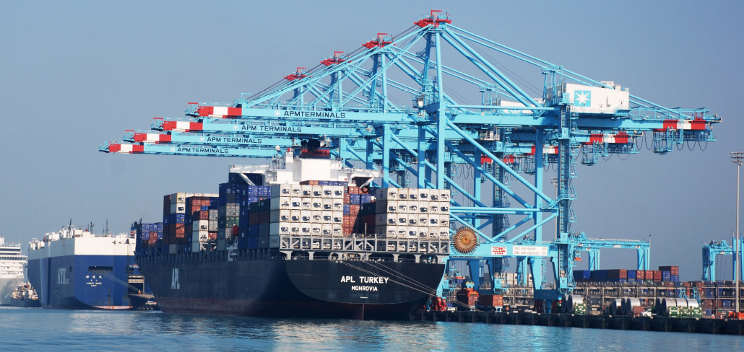
DOCKER COMPOSE – NEED OF ORCHESTRATION
Problems with standalone Docker Running a server cluster on a set of Docker containers, on a single Docker host is vulnerable to single point of failure !!!

Slide 4
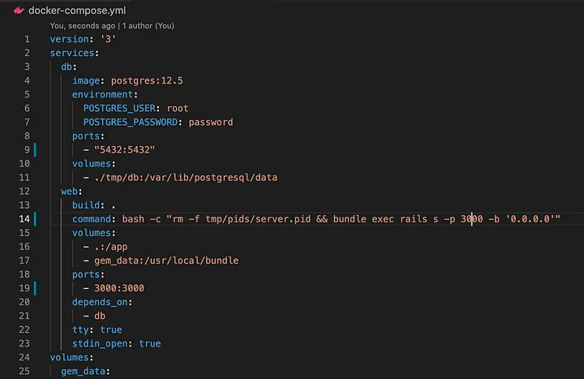
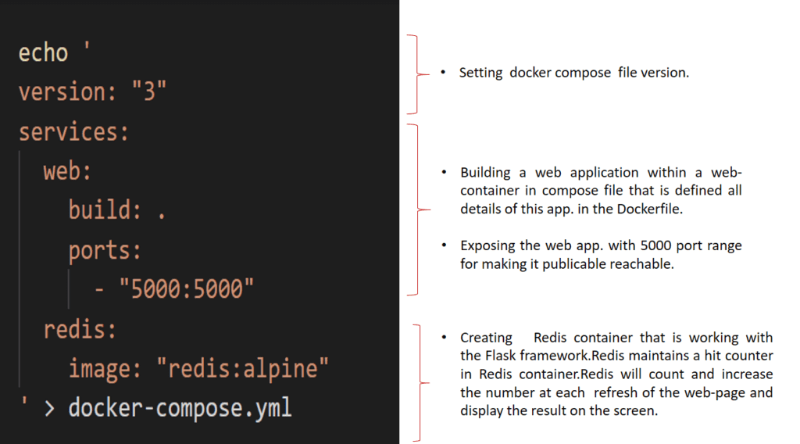
DOCKER COMPOSE
Tool for defining and running multi-container
applications with Docker in a single file
Fast, isolated development environments using Docker.
Quick and easy to start

Slide 5
Artifacts
Docker command Executed reference guide
Docker Compose – Reference links
YAML Quick Reference - https://www.cloudbees.com/blog/yaml-tutorial-everything-you-need-get-started
JSON to YAML conversion
Docker Compose Details
Docker Network Details

