Slide 1
DAY 10
docker and Kubernetes – Journey

Slide 2
AGENDA
Any query from previous session
Docker Compose - Demo
Container Orchestration
Docker Networking
Docker Swarm Architecture
Docker Swarm Demo

Slide 3
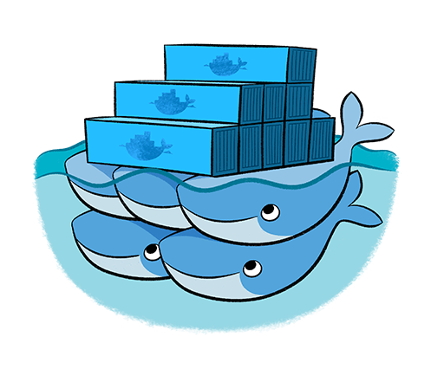
CONTAINER ORCHESTRATION – DOCKER SWARM
Native Clustering System
Clustering (management) for Docker
Manage multiple Docker daemons
Distribute workloads

Slide 4
Artifacts
Docker command Executed reference guide
Docker Swarm Referenced Architecture
Other references

