Slide 1
DAY 8
docker and Kubernetes – Journey

Slide 2
AGENDA
Any query from previous session
Dockerfile System Flow – Changes/Updates
Dockerfile Writeup/example/explanation – Nodejs/Java
CMD vs EntryPoint
Dockerfile Build & Push to registry
Docker volume
Docker Port Expose/Publish
Docker Network
Docker logging and tracing/inspect

Slide 3
DOCKER SYSTEM FLOW
Container A
Docker
Container
Image Registry
Push
Search
Pull
Source Code Repository
Run
Build
Dockerfile
For
A
Container A
Container B
Container C
Docker
Docker Engine
Host 1 OS (Linux)
Host 2 OS (Linux)

Slide 4
DOCKER SYSTEM – CHANGES & UPDATES
Docker
Container
Image Registry
App
A
Push
App Δ
Bins/
Libs
Bins/
Base
Container
Image
Container Mod A’
Container Mod A’’
App Δ
Update
App
A
Bins/
App
A’’
Bins/
Libs
Bins/
Libs
Bins/
Docker Engine
Docker Engine
Host is now running A’’
Host running A wants to upgrade to A’’. Requests update. Gets only diffs

Slide 5
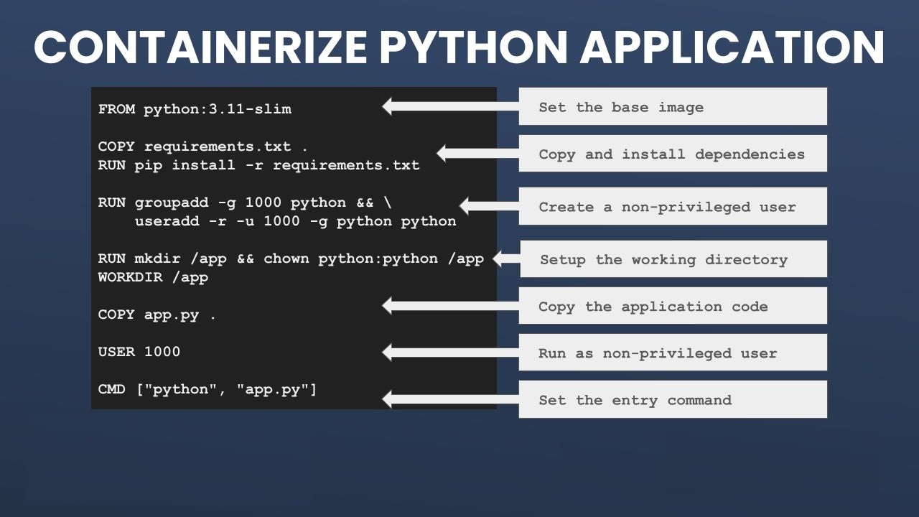
DOCKERFILE – PYTHON EXAMPLE

Slide 6
Artifacts
Docker command cheat sheets
Docker command handy reference documents
Docker Volumes - https://docs.docker.com/storage/volumes/
DockerFile NodeJS Practice – https://docs.docker.com/language/nodejs/
DockerFile Java Practice - https://docs.docker.com/language/java/
DockerFile Python Reference

