Slide 1
MED WITH AIR: DELIVERING AID TO WAR- TORN REGIONS

Slide 2
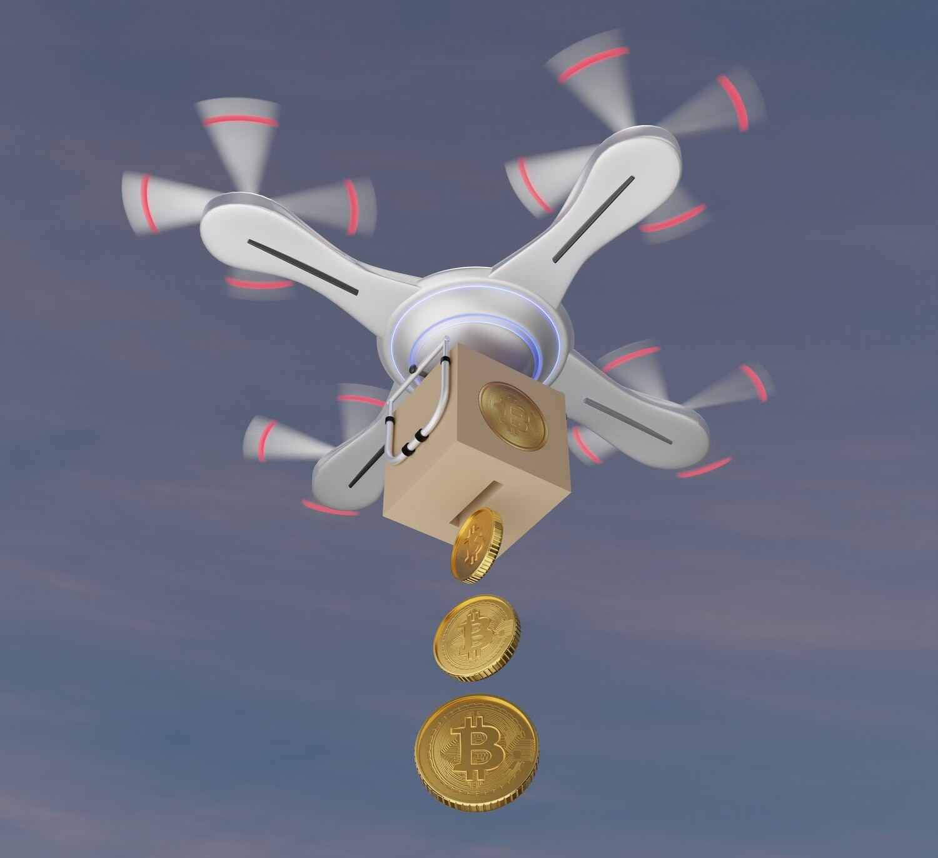
INTRODUCTION
THE MODE OF DELIVERING FACILITIES IS REVOLUTIONISED WITH THE ENTRANCE OF DRONE SERVIECES IN THE WAR SCENARIONS AND TERRAINS WHICH ARE IMPOSSIBLE TO BE REACHED BY SIMPLE TRANSPORT FACILITIES BUT THE PROPER CONTROL OF THE DRONE MODEL IS STILL A QUESTION FOR THE CURRENT SCENARIO.
THERE IS STILL LOT IN THE WAY TO BE DEVELOPED IN THIS DOMAIN WE MED WITH AIR ARE TRYING TO REVOLUTIONISE AND IMPROVE THE DOMAIN FACILITIES SO THAT NOONE DIES WITHOUT GETTING A CHANCE OF SURVIVAL..

Slide 3

Limited Range and Payload Capacity
Drones have limited range and payload capacity, restricting the amount and distance they can cover. This limitation can be a challenge in reaching remote areas with sparse populations.

Slide 4
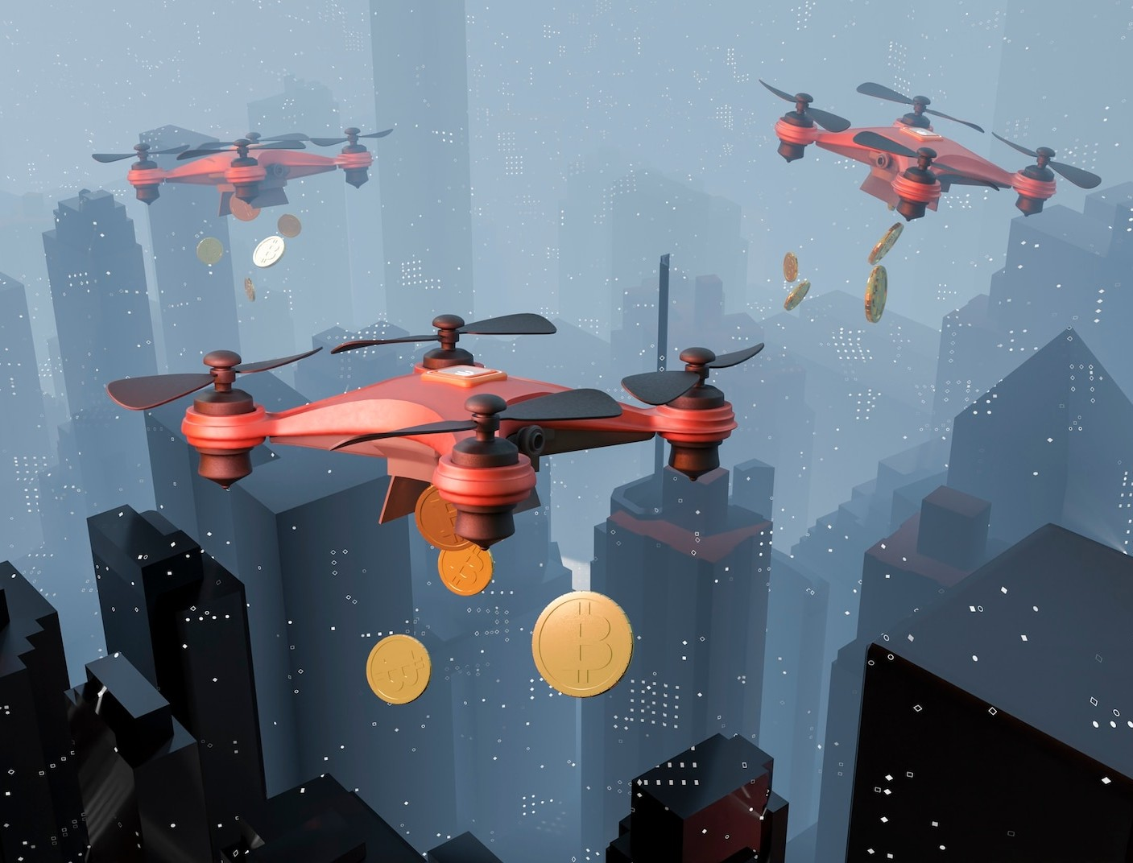
Airspace Restrictions and Regulations
Strict regulations and airspace restrictions can hinder the deployment of drones, particularly in war-hit regions where military activities may dominate the airspace.

Slide 5
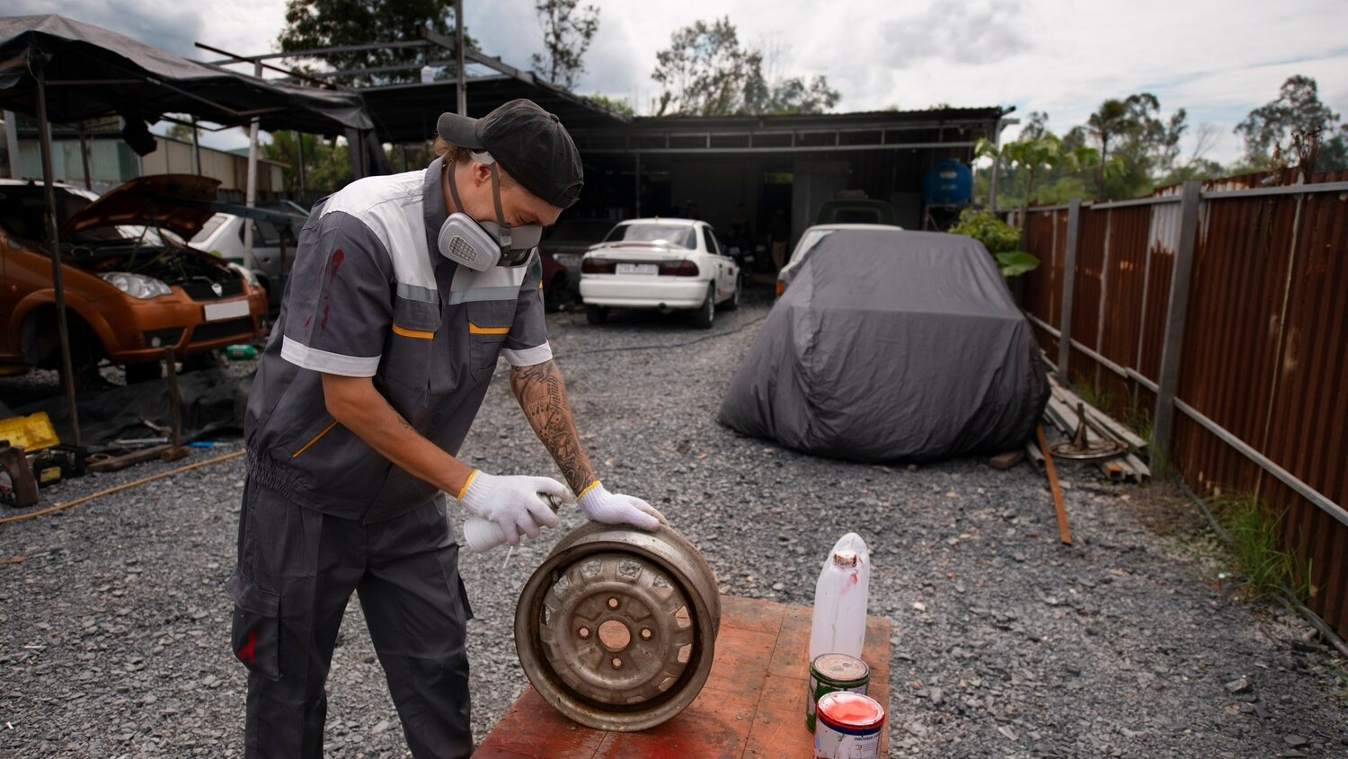
Weather Conditions: Adverse weather conditions, such as strong winds, rain, or snow, can affect the stability and safety of drone flights, particularly in areas prone to extreme weather events.

Slide 6

Security Risks
Drones are vulnerable to theft, damage, or interception, especially in conflict zones where they may be targeted due to their perceived association with military activities.

Slide 7
Communication Challenges:
Remote regions may lack reliable communication infrastructure, making it difficult to establish and maintain a stable connection with drones for real-time monitoring and control.

Slide 8
INCREASING PAYLOAD CAPACITY AND RANGE OF THE DRONE
SOLUTIONS TO THE PROBLEMS OF THE CURENT SCENARIO IN HANDLING THE DRONE FOR THE WAR SCENARIOS
Hybrid power batteries are used which can use the solar power and the traditional battery design and can be operated as per the weather requirements and the model can be designed to reduce the weight and optimise the payload capacity

Slide 9
WEATHER STABILITY
THE PID control should be calibrated with the digital pressure sensor such that when the pressure on the propellers of the drone changes , the PID tuning constants change accordingly and the perfect tuning is attained according to the pressure, thus increasing the stability of the drone.

Slide 10
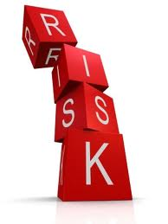
SECURITY RISKS
A lock check system can be added in the drone so that as soon as it is locked as the target the coordinate path at the particular instant changes so that there is a motion in XYZ direction along with some angle controls such that locking the drone is near to impossible and the risks of being the target reduces and the proper delivery of the medical facilities are attained

Slide 11
COMMUNICATION CHALLENGES
A sensor should be attained to give the feedback to the input(propeller speed ,direction of velocity at that instant, angle of rotation) according to the distance of the obstacles so that the path changes according to the disturbance in the output coordinates of the drone at the instant due to the obstacles generated due to war situation. This can be done by integrating the drone with the digital ultrasonic sensor which would be feeded directly by the propeller speed data so that it can act on its own according to the terrain.

Slide 12
WEBSITE DETAILS
NAME OF THE SITE- MED WITH AIR
WEBSITE LINK-
https://medwithair.godaddysites.com/

