Slide 1
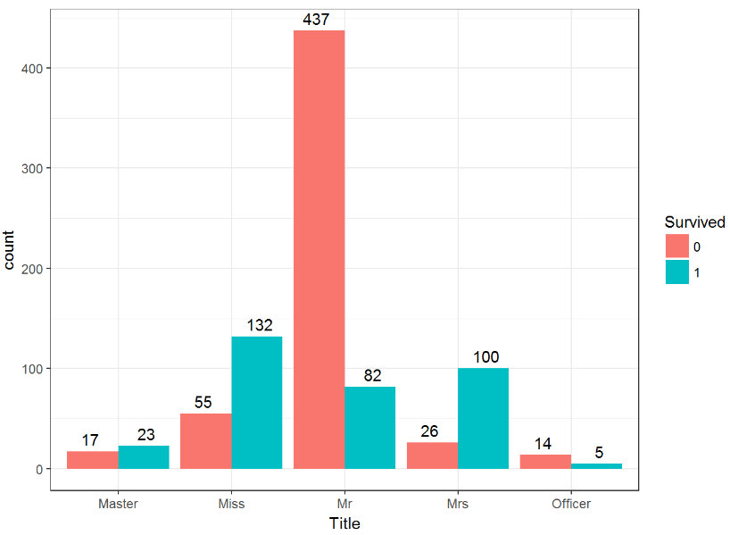
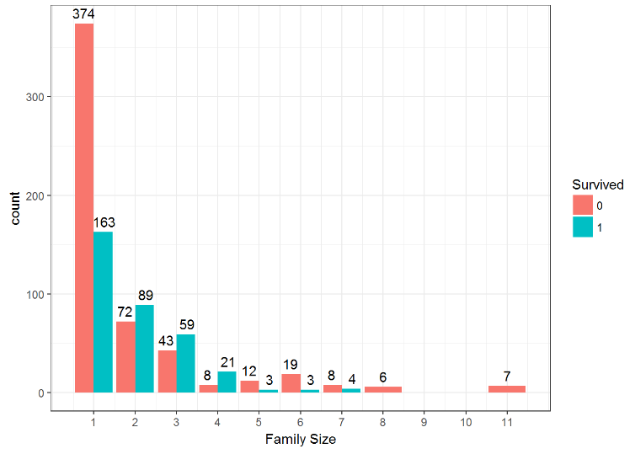
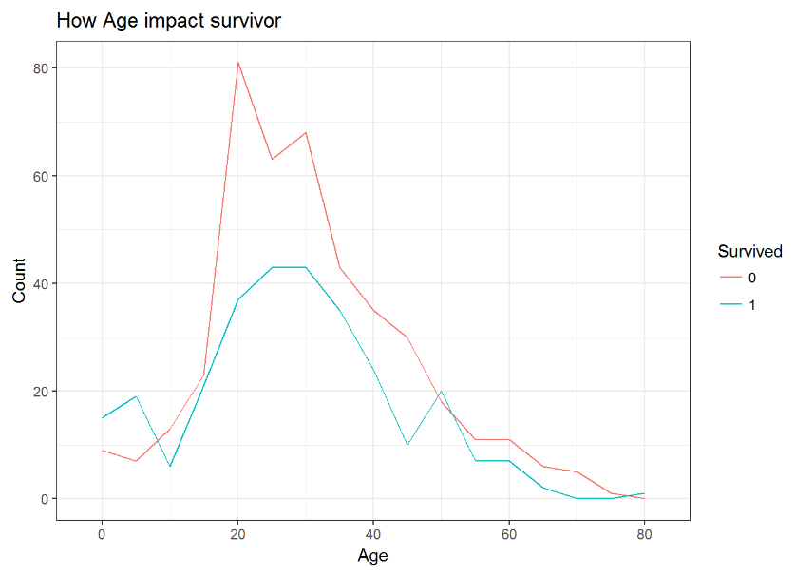
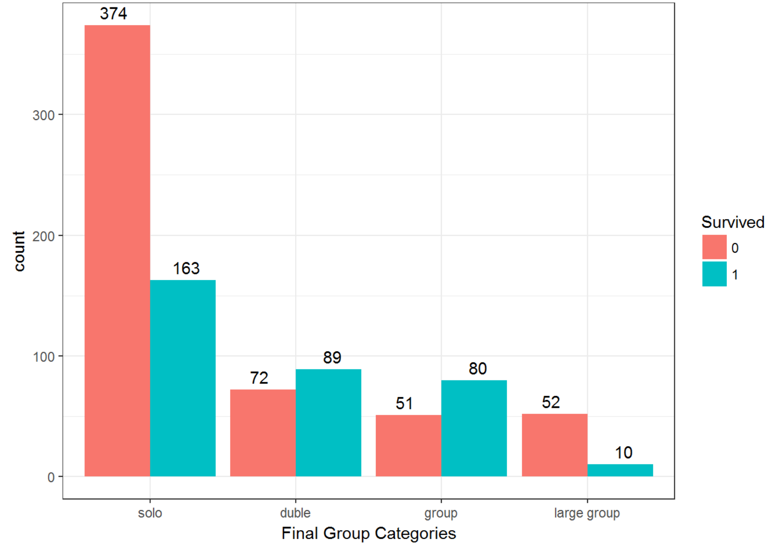
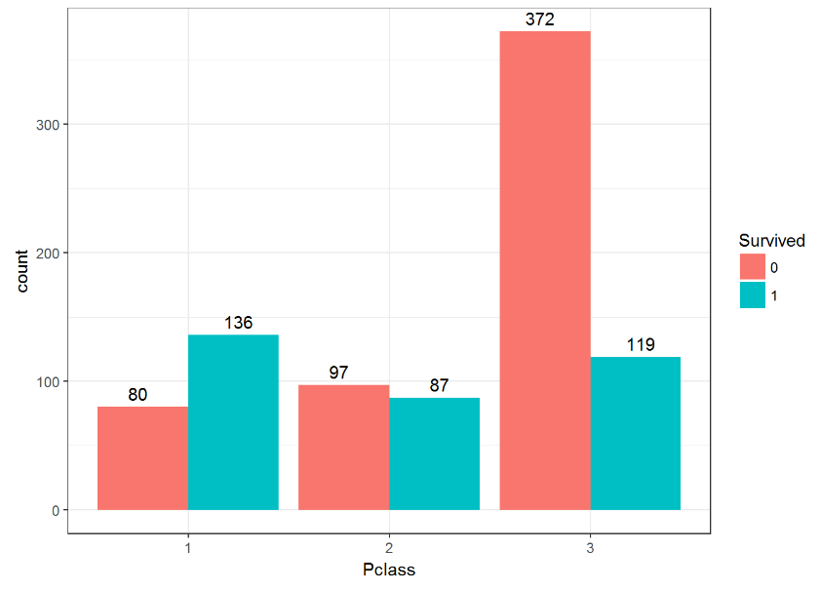
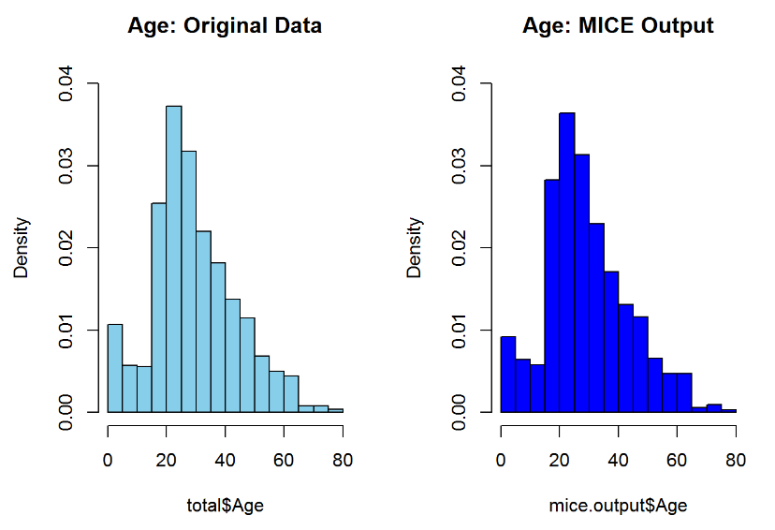
MATH 4432 Mini-Project 2: Statistical Learning Models on Titanic Dataset
Yang Yifeng¹, Deng Yibo¹ and Li Mingxuan² {yyangbf, ydengat, mlibw}@ust.hk
¹: Department of Mathematics, HKUST ²: Department of Computer Science and Engineering, HKUST
1. Introduction
4. Random Forest on Titanic Dataset
The sinking of the RMS Titanic is one of the most famous shipwrecks in history. On April 15, 1912, during her maiden voyage, the Titanic sank after colliding with an iceberg, killing 1502 out of 2224 passengers and crew. Although there was some element of luck involved in surviving the sinking, certain groups of people were more likely to survive, such as women, children and the upper-class. Our goal is to analyze which group of people was more likely to survive. This is a binary classification problem with most of attributes being categorical.
A series of random seed, different number of base trees and combination of predictors were tested. We achieved optimal result when using seed of 10, ntree=1000 and Pclass + Sex + Age + Fare + Embarked + FamilySize + title + FamilyID + TicketCount as predictors. The accuracy is 82.7%.
5. Xgboost on Titanic Dataset
From Top Left to Top Right
Survival Rate against Title(Generated from Name)
Survival Rate against Family Size
Survival Rate against age
We performed exhausting search of typical Xgboost parameters, e.g. rounds and max depth. However, for the interest of time, we didn’t iteratively perform feature engineering and Xgboost algorithm.
Finally, Xgboost gave us 78% accuracy on the test set, which was supposed to be much higher than traditional algorithms.
2. Pre-processing
We tried to extract useful information from available attributes in the dataset by making reasonable assumption. For example, we combined uncommon surname into one artificial sursame. We also merged titles to reduce the number of different titles. We converted family size into categorical variables by partitioning them into different intervals. At next step, we address the issue of missing values.
6. Analysis and Conclusion
3. Data Rendering
The high accuracy results from our feature engineering and data rendering procedure. For example, people with the same surname might belong to the same family, and thus might all survive or die. In this case, valuable information was extracted from attribute Name, which might be difficult to use as a predictor without any processing. Moreover, since we merged several titles together, we also reduced sparsity of our data, which reduced computation time and improved model accuracy. We also point out some interesting findings: “Mrs” has the highest survival rate. First class has the highest survival rate. Children and the elderly have high survival rate
As mentioned above, some of the attributes suffered from the issue of missing values. For example, Cabin and Age.
We used Mice package in R to fill the missing values of Age.
(Age Distribution Left: Raw data Right: Mice output)
8. Contribution
Titanic Dataset
Algorithm Implementation: Deng and Li
Analysis: Deng, Yang and Li
Poster: Li, Yang
Family-size Group Categories
Survival Rate against Pclass

