Slide 1
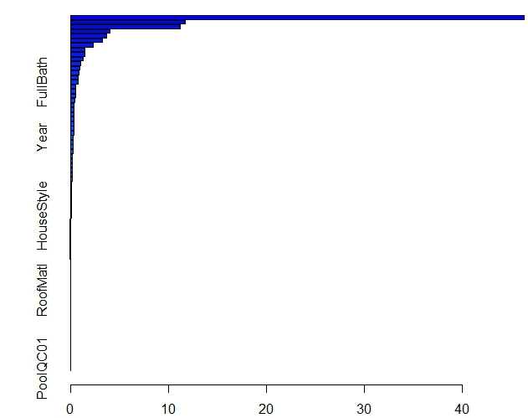
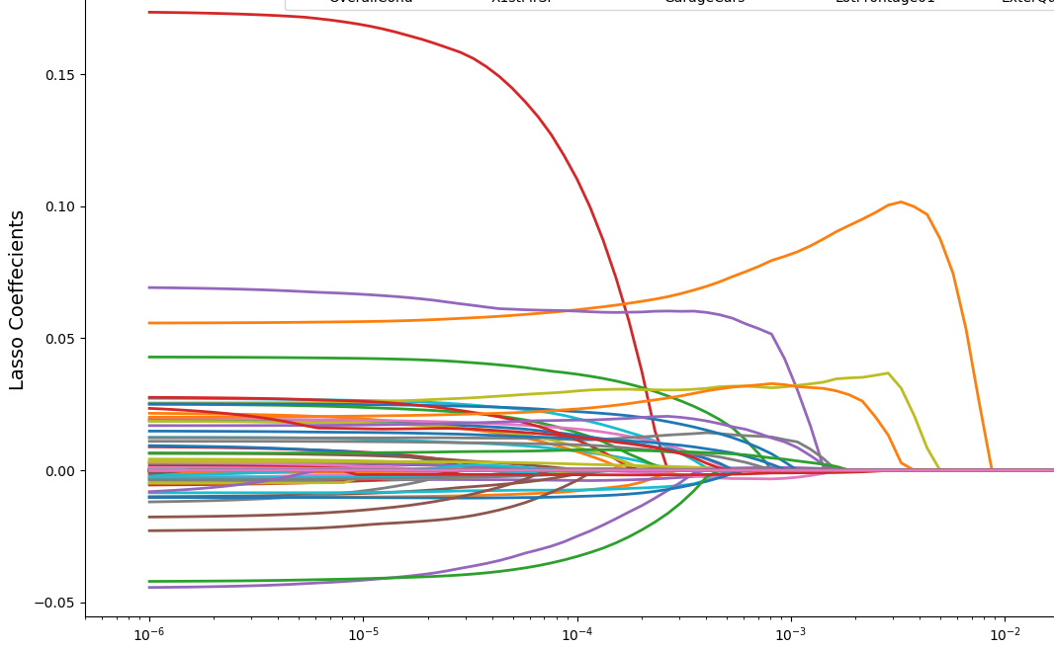
MATH4332 Mini-Project 2: Predicting House Sales Prices Using Model Selection, Regularization Method and Regression Tree Choi Ming Yeung, Chu Chun Kit, Department of Mathematics; Lo Ho Fung, Department of Finance
1. Introduction
In this project, we aim to predict the house sale price using various modeling methods. The predictions made by the models will then submit to Kaggle to test. We aim to have the lowest Kaggle score, i.e. the lowest test error, by considering different modeling methods. In general, we would like to reduce the variables in the model. Therefore, in the following, we will consider linear model selection, including forward, backward and stepwise. For dimension reduction method, we consider PCR as well as Lasso. For regression tree, bagging, random forest and boosting will be utilized.
3. Linear Model Selection and Regularization
 | R-square on training dataset | Kaggle Score
Forward | 0.9321 | 0.13999
Backward | 0.9256 | 0.14
Stepwise | 0.9321 | 0.15015
PCR (10 component) | 0.86 | 0.15343
Lasso | 0.9179 | 0.12605
Figure 2: Results for Linear Model Selection and Regularization methods. For the linear model selection method, satisfactory results are got. These three models consists of 46, 47, 45 predictors respectively. For PCR, we find the optimal number of components is 10. However, its Kaggle Score is not satisfactory. For the lasso, this is the lowest Kaggle score that we obtained.
4. Regression Tree
 | R-square on training dataset | Kaggle Score | Parameters
Bagging | 0.98 | 0.14527 | n.tree=1000
Random Forest | 0.98 | 0.14111 | m=39, n.tree=1000
Boosting | 0.9531 | 0.13767 | m=32, λ=10^-2.45, n.tree=1000
Figure 3: Results for Regression Tree, m is the number of predictors sampled for spliting at each node in the tree, n.tree is the number of tree used in the model for averaging and λ is the shrinkage parameter. We see that the performance for bagging and random forest is slightly worse than the variable selection method for linear model. However, if we choose the parameters for boosting carefully, the result is much improved in terms of Kaggle score, comparing with bagging and random forest.
2. Data Pre-processing
Features | After transformation | Remarks
YrSold | Year | YrSold − YrBuilt
Yr Built
Condition1 | ConditionTotal | Combine these two based on the criteria “Norm”
Condition2
MoSold | SeaSold | Group MoSold into 4 levels
Figure 1: Explanation of some features that we transform. The data set has 1460 observations with 79 features, for which 36 are quantitative and 43 are categorical. Also, there are 19 out of 79 attributes have missing values, which stated as NA. The main idea for the treatment on missing data is as follows: For categorical variable, we correct the “NA” into None or 0 for ordered data case. For qualitative variable, we replace it by its median. And we also replace it by 0 in some cases. Figure 1 demonstrates the transformation of variables that are not because of missing data. Noted that the variable “Utilities” is deleted as all the value in it are the same.
7. Conclusion
Variables reduction do give us a better result, showing that much variables do not really participate on affecting the sale price. Also, we see that using lasso, we can produce the lowest Kaggle score. And the second best is boosting which is also capable to predict the house sale price with a lower error rate. For the analysis of variable, we can see that for the best two model, lasso and boosting, they also indicate that OverallQual and Neighborhood are the most significant variables to be considered. However, there is still a very big gap to correct prediction and many other considerations are not included in this project, for example, better data pre-processing and full consideration of the parameters for boosting. Surely, further investigation is needed.
5. Deeper Look Into Important Variable
Figure 4: Left: Relative influence plot for boosting. Right: The standardized lasso coefficients as a function of λ. For both lasso and boosting, OverallQual and Neighborhood are the most two important variables. However, the result differs from the third variable. This suggests that in predicting the house sale price, one should always consider the overall quality and the neighborhood of the house first.
OverallQual
Neighborhood
Choi Ming Yeung: Data pre-processing, Linear Model Selection Chu Chun Kit: Boosting, Poster Lo Ho Fung: PCR, Lasso, Bagging, Random Forest

