Slide 1
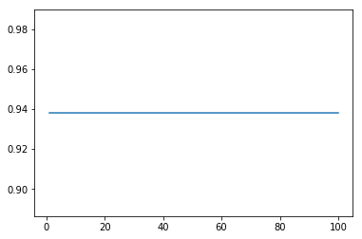
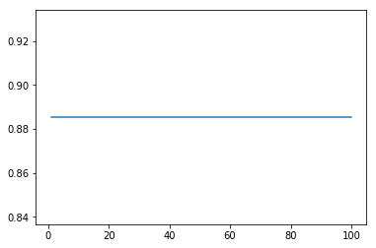
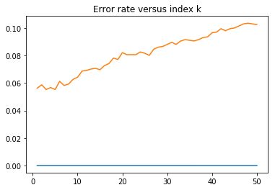
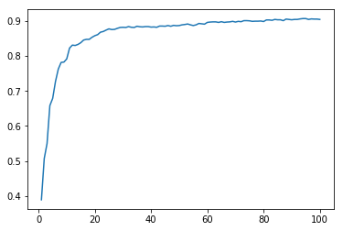
MATH 4432 Mini-Project 1: Multi-classification: Hand-written Digits
LI, Junrong (Analysis, Algorithm)¹, LIU, Cheng (Analysis, Algorithm)² and ZHANG, Wenhao (Analysis, Poster)³
¹: jlibz@connect.ust.hk ²: cliubg@connect.ust.hk ³:wzhangat@connect.ust.hk
1. Introduction
4. Linear Discriminant Analysis
A generalization of Fisher linear discriminant used to find a linear combination of features that characterizes classes of objects
The two graphs shows the training and testing accuracy given different number of features retained by PCA.
Data Format
Both the train and test data are composed of normalized handwritten digits. The original scanned digits are binary and of different sizes and orientations, which have been normalized into 16 x 16 grayscale images. Each piece of data consists of the digit id (0-9) followed by the 256 grayscale values. There are 7291 training observations and 2007 test observations.
Intention
Apply proper algorithms on the train set and predict the digit id based on the given grayscale values given by the test set.
Parameters
n_components: integer, optional
Number of components (< n_classes - 1) for dimensionality reduction
6. Analysis
The principle of Occam’s razor encourages us to use parameters as simple as possible, and thus we adopt LDA to reduce the number of dimensions. Meanwhile, Curse of Dimensionality believes that more features represents more dimensions. This is why we also try reducing the number of features.
It is really natural to compare the LDA method with PCA, because they are similar. However, the main application of PCA is on the unsupervised learning because its aim is to maximize the variance of different groups of features while the LDA maximizes the variance among different classes and at the same time minimizes the in-class variance. So here I come up with the idea of mixing PCA and LDA, I would use PCA first to throw away unrelated data and then use the LDA to analysis. This is intuitive because as we may notice, there are some white space at the four corners of the data, and they are actually trivial. The variances for them is also very low. If we can throw away them, then we can make the features more meaningful.
2. Algorithms Adopted
K-Nearest Neighbors Algorithm (KNN)
Linear Discriminant Analysis (LDA)
Principle Component Analysis and Linear discriminant analysis (PCA-LDA)
LDA Train Accuracy
LDA Test Accuracy
5. PCA-LDA
Before applying LDA, adopt PCA by using an orthogonal transformation to convert a set of observations of possibly correlated variables into a set of values of linearly uncorrelated variables called principal components in order to maintain the features that contribute the most to the variance
7. Reference
3. K-Nearest Neighbors Algorithm
A type of instance-based learning or lazy learning
Course Material of CSE446, University of Washington
https://courses.cs.washington.edu/courses/cse446/17au/
Sebastian Raschka(2014) “Linear Discriminant Analysis
– Bit by Bit”
http://sebastianraschka.com/Articles/2014_python_lda.html
The error rate shows an increasing trend along with the increase in the index k. And the smallest error rate reaches the minimum at around 5.5% with k equal to 5.
8. Supplement
The QDA result is also attached to the zipped file. And we find that the accuracy is slightly higher than that generated by LDA, because the class-specific normal distributions of 9 classes show different mean and class variance which violates the assumption of LDA model.
KNN Test Accuracy
PCA-LDA Train Accuracy
PCA-LDA Test Accuracy

Slide 2
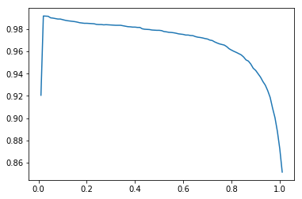
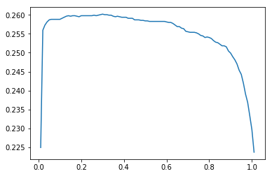
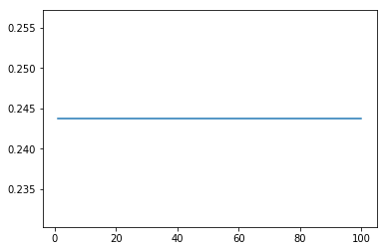
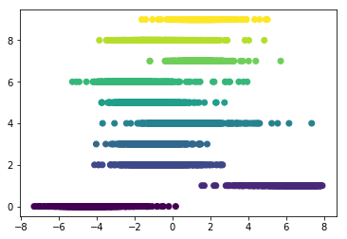
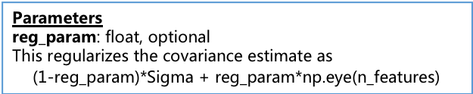
5. Quadratic Discriminant Analysis
4. Linear Discriminant Analysis
Parameters
reg_param: float, optional
This regularizes the covariance estimate as
$$\text{(1−}\text{reg}\text{_}\text{param}\text{)∗}\text{Sigma}\text{ + }\text{reg}\text{_}\text{param}\text{∗}\text{np}\text{.}\text{eye}\text{(}\text{n}\text{_}\text{features}\text{)}$$
Parameters
n_components: integer, optional
Number of components (< n_classes - 1) for dimensionality reduction
QDA Train Accuracy
QDA Test Accuracy
LDA Train Accuracy
LDA Test Accuracy
The left graph show that the corresponding features of each class (10 different digits), if we reduce the number of features from 256 to 1.
3. K-Nearest Neighbors Algorithm
The left graph shows that the error rate is lifted up along with the increase in the index number k. And the smallest error rate reaches the minimum at around 5.5% with index number equal to 5.
KNN Test Accuracy
8. Contribution
Algorithm, Poster | Analysis | Algorithm, Poster
LI, Junrong | LIU, Cheng | ZHANG, Wenhao

