Slide 1

ITEC Talent Fusion
Customer Presentation
University Collaboration in
Technology Platforms
A standalone world-class company for Discretes, Logic and Mosfets

Slide 2
Nexperia Talent Fusion
grow an own talent pool
Nexperia Talent fusion is a collaboration model for current university partners. It is part of the ITEC mission to “Develop people to be experts and leaders in a global high-tech environment.”
Goals
Realize a network of University Partners in relevant high-tech area of applied technology.
Work on roadmap technology building blocks in an cost effective manner.
Establish a talent pool of young talents from Universities for possible future employment.
Continuous development of People Competences via joint projects, education and technology Interaction.
Consider business engagement, like using University infrastructure, software and laboratory tools.
Professional collaboration program for key technology area.

Slide 3






University Partners
Condense it, focus to keep it manageable
Define Technology Platforms
Focus area aligned with technology roadmap link
Follow technology trends, cross functional
Define technology Partners, delegate
Limit the number of Bachelor and Master Institutes
Delegate Nexperia Ownership in the teams- empowerment
Consider funding and IP agreements upfront
Stream-line programs in existing structures.
Scout opportunities, e.g. University Institutes, Public Funding, …
Use known collaboration structures, managed by Universities, e.g. Coops, PhD, CoE,…
Stimulate Asia-Europe collaboration for activities in the same platforms, e.g. student exchange,…

Slide 4






ITEC Core Competences
OEM Technology Platforms- 8 University Coop Projects in The Netherlands and Hong Kong
Design& control
Motion Control
Mechatronics
Robotics
Precision Mechanisms
Additive Manufacturing
Imaging
High Resolution Imaging
Compressed Sensing
Opto-mechatronics
Adaptive optics
3D measurement
Structured light
Lensless imaging
Data Intelligence
Connectivity
Sensors
Signal Processing
Data Science
Autonomous Systems
Learning
Process Technology
Materials
Interconnect
Technology
Multi-Physics
Simulation
Virtual Prototyping

Slide 5

Nexperia ITEC Technology R&D Network
Context of ITEC collaboration with R&D Partners
Development
Apply Known technologies in Nexperia field
``````
Research
Explore New technologies for Nexperia field
Nexperia-HKUST Research Center
Projects support ITEC Product Roadmaps
Managed by scientific board
Global Nexperia University Collaborations
Projects ITEC Technology Roadmap
Managed by ITEC Innovation Team
Complexity
Commercial R&D partners
Internships
Short term 1-2 years
Long term 3-5 years

Slide 7
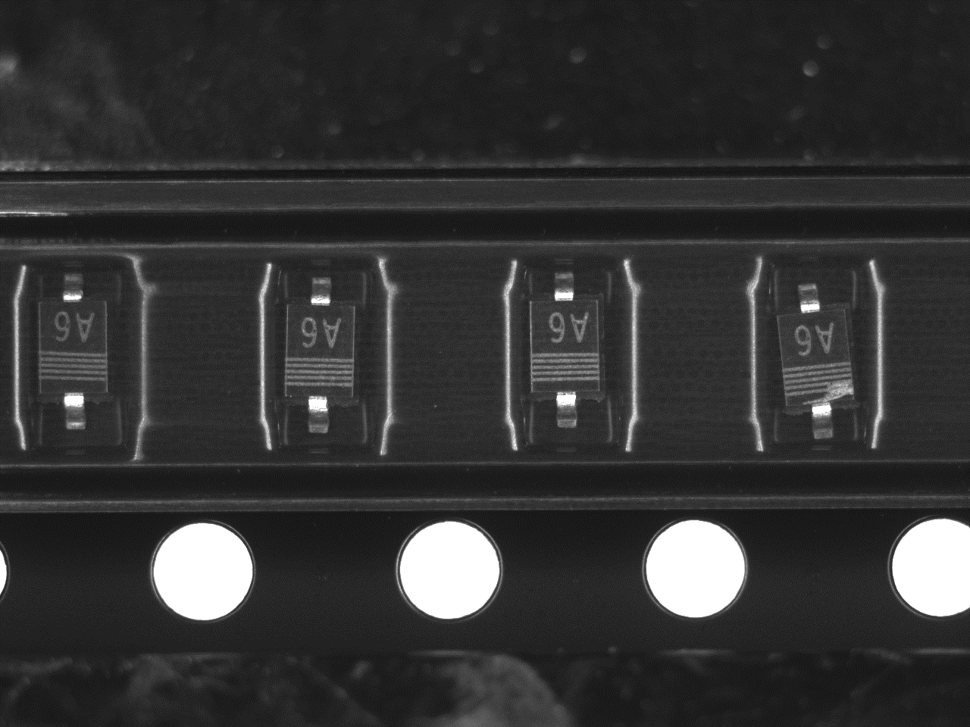
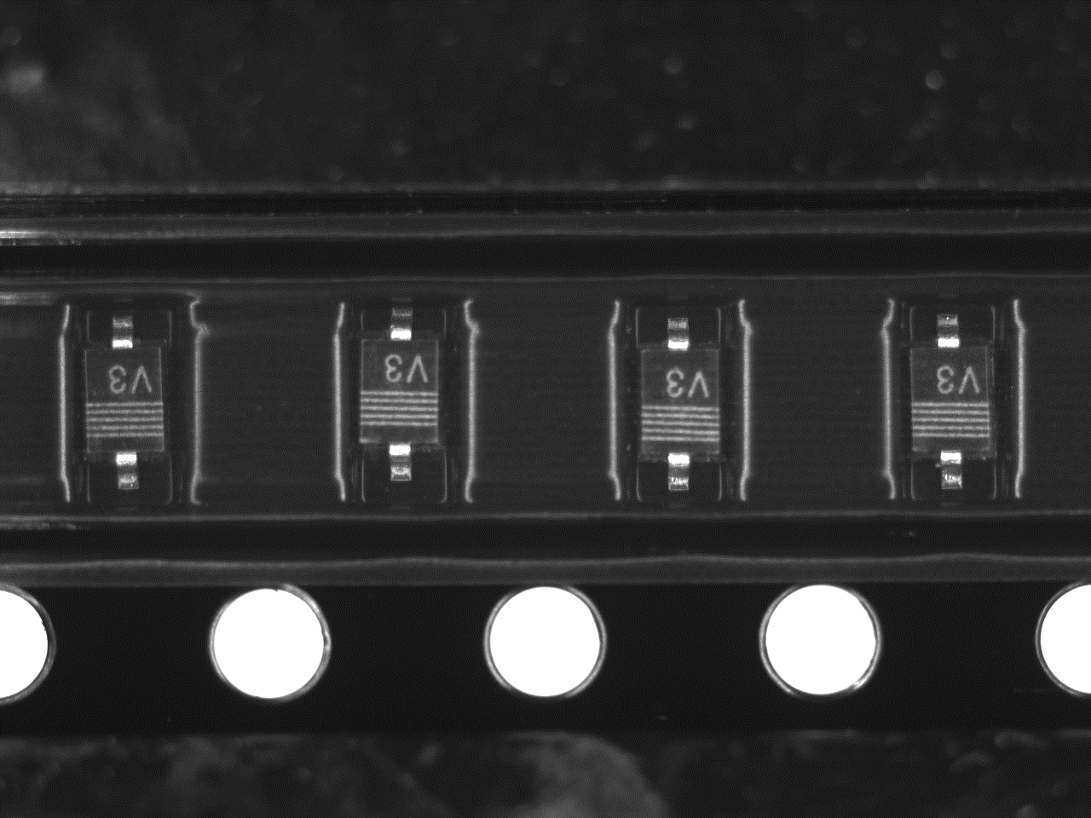
Project 1: Defect Detection of Product Images
Predict the defected product images with the state-of-the-art machine learning tech.
Period: 1~2 years
Goals:
Improve the current computer algorithm (overkill-rate~0.5%; rejection-rate~0.015%, Figure left below)
Reduce the errors by human operators (Figure right below, by our algorithm)
Our current preliminary algorithm is promising: AUC=99.4%, Accuracy=97%
Human Mistake as `overkill’
(WDP80422755A_01_2_240)
Possible Human mis-rejection
(WDP805055A0A_08_2_731)
Data
Computer
Pass
0.5%
0.015%
Human
Overkill
Reject

Slide 8
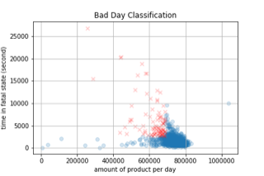
Project 2: Predictive Maintenance
Predict machine failures based on historic log data
Period: 1~2 years
Data:
Historic log files as time series about the cumulate amount of products, error records, and state mapping (failures vs. others)
Goals:
Predict machine failures as abnormal states based time series record
Explore and set up baseline methods for industrial usage
Our current exploratory model achieves 83% accuracy (AUC=72%) on 1-day in-advance prediction of abnormal states (20% deviation fig below)
Large space for improvements in future
Explore the techniques from the literature

Slide 9
Project 3: Optimal Designs of Conjugate Heat Transfer System
Develop thermal models for numerical topology optimization of heatsinks
Period: 3~5 years
Topology Optimization is a rising methodology for optimal engineering designs for predefined objectives and constraints. It can be applied in numerous multiphysics applications like structure analysis, fluid flow, electromagnetism and conjugate heat transfer. New industrial technologies like metal 3D printing opens up a new era for the applications of topology optimization.
Our strength in fluid dynamics simulation and large scale scientific computing will enable us to develop robust numerical design techniques for optimal designs of thermal system.
Goals:
Develop efficient numerical models for systematic design of optimal heatsink.
Collaborate with the engineering colleagues at HKUST to verify the numerical models by performing real-world tests on heatsinks.

Slide 10
Other potential collaborations
Period: 3~5 years
Control
reinforcement learning in robotics
Imaging
High resolution imaging, compressed sensing, lenseless imaging etc.
Data Intelligence
Data Science
Connectivity Sensors
Signal Processing
Autonomous systems learning
etc.
Process Technology: materials?
A strong team of researchers in imaging science and signal processing at HKUST: Prof. Jianfeng Cai, Prof. Tim S.-Y. Leung, Prof. Yang WANG (dean of science), et al.

