Slide 1
Tencent ML-Images: Large-Scale Visual Representation Learning
Baoyuan Wu
Senior Research Scientist, Tencent AI Lab
wubaoyuan1987@gmail.com
https://github.com/Tencent/tencent-ml-images

Slide 2
Contents
ML-Images
Why need large-scale multi-label image database?
How to construct the large-scale database?
Statistics of ML-Images
Large-Scale Visual Representation Learning
Train CNNs on ML-Images
Transfer learning to single-label image classification, detection and segmentation
Some Implementation Tricks

Slide 3
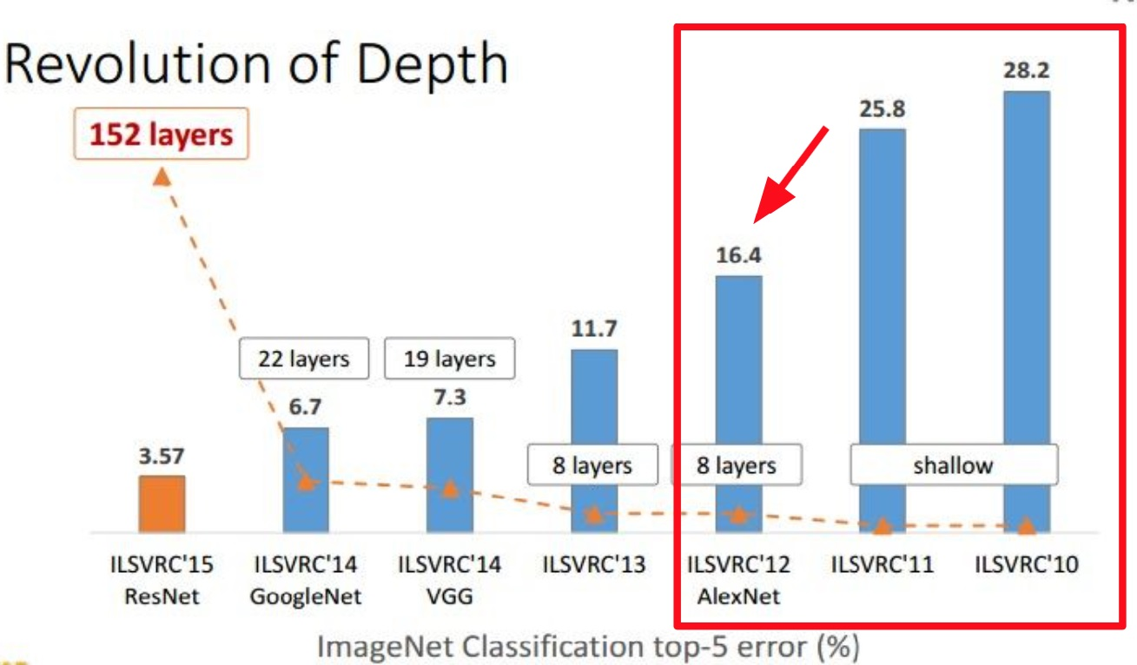
Why need large-scale multi-label image database?
Why need large-scale image database?
Deep neural networks has been a long history. But it didn’t show very success performance on visual tasks, until 2012, when AlexNet trained on ImageNet 2012 significantly decreases the classification error
(This figure is copied from Kaiming He’s presentation on ICCV 2015)

Slide 4
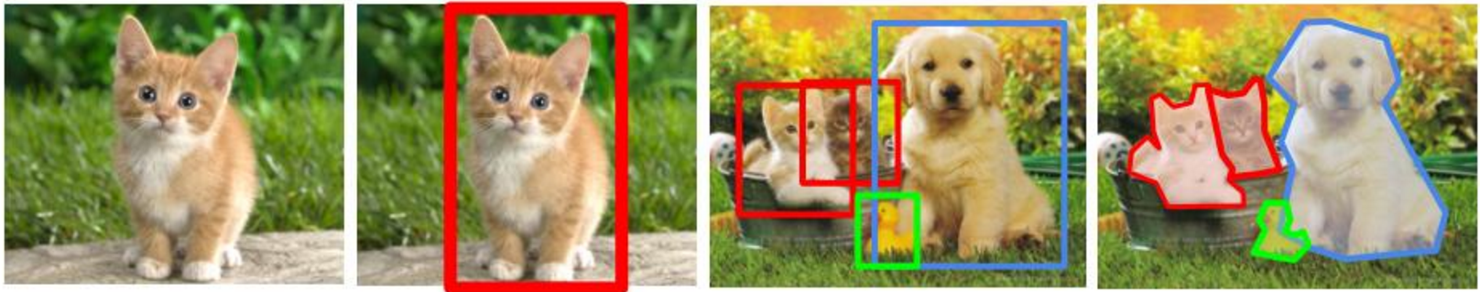
Why need large-scale multi-label image database?
Why need large-scale image database?
In many other visual tasks, like object localization, object detection and semantic segmentation, there are insufficient training data
They need initial models with good visual representation quality, such as models pre-trained on ImageNet
classification
localization
detection
segmentation
Is it cat?
Where is cat?
What animals? Where?
What animals? Which pixels?
(The above figures is copied from cs224n.stanford.edu )

Slide 5
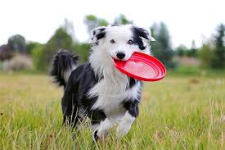
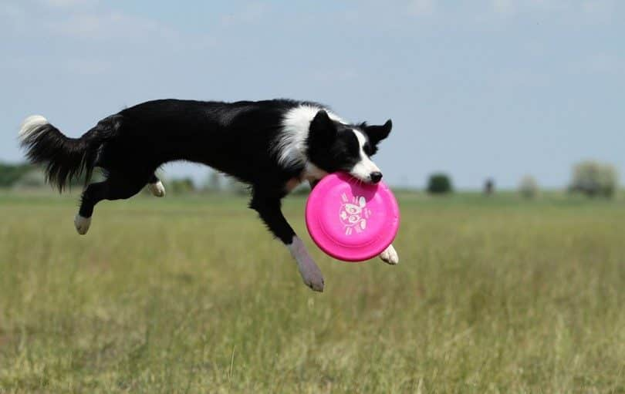
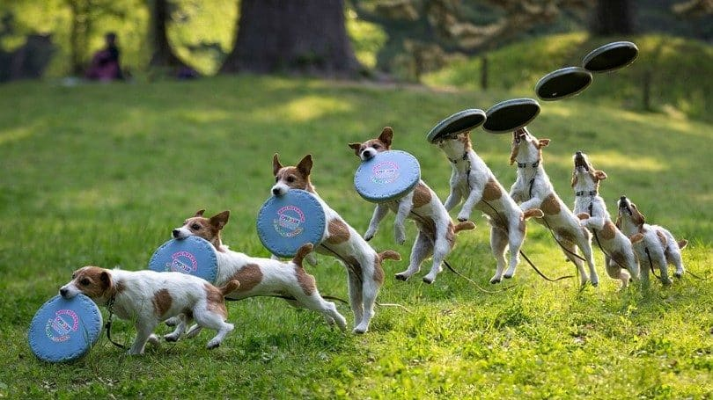
Why need large-scale multi-label image database?
Why need multi-label image database?
dog
frisbee
grass
Each image may include multiple objects. Single-labeled training data may mislead the model, leading to the performance degradation.
(The above figures are collected from Google Image Search )

Slide 6
Current large-scale multi-label image databases
Database | Founder | #Images | #Categories | Publicly available?
Open Images | Google | 9M | 7K | Yes
JFT-300M | Google | 300M | 18K | No
ML-Images | Tencent AI Lab | 18M | 11K | Yes

Slide 7
How to construct the large-scale database
Image source
Collecting from existing image database
Searching images from image search engine, like Flickr
Class vocabulary
The set of categories
The semantic relationship among categories
Annotation
Annotating all collected images using the new class vocabulary

Slide 8
ML-Images: image source
Source | # train images | # val Images | # categories
ImageNet | 10,706,941 | 50,000 | 10,032
Open Images | 6,902,811 | 38,739 | 1,134
ML-Images | 17,609,752 | 88,739 | 11,166
NOTE: we also collect many images from Flickr. However, due to the copyright,
we didn’t include them in ML-Images

Slide 9
ML-Images: class vocabulary
Determine the set of categories
Based on the original vocabularies of ImageNet and Open Images, we firstly remove the rare categories (with very few training images)
Remove the abstract categories in visual domain (e.g., ‘event’, ‘summer’)
Merge redundant categories
Build the semantic hierarchy among categories
Map the category to WordNet ID, and build the semantic hierarchy of our 11,166 categories according to WordNet
Four trees, rooted from thing, matter, object, physical object and atmospheric phenomenon, respectively
The length of the longest semantic path from root to leaf nodes is 16, and the average length is 7.47.

Slide 10
ML-Images: annotations
Using semantic hierarchy
If a child tag (e.g., husky) is annotated for an image, then all its ancestor categories should also be annotated (e.g., dog, animal)
Using class co-occurrence
Some pairs of categories are likely to occur in the same image, such as cow and grass
For a pair (a1, a2) with strong co-occurrence, if a1 is annotated, we also add a2 as the tag, with a confidence score

Slide 11
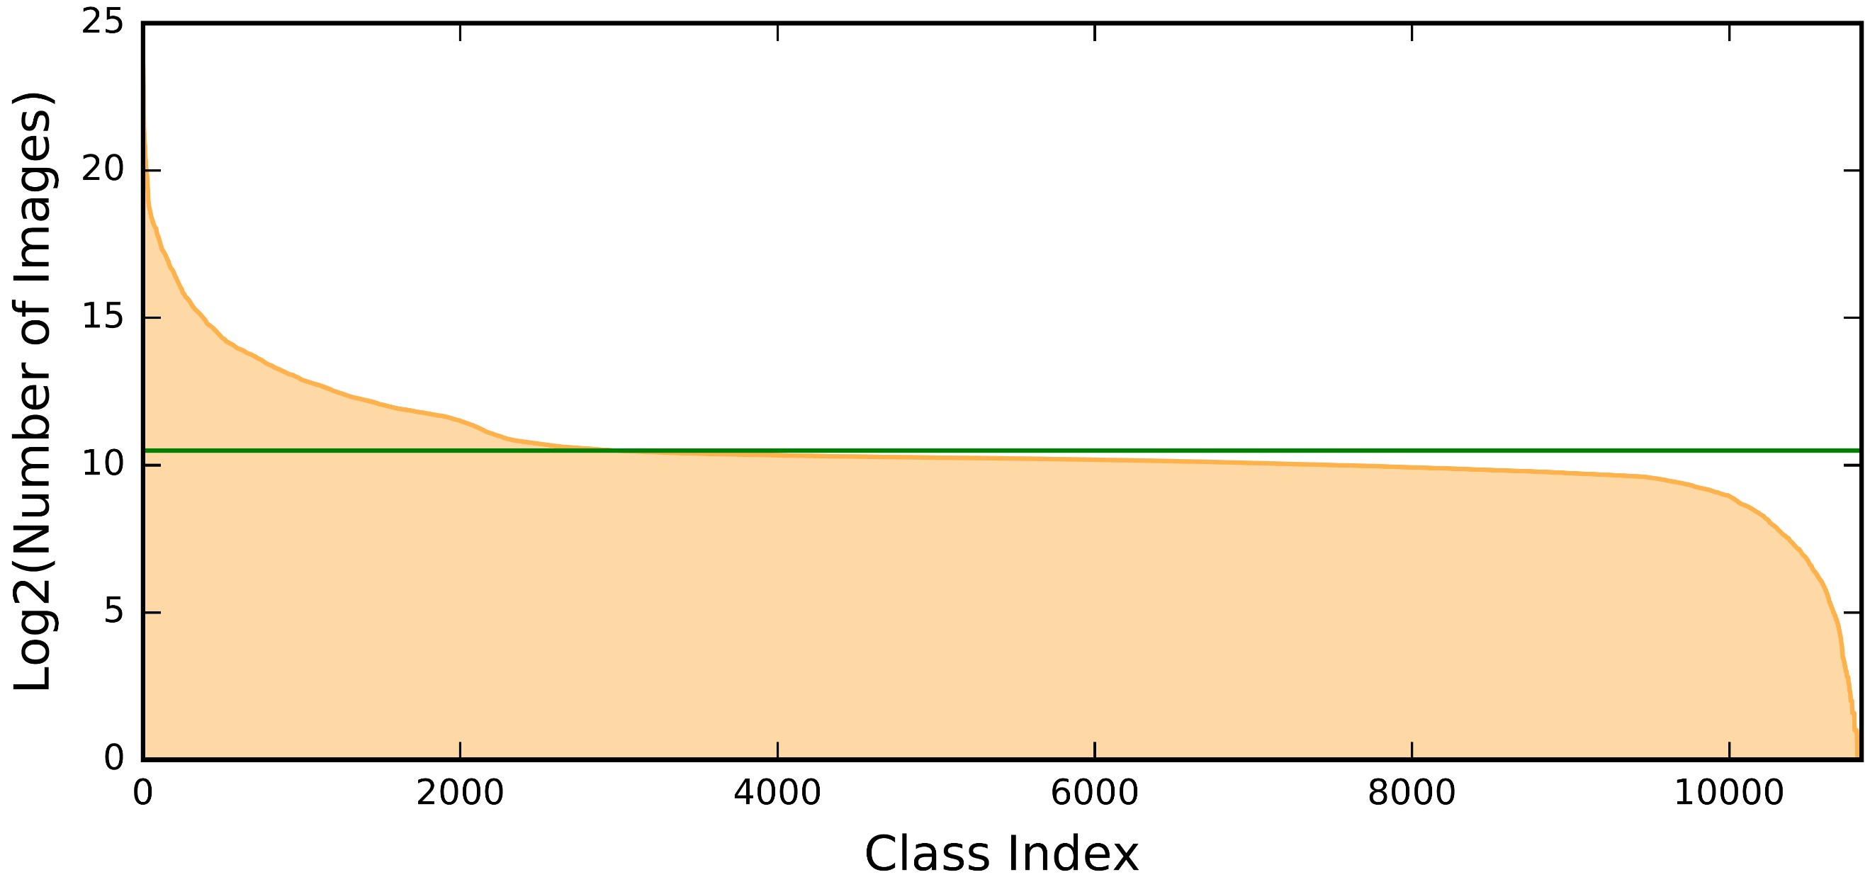
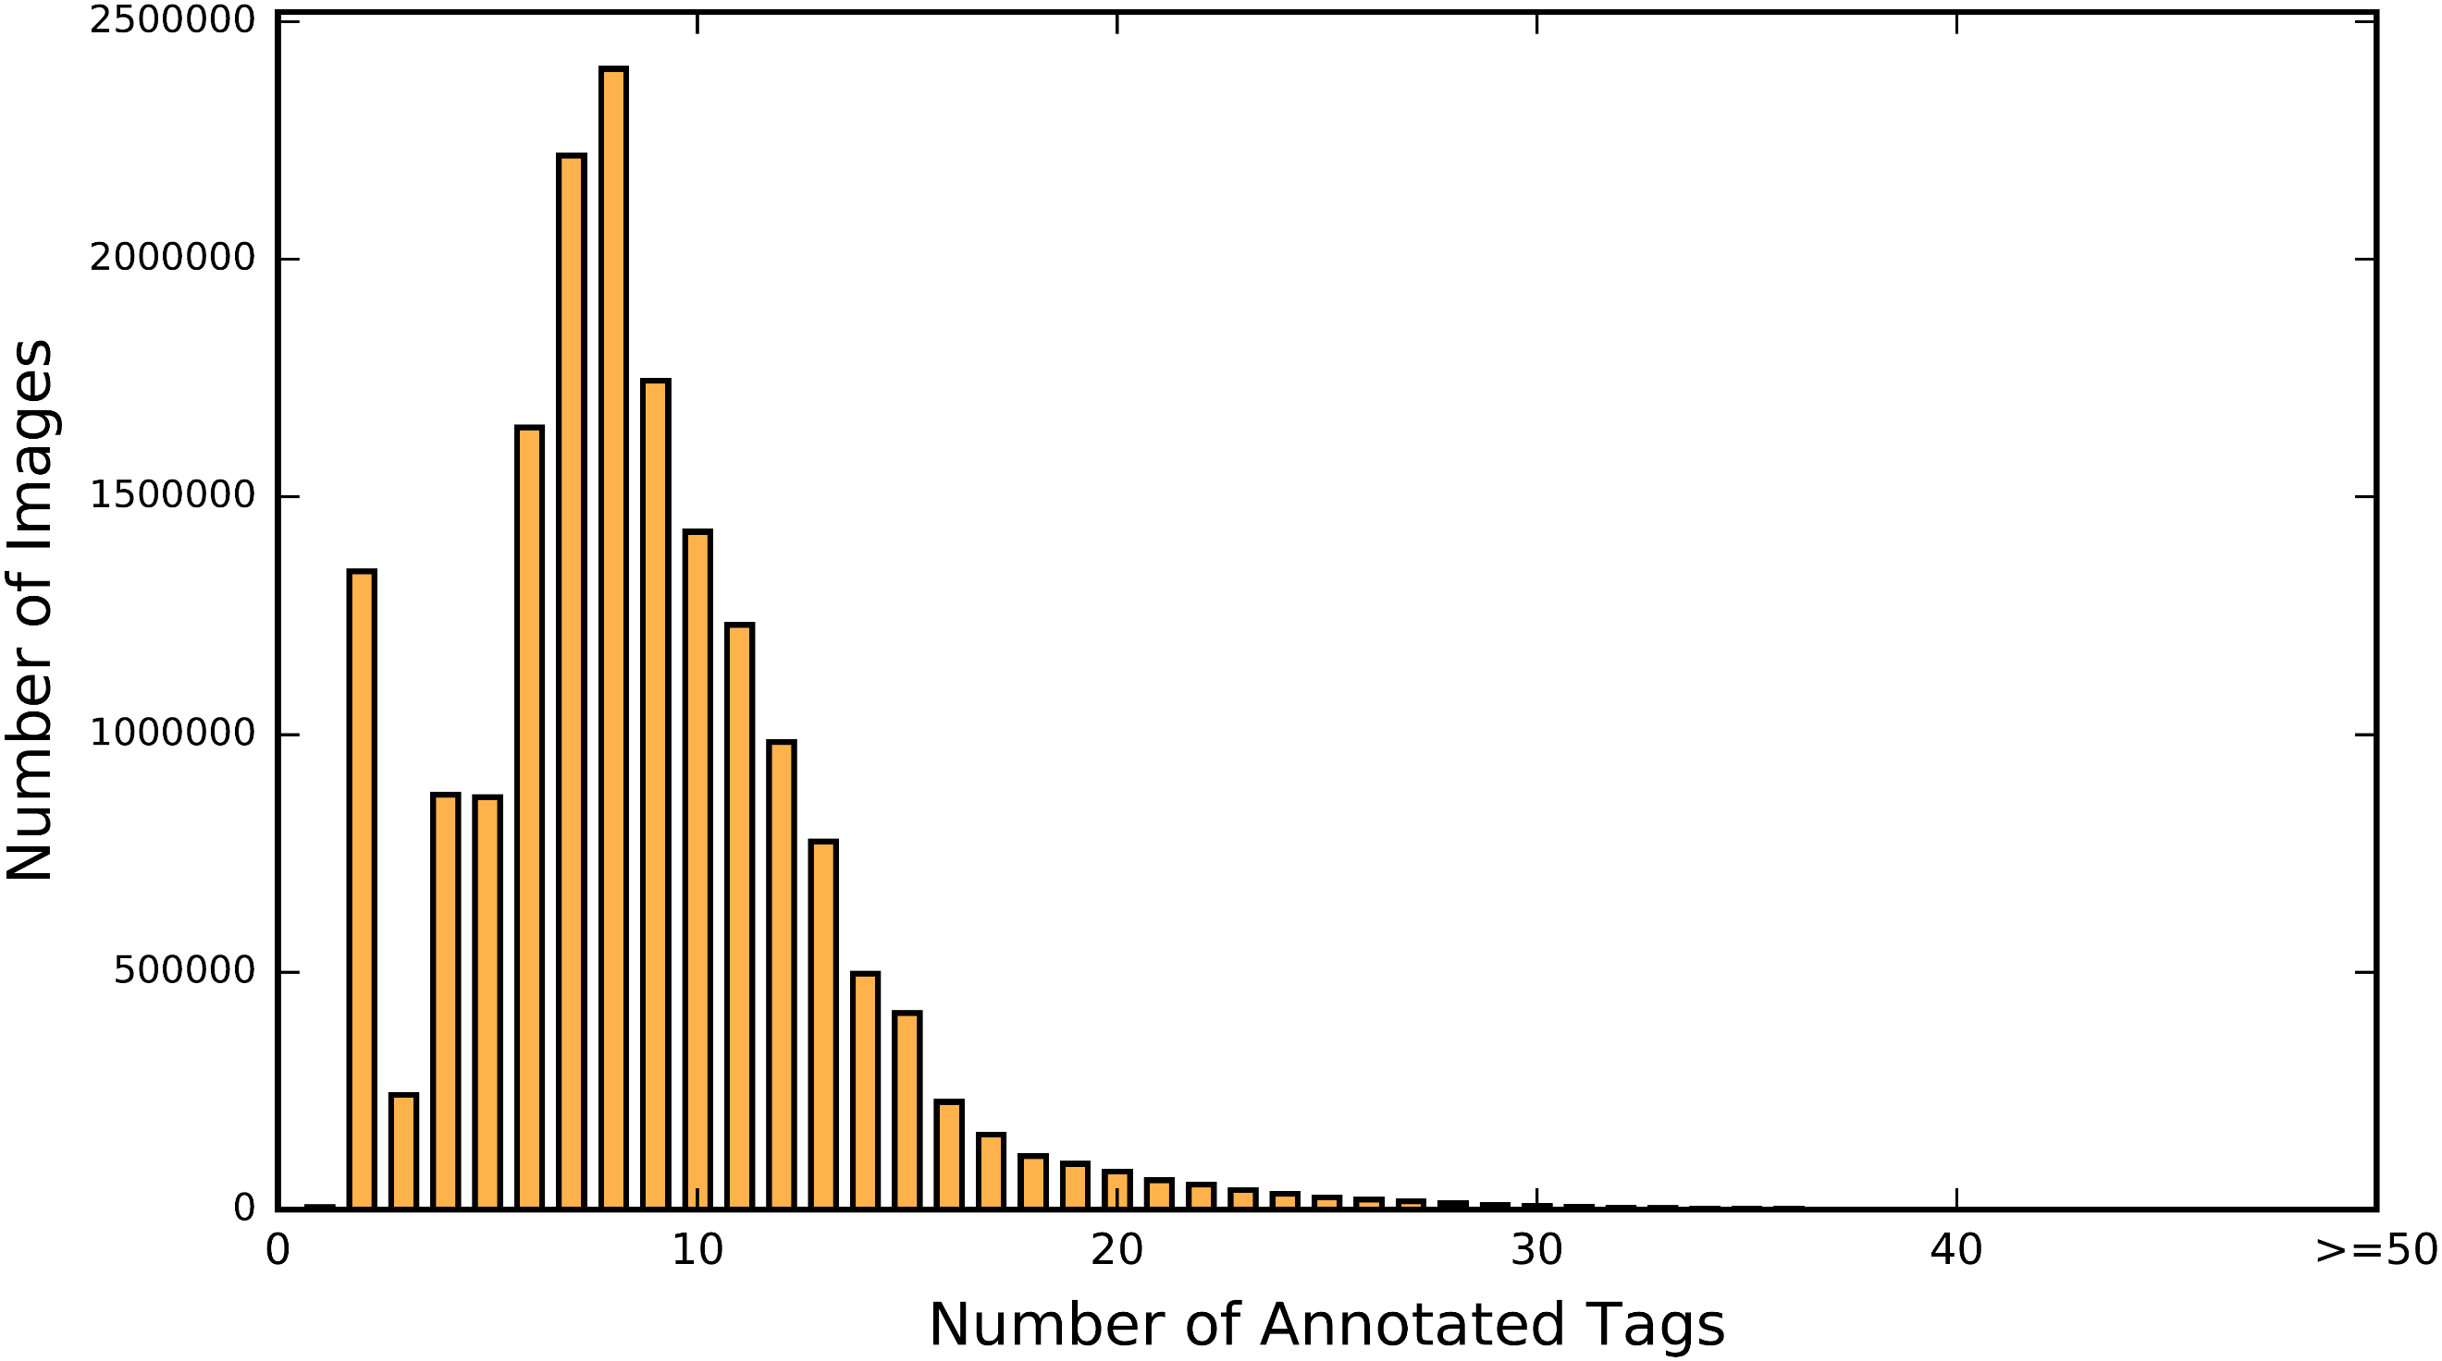
ML-Images: statistics

Slide 12
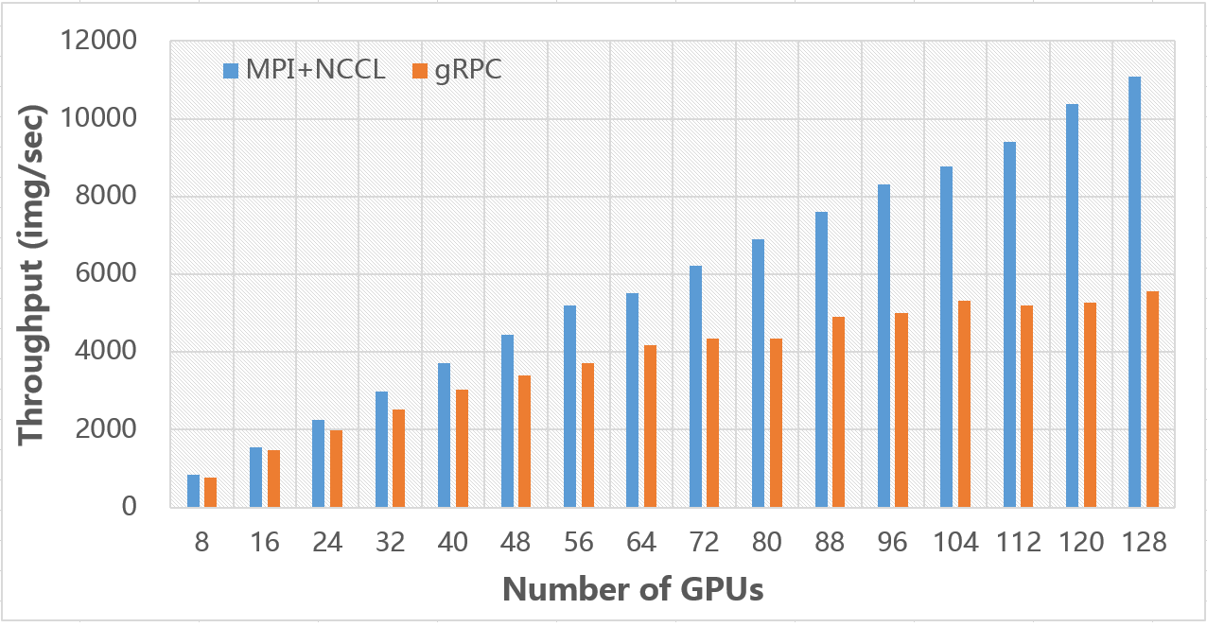
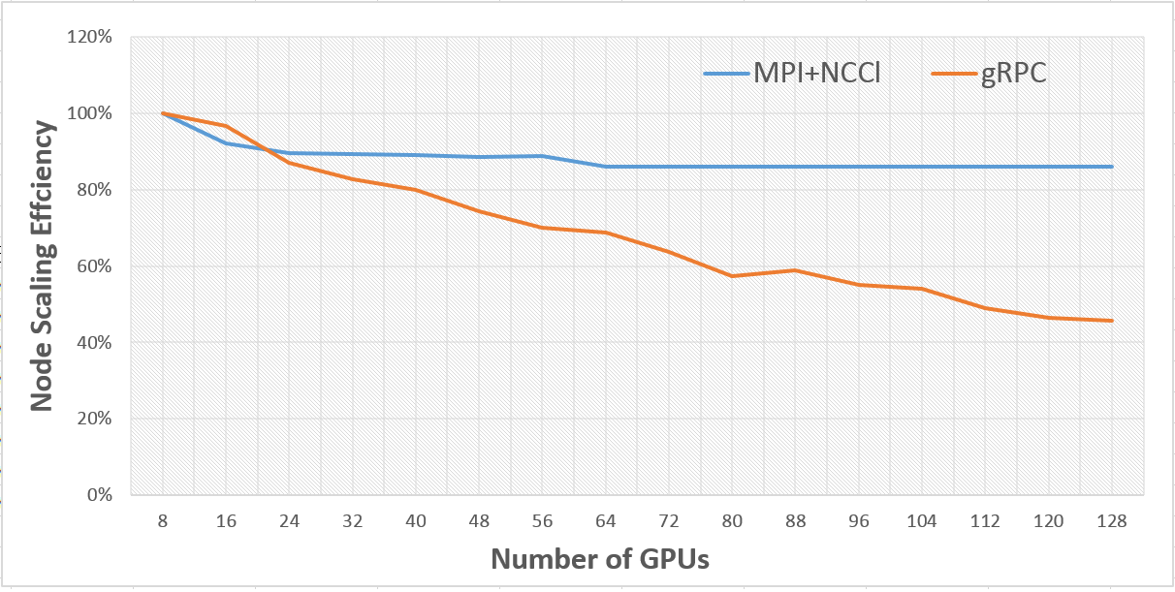
Large-Scale Visual Representation Learning
Distributed training
We utilize Tfplus (MPI + NCCL), a multi-nodes multi-GPUs training framework upon Tensorflow
Training 60 epochs takes 90 hours on ML-Images
The GPU efficiency is 5X of that of Google’s implementation

Slide 13
Large-Scale Visual Representation Learning
Class imbalance
For each image, the number of negative tags is much larger than the number of positive tags
Among the vocabulary, there are very frequent categories (e.g., animal) and very rare categories
A novel loss
Weighted cross entropy
Adaptive weight during the training process
Negative down-sampling

Slide 14
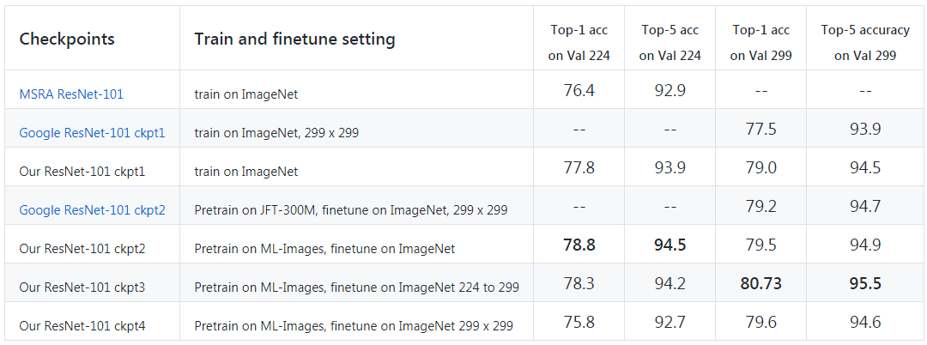
Transfer learning to single-label image classification
Results on the validation set of ImageNet (ILSVRC 2012)
NOTE: our implementation of baseline is much higher than MSRA and Google
NOTE: the size of JFT-300M is 17 times of ML-Images, but our transfer results on ImageNet is much higher than Google’s results

Slide 15
Transfer learning to object detection and segmentation
Detection Results on the test set of PASCAL VOC 2007
Checkpoint | Setting | MAP@0.5
ImageNet | Pre-train on ImageNet, fine-tune on VOC | 76.3
Google 1 | Pre-train on JFT-300M, fine-tune on VOC | 81.4
Google 2 | Pre-train on JFT-300M+ImageNet, fine-tune on VOC | 81.3
Our | Pre-train on ML-Images , fine-tune on ImageNet, then fine-tune on VOC | 81.5
Segmentation Results on the val set of PASCAL VOC 2012
Checkpoint | Setting | MAP@0.5
ImageNet | Pre-train on ImageNet, fine-tune on VOC | 73.6
Google 1 | Pre-train on JFT-300M, fine-tune on VOC | 75.3
Google 2 | Pre-train on JFT-300M+ImageNet, fine-tune on VOC | 76.5
Our | Pre-train on ML-Images , fine-tune on ImageNet, then fine-tune on VOC | 76.3

Slide 16
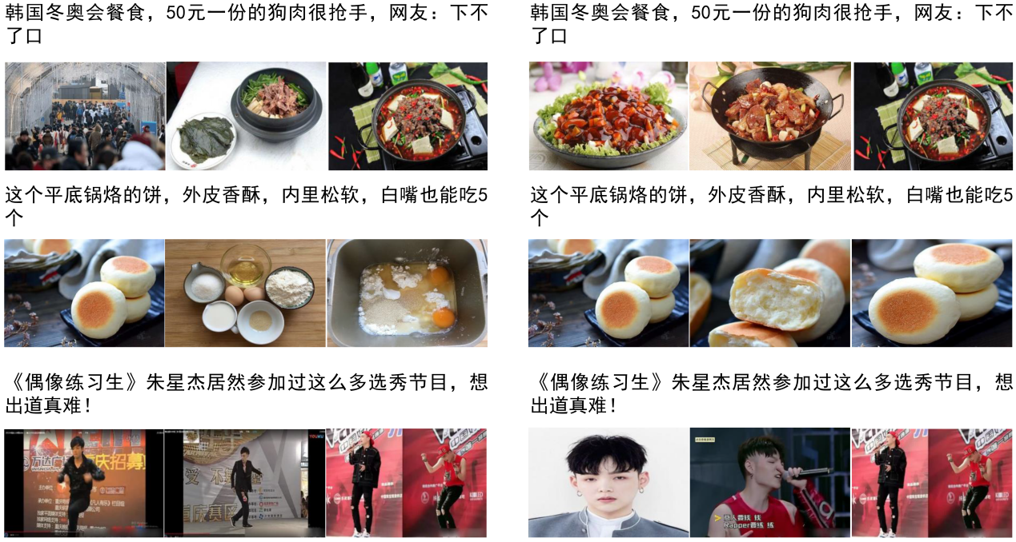
Transfer learning to evaluation of image quality
Tencent news product Tiantian Kuaibao
Before
After using our model

Slide 17
Others
Some Implementation Tricks
Try the hyper-parameters suggested in other successful projects
Complex image pre-processing is helpful for generalization
The loss function to handle class imbalance is very important
Remaining difficulties
Label noises
Class imbalance
Insufficient validation set

Slide 18
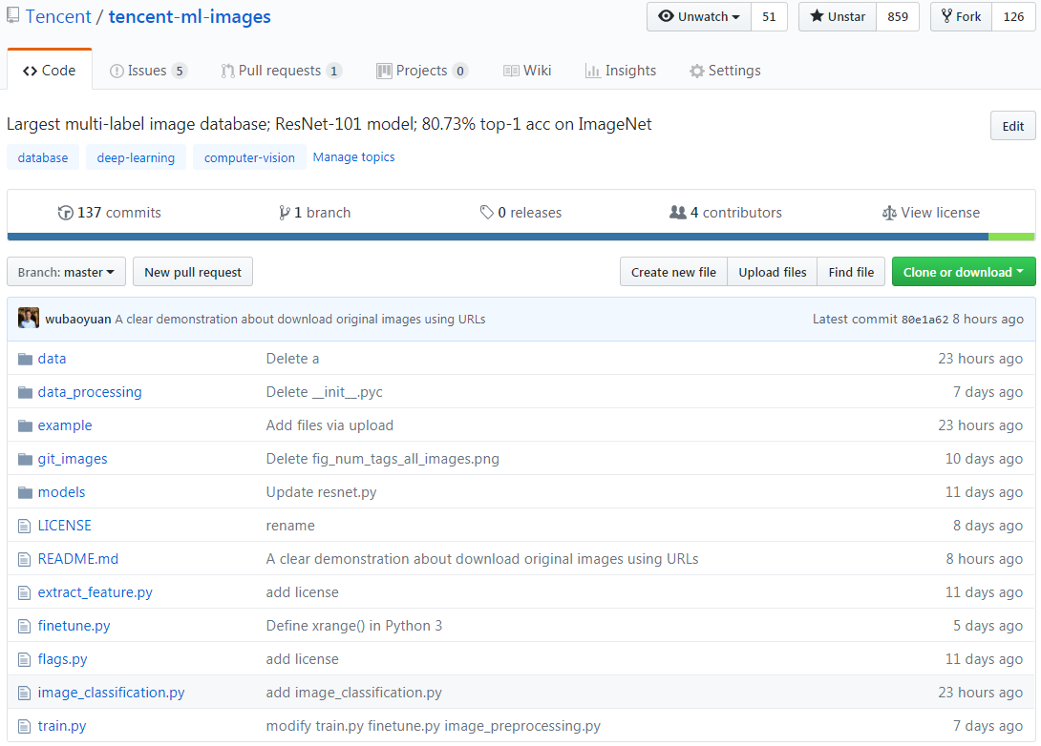
Welcome to try our project
https://github.com/Tencent/tencent-ml-images

Slide 19
Thanks

