Slide 1
Experiments on DCFNet
Huang Zhichao, Liang Zhicong, Wen Ruixue
Department of Mathematics, HKUST
Date: 19-11-2018

Slide 2
Outline
Introduction to DCFNet
Implementation Settings
Outcome & Conclusion
Discussion & Exploration
Notes:
We focused on the experiments on DCFNet for project 2. My presentation consists of four parts: introduction to DCFNet, Implementation settings, outcomes and conclusion, discussion and some exploration

Slide 3
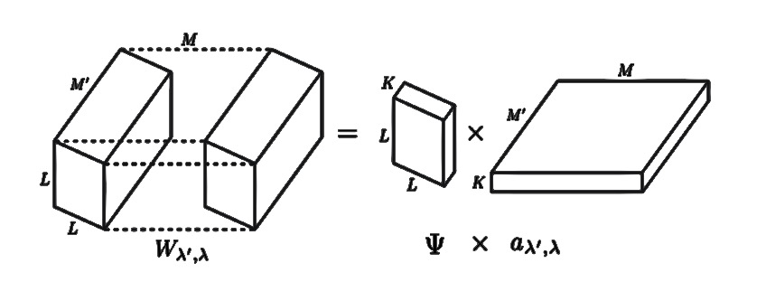
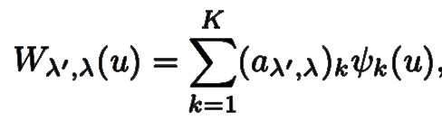

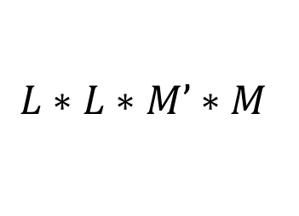
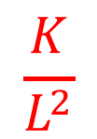
Introduction to DCFNet
Network structure: VGG, ResNet, etc.
Filter structure: Decomposed convolutional filters (DCF)
$$\frac{K}{L^{2}}$$
$$L∗L∗M’∗M$$
$$1∗1∗M’K∗M$$
Notes:
Many people has achieved satisfactory results by constructing different network structures, such vgg and resnet. In fact, filters are also of vital importance during the forward and backward process of networks. The decomposed convolutional filters, DCF for abbreviation, is a method changing the structure of filters. The key idea of DCFNet is to decompose each convolutional filter into a truncated expansion with pre-fixed bases in the spatial domain, where the expansion coefficients remain data dependent. In this case, a convolutional layer with weight size $L∗L∗M’∗M$is transformed into a layer with weight size $1∗1∗M’K∗M$, so the number of parameters of this layer is a factor $K/L^{2}$ smaller. For example, here a convolutional layer of 3*3*3*64 is transformed to a convolutional layer of 1*1*9*64, after the 3*3 filter is replaced by 3 3*3 bases. Other operations like ReLu and maxpooling remain unchanged. According to experiments, the model can reduce the redundancy of parameters of each layer without loss of too much accuracy or even with better performance. While there are also some drawbacks, for example, when pursuing better performance of the network, selection of bases is important. FB, RB, PCA three bases all have deficiencies:
Fourier Bessel Bases (FB): ignore high-frequency information when truncated
Random Bases (RB): not necessarily linearly independent
PCA: rely on pre-trained filters

Slide 4
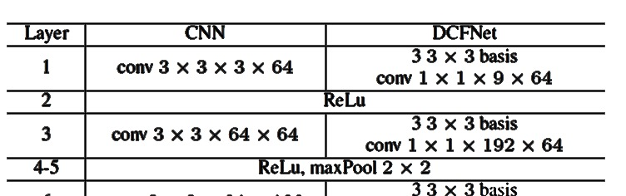
Introduction to DCFNet
Advantages: reduce the redundancy of parameters of each layer without loss of too much accuracy or even with better performance.
Disadvantages: selection of bases is important when pursuing higher accuracy
Drawbacks of different bases
Fourier Bessel Bases (FB): ignore high-frequency information when truncated
Random Bases (RB): not necessarily linearly independent
PCA: rely on pre-trained filters
Notes:
Many people has achieved satisfactory results by constructing different network structures, such vgg and resnet. In fact, filters are also of vital importance during the forward and backward process of networks. The decomposed convolutional filters, DCF for abbreviation, is a method changing the structure of filters. The key idea of DCFNet is to decompose each convolutional filter into a truncated expansion with pre-fixed bases in the spatial domain, where the expansion coefficients remain data dependent. In this case, a convolutional layer with weight size $L∗L∗M’∗M$is transformed into a layer with weight size $1∗1∗M’K∗M$, so the number of parameters of this layer is a factor $K/L^{2}$ smaller. For example, here a convolutional layer of 3*3*3*64 is transformed to a convolutional layer of 1*1*9*64, after the 3*3 filter is replaced by 3 3*3 bases. Other operations like ReLu and maxpooling remain unchanged. According to experiments, the model can reduce the redundancy of parameters of each layer without loss of too much accuracy or even with better performance. While there are also some drawbacks, for example, when pursuing better performance of the network, selection of bases is important. FB, RB, PCA three bases all have deficiencies:
Fourier Bessel Bases (FB): ignore high-frequency information when truncated
Random Bases (RB): not necessarily linearly independent
PCA: rely on pre-trained filters

Slide 5
Implementation Settings
Dataset: CIFAR10
 | epoch | batch size | weight decay | Optimizer | learning rate
VGG16 | 300 | 256 | 5e-5 | Adam | 0.001 (halved every 30 epochs)
ResNet50 | 300 | 64 | 5e-4 | SGD | 0.1 (halved every 30 epochs)
Bases: Fourier Bessel bases, Randomly generated bases, PCA-bases
Notes:
For VGG16, we set … When tuning hyper parameters in this part, loss function decays slow as learning rate is set larger than 0.01. As for ResNet50, the size of the filters of the first convolutional layer is 7*7. … We implement the experiments with the number of bases as K=3,5,9. As for DCF-PCA, bases are constructed layer by layer, by choosing the principle components with the biggest K eigenvalues, from the same layer of corresponding pre-trained CNN model.

Slide 6

Outcome & Conclusion
 |  | K=3 |  | K=5 |  | K=9
VGG16-CNN acc. | 0.8702
#param. | 1.47e+7
VGG16-DCF (results in paper) acc. | FB |  | 0.8821 |  | 0.8779 |  | /
 | RB |  | 0.7846 |  | 0.8416 |  | /
 | PCA |  | 0.8754 |  | 0.8760 |  | /
VGG16-DCF acc. | FB |  | 0.9013 |  | 0.9127 |  | /
 | RB |  | 0.8911 |  | 0.9048 |  | 0.9159
 | PCA |  | 0.8677 |  | 0.8865 |  | 0.8912
#param. |  |  | 4.91e+6 |  | 8.18e+6 |  | 1.47e+7
ResNet50-CNN acc. | 0.9362
#param. | 2.46e+7
ResNet50-DCF acc. | FB | 0.8341 |  | 0.8408 |  | /
 | RB | 0.8029 |  | 0.8315 |  | 0.8468
 | PCA | 0.8602 |  | 0.8802 |  | 0.8956
#param. |  | 8.20e+6 |  | 1.37e+7 |  | 2.46e+7
K ↑, accuracy ↑
Reduction of the number of parameters with comparable accuracy
VGG outperforms ResNet
K = 3, 5
$L_{1}=3$, $L_{2}=7$
VGG: $\frac{K}{{L_{1}}^{2}} ≈0.33, 0.56$
ResNet: $\frac{K}{{L_{2}}^{2}} ≈0.06, 0.10$
Notes:
By fine-tuning the hyper parameters above, we achieve better results than the ones shown in the paper. As you can see, in each bases case, the classification accuracy of DCFNet increases as K becomes larger. And generally speaking, it is verified that DCFNet has comparable accuracy with regular CNN with reduced parameters.
Notice that results of ResNet50-DCF are not as good as that of VGG16-DCF, we think one reason is that the number of parameters is reduced too much in ResNet50, since the filter size of the first layer in ResNet50 is 7*7, when choosing k = 3,5, the number of parameters is a factor of 0.06, 0.10 smaller respectively, losing too much information from original input.

Slide 7
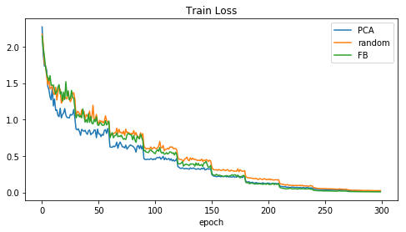
Discussion & Exploration
ResNet50, k=5
In ResNet: PCA > FB >RB
In VGG: FB > PCA > RB
Notes:
The diagram shows the train loss-epochs in ResNet under the condition of k = 5. A noteworthy phenomenon is that in ResNet50, PCA > FB >RB, while in VGG: FB > PCA > RB.
One thing common about two networks is that, DCFNet with random bases converges slowest, which shows that structured bases advanced the random ones in training.

Slide 8
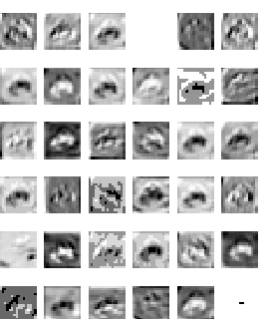
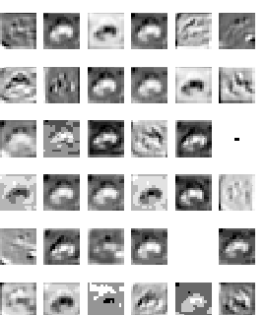
Discussion & Exploration
V.S.
Mixed net: layer 2
DCF-ResNet50: layer 2
Mixed net: replace the first conv layer of original ResNet50 with DCF conv layer
Notes:
The paper mentions that high-frequency nuance details are often irrelevant to classification tasks. However, this may not be true with respect to deeper feature maps in the middle or near the end of a neural network, since their distribution is totally different from the input image.
This also provides a reasonable explanation for our experiment outcome that, in ResNet50, FB bases seems inferior to PCA bases. Since the residual parts of ResNet act like perturbation sometimes, it may be mis-ingored by the low-frequency capturing DCFNet filters.
To verify this hypothesis, we conduct another experiment: visualizing the outcome of several layers. The original input is a frog. Mixed net is a combination of DCFNet and ResNet50. In layer 2, some filters show similar output and some are totally different. When the network forward to layer 7, the deviation becomes large, and pictures in DCF-ResNet50 seems more smoother and contain more high-frequency information, which contradicts our expectancy. We are confused about this phenomenon. Is there any better explanation?

Slide 9
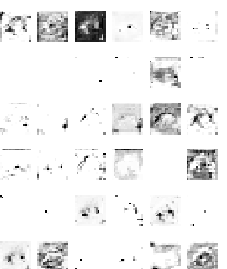
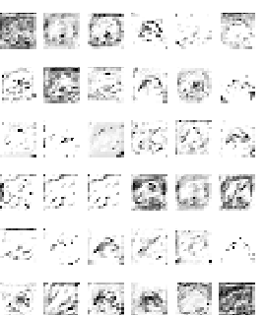
Discussion & Exploration
V.S.
Mixed net: layer 7
DCF-ResNet50: layer 7
Mixed net: replace the first conv layer of original ResNet50 with DCF conv layer
Notes:
The paper mentions that high-frequency nuance details are often irrelevant to classification tasks. However, this may not be true with respect to deeper feature maps in the middle or near the end of a neural network, since their distribution is totally different from the input image.
This also provides a reasonable explanation for our experiment outcome that, in ResNet50, FB bases seems inferior to PCA bases. Since the residual parts of ResNet act like perturbation sometimes, it may be mis-ingored by the low-frequency capturing DCFNet filters.
To verify this hypothesis, we conduct another experiment: visualizing the outcome of several layers. The original input is a frog. Mixed net is a combination of DCFNet and ResNet50. In layer 2, some filters show similar output and some are totally different. When the network forward to layer 7, the deviation becomes large, and pictures in DCF-ResNet50 seems more smoother and contain more high-frequency information, which contradicts our expectancy. We are confused about this phenomenon. Is there any better explanation?

Slide 10
Reference
Qiang Qiu, Xiuyuan Cheng, Robert Calderbank, Guillermo Sapiro. DCFNet: Deep Neural Network with Decomposed Convolutional Filters. arXiv: 1802.04145, 2018.

Slide 11
THANK YOU!

