Slide 1

Home Credit Default Risk
predict how capable each applicant is of repaying a loan
Notes:
To help people who struggle to get loans because of insufficient credit history, Home Credit would like to evaluate their clients‘ repayment ability via other alternative data. With this new criteria, Home Credit gives more loans to those people but also guarantee a certain repayment rate.

Slide 2

Dataset

Slide 3
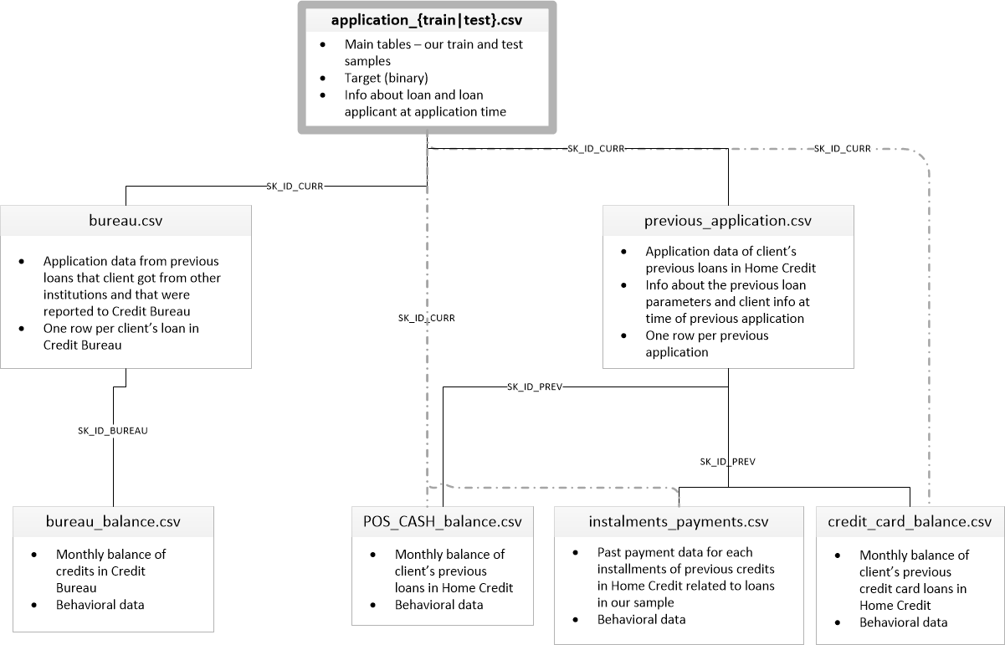

Slide 4
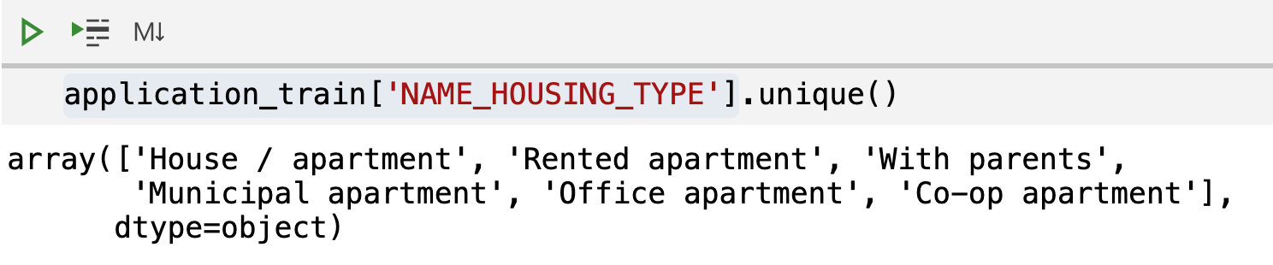
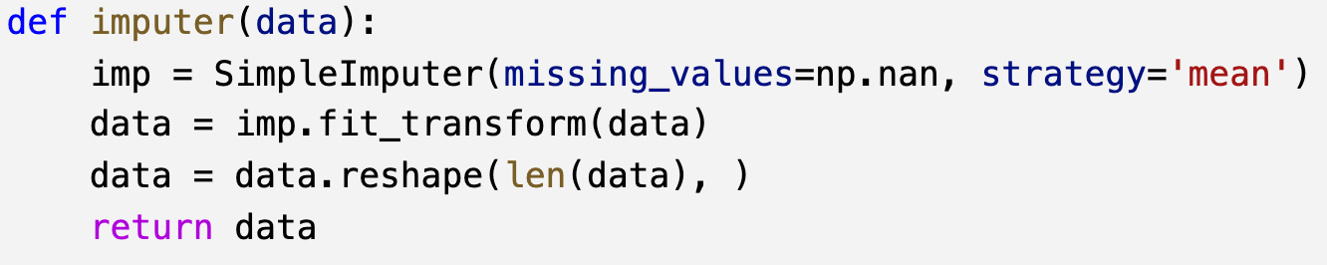
Step 1
Convert categorical variables to dummy variables
Step 2
Complete the missing values via the imputation transformer
Step 3
Combine features from different tables
Data Preprocessing

Slide 5

Methodology
Light GBM & Linear Discriminant Analysis

Slide 6

Light GBM (Light Gradient Boosted Machine)
Developed by Microsoft
Based on Gradient Boosting Decision Tree algorithms
Compute the gradient as response of the observation
Fit the model to the training data (x, gradient)
Applied for ranking, classification
Widely used in some Machine Learning Challenges

Slide 7
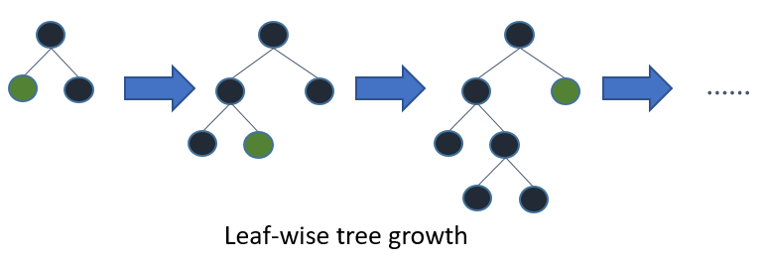
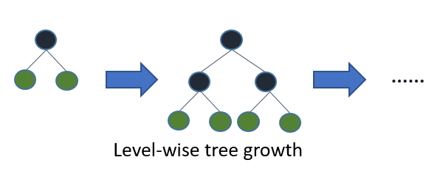
Lighg GBM - Feature
It will firstly choose the leaf with max delta loss to grow.
Lower loss
max_depth parameter to limit tree depth to avoid overfitting when the data is small
Other decision tree learning algorithms

Slide 8
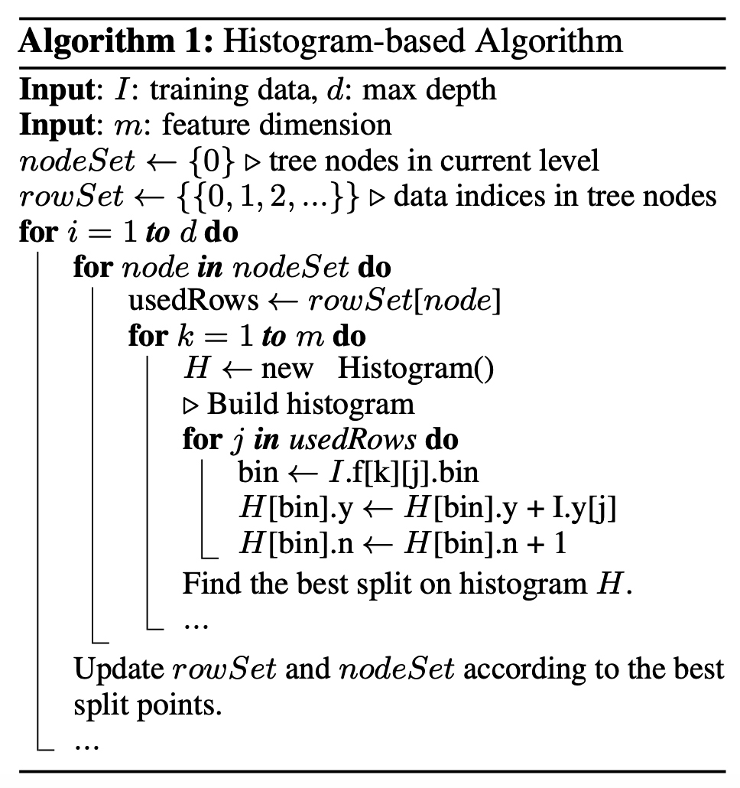
Light GBM - Feature
Covert features into bins
convert continuous features or variables to discretized features
Create a histogram for each feature(leaf node)
Use bin as index of the histogram
From all the histograms, find the best splitting point

Slide 9
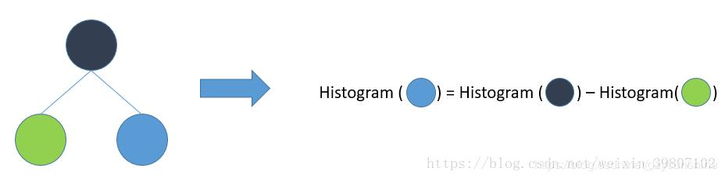
Light GBM
Histogram subtraction:
In order to speed up training, light GBM communicates histograms only for one leaf, and get its neighbor’s histograms by subtraction

Slide 10
Linear Discriminant Analysis
Based on Bayes theorem, LDA classifies a subject into the class which has the largest conditional density.
In assumption, the model fits a Gaussian density to each class with the same covariance matrix for all classes.
Notes:
In tradition, LDA is sometimes a leading model in default risk prediction. After selecting some significant features, fitting them in LDA model for further prediction gets an equivalent score as light GBM but using less features input.

Slide 11
Procedures
Train the light GBM classifier on application table and previous application table individually with 5-fold cross validation
Select 30 most important features from application table and 20 most important features from previous application table
Combine these features selected from two tables, train the light GBM classifier on these combined features with 5-fold cross validation
Load data from other tables (POS_CASH_balance, installments_payments, credit_card_balance, bureau), and then merge these tables with the 50-feature data above

Slide 12
Procedures
Train the new dataset with 5-fold validation, and then do the prediction.
Get the 75 most important features in this model, use these features to train the LDA classifier for prediction

Slide 13
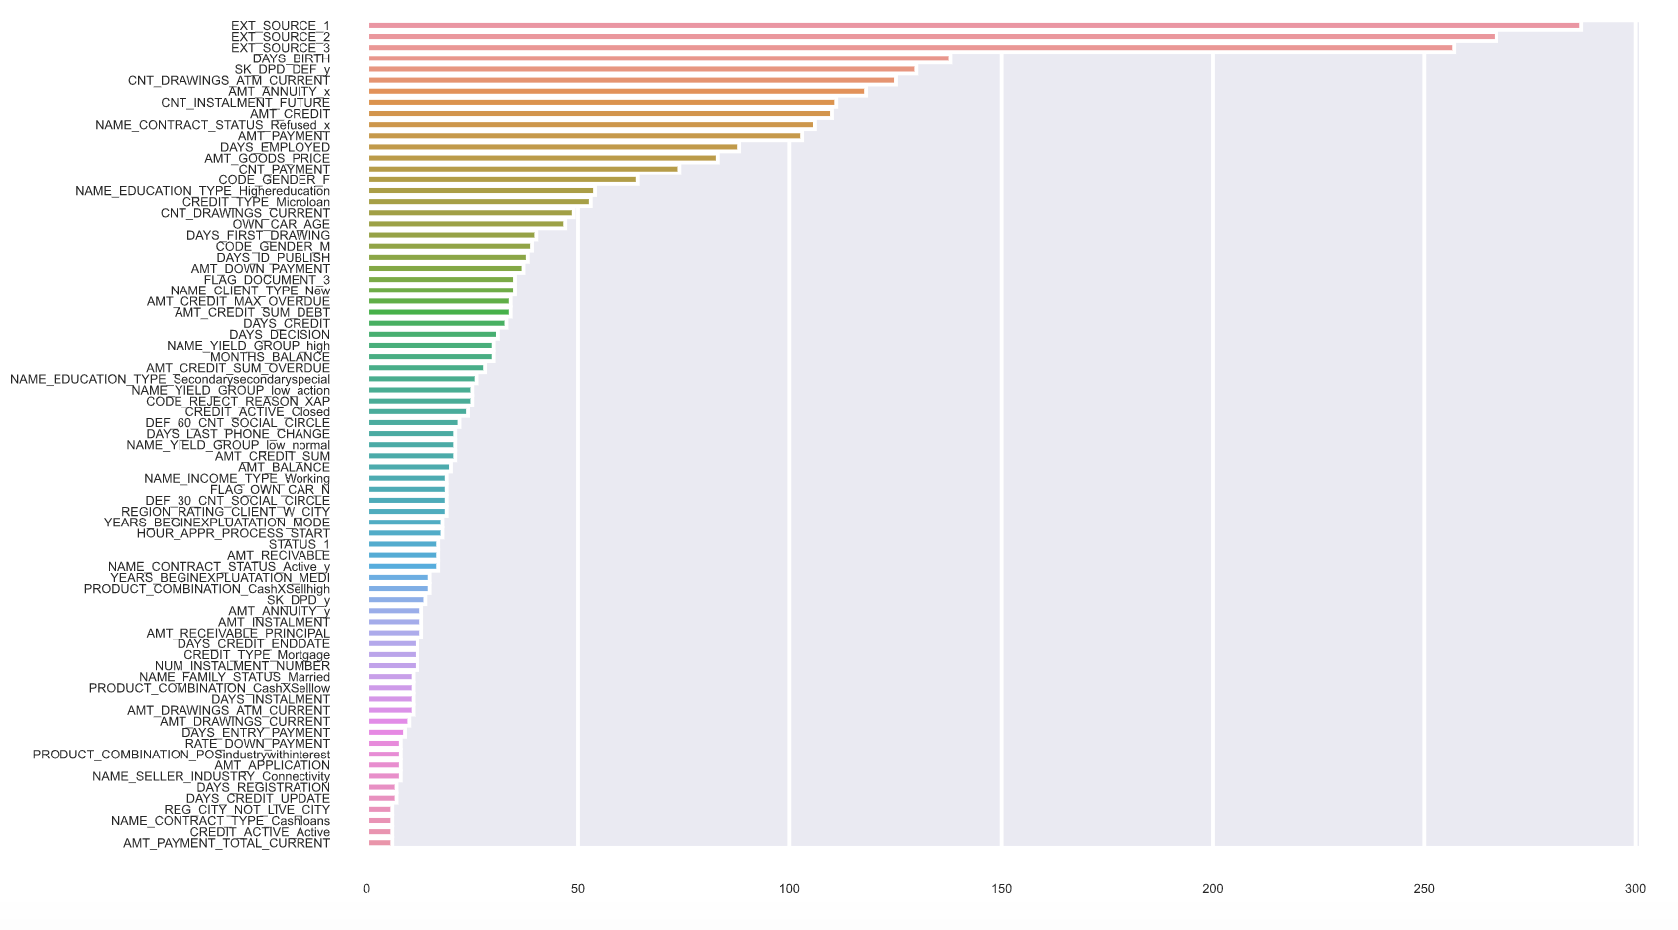
Notes:
With light GBM, it is efficient to know which features are important when analyzing a large and sparse dataset with high-dimension features space. It provides some concrete features as reference to evaluate client’s repayment ability.

Slide 14
Result
Dataset & Features | Kaggle Score
application data | 0.72696
application data (30 feats) + previous application (20 feats) | 0.73885
all table data | 0.75249
LDA with top 75 important features | 0.75523
Notes:
As the results show, extracting features from more tables will improve the score and no need to use all the features in one table.
In tradition, LDA is sometimes a leading model in default risk prediction. After selecting some significant features, fitting them in LDA model for further prediction gets an equivalent score as light GBM but using less features input.
That may help Home Credit Company to narrow down the feature space, as we have known which features are important to the prediction
So maybe in the future, Home Credit Company can firstly consider these features to do the prediction

Slide 15
Future Works
More tuning
Do more data visualization
Try to find more feature from the existing table

Slide 16
Reference
Guolin Ke, Qi Meng, Thomas Finley, Taifeng Wang, Wei Chen, Weidong Ma, Qiwei Ye, Tie-Yan Liu. “LightGBM: A Highly Efficient Gradient Boosting Decision Tree.” Advances in Neural Information Processing Systems 30 (NIPS 2017), pp. 3149-3157.

