Slide 1
Linear Algebra HW4
Page Rank
助教 許博竣 r07942095@ntu.edu.tw

Slide 2
Outline
Introduction
ToDo
Data Format
Grading
Submission
Rules

Slide 3
Introduction - PageRank
PageRank is an algorithm to measure the importance of a website.
It was developed by Larry Page and Sergey Brin in 1996.
The more links a website received from other websites, the more important it is.
The algorithm iteratively calculate the importance of a website according to the websites that have links to it and their importance.

Slide 4

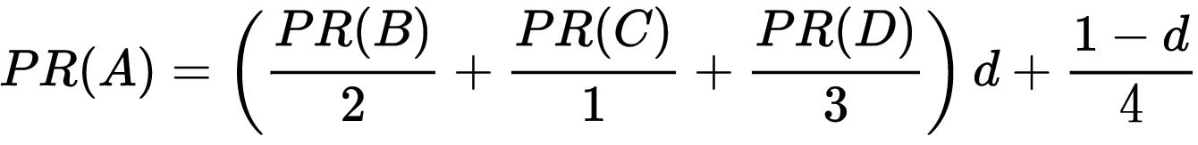
Introduction
A
B
C
D

Slide 5

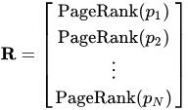
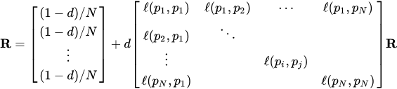
Introduction
/L(p₁)
/L(p₂)
: 1 if p_{j} has a link to p_{i}, else 0
/L(p_{N})
'
/L(p₁)
, repeat util R’ ≈ R
/L(p_{j})
/L(p₁)
/L(p_{N})
transition matrix

Slide 6
ToDo
Download hw4.zip here.
Write hw4.py that can
Make the transition matrix.
Calculate the rank of every node.
Answer the question here.

Slide 7
ToDo
Finish 3 ToDos in hw4.py
get_tran() -> get the transition matrix
cal_rank() -> calculate the rank of every node
d = 0.85
save() -> save the transition matrix, ranks to 1.txt, 2.txt
Run the code to get 1.txt, 2.txt
python3 hw4.py graph.txt
use graph_n.txt according to last number of your student ID (b01234567 -> graph_7.txt)
1.txt and 2.txt should be in the same directory as where hw4.py is

Slide 8
ToDo - cal_rank()
Step 1: Initiala all PageRank in R₀ with 1/N. (N: the number of nodes)
Step 2: Use R_{t} and transition matrix to calculate R_{t+1}
Step 3: Repeat Step 2 until:
|| R_{t+1} - R_{t} ||₁ ≤ alpha (Use the funcion dist(R_{t+1} , R_{t}) to calculate || R_{t+1} - R_{t} ||₁)
or when t ≥ max iterations
max iterations = 1000, alpha = 0.001

Slide 9
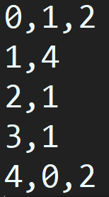
Data Format
graph.txt
0
1
2
3
4

Slide 10
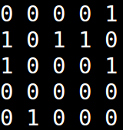
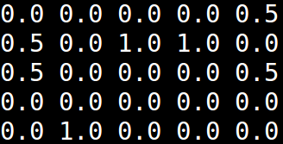
Data Format
1.txt
0
1
2
3
4
this is the transition matrix we want

Slide 11
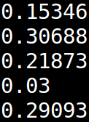
Data Format
2.txt
Note: don’t worry about the number of the digits, small deviation is allowable

Slide 12
Grading
Save the transition matrix of the graph in 1.txt. (1%)
Check ex/1.txt to make sure that your submission is in correct format.
Save the rank score of every node in 2.txt. (3%)
Check ex/2.txt to make sure that your submission is in correct format.
Q: If we initial R₀ with random numbers and keep SUM(R₀) = 1, will the ranking be different ? Try to explain it. (2%)
Write your answer in report.pdf.
No template for report.pdf, but write the answer in 1 page.

Slide 13
Submission
You should put all your files in a folder and compress it in a zip file.
b01234567_hw4.zip
|—./b01234567_hw4.zip
|—hw4.py
|—1.txt
|—2.txt
|—report.pdf
Note: do not upload any graph.txt or other files

Slide 14
Rules
Plagiarism = 0 point
Upload b01234567_hw4.zip to CEIBA
DEADLINE: 2018/12/11 (Tue.) 23:59 (GMT+8:00)
Late submission: total score x 0.8 (per day)
Any other error: total score x 0.8
Python packages: numpy, pandas, and any built-in package
請確定投影片中出現的紅字都注意看過：）

Slide 15
FAQ

