Slide 1

MAD Team
Michela petrozzi
Alienor Viollet
Deepmala agarwal

Slide 2
AGENDA
Introduction: Project Overview
User Stories for this project
Data sources
Libraries & Packages
Goals
Explanation of project execution steps
Findings
Conclusion

Slide 3
Introduction
Resources:
- UBER API issue
-
- Russian customer csv file

Slide 4
Explanation of project execution steps
Analysis
Understand the stories
Identify the data sets needed to answer these questions
Design
Data design
UI design
Algorithms to answer each story
Development
Build data sources for Uber data using Kaggle for Russia and Newyork
Derivation of city name based on Latitude and Longitude using citypy package
Creation of dataframes
Creation of charts (pie charts, bar charts, scatter plots, line graphs, box plots)
Statistical analysis (correlation, linear regression, ANOVA)
Hypothesis analysis and null hypothesis

Slide 5
Understand the stories
As a Uber customer, I want to lower my payments and find out what the best time is to book Uber – Rush hour analysis.
As a Uber customer, I want to know the peak time.
As a Uber customer, I want to know which cities have maximum Uber drivers level and offer least expensive rides.
As a Uber customer, I want to know the average waiting time and the probability that the ride will get cancelled.
As a Uber driver, where I should choose to drive for Uber in order to earn the highest income.
As a data analyst, we can analyze the correlation between number of Uber trips and affordable income in the major US cities.
As a data analyst, we want to know the seasonality of Uber trips.

Slide 6
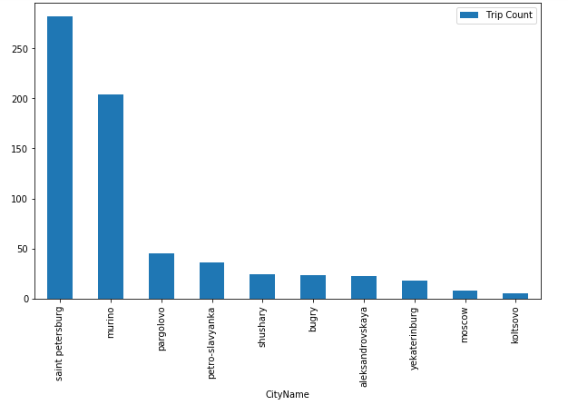
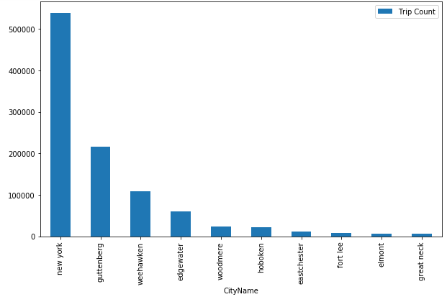
Rush City Analysis
In Russian Geography, availability of UBER driver is high so as a customer you can get an UBER in Saint Peterburg with minimum wait time and Koltosova with maximum wait time.
In New York Geography, availability of UBER driver is high so as a customer you can get an UBER in New York with minimum wait time and Great Neck with maximum wait time.

Slide 7
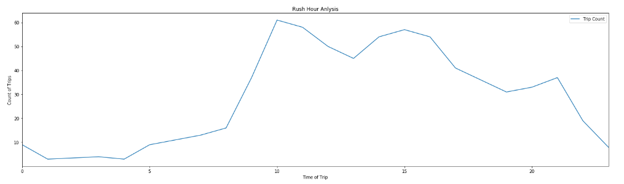
Rush Hour Analysis
In Russian Geography, availability of UBER driver is high so as a customer you can get an UBER in Saint Peterburg with minimum wait time and Koltosova with maximum wait time.
In New York Geography, availability of UBER driver is high so as a customer you can get an UBER in New York with minimum wait time and Great Neck with maximum wait time.

Slide 8
Rush Hour Analysis
In Russian Geography, availability of UBER driver is high so as a customer you can get an UBER in Saint Peterburg with minimum wait time and Koltosova with maximum wait time.
In New York Geography, availability of UBER driver is high so as a customer you can get an UBER in New York with minimum wait time and Great Neck with maximum wait time.

