Slide 1

MAD Team
Michela petrozzi
Alienor Viollet
Deepmala agarwal

Slide 2
AGENDA
Introduction: Project Overview
User Stories for this project
Data sources
Libraries & Packages
Goals
Explanation of project execution steps
Findings
Conclusion

Slide 3
Introduction
Resources:
- UBER API issue
-
- Russian customer csv file

Slide 4
Explanation of project execution steps
Analysis
Understand the stories
Identify the data sets needed to answer these questions
Design
Data design
UI design
Algorithms to answer each story
Development
Build data sources for Uber data using Kaggle for Russia and Newyork
Derivation of city name based on Latitude and Longitude using citypy package
Creation of dataframes
Creation of charts (pie charts, bar charts, scatter plots, line graphs, box plots)
Statistical analysis (correlation, linear regression, ANOVA)
Hypothesis analysis and null hypothesis

Slide 5
Understand the stories
As a Uber customer, I want to lower my payments and find out what the best time is to book Uber – Rush hour analysis.
As a Uber customer, I want to know the peak time.
As a Uber customer, I want to know which cities have maximum Uber drivers level and offer least expensive rides.
As a Uber customer, I want to know how much I have to pay based on distance.
As a Uber customer, I want to know the average waiting time and the probability that the ride will get cancelled.
As a Uber driver, I want to know which car is the preferred one to drive while working for Uber.
As a Uber driver, where I should choose to drive for Uber in order to earn the highest income.
As a Uber driver, I want to know during what kind of weather there is the max number of trips.
As a data analyst, we want to know the seasonality of Uber trips.

Slide 6
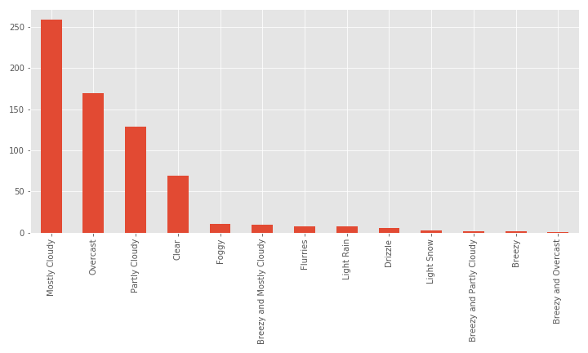
Uber trip count for type of weather
Notes:
The above bar chart shows the trip count for each type of weather. We can see that majority of trips were taken during mostly cloudy days.

Slide 7
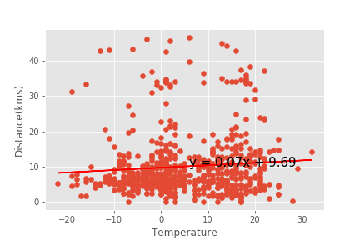
Temperature/Distance correlation
Notes:
Based on the above graph there is no correlation between the temperature value and the distance in kms of Uber trips since the correlation is only 0.08, very close to 0. The r-squared is also near 0 which means that only 7.8% of the variance for the Distance (kms) can be explained by the temperature.

Slide 8
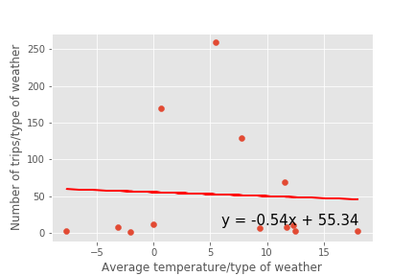
Avg temp/number of trips

Slide 9
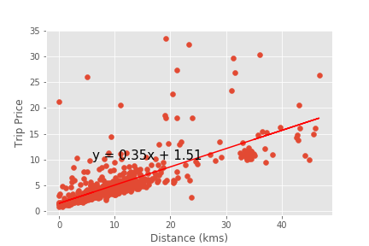
Distance/Trip price
Notes:
Based on the above scatter plot there is a moderate correlation between the distance in kms and the trip fare since the correlation number is 0.73, closer to 1. The r-squared is also near 1 which means that 72.6% of the variance for the trip fare can be explained by the distance in kms. The linear equation shows a positive linear regression line between the 2 variables, which means that an increase in the distance in kms corresponds to an increase in the trip fare.

Slide 10
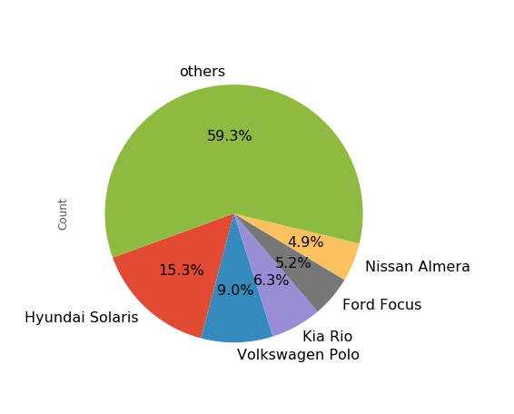
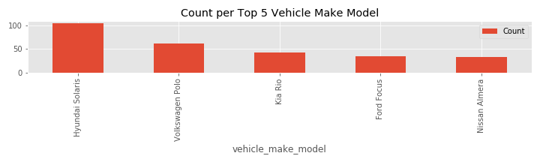
5 top cars used by Uber drivers
Notes:
The above pie chart shows the top 5 vehicle make models used by UBER drivers in Russia. The 1st one is the Hyunday Solaris, a south Korean car, which is sold as Hyundai Accent in the USA. For the Russian market it is assembled by the TagAZ plant in Taganrog. The 2nd one is the Volkswagen Polo, a car produced by the German manufacturer Volkswagen since 1975. The 3rd one is Kia Rio, another South Korean car.

Slide 11
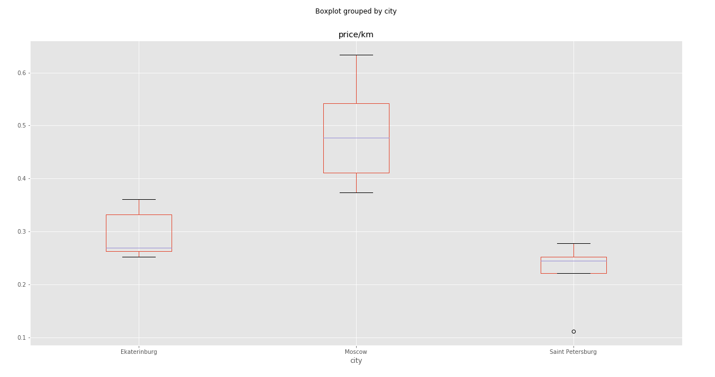
Comparison of prices/km in the 3 Russian cities

