Slide 1
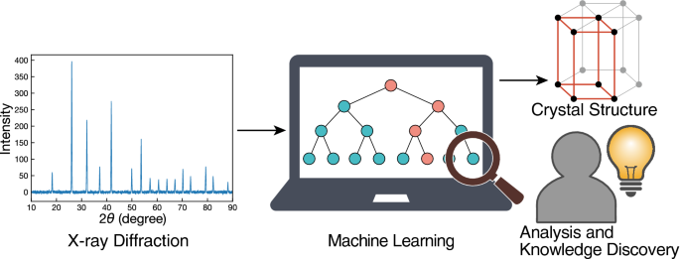
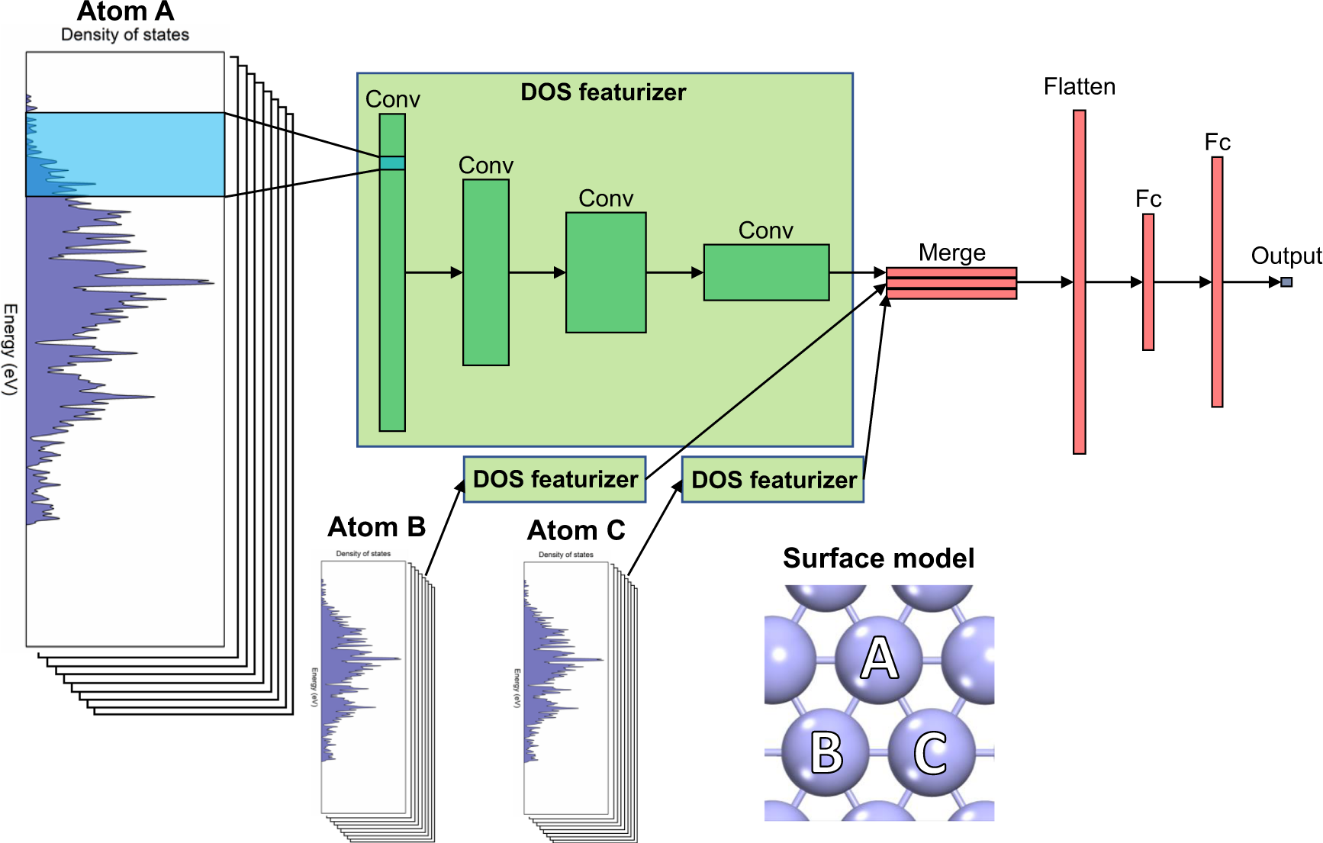
(a)
(b)
Notes:
https://www.nature.com/articles/s41598-020-77474-4
https://www.nature.com/articles/s41467-020-20342-6/figures/1

