Slide 1
Overview of the system
Our project is an Artificial Intelligence application that generates the ingredients list for the recipe using user input.
It takes the dish name and number of servings information from the user and returns the name, quantity (with unit) of each item in the ingredients list.
It can also associate the ingredients with existing products in a given product database, adding product ID for each ingredient.
Notes:
During development these technologies are used:
+ Python
+ Azure OpenAI
+ Azure Speech to Text Service
Inputs can be given as a sentence (Not just a word). Moreover, sentence can be both question and statement etc.
For example, both "How can I do margarita pizza?" and "Today, I would like to eat margarita pizza." Are valid inputs.
Only needs 2 inputs:
+ Dish Name
+ Servings Count
Returns 2 outputs:
+ Required Items
+ Quantities

Slide 2
Overview of the system
The application can utilize an existing recipe database or it can generate the recipe directly using Azure OpenAI.
It is able to get inputs as text or speech. The application leverages Azure Speech Service for text-to-speech operations.
It supports multi language inputs.
Notes:
During development these technologies are used:
+ Python
+ Azure OpenAI
+ Azure Speech to Text Service
Inputs can be given as a sentence (Not just a word). Moreover, sentence can be both question and statement etc.
For example, both "How can I do margarita pizza?" and "Today, I would like to eat margarita pizza." Are valid inputs.
Only needs 2 inputs:
+ Dish Name
+ Servings Count
Returns 2 outputs:
+ Required Items
+ Quantities

Slide 3
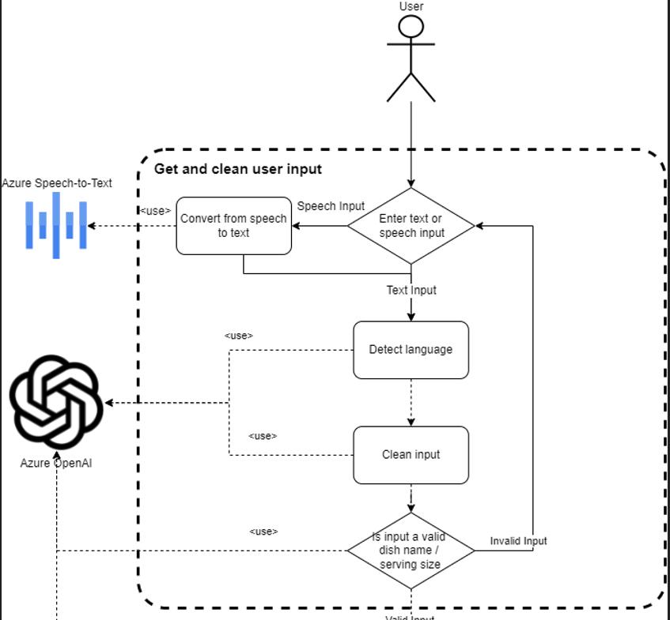
Generating recipe with user prompt
Get user request
Text (All languages)
Speech (English, German or Turkish)
Language Detection (Both for Text and Speech input)
Used Azure OpenAI for text inputs, and 'AutoDetectSourceLanguageConfig' for audio inputs
Notes:
The first step of the application is giving inputs.
Inputs can be given as only dish name and servings count ("hamburger", "margarita pizza", "seven", "8") or as sentence ("How can I do margarita pizza?", "We are seven men.").
Prompt input can be given by using terminal. For audio input, application will find default audio option in computer (Which microphone), and start to listen user sentences.
After a few seconds of silence, it will be ready to convert audio input to the text.
After getting inputs, system will determine the language of them. There are two possible options for that step:
+ Asking Azure OpenAI. That case is an option when user use prompt (Text) input
+ Speech-to-Text Service's Automatic Language Detection feature. That case is an option when user use audio (Microphone).

Slide 4
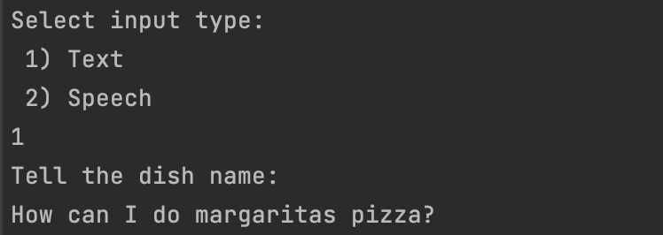
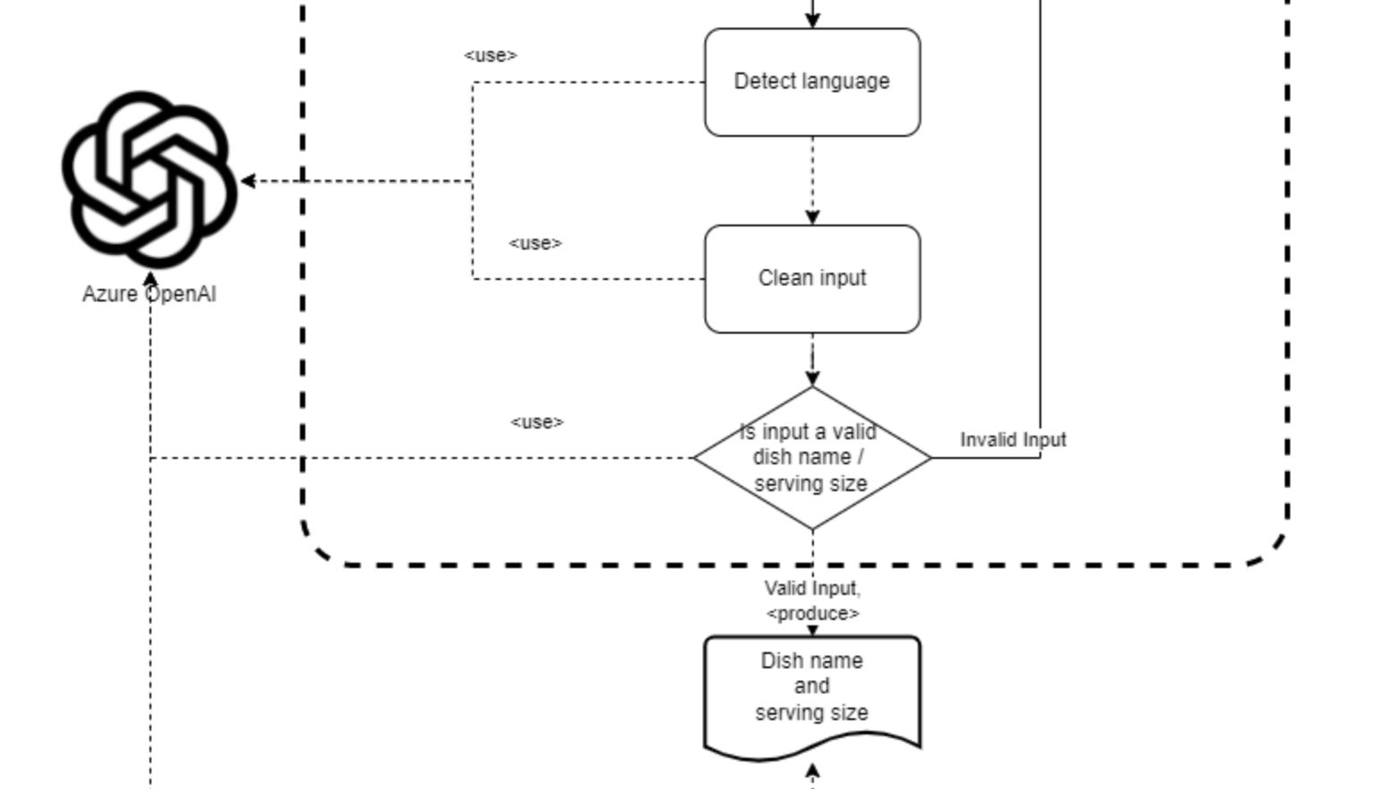
Generating recipe with user prompt
After getting input from user (Speech or Text):
Clean ‘Dish Name’ / 'Serving Count’ from the input sentence
Double check with Azure OpenAI
If the ‘Dish Name’ or 'Serving Count’ is valid or not
If pass both tests forward inputs to the ‘Recipe Generator’, otherwise ask invalid ones
Notes:
After getting user inputs (For Dish Name and Servings Count), system will clean them.
That means if the user gives sentence as an input such as "I want to make margarita pizza today.", application will clean the sentence and gets only "margarita pizza".
Likewise, same method is also applied for servings count. From inputs such as "We are seven people.", applciation gets "7" as integer (Converts all string number/counts to integer).
For this scraping part, we are using Azure OpenAI Service. Giving full sentence (User input) and language of the input to the Azure OpenAI, we get only the valid Dish Name or Servings Count.
After getting scraped inputs (Dish Name/Servings Count), we use second check mechanism. It will ask Azure OpenAI, if given input is valid for that type (Dish Name / Integer).
For example, if user gives such sentence as input "I would like to cook car today", first check (Clean input method) gives "car" as Dish Name mistakenly. So, we implemented second check mechanism.

Slide 5
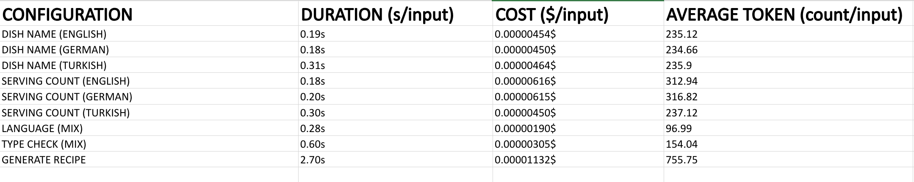
Performance and Cost
We ran unit tests for duration and cost.
Test configurations:
3 languages: English, German and Turkish
Dish Name and Serving Count tests
Language detection and double check (‘Type Check’) parts are also done with these 3 languages
Generate Recipe tests for creating items-quantities from 'Dish Name' and 'Serving Counts'
Notes:
We tested our application with various unit tests.
We tested our clean Dish Name and clean Servings Counts methods (They use Azure OpenAI service) with 3 languages (English, German and Turkish) and with various input sentences.
We also implement unit tests for Type Check and Language Detection of application (If given input is valid for that type / Determine the langiage of user input).
These are the results of unit tests.
We measured Duration, Cost and Average Token for per input.
[Evaluation of results in next page]

Slide 6
Performance and Cost
Several key points from the performance/cost tests:
Duration:
The main cost of the system is Azure OpenAI usage
Azure Speech service is free for 5 hours per month (F0)
English and German inputs takes about 200-350ms for both ‘Dish Name’ and ‘Serving Count’ inputs (First Checks)
Duration for Double Check methods is also so similar to First Checks, it takes about 200ms
Language detection takes more time than First and Double Checks. It takes about 350ms.
Generate Recipe's duration is about 3s per input
Cost:
Cost of the First Checks and Double Check are so similar and about 0.00000454$ per input sentence
Language determination's cost is so small such as about 0.00000305$ per input
However, cost of the Generate Recipe is over than 0.00001$ per instance which is nearly 2 times of First/Double Checks
Notes:
As the main cost of the application is Azure OpenAI usage, we focused on that cost.
Our Speech-to-Text service is free for 5 hours monthly, after that amount it costs about 90 cents per hour in Pay as You Go plan.
Key insights:
Duration:
+ Durations of English and German sentences are so similar and per input takes about 200ms (For both Dish Name and Servings Count inputs).
+ Duration for type check is also so similar to First Checks. It is about 200ms
+ Language detection takes more time than First Checks and Double Checks. It takes about 350ms.
+ Generate Recipe method takes much more time. It takes Dish Name and Servings Count as input and returns required items and quantities. It takes about 2.7s.
Cost:
As main cost of the application is Azure OpenAI usage, we focused on that part.
+ Cost of the First and Second Checks are so similar and about 0.00000454$ (Really so small).
+ The most important (And high) cost in here is coming from Generate Recipe part of the system. It takes Dish Name and Servings Count and return required items and quantities.
It also uses few shot learning to increase accuracy. So, it's cost is about 2 times higher than other parts and takes 0.00001$

