Slide 1
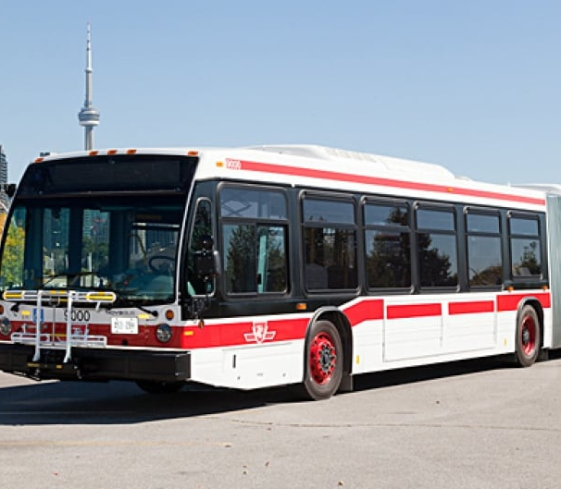
Real-Time Bus Delay Prediction
City of Toronto

Slide 2
Agenda
Overview
Applications
Model Details
Next Steps

Slide 3
Overview
Predictive Machine Learning Model.
Predicts how late a bus will be in the following ranges
0-5 Minutes
6-10 Minutes
10-20 Minutes
21-40 Minutes
40+ Minutes
Needs 7 simple data features like date, time, route, direction, location, incident and gap.

Slide 4
Potential Applications
Internal Uses
1) Contingency Planning.
2) Ad-hoc Response Tool.
3) Resource Allocation Aid.
External Uses
1) Real-time delay updates.
2) Trip planning.

Slide 5
Model Details and Performance
Predictive Classifier Model (Random Forest)
Uses last 2 year’s delay data for training.
Real-time quick prediction.
Correctly predicts 89% of the delays (Appendix 1) – with potential to be even better

Slide 6
The Future
Model Performance Improvement
Data from more past years for training.
Technical Improvements with better computation resources.
Interactive Dashboard for Internal Use
Pipeline building for real-time use.
Visualizations for areas of concern and trends.
Application for Transit Staff and Customers
Portal to Input Data.
End-user customer app for trip planning.

Slide 7
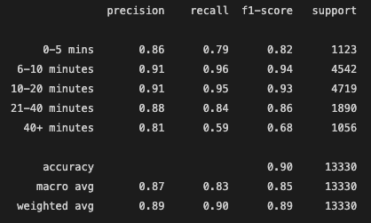
Appendix 1a – Model Performance

Slide 8
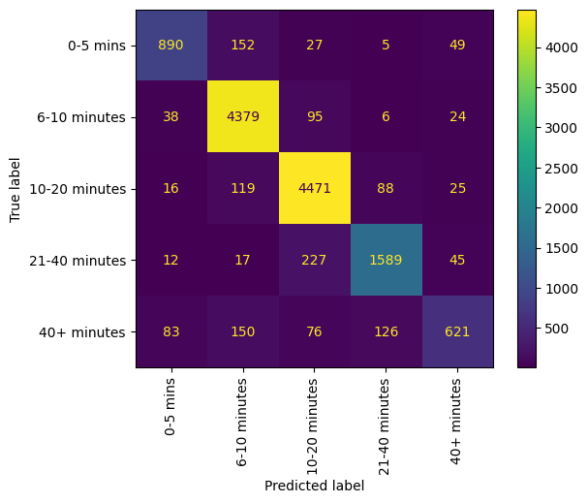
Appendix 1b – Model Performance

