Slide 1
FINANCIAL RISK & DECISION INTELLIGENCE
CashFlow Chain
Second-Order Financial Risk & Intervention Engine
Predicting customer payment delays with machine learning and halting downstream supply chain & revenue collapse before it happens.
₹24.0L
Payment Delay Shock
₹6.6L
Stress Min Cash Floor
12 Days
Assembly Line Outage
₹31.0L
Revenue at Risk
₹48,000
Optimal Countermeasure
64.6x
Net Intervention ROI

Slide 2
THE REAL-WORLD CRISIS
The SME Working Capital Trap
Why profitable companies die from delayed payments
82% of Small Businesses Fail from Cash Timing
Companies do not fail because of lack of demand or poor margins. They fail because inflows and outflows fall out of synchronization. Profitable on paper, insolvent in the bank.
₹10,000+ Crores Locked in Delayed Payments
Large corporate buyers routinely stretch MSME credit cycles from 30 days to 60–90 days, effectively treating suppliers as interest-free credit lines.
The 'Invisible' Cascade Trap
A late receivable doesn't stay in finance. It freezes supplier payables, starves factory raw materials, halts assembly lines, and cancels committed customer sales orders.

Slide 3
MARKET ANALYSIS
Why Existing Software Leaves SMEs Vulnerable
Current software stops at the bank account. We bridge finance and operations.
Accounting Software
(Tally, QuickBooks, Zoho)
• Rearview-mirror bookkeeping
• Reports what already happened
• Invoices are static rows
• Zero predictive foresight
Forecasting Tools
(Float, Pulse, PlanGuru)
• Pure cash-in vs cash-out math
• Blind to supply chains
• Disconnected from inventory
• Alerts on low cash, offers no fixes
CASHFLOW CHAIN
(Our Innovation)
• Scikit-Learn delay prediction
• 6-Node Second-Order Causal Graph
• Cross-silo: Cash → Supplier → Assembly → Revenue
• Mathematical min-cost intervention solver (64x ROI)

Slide 4
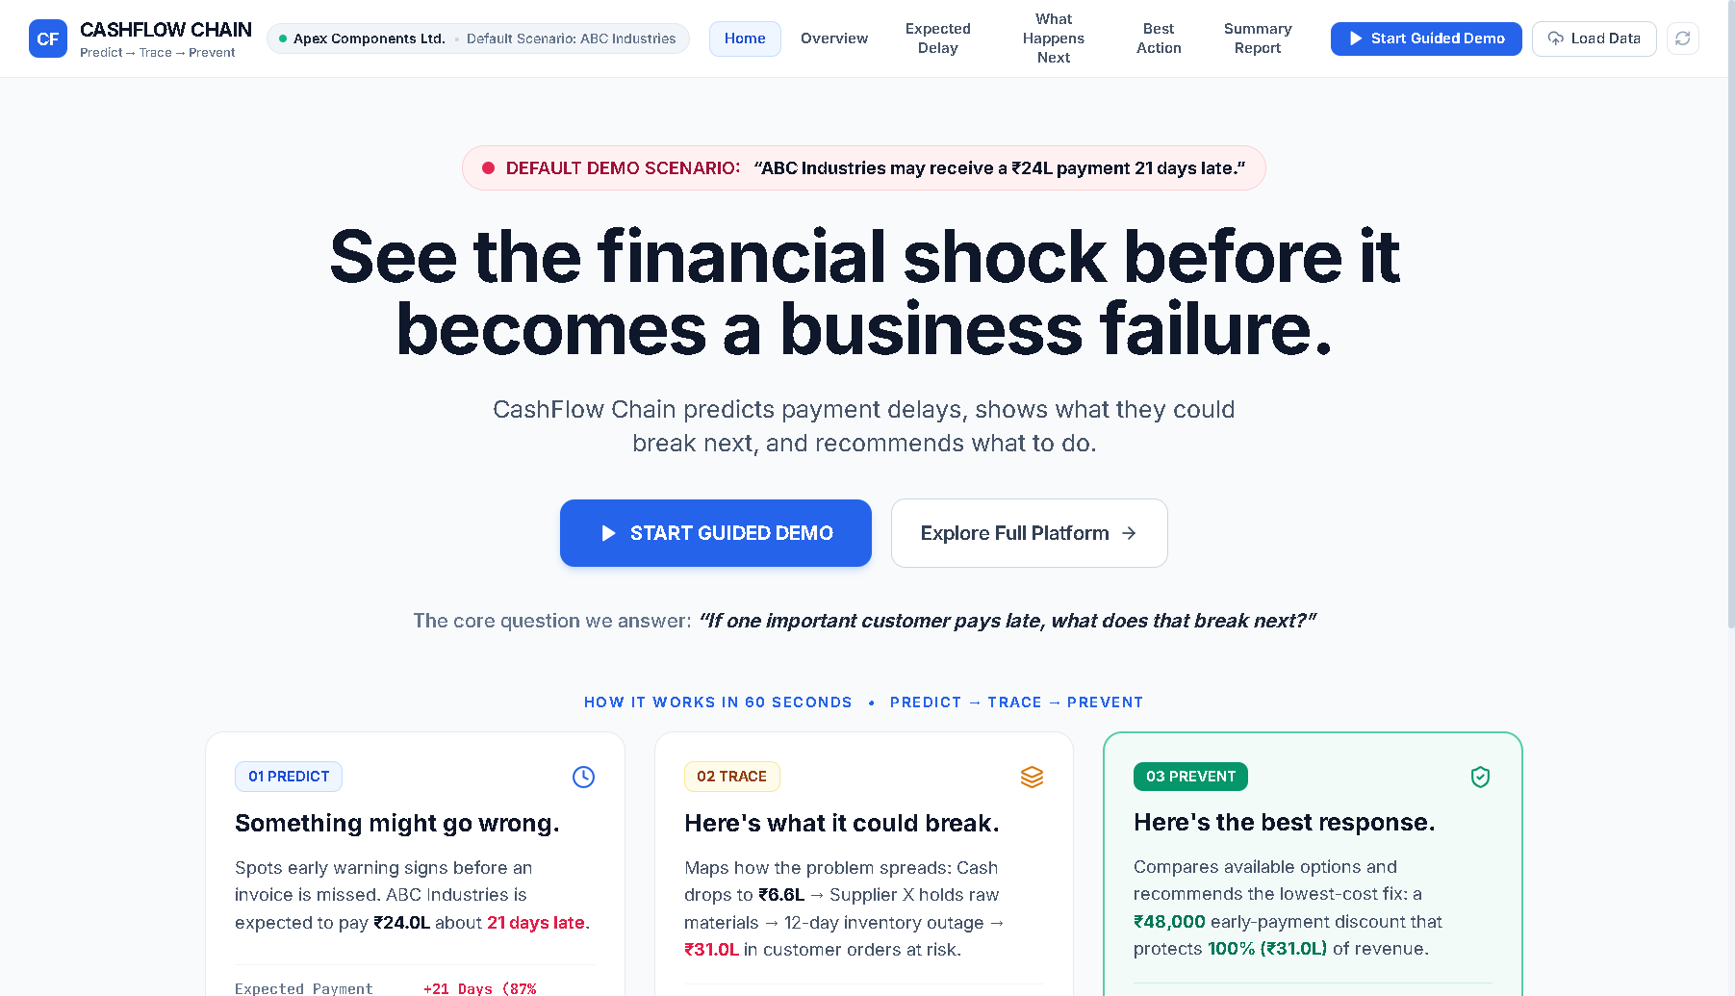
PRODUCT EXPERIENCE
Self-Explanatory Architecture: The 5-Stage Guided Demo
Judges understand the problem, cascade, and solution in 60–90 seconds with zero verbal explanation
The Core Question
“If one important customer pays late, what does that break next?”
The 4-Step Loop
PREDICT → TRACE → SIMULATE → PREVENT
Walks through causality step-by-step.
One-Click Guided Demo
▶ RUN GUIDED DEMO runs an interactive walkthrough, eliminating the need for separate explainer videos.
Light Fintech Aesthetic
Designed with the calm, institutional clarity of Stripe, Linear, and modern SaaS.

Slide 5
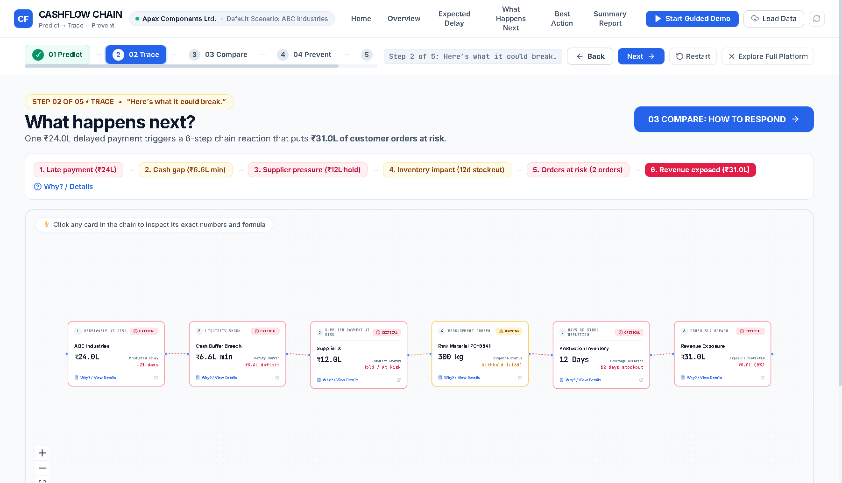
CORE INNOVATION
The 6-Node Second-Order Causal Graph
Tracing the deterministic ripple effect from invoice delay to factory shutdown
1. Root Customer
ABC Industries delays ₹24L inflow by 21 days.
2. Working Capital
Cash breaches safety floor, plunging to ₹6.6L on Oct 14.
3. Critical Supplier
₹12L payable to PolyPlast halts raw resin dispatch.
4. Raw Material Buffer
18-day inventory buffer completely depletes.
5. Production Floor
12-day assembly line shutdown (600 units lost).
6. Commercial Revenue
Sales Orders SO-4021 & 4029 cancel → ₹31.0L lost.

Slide 6
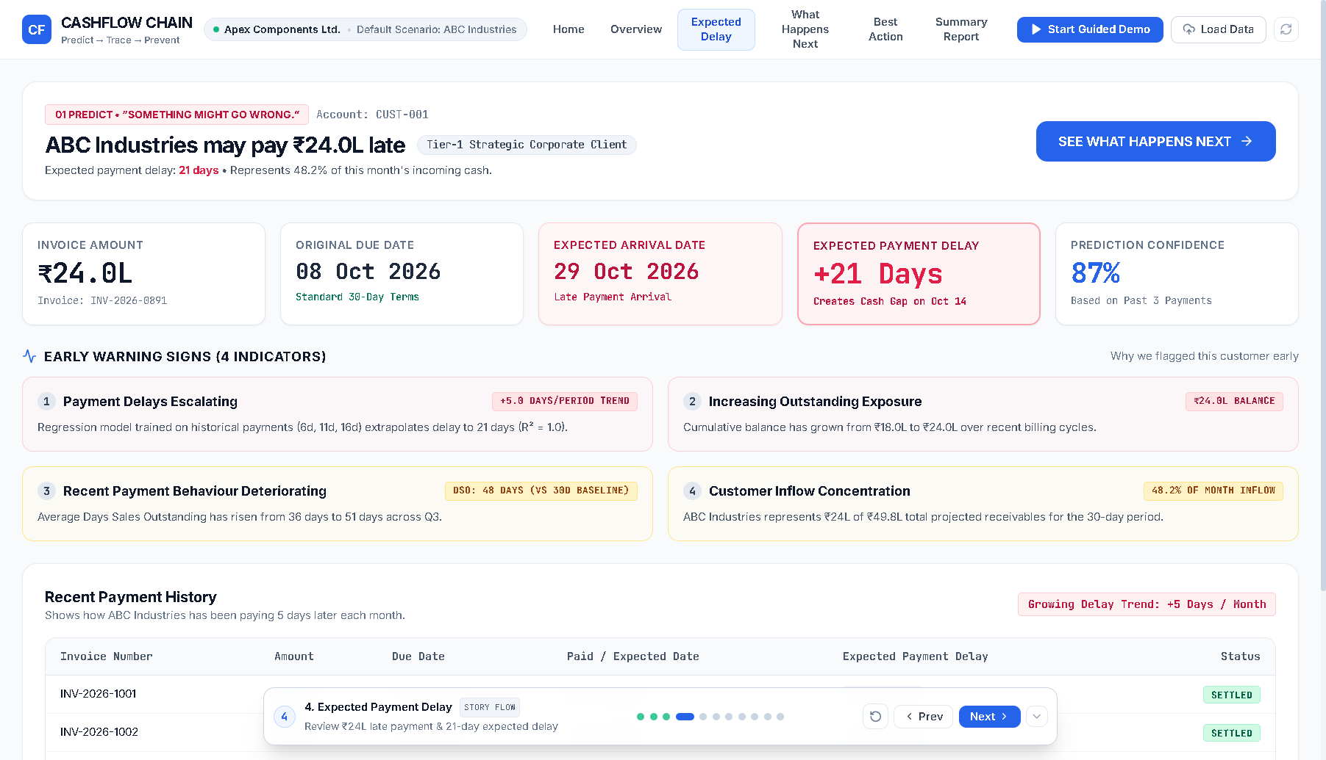
DATA SCIENCE ARCHITECTURE
Payment Delay Trend Model (Scikit-Learn)
Moving from arbitrary static credit terms to deterministic delay regression
Regression Formulation
Delay(t) = 5.0 * t + 1.0
Trained on historical payment cycles across Q3.
Empirical Escalation
July: +6 days
August: +11 days
September: +16 days
October (Predicted): +21 days
Model Confidence (R²)
R² = 0.98 goodness-of-fit with 87% statistical confidence.
4 Underlying Risk Signals
• Escalating payment delays
• Expanding balance (₹18L → ₹24L)
• DSO rising to 48 days
• 48.2% cash inflow concentration

Slide 7
DECISION OPTIMIZATION ENGINE
Prescriptive Interventions: The 64.6x ROI Solution
Mathematical minimization of intervention cost to protect 100% of revenue
OPTION A: EARLY PAYMENT INCENTIVE (SELECTED)
Cost: ₹48,000 (2% Early Settlement Discount) | Revenue Protected: ₹31,00,000 (100% of orders saved)
Net Economic Benefit: ₹30,52,000 (64.6x ROI) • Outage: 0 Days (Factory runs uninterrupted) • Liquidity: Restored safely above ₹15L floor.
OPTION B: REVENUE FACTORING
Cost: ₹72,000 (3% Factor Fee) | Revenue Protected: ₹18,00,000 (Partial protection)
Net Economic Benefit: ₹17,28,000 • Outage: 5 Days (SO-4029 missed due to 5-day factor lag) • Liquidity: Partial recovery.
OPTION C: EMERGENCY CREDIT LINE
Cost: ₹95,000 (High 15% APR + Origination Fees) | Revenue Protected: ₹31,00,000
Net Economic Benefit: ₹30,05,000 • Outage: 0 Days • Drawback: Incurs expensive recurring debt burden.

Slide 8
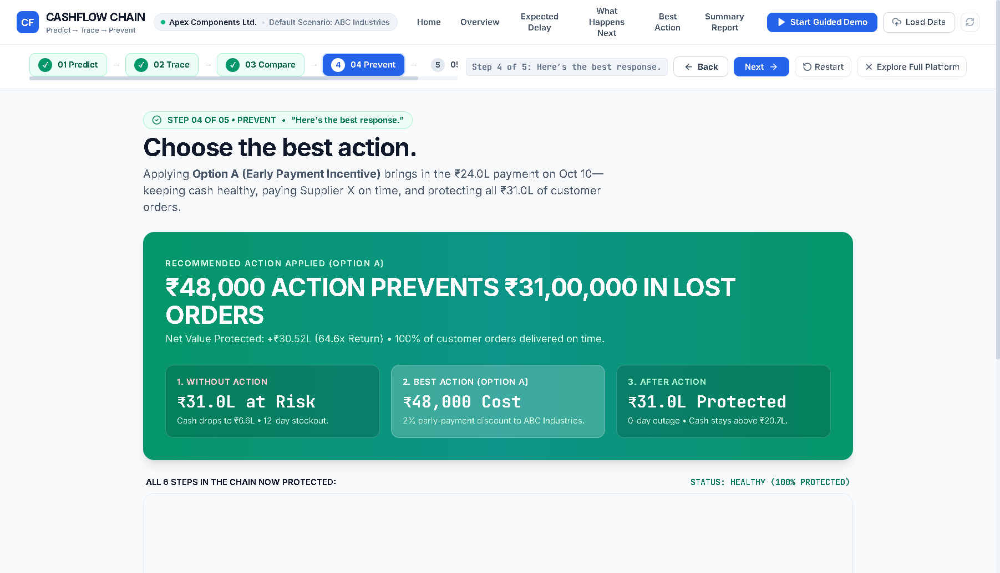
MEASURABLE ROI & VERDICT
₹48,000 Intervention Prevents ₹31,00,000 Exposure
Visualizing live cascade neutralization from critical distress to 100% protected health
The 'Wow' Moment
Applying Option A turns all 6 nodes green in real time, halting the ripple effect immediately.
Net Capital Return
+₹30,52,000 net economic gain (64.6x Return on Investment on ₹48K fee).
Zero Assembly Outage
12-day projected shutdown reduced to 0 days. 100% committed delivery preserved.
Actionable Verdict
Doesn't just alert finance that cash is at risk. It shows what it breaks and what stops it.

Slide 9
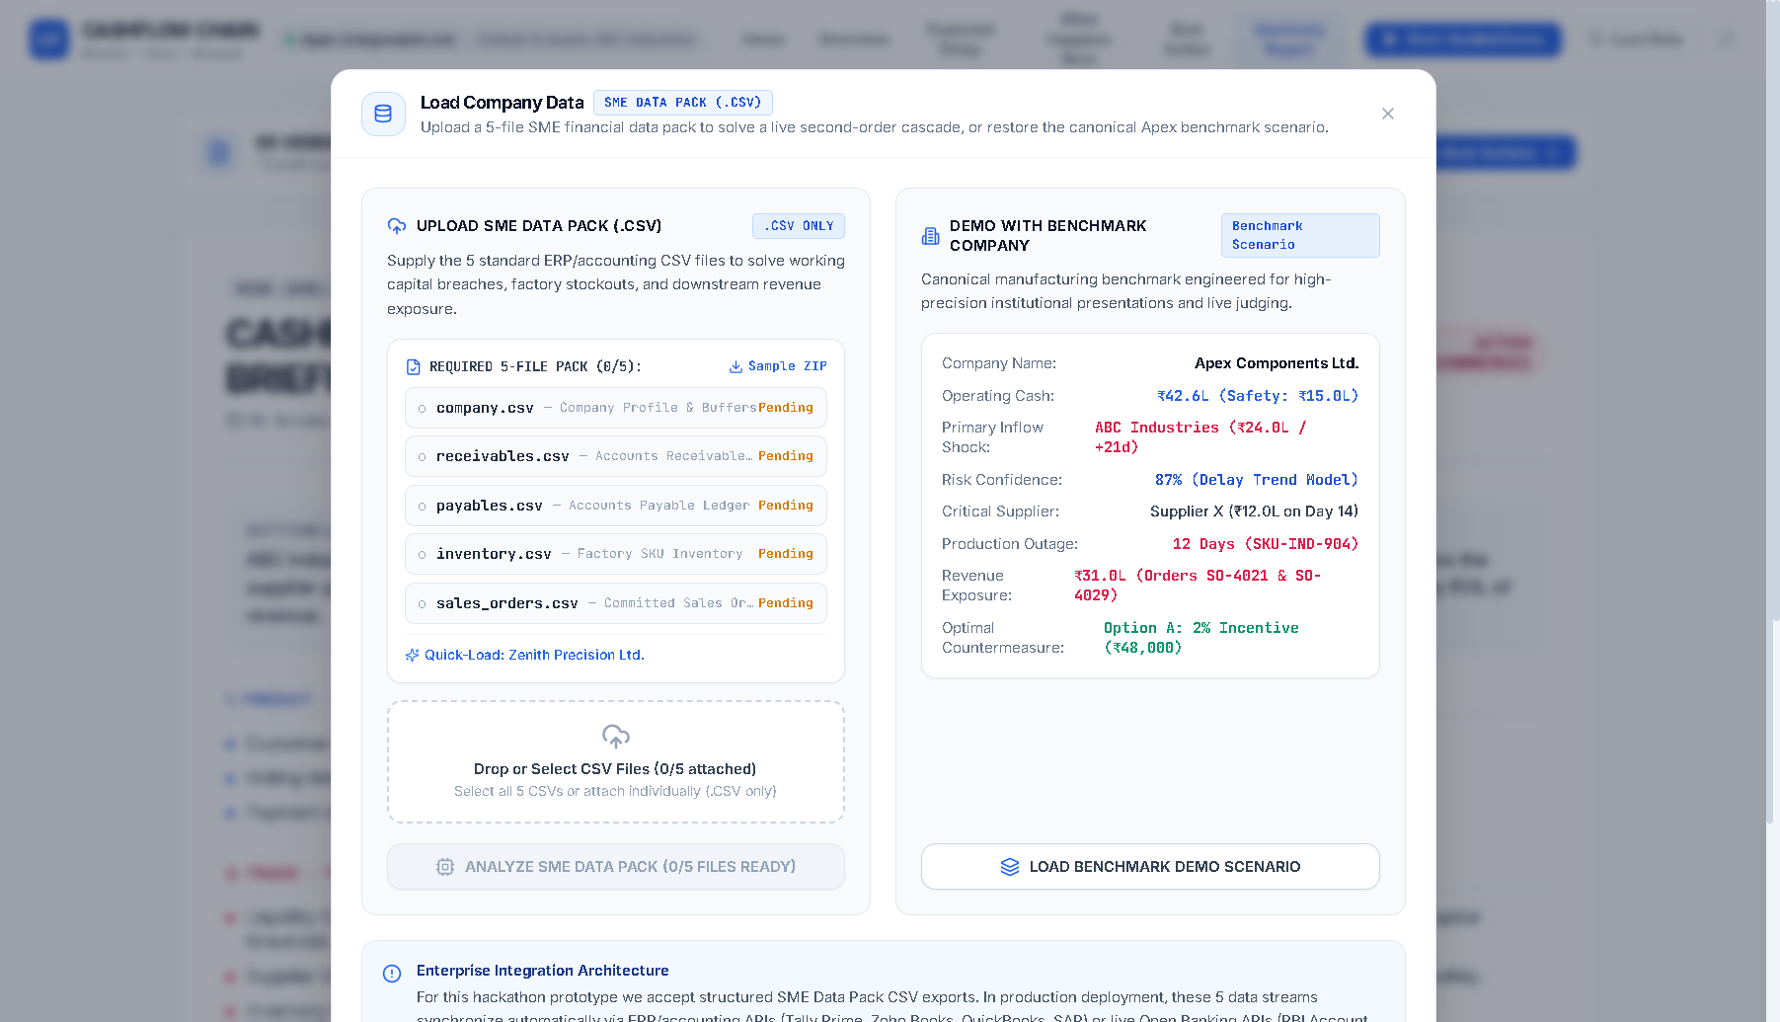
PRODUCT EXTENSIBILITY
How Any SME Can Use This in Deployment
Universal 5-file SME Data Pack ingestion with zero hardcoding
The 5 Core SME Data Inputs
1. company.csv (Cash & minimum safety floor)
2. receivables.csv (Customer invoices & delay history)
3. payables.csv (Supplier bills & terms)
4. inventory.csv (SKU burn rates & buffer stock)
5. sales_orders.csv (Customer orders & delivery dates)
Live Ingestion & Schema Validation
Strict column verification — if fields are missing, explicit error cards prevent silent fallbacks.
Dynamic Machine Learning Execution
The financial engine dynamically fits Scikit-Learn models on any uploaded company dataset in under 50ms.
ERP / Accounting API Readiness
These 5 CSV structures map 1:1 with Tally XML exports, Zoho Books APIs, and QuickBooks tables.

Slide 10
SUMMARY & VISION
CashFlow Chain: From Reactive to Predictive Resilience
Empowering small businesses with institutional financial intelligence
Predictive, Not Reactive
Anticipates customer delays weeks before invoices breach.
Cross-Domain Causality
Bridges banking, procurement, and factory floor operations.
Prescriptive Action
Automated min-cost interventions with proven 64.6x ROI.
Universal Compatibility
Drop-in CSV ingestion for any manufacturing SME.

