Slide 1
Handwritten Digit Recognition Made By Mantra Joshi 170110116017 Kashyap Patel 170110116039 Deep Patel 170114116001
Sub-Project2
2181606

Slide 2
Content
Introduction to definition
Motivation to Select Definition / Problem Statement
Why this definition
Analysis
Approach
Conclusion and references

Slide 3
Introduction to definition
0
The handwritten digit recognition is the ability of computers to recognize human handwritten digits.
It is a hard task for the machine because handwritten digits are not perfect and can be made with many different flavors.
The handwritten digit recognition is the solution to this problem which uses the image of a digit and recognizes the digit present in the image.

Slide 4
Problem Statement
The goal of this project is to create a model that will be able to recognize and determine the handwritten digits from its image by using the concepts of Convolution Neural Network.
It is easy for humans to identify the digits but machines cannot. For that we need to train our machines so that it can be identified by machine as well.
Though the goal is to create a model which can recognize the digits, it can be extended to letters and an individual’s handwriting.
The major goal of the proposed system is understanding Convolutional Neural Network and applying it to the handwritten recognition system.

Slide 5
Why This Definition?
Before Computers Existed All the information was stored in Written form.
This is very Inefficient form of Storage as the paper Information cannot be stored for very long time and can get lost or be destroyed.
On the Contrary Information on computer is stored for long time and multiple copies of same in formation can be made easily.
Thus after Inventing the computers lot of money was wasted in manually converting this paper information into digital information.
Instead Machine learning and deep learning can be used to identify and convert this paper information into digital information without human intervention or manual labor.
Our project is just an introduction to this approach.

Slide 6
Analysis
Dataset: MNIST database of handwritten digits is used as dataset.
Consists of a training set of 60,000 examples, and a test set of 10,000 examples.
Digits have been size-normalized to identify.
Approach would be Centered in a fixed-size image of 28*28 pixels (784 pixels).
We have done some analysis and we found that error rate is lower in CNN.
Keras library and the Tkinter library for building GUI.

Slide 7
MNIST DATASET
Modified National Institute of Standards and Technology (MNIST) is a large set of computer vision dataset .
Extensively used for training and testing different systems.
It was created from the two special datasets of National Institute of Standards and Technology (NIST).
Holds binary images of handwritten digits.
The training set contains handwritten digits from around 200-250 people.
MNIST is often attributed as the first datasets among other datasets to prove the effectiveness of the neural networks.

Slide 8
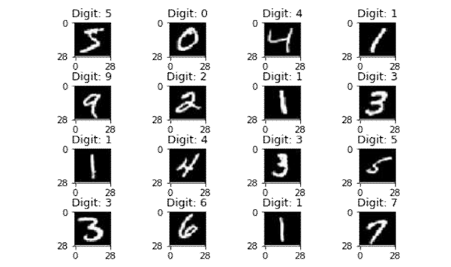
The database contains 60,000 images used for training.
Few images can be used for cross-validation purposes.
All the digits are grayscale and positioned in a fixed size.
The intensity lies at the center of the image with 28×28 pixels.
Since all the images are 28×28 pixels, it forms an array which can be flattened into 28*28=784 dimensional vector.

Slide 9
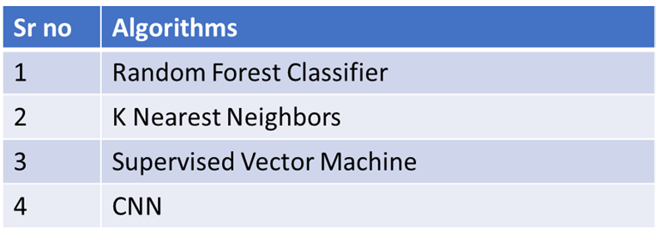
Algorithms
Convolutional Neural Network (CNN) is best among above machine learning and deep learning algorithms with an error rate of approximate 3-4%.

Slide 10
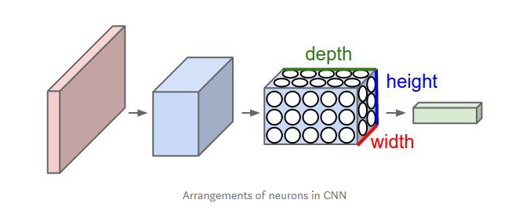
CNN (Convolutional Neural Network)
CNN is part of deep & forward artificial neural networks.
It can perform a variety of task with even better time and accuracy than other classifiers.
Used in different applications of image and video recognition, and natural language processing.

Slide 11
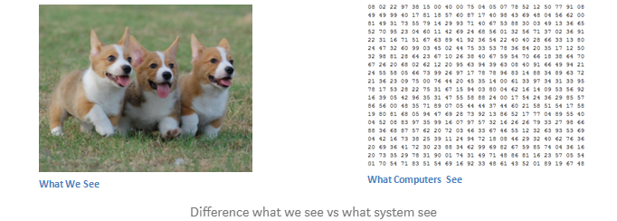
Image classification or object recognition is a problem that passes an image as a parameter.
System predicts whether a condition is satisfied or not (cat or not, dot or not) same as the below image. or the probability or most satisfying condition for an image.
We are able to quickly recognize patterns, generalize from previous information and knowledge.

Slide 12
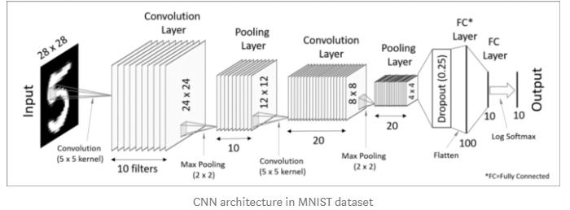
Inputs and output
System takes an image, it just sees as an array of pixel values.
Suppose 480*480*3 where 480*480 is size, 3 refers to RGB values.
Each of these numbers is assigned with a value of 0 to 255 as pixel intensities at that point.
The key point is that based on taking the image as an input, computer system predicts and make an assumption as output for describing the probability .

Slide 13
Layers of Convolutional neural network
Input - raw pixel values are provided as input.
Convolutional layer - Input layers translates the results of neuron layer. There is need to specify the filter to be used. Each filter can only be a 5*5 window that slider over input data and get pixels with maximum intensities.
Rectified linear unit [ReLU] layer: provided activation function on the data taken as an image. In the case of back propagation, ReLU function is used which prevents the values of pixels form changing.
Pooling layer: Performs a down-sampling operation in volume along the dimensions (width, height).
Fully connected layer: score class is focused, and a maximum score of the input digits is found.
As we go deeper and deeper in the layers, the complexity is increased a lot. But it might worth going as accuracy will also increase.

Slide 14
Approach
Adding MNIST dataset and adding some of our dataset
Preprocess the data to make it ready for the neural network
CNN model creation
Train the CNN model
Check the model
Implimenting GUI for communication

Slide 15
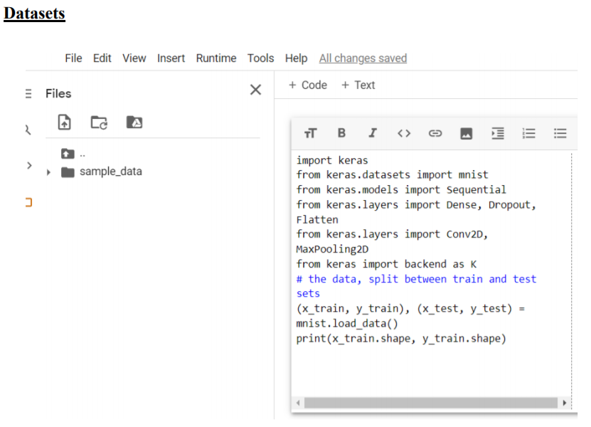
Implementation

Slide 16
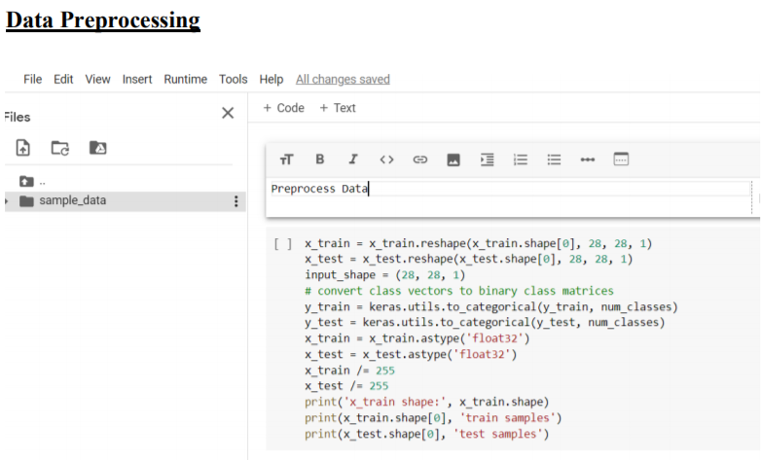

Slide 17
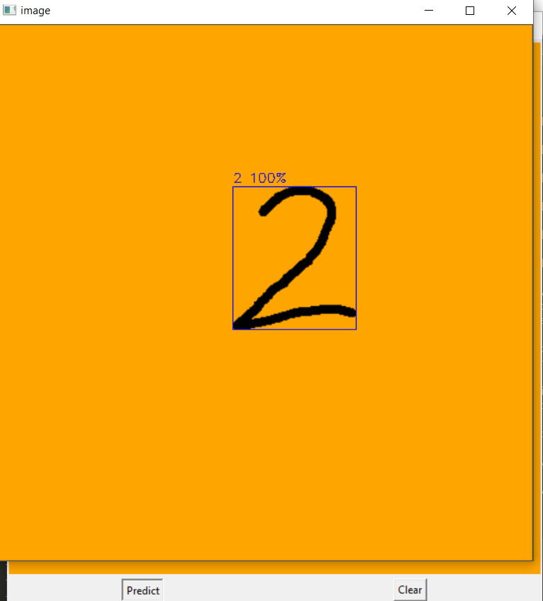
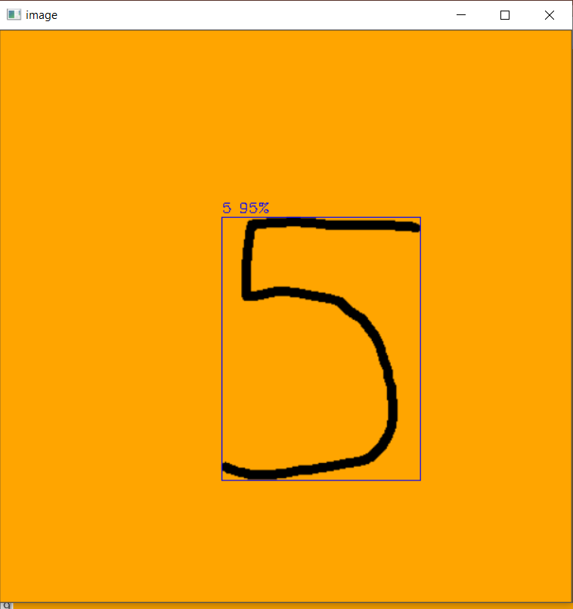

Slide 18
Conclusion
There are numerous ways in which humans can represent digits, so if our implementation is successful it would be easy to understand human handwritten digits
Further we can create a system which can recognize alphabet & number both that could be easy to understand human handwriting as well that’s our main moto.
Reference:
https://homes.cs.washington.edu/~dericp/assets/projects/digit-recognition/writeup.pdf

Slide 19
REFERENCE
https://en.wikipedia.org/wiki/Convolutional_neural_network
https://medium.com/@himanshubeniwal/handwritten-digit-recognition-using-machine-learning-ad30562a9b64
https://machinelearningmastery.com/how-to-develop-a-convolutional-neural-network-from-scratch-for-mnist-handwritten-digit-classification/

Slide 20
Thank You

Slide 21
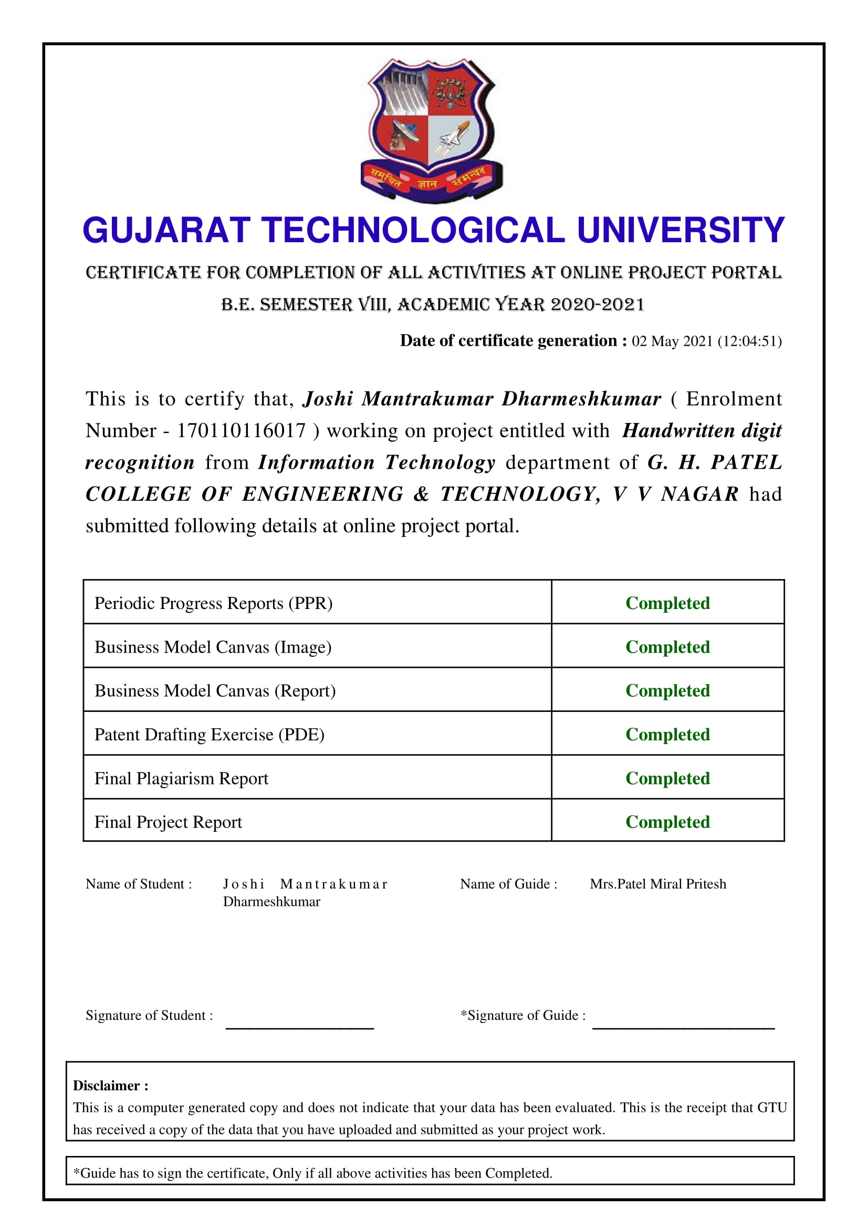

Slide 22
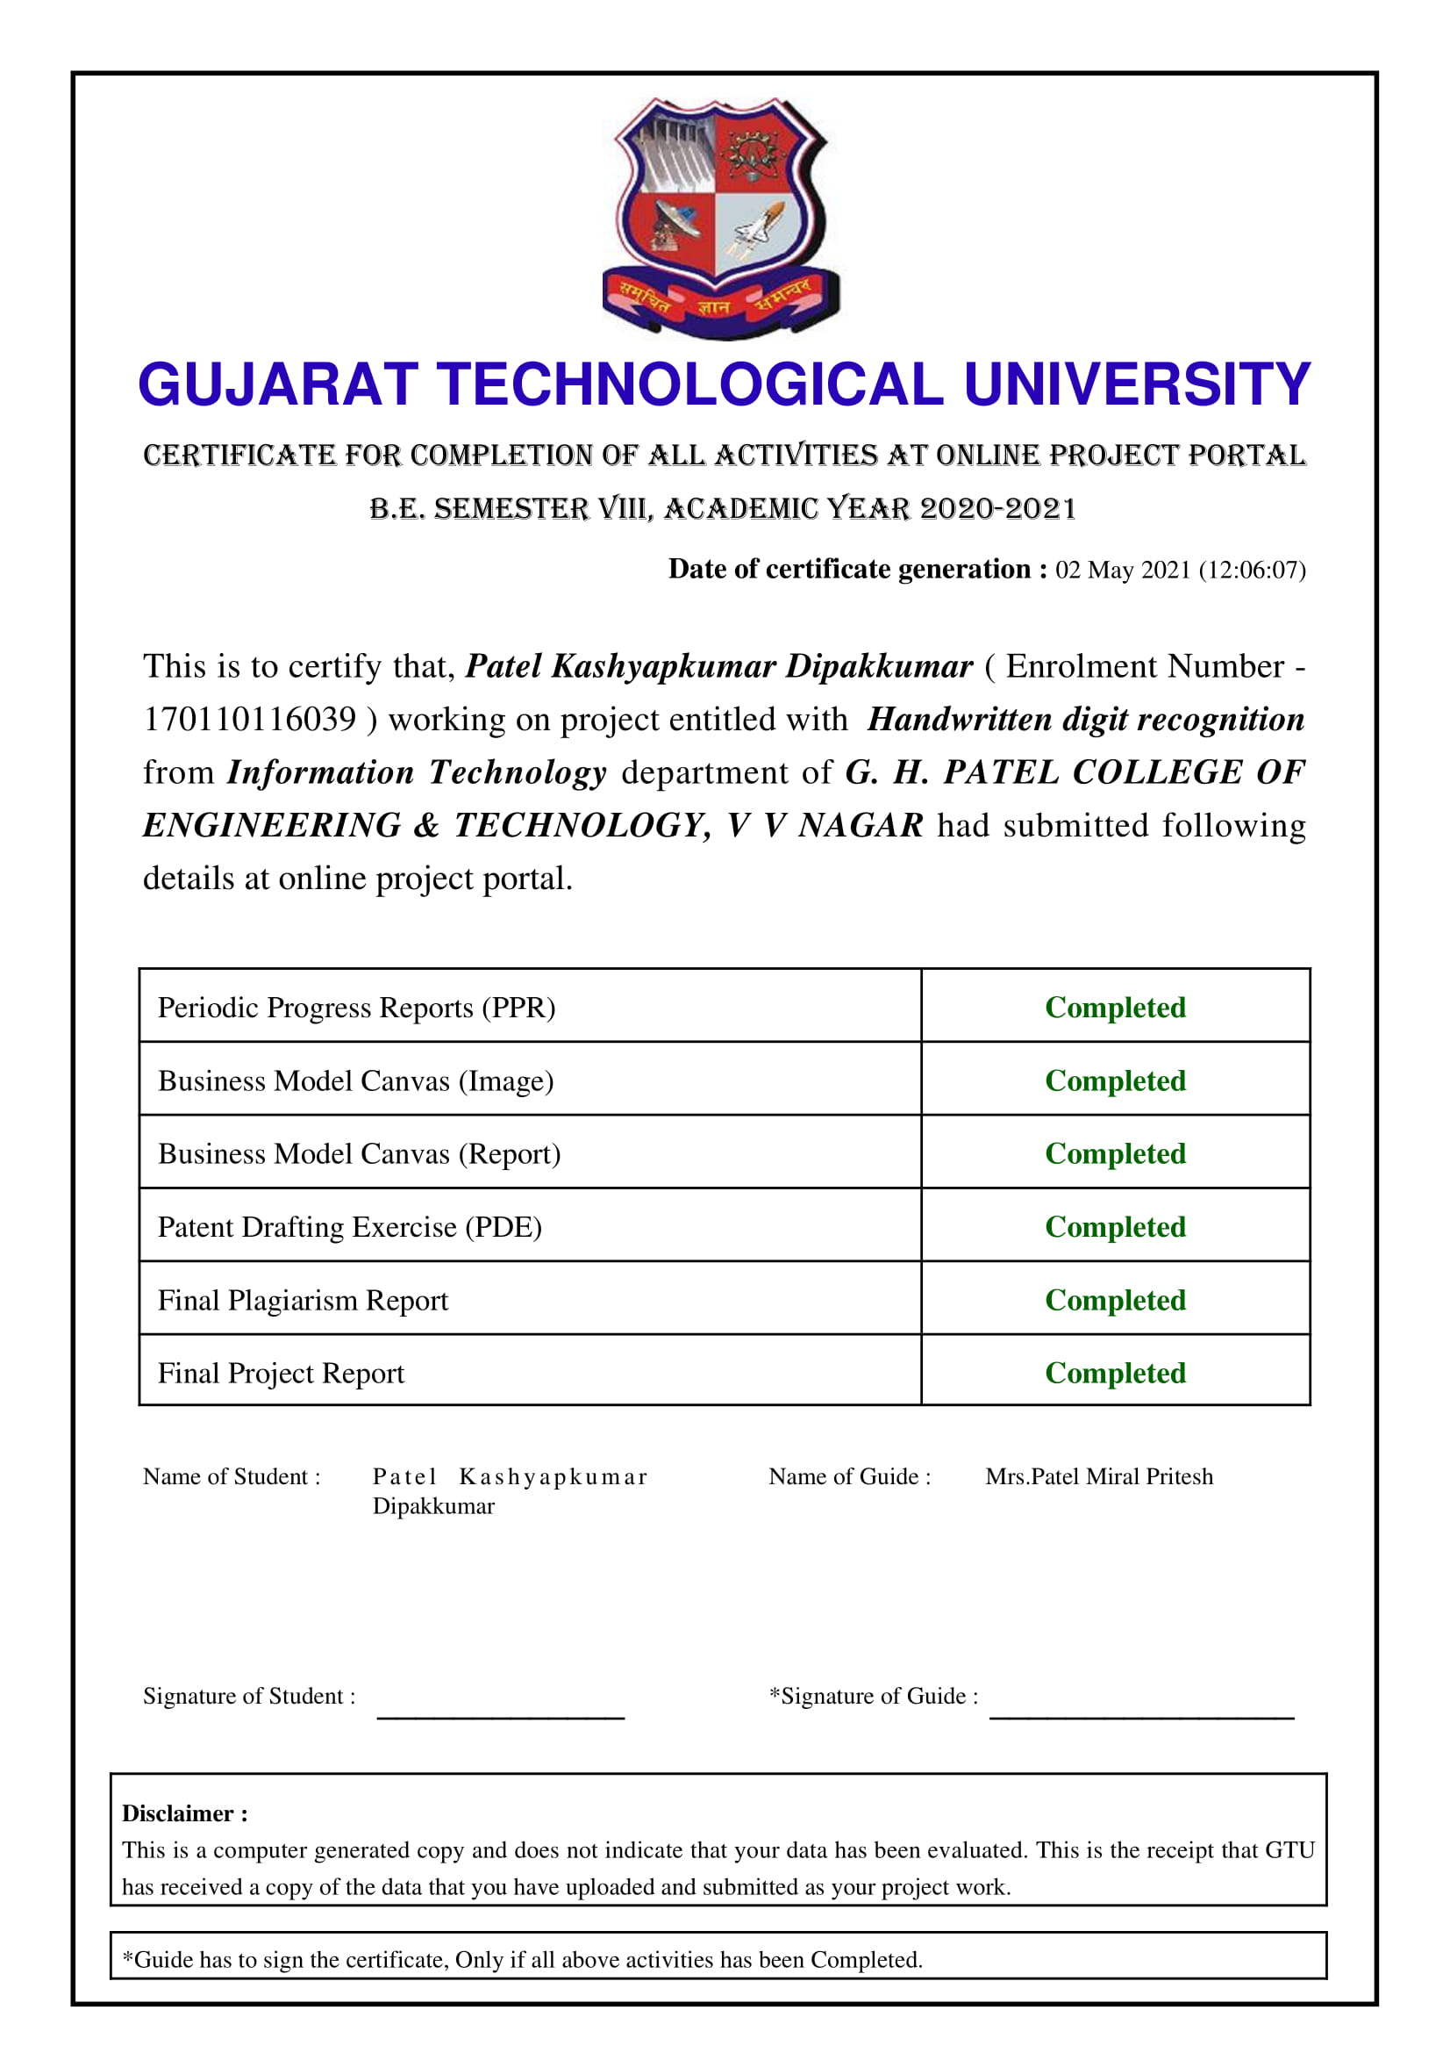

Slide 23


