Slide 1

IBM
CAPSTONE PROJECT

Slide 2
PREDICTING OPENING OF INDIA RESTAURANTS IN TORRONTO
A BUSSINESS MODEL

Slide 3
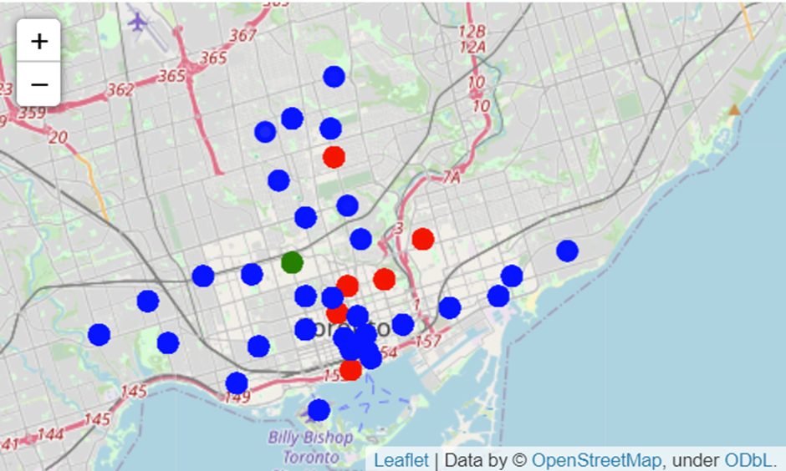
CLUSTERS

Slide 4
RESULTS
The results from k-means clustering show that we can categorize Toronto
neighbourhoods into 3 clusters based on how many Indian restaurants are
in each neighbourhood:

Slide 5
CONCLUSION
● Cluster 0: Neighbourhood’s with the smaller number of Indian
restaurants.
● Cluster 1: Neighbourhood’s with no Indian restaurants.
● Cluster 2: Neighbourhood’s with a greater number of Indian restaurants

