Slide 1
Semantic Web
Presented by Xia Li

Slide 2
Outline
Introduction
Examples
Semantic Web technologies
Applications
Concerns

Slide 3

SW technologies go back to few years ago……
The Semantic Web = a Web with a meaning.
"If HTML and the Web made all the online documents look like one huge book, RDF, schema, and inference languages will make all the data in the world look like one huge database"
--Tim Berners-Lee, Weaving the Web, 1999

Slide 4
Towards a Semantic Web…
Current web represents information using natural language, graphics, multimedia...
Humans can process and combine these information easily
However, machines are ignorant!
Notes:
I can see on the web, my photographs, and I can see my appointments in a calendar. But can I see my photos in a calendar to see what I was doing when I took them?
Why not? Because we don't have a web of data. Because data is controlled by applications, and each application keeps it to itself.

Slide 5
SW is about two things:
It is about common formats for integration and combination of data drawn from diverse sources, where on the original Web mainly concentrated on the interchange of documents.
It is also about language for recording how the data relates to real world objects.
Notes:
That allows a person, or a machine, to start off in one database, and then move through an unending set of databases which are connected not by wires but by being about the same thing.
The Semantic Web is not about links between web pages.
The Semantic Web describes the relationships between things (like A is a part of B and Y is a member of Z) and the properties of things (like size, weight, age, and price)

Slide 6
So what is the Semantic Web?
In a word, SW is: Next generation Web of data that is understandable by machines.
  It allows machines to “connect the dots”
  It provides a common framework to share data on the Web across application boundaries
Notes:
This is what the Semantic Web is all about. Describing things in a way that computers applications can understand.

Slide 7
Example: automatic airline reservation
Your automatic airline reservation
  knows about your preferences
  builds up knowledge base using your past
  can combine the local knowledge with remote services:
    airline preferences
    dietary requirements
    calendaring
    Etc
It communicates with remote information (i.e., on the Web!)

Slide 8
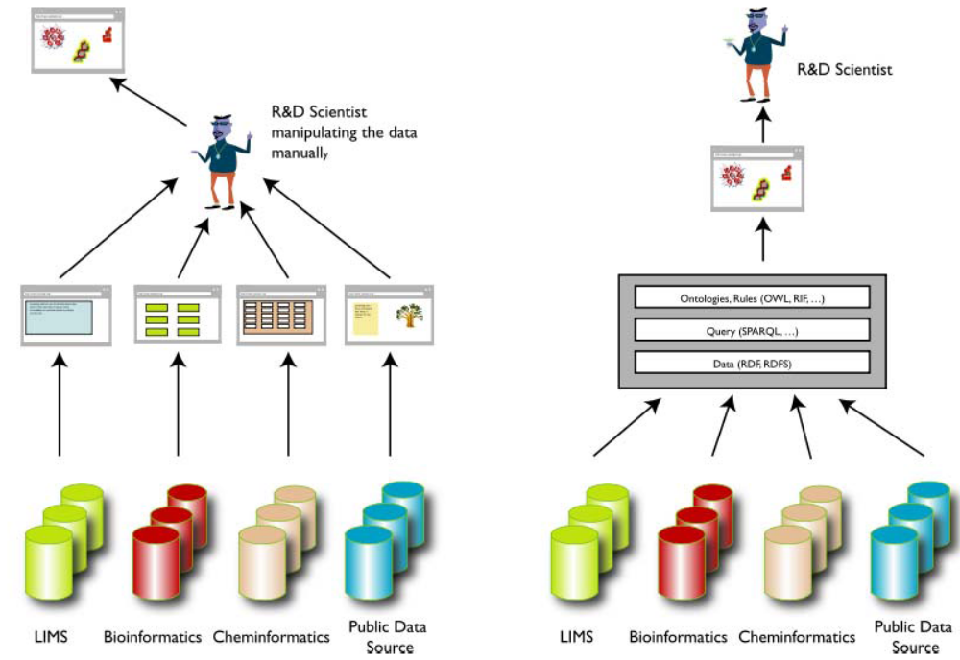
Example: data integration in life science

Slide 9
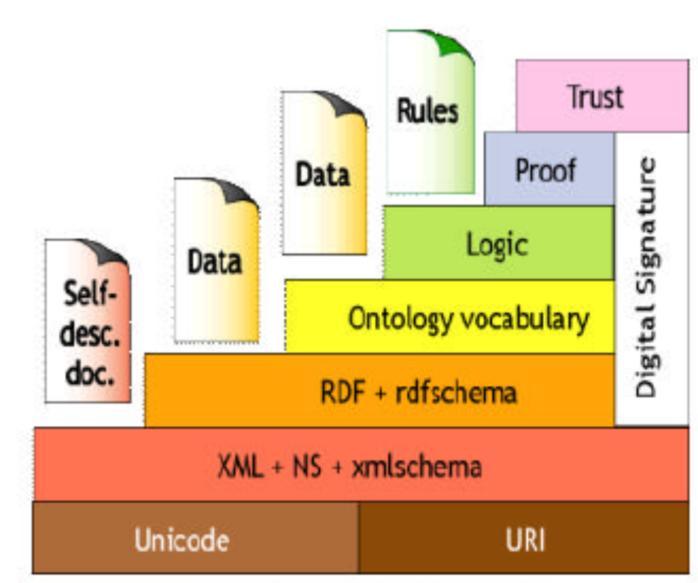
SW Architecture
Notes:
The development of the Semantic Web proceeds in steps, each step building
a layer on top of another.
Figure 1.3 shows the “layer cake” of the SemanticWeb (due to Tim Berners-
Lee), which describes the main layers of the SemanticWeb design and vision.
At the bottom we find XML, a language that lets one write structured Web
documents with a user-defined vocabulary. XML is particularly suitable for
sending documents across the Web. XML has no built-in mechanism to convey
the meaning of the user’s new tags to other users.
RDF Resource Description Framework is a basic data model, like the entity-relationship model, for writing
simple statements about Web objects (resources).. A scheme for defining information on the Web.
RDF provides the technology for expressing the meaning of terms and concepts in a
form that computers can readily process. RDF can use XML for its syntax and URIs to
specify entities, concepts, properties and relations.
The RDF data model does
not rely on XML, but RDF has an XML-based syntax. Therefore, in figure 1.3,
it is located on top of the XML layer.
RDF Schema provides modeling primitives for organizing Web objects into
hierarchies. Key primitives are classes and properties, subclass and subproperty
relationships, and domain and range restrictions. RDF Schema is based
on RDF.
RDF Schema can be viewed as a primitive language for writing ontologies.
But there is a need for more powerful ontology languages that expand
RDF Schema and allow the representations of more complex relationships
between Web objects.
Collections of statements written in a language such as RDF that
define the relations between concepts and specify logical rules for reasoning
about them. Computers will “understand” the meaning of semantic data on a Web
page by following links to specified ontologies.
The Logic layer is used to enhance the ontology language
further and to allow the writing of application-specific declarative
knowledge.
The Proof layer involves the actual deductive process as well as the representation
of proofs in Web languages (from lower levels) and proof validation.
Finally, the Trust layer will emerge through the use of digital signatures and
other kinds of knowledge, based on recommendations by trusted agents or
on rating and certification agencies and consumer bodies.

Slide 10
Example
Data integration

Slide 11
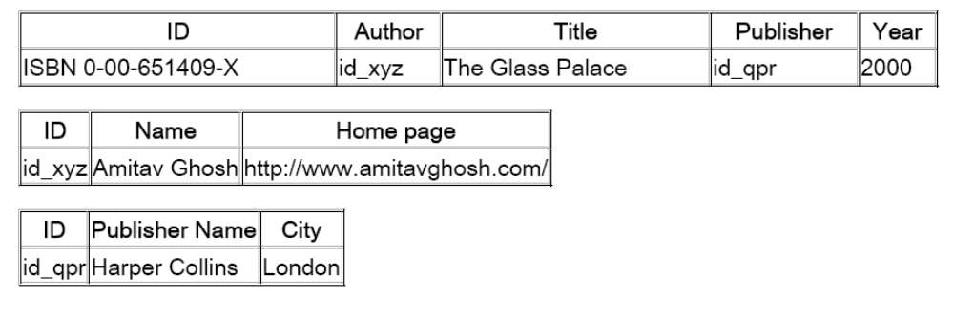
A Simplified Bookstore Data
Dataset “A”:

Slide 12
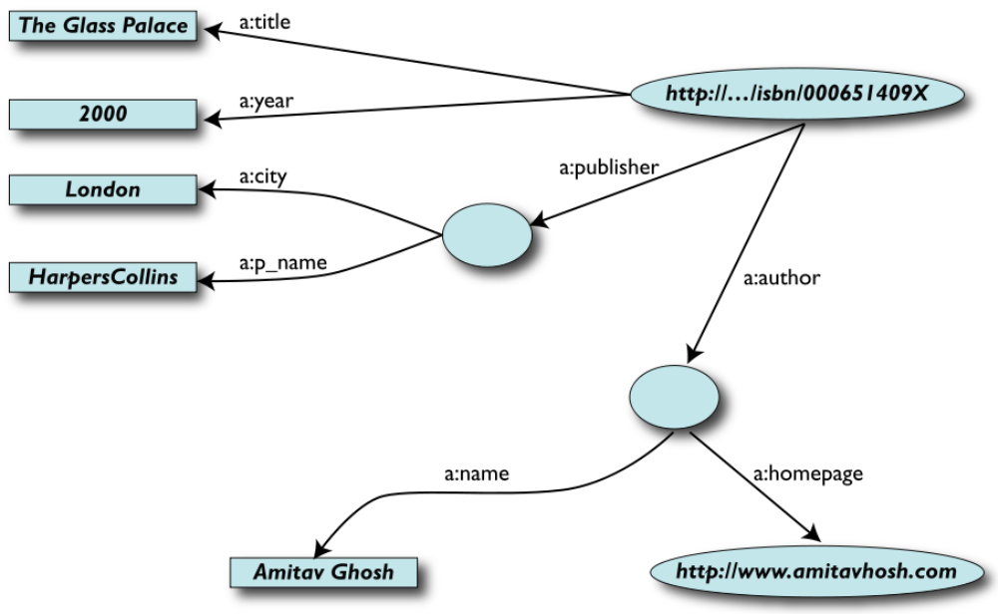
1st Step: Export your data as a set of relations…

Slide 13
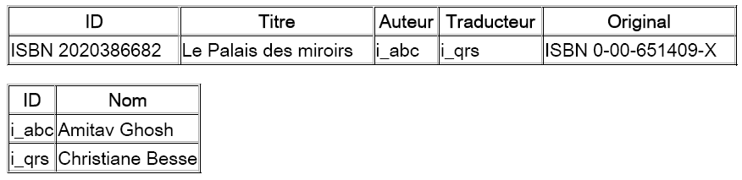
Another Bookstore Data
Dataset “F”

Slide 14
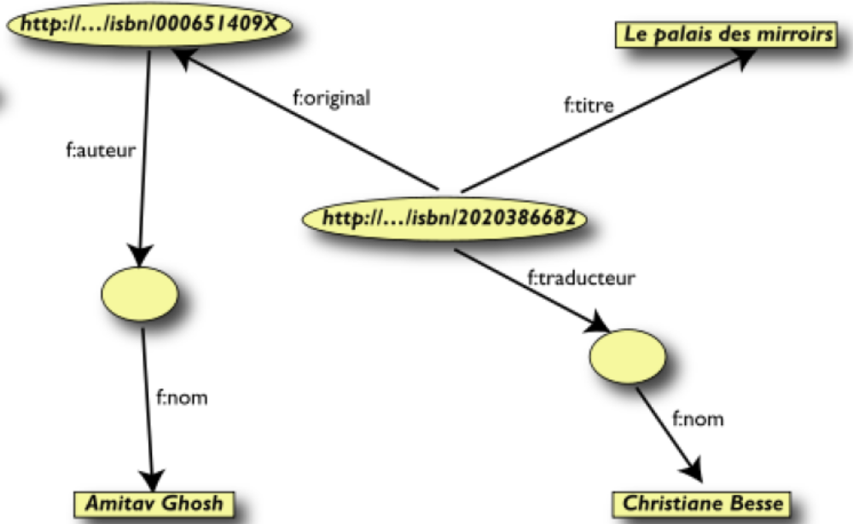
2nd Step: Export Your Second Set of Data

Slide 15
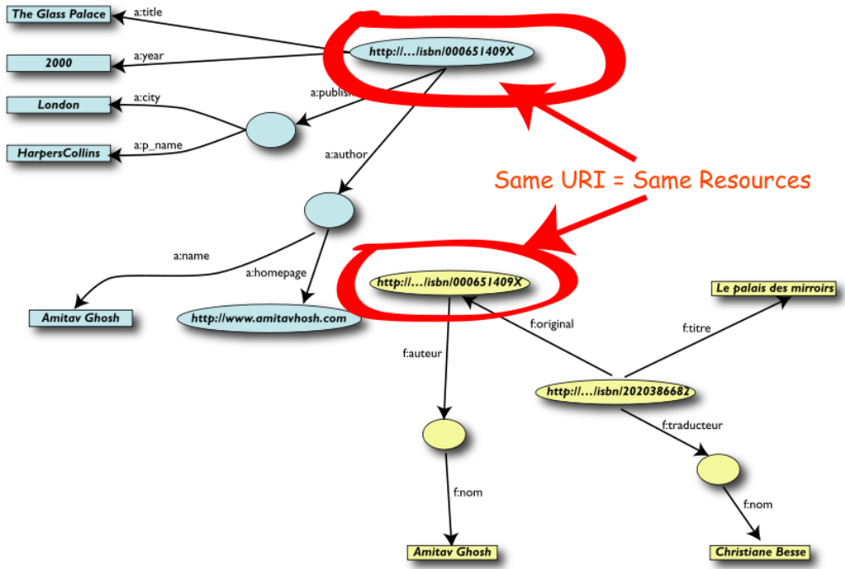
3rd Step: Start Merging Your Data

Slide 16
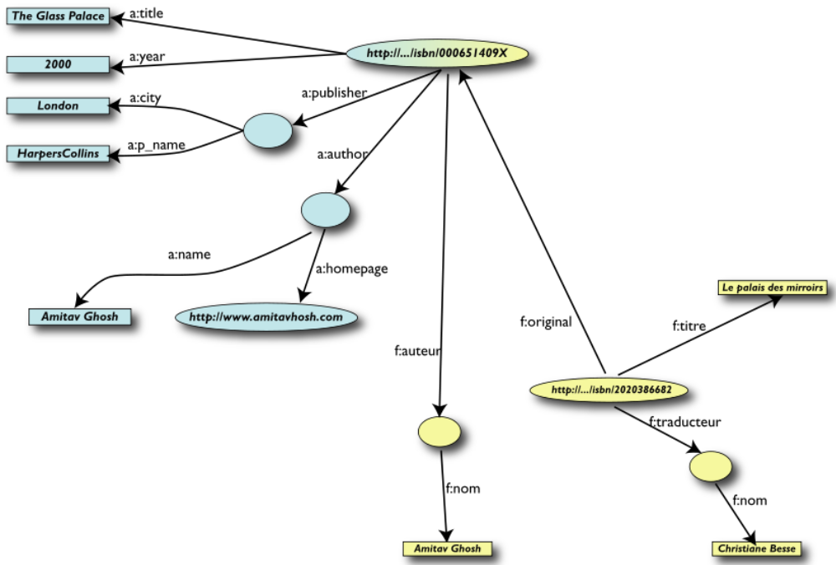
After merging
donnes-moi le titre de l’original
“give me the title of the original”

Slide 17
So what is then the role of ontologies and/or rules?
We “feel” that a:author and f:auteur should be the same
Add some extra information to the merged data:
  a:author same as f:auteur
  both identify a “Person”:
    a term that a community has already defined (part of the “FOAF” terminology)
    a “Person” is uniquely identified by his/her name and, say, homepage
    it can be used as a “category” for certain type of resources
These statements can be described in an ontology (or, alternatively, with rules)
The ontology/rule serves as some sort of a “glue”

Slide 18
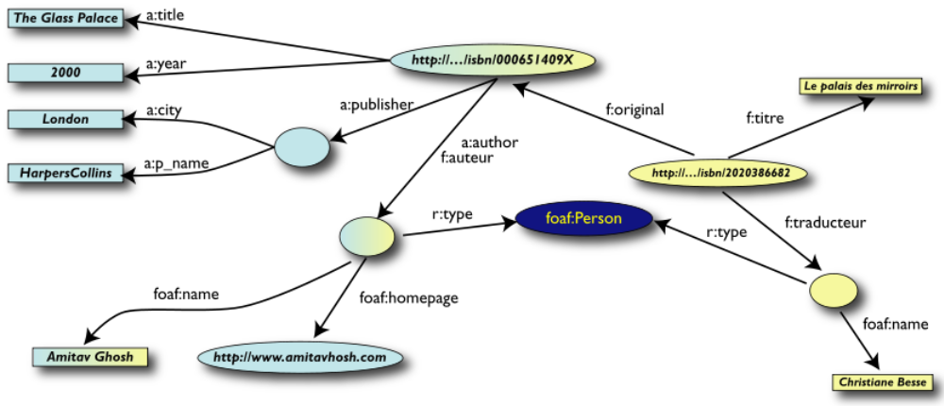
Better merge
Notes:
It Could Become Even More Powerful
The added extra knowledge could be much more complex to the merged datasets
e.g., a full classification of various type of library data, types of books (literature or not, fiction, poetry,
etc)
geographical information
information on inventories, prices
etc.
This is where ontologies , extra rules, etc, may come in
Even more powerful queries can be asked as a result

Slide 19
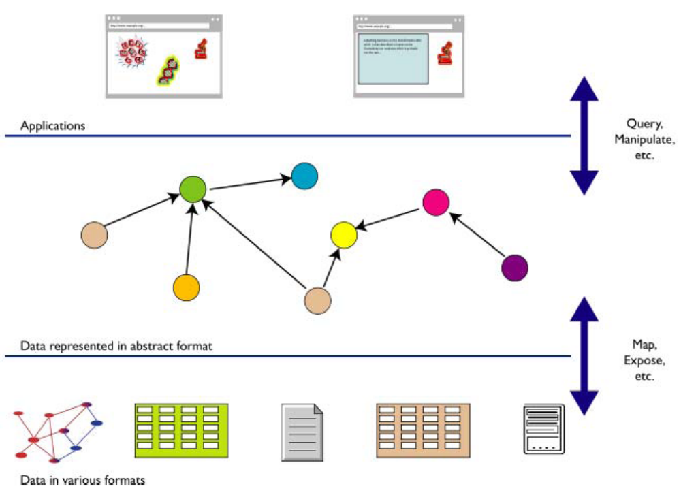
What did we do?
Notes:
We combined different datasets
all may be of different origin somewhere on the web
all may have different formats (mysql, excel sheet, XHTML, etc)
all may have different names for relations (e.g., multilingual)
We could combine the data because some URI-s were identical (the ISBN-s in this
case)
We could add some simple additional knowledge, also using common terminologies
that a community has produced
As a result, new relations could be found and retrieved

Slide 20
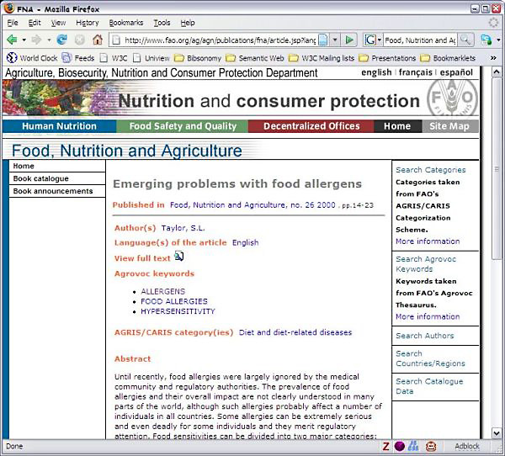
The Semantic Web for the Agricultural Domain, Semantic Navigation of Food, Nutrition and Agriculture Journal
Notes:
AFTER WE GIVE a presentation about the
Semantic Web, we’re often asked, “Okay, so
what is the killer application of the Semantic
Web?”
“The Semantic Web is the killer app.”
Food and Agriculture Organization of the United Nations, Italy

Slide 21
Applications
A Digital Music Archive (DMA) for the Norwegian National Broadcaster (NRK) using Semantic Web techniques, ESIS and NRK
A Semantic Web Content Repository for Clinical Research, Cleveland Clinic
An Intelligent Search Engine for Online Services for Public Administrations, Municipality of Zaragoza
An Ontology of Cantabria’s Cultural Heritage, Fundación Marcelino Botín
Composing Safer Drug Regimens for the Individual Patient using Semantic Web Technologies, PharmaSURVEYOR Inc.
Enhancing Content Search Using the Semantic Web, Siderean Software and Oracle Corporation
Etc...

Slide 22
Conclusion
The semantic web is not as complex as people believe
The semantic web doesn’t require huge investments before seeing its value
Don’t forget privacy: set usage guidelines to safeguard privacy
Don’t expect perfection: they’re far from perfect
Don’t be impatient: there must be a multiyear commitment to have any hope of success
Notes:
Forget privacy: Just because you can gather and correlate data about employees doesn’t mean you should. Set usage guidelines to safeguard employee privacy.
Expect perfection: While these technologies will help you find and correlate information more quickly, they’re far from perfect. Nothing can help if data are unreliable in the first place.
Be impatient: One early adopter at NASA says that the potential benefits can justify the investments in time, money, and resources, but there must be a multi-year commitment to have any hope of success

Slide 23
References
http://www.w3.org/2001/sw/
http://www.w3schools.com/semweb/default.asp
<Semantic Web Primer>

Slide 24
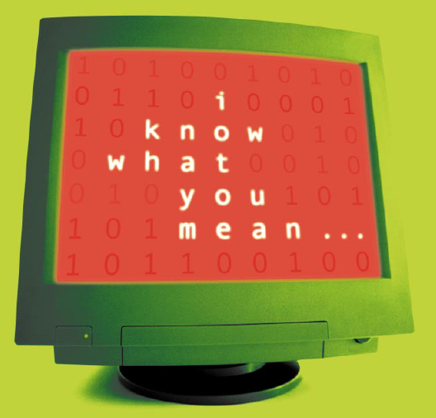
Thank you for your attention

