Slide 1
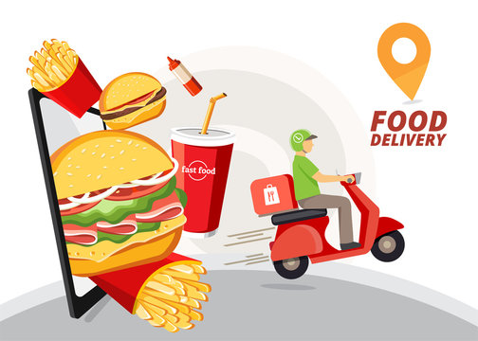
FOOODYYY
Ardent Computech Computer science and Technology

Slide 2

Introduction
Foody is an online food ordering and delivery web application built using the MERN Stack (MongoDB, Express.js, React.js, Node.js).
It allows users to browse menus, add items to their cart, and place orders seamlessly.
The platform also includes an admin dashboard for managing menu items, tracking orders, and maintaining business operations.

Slide 3
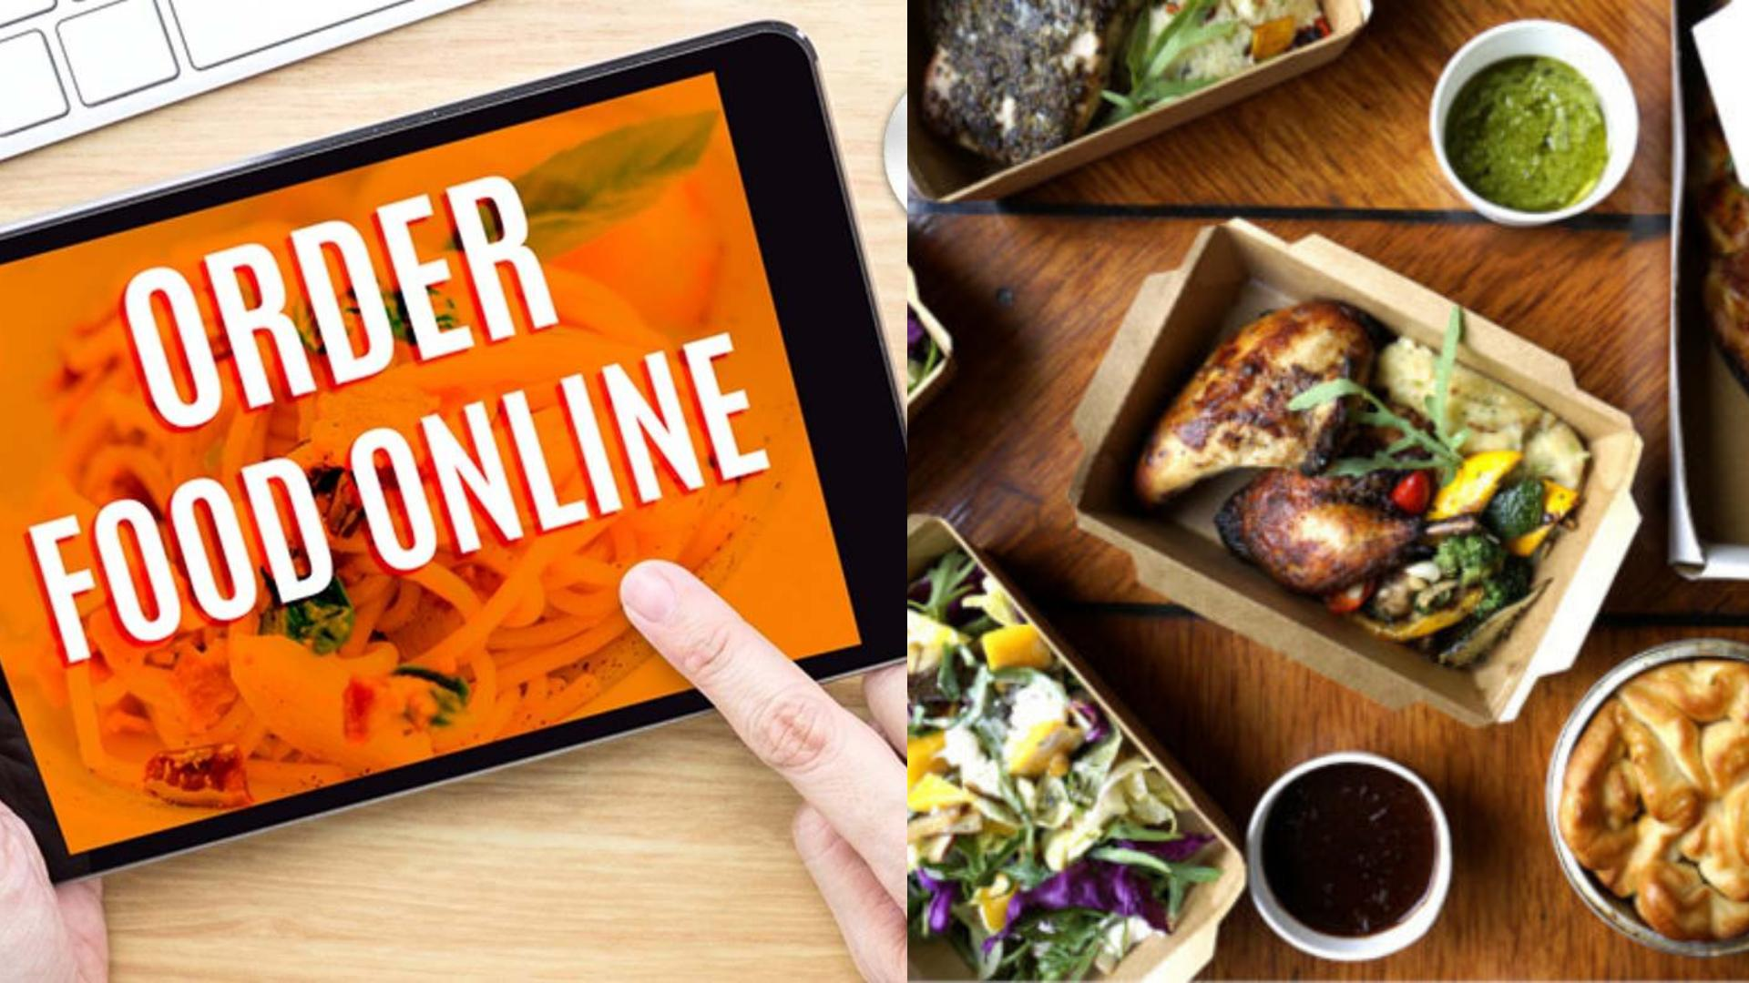
Objective
▶ Provide a user-friendly interface for online food ordering.
▶ Enable secure authentication for customers and admins.
▶ Streamline restaurant operations through a centralized admin panel.
▶ Ensure fast and responsive browsing on all devices.
▶ Integrate a scalable architecture for future growth.

Slide 4

Advance Features
▶ Real-time cart updates without page reloads.
▶ Responsive design for mobile, tablet, and desktop.
▶ Dynamic menu management from the admin panel.
▶ Order tracking system for customers.

Slide 5
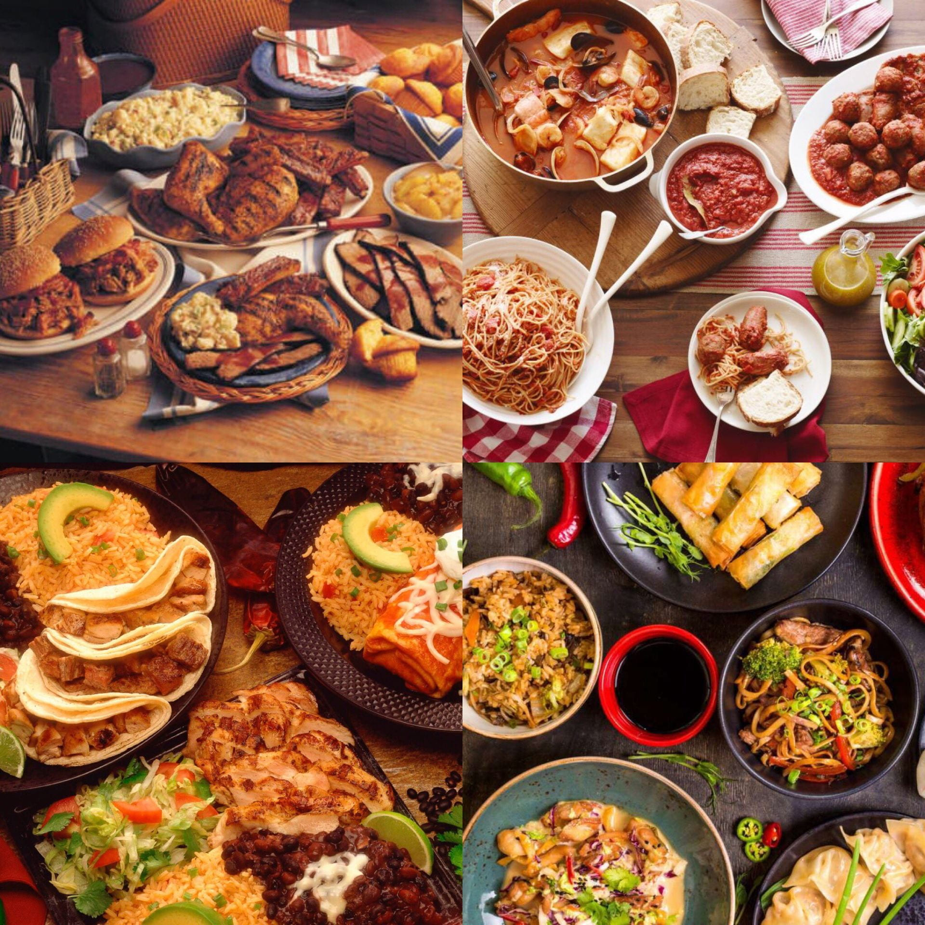
SCOPE
▶ For Customers: Browse menu, place orders, track delivery.
▶
▶ For Admins: Manage menu items, process orders, view reports.
▶
▶ Future Expansion: Multiple restaurants, mobile app integration, AI recommendations.

Slide 6
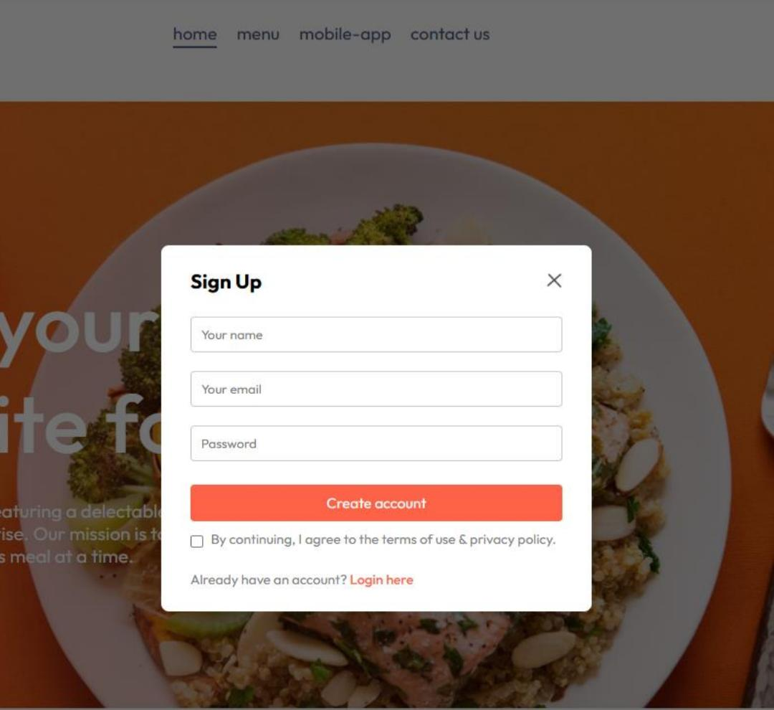
Unique Features
Minimal and visually appealing UI. Quick loading time with optimized queries. Flexible backend for adding new services easily. Categorized menu for easier navigation.

Slide 7
STRUCTURE
▶ Architecture:
▶ Frontend: React.js (UI rendering, API calls)
▶ Backend: Node.js + Express.js (business logic, APIs)
▶ Database: MongoDB (data storage)
▶ Hosting: Cloud-based for scalability

Slide 8
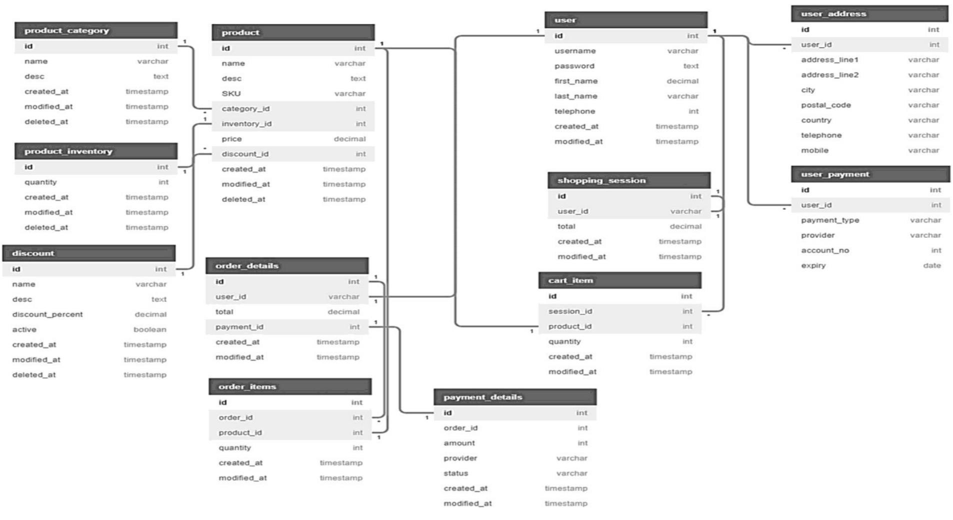
SCHEMA DIAGRAM

Slide 9
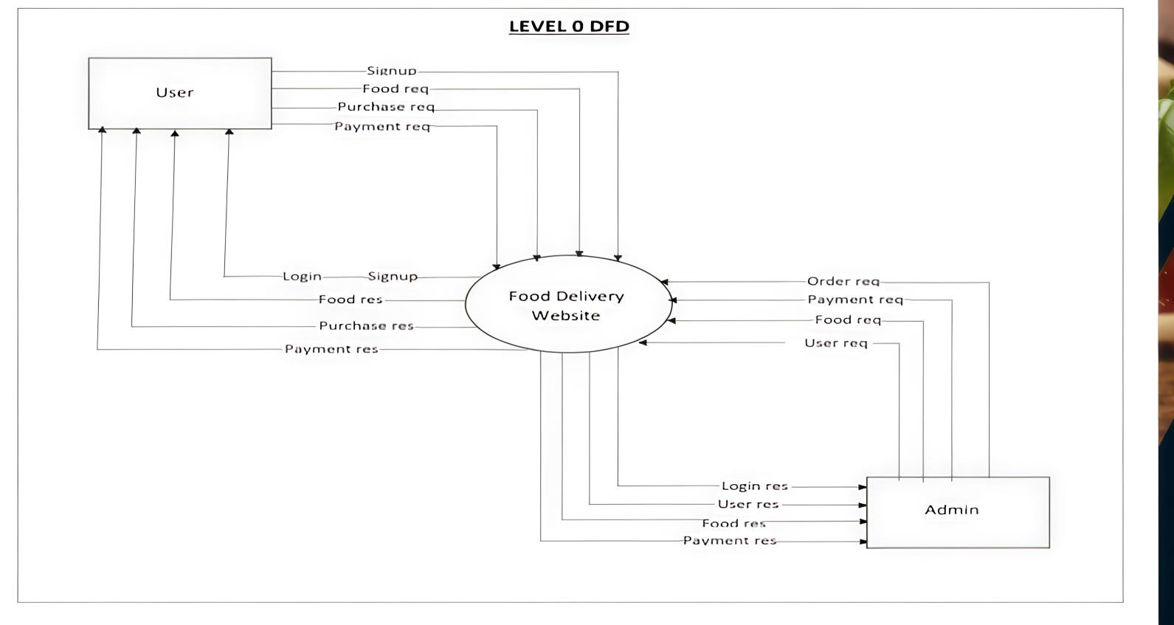
LEVEL 0 DFD STRUCTURE

Slide 10
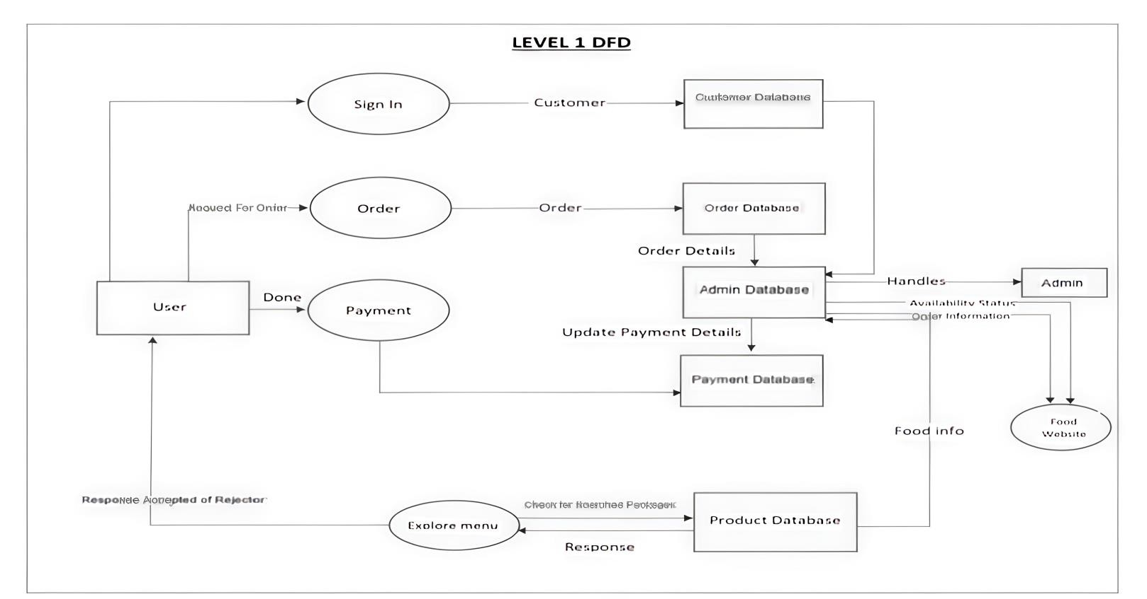
LEVEL 1 DFD STRUCTURE

Slide 11
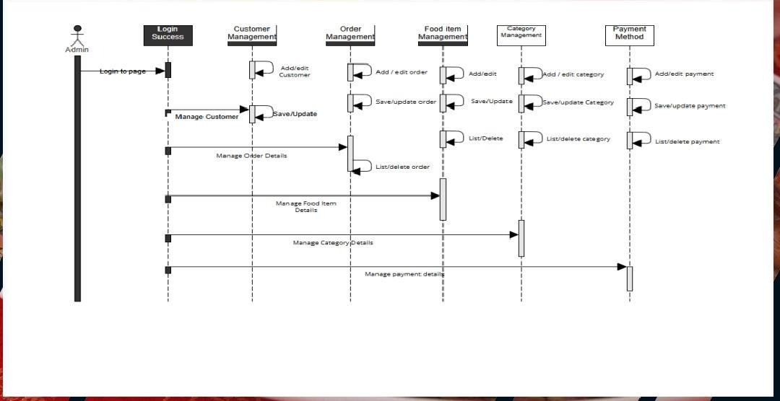
SEQUENCE DIAGRAM

Slide 12
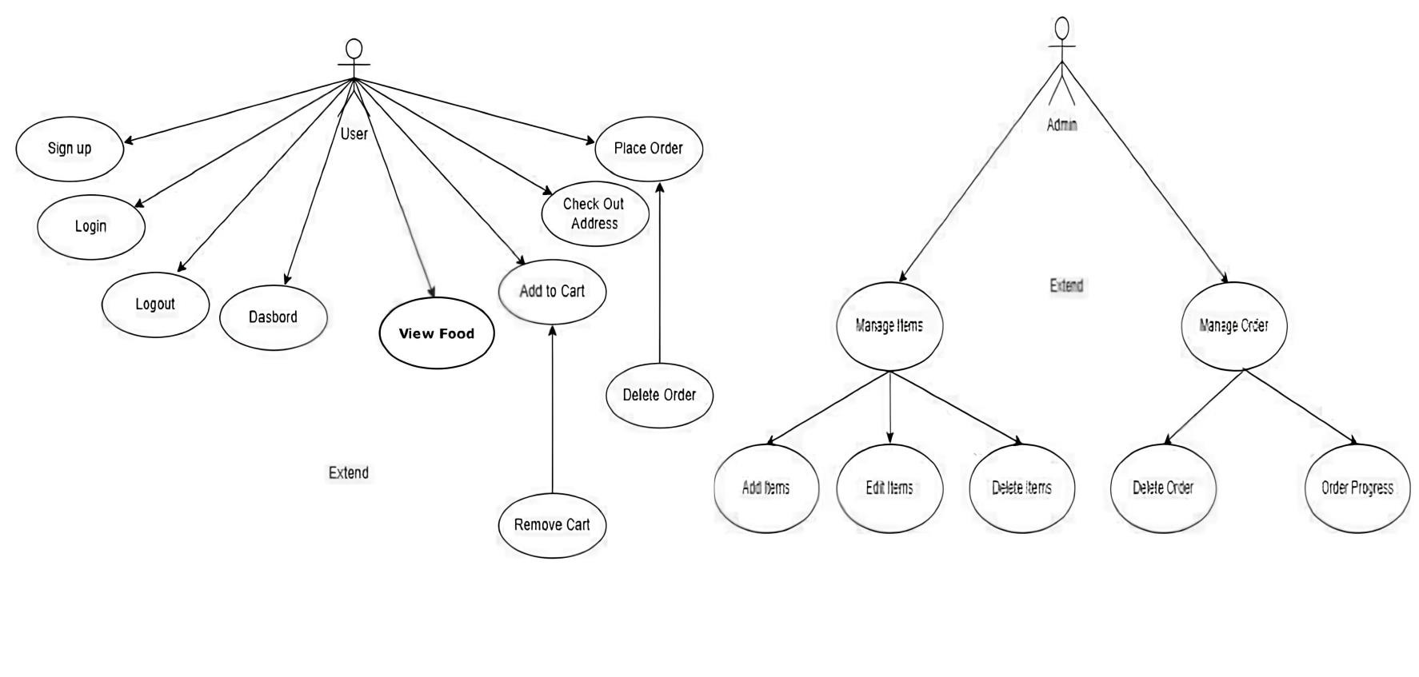
USE CASE DIAGRAM

Slide 13

PROJECT UI

Slide 14
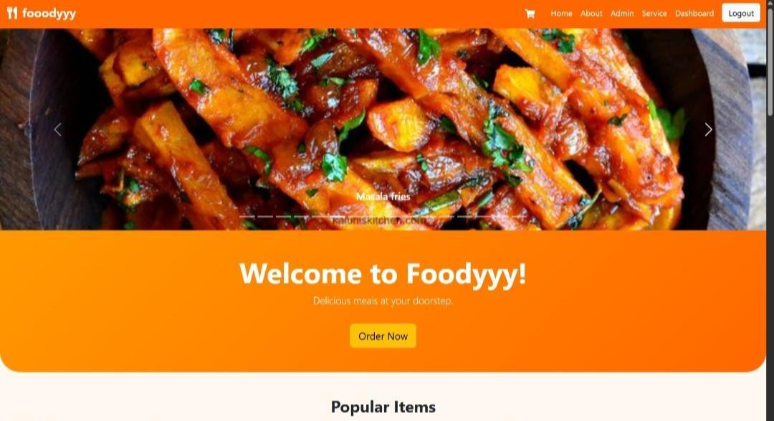
Home Page

Slide 15
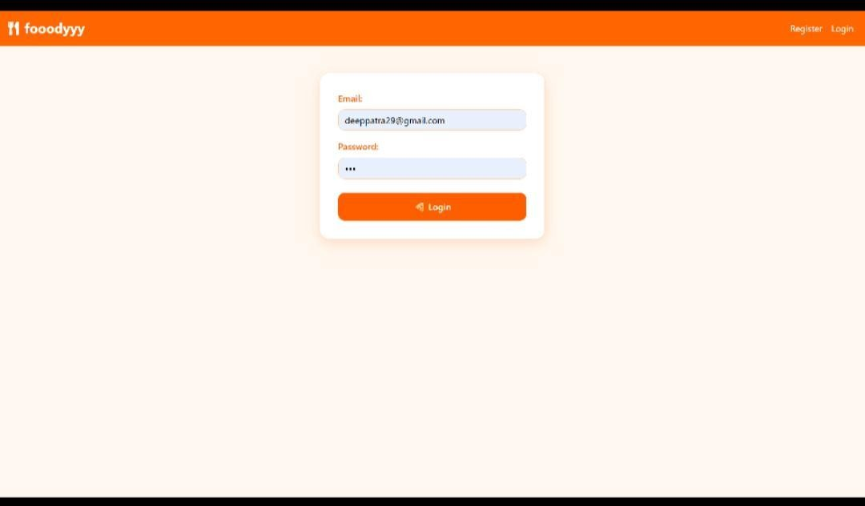
LOGIN PAGE

Slide 16
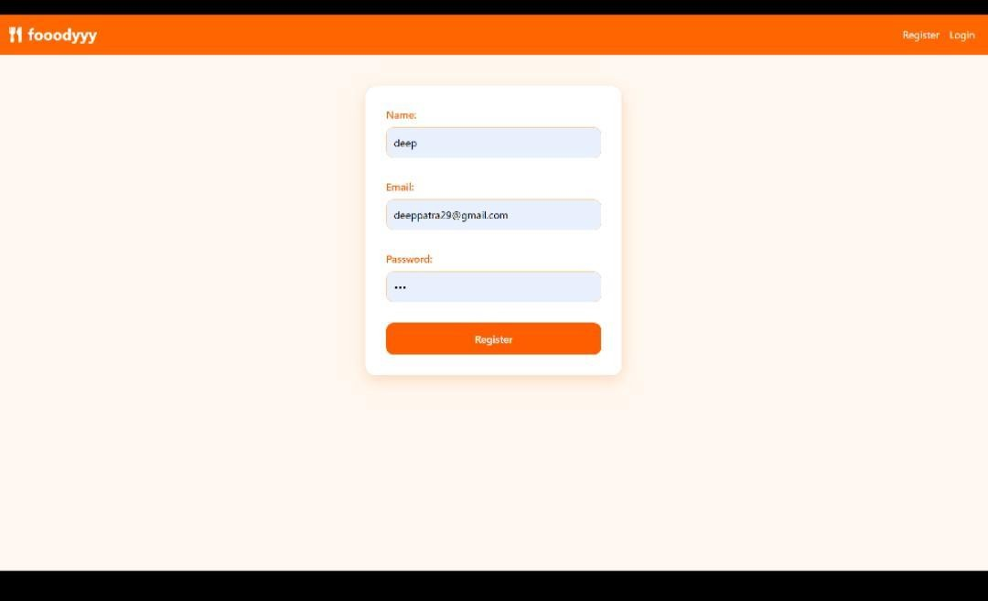
SIGN UP PAGE

Slide 17
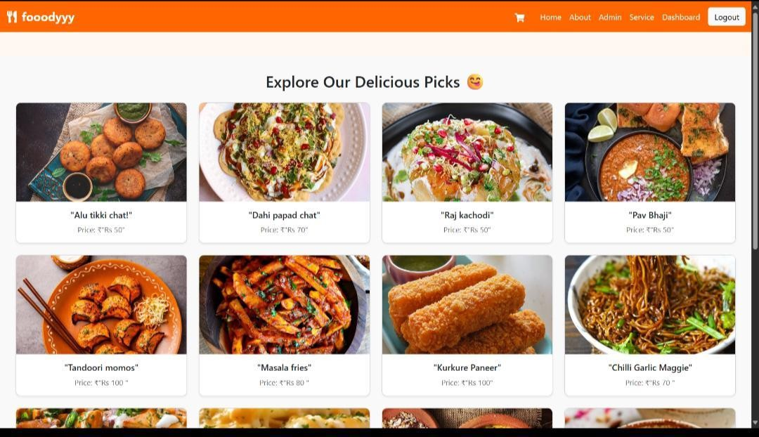
EXPLORE MENU PAGE

Slide 18
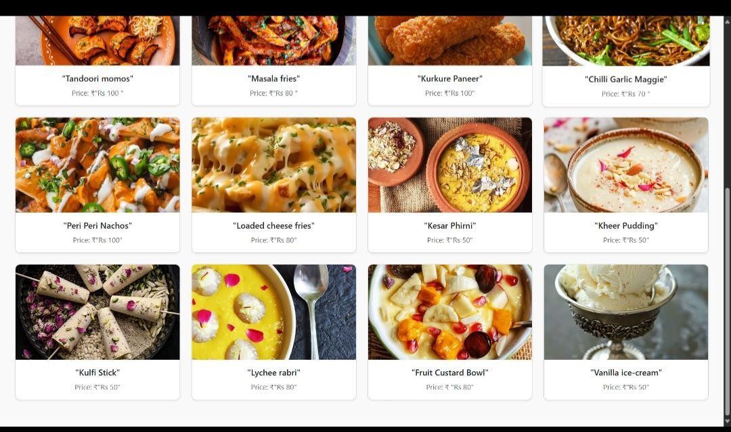
MENU PAGE

Slide 19
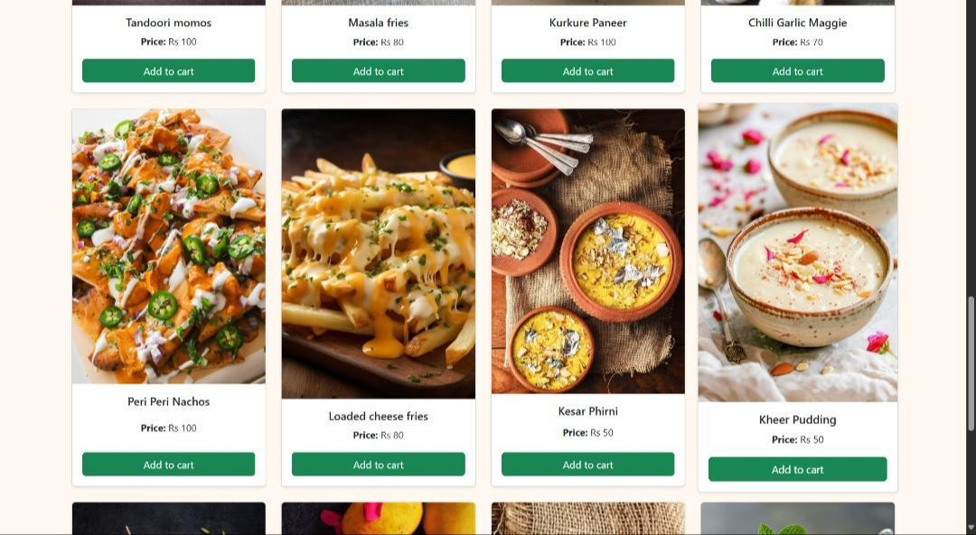
MENU PAGE

Slide 20
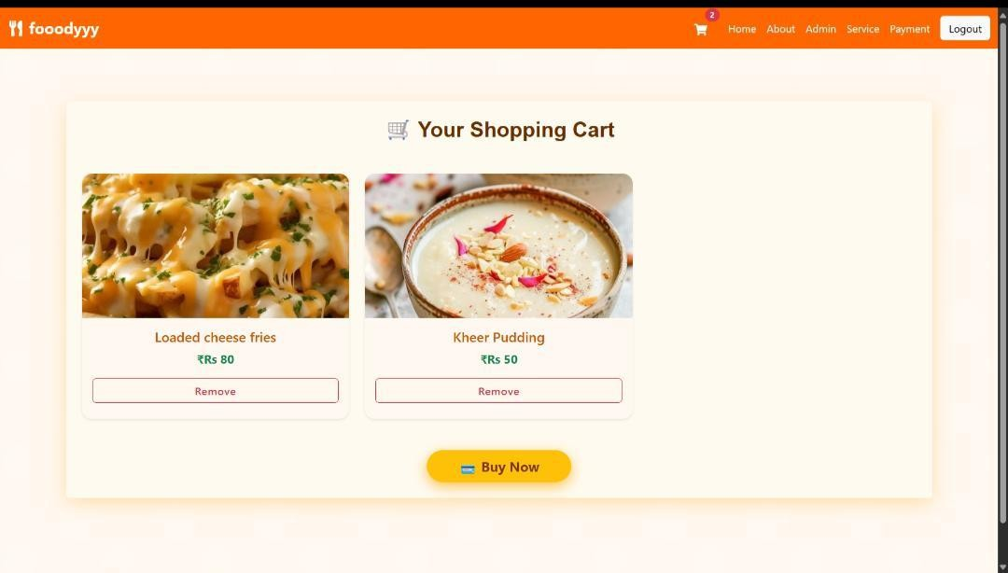
MY CART

Slide 21
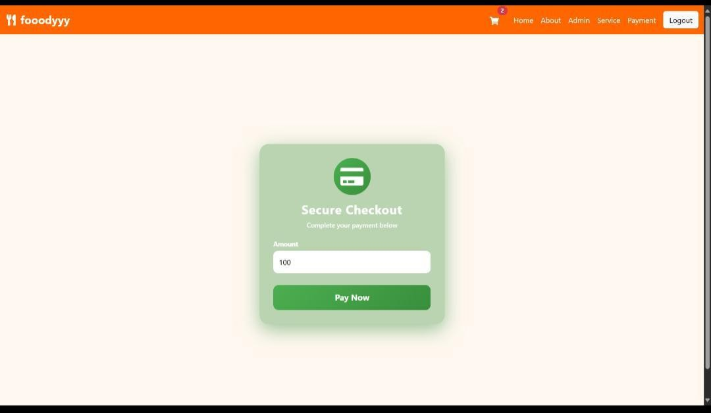
Checkout

Slide 22
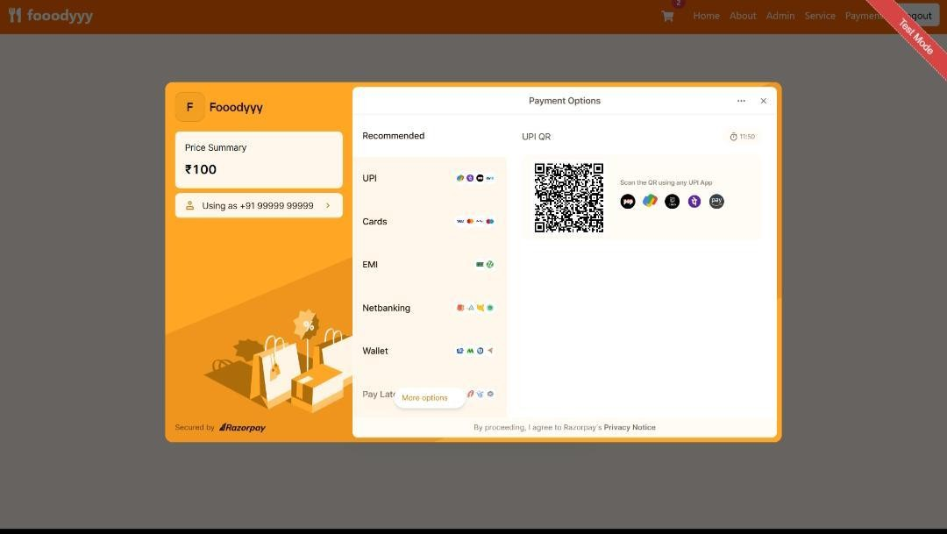
Payment Gateway

Slide 23
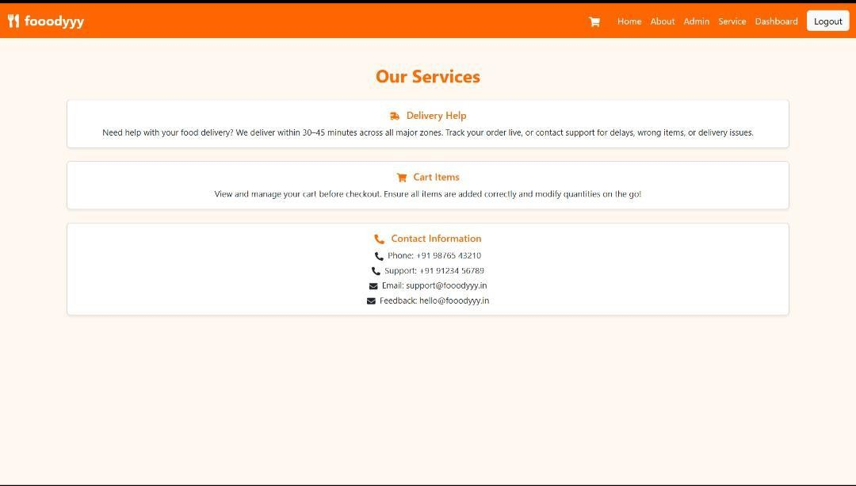
SERVICES

Slide 24
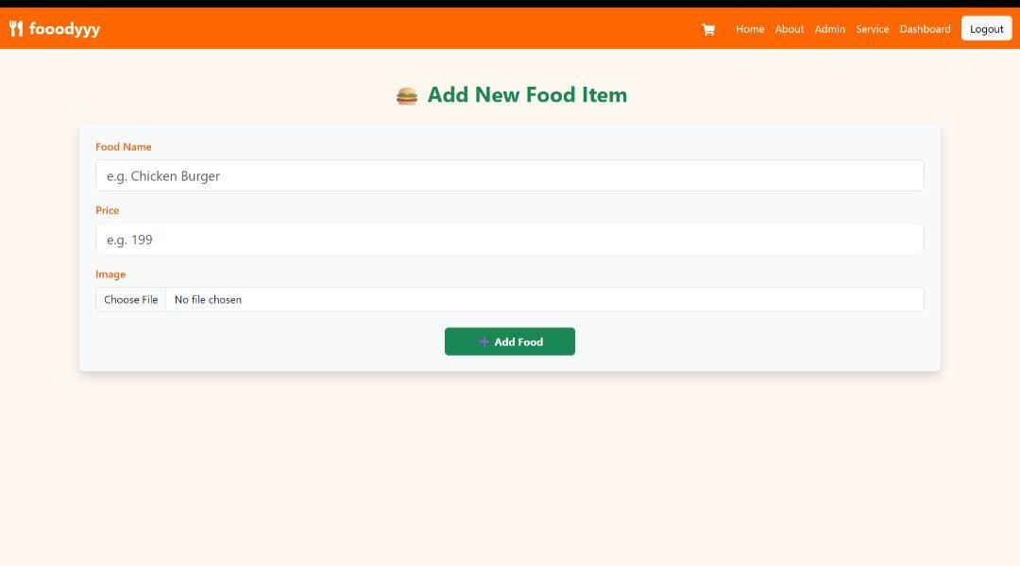
Admins Page – Add items

Slide 25
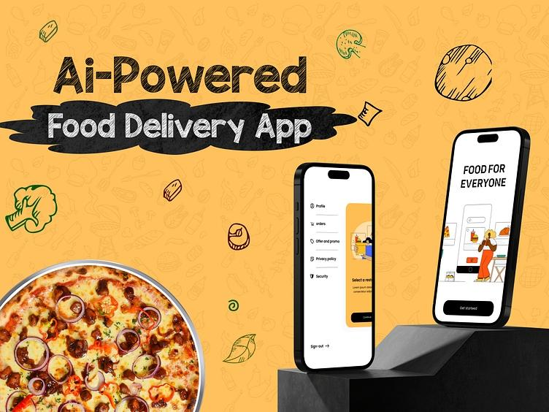
FUTURE SCOPE
▶ Mobile app version (React Native)
▶ AI-powered recommendations
▶ Multi-language & multi-currency support
▶ Live delivery tracking with GP

Slide 26
CONCLUSIONS
▶ Foody successfully demonstrates how a MERN stack application can streamline the food ordering process for both customers and restaurants.
▶ With its scalable architecture and modern UI, it’s well-positioned for future growth

Slide 27
THANK YOU

